Slide 1


The PiXL Club The PiXL Club The PiXL Club The PiXL Club The PiXL Club The PiXL Club The PiXL Club The PiXL Club The PiXL Club The PiXL Club The PiXL Club The PiXL Club The PiXL Club The PiXL Club The PiXL Club The PiXL Club The PiXL Club The PiXL Club The PiXL Club The PiXL Club The PiXL Club The PiXL Club The PiXL Club The PiXL Club The PiXL Club The PiXL Club The PiXL Club The PiXL Club The PiXL Club The PiXL Club The PiXL Club The PiXL Club The PiXL Club The PiXL Club The PiXL Club The PiXL Club The PiXL Club The PiXL Club The PiXL Club The PiXL Club The PiXL Club The PiXL Club The PiXL Club The PiXL Club The PiXL Club XL Club The PiXL Club The PiXL Club The PiXL Club The PiXL Club The PiXL Club The PiXL Club The PiXL Club The PiXL Club The PiXL Club The PiXL Club The PiXL Club The PiXL Club The PiXL Club The PiXL Club The PiXL Club The PiXL Club The PiXL Club The PiXL Club The PiXL Club The PiXL Club The PiXL Club The PiXL Club The PiXL Club The PiXL Club The PiXL Club The PiXL Club The PiXL Club The PiXL Club The PiXL Club The PiXL Club The PiXL Club The PiXL Club The PiXL Club The PiXL Club The PiXL Club The PiXL Club The PiXL Club The PiXL Club The PiXL Club The PiXL Club The PiXL Club The PiXL Club The PiXL Club The PiXL Club The PiXL Club The PiXL Club The PiXL Club The PiXL Club The PiXL Club The PiXL Club The PiXL Club The PiXL Club The PiXL Club The PiXL Club The PiXL Club The PiXL Club The PiXL Club The PiXL Club The PiXL Club The PiXL Club The PiXL Club The PiXL Club The PiXL Club The PiXL Club The PiXL Club The PiXL Club The PiXL Club The PiXL Club The PiXL Club The PiXL Club The PiXL Club The PiXL Club The PiXL Club The PiXL Club The PiXL Club The PiXL Club The PiXL Club The PiXL Club The PiXL Club The PiXL Club The PiXL Club The PiXL Club The PiXL Club The PiXL Club The PiXL Club The PiXL Club The PiXL Club The PiXL Club The PiXL Club The PiXL Club The PiXL Club The PiXL Club The PiXL Club The PiXL Club The PiXL Club The PiXL Club The PiXL Club The PiXL Club The PiXL Club The PiXL Club The PiXL Club The PiXL Club The PiXL Club The PiXL Club The PiXL Club The PiXL Club The PiXL Club The PiXL Club The PiXL Club The PiXL Club The PiXL Club The PiXL Club The PiXL Club The PiXL Club The PiXL Club The PiXL Club The PiXL Club The PiXL Club The PiXL Club The PiXL Club The PiXL Club The PiXL Club The PiXL Club The PiXL Club The PiXL Club The PiXL Club The PiXL Club The PiXL Club The PiXL Club The PiXL Club The PiXL Club The PiXL Club The PiXL Club The PiXL Club The PiXL Club The PiXL Club The PiXL Club The PiXL Club The PiXL Club The PiXL Club The PiXL Club The PiXL Club The PiXL Club The PiXL Club The PiXL Club The PiXL Club The PiXL Club The PiXL Club The PiXL Club The PiXL Club The PiXL Club The PiXL Club The PiXL Club The PiXL Club The PiXL Club The PiXL Club The PiXL Club The PiXL Club The PiXL Club The PiXL Club The PiXL Club The PiXL Club The PiXL Club The PiXL Club The PiXL Club The PiXL Club The PiXL Club The PiXL Club The PiXL Club The PiXL Club The PiXL Club The PiXL Club The PiXL Club The PiXL Club The PiXL Club The PiXL Club The PiXL Club The PiXL Club The PiXL Club The PiXL Club The PiXL Club The PiXL Club The PiXL Club The PiXL Club The PiXL Club The PiXL Club The PiXL Club The PiXL Club The PiXL Club The PiXL Club The PiXL Club The PiXL Club The PiXL Club The PiXL Club The PiXL Club The PiXL Club The PiXL Club The PiXL Club The PiXL Club The PiXL Club The PiXL Club The PiXL Club The PiXL Club The PiXL Club The PiXL Club The PiXL Club The PiXL Club The PiXL Club The PiXL Club The PiXL Club The PiXL Club The PiXL Club The PiXL Club The PiXL Club The PiXL Club The PiXL Club The PiXL Club The PiXL Club The PiXL Club The PiXL Club The PiXL Club The PiXL Club The PiXL Club The PiXL Club The PiXL Club The PiXL Club The PiXL Club The PiXL Club The PiXL Club The PiXL Club The PiXL Club The PiXL Club The PiXL Club The PiXL Club The PiXL Club The PiXL Club The PiXL Club The PiXL Club The PiXL Club The PiXL Club The PiXL Club The PiXL Club The PiXL Club The PiXL Club The PiXL Club The PiXL Club The PiXL Club The PiXL Club The PiXL Club The PiXL Club The PiXL Club The PiXL Club The PiXL Club The PiXL Club The PiXL Club The PiXL Club The PiXL Club The PiXL Club The PiXL Club The PiXL Club The PiXL Club The PiXL Club The PiXL Club The PiXL Club The PiXL Club The PiXL Club The PiXL Club The PiXL Club The PiXL Club The PiXL Club The PiXL Club The PiXL Club The PiXL Club The PiXL Club The PiXL Club The PiXL Club The PiXL Club The PiXL Club The PiXL Club The PiXL Club The PiXL Club The PiXL Club The PiXL Club The PiXL Club The PiXL Club The PiXL Club The PiXL Club The PiXL Club The PiXL Club The PiXL Club The PiXL Club The PiXL Club The PiXL Club The PiXL Club The PiXL Club The PiXL Club The PiXL Club The PiXL Club The PiXL Club The PiXL Club The PiXL Club The PiXL Club The PiXL Club The PiXL Club The PiXL Club The PiXL Club The PiXL Club The PiXL Club The PiXL Club The PiXL Club The PiXL Club The PiXL Club The PiXL Club The PiXL Club The PiXL Club The PiXL Club The PiXL Club The PiXL Club The PiXL Club The PiXL Club The PiXL Club The PiXL Club The PiXL Club The PiXL Club The PiXL Club The PiXL Club The PiXL Club The PiXL Club The PiXL Club The PiXL Club The PiXL Club The PiXL Club The PiXL Club The PiXL Club The PiXL Club The PiXL Club The PiXL Club The PiXL Club The PiXL Club The PiXL Club The PiXL Club The PiXL Club The PiXL Club The PiXL Club The PiXL Club The PiXL Club The PiXL Club The PiXL Club The PiXL Club The PiXL Club The PiXL Club The PiXL Club The PiXL Club The PiXL Club The PiXL Club The PiXL Club The PiXL Club The PiXL Club The PiXL Club The PiXL Club The PiXL Club The PiXL Club The PiXL Club The PiXL Club The PiXL Club The PiXL Club The PiXL Club The PiXL Club The PiXL Club The PiXL Club The PiXL Club The PiXL Club The PiXL Club The PiXL Club The PiXL Club The PiXL Club The PiXL Club The PiXL Club The PiXL Club The PiXL Club The PiXL Club The PiXL Club The PiXL Club The PiXL Club The PiXL Club The PiXL Club The PiXL Club The PiXL Club The PiXL Club The PiXL Club The PiXL Club The PiXL Club The PiXL Club The PiXL Club The PiXL Club The PiXL Club The PiXL Club The PiXL Club The PiXL Club The PiXL Club The PiXL Club The PiXL Club The PiXL Club The PiXL Club The PiXL Club The PiXL Club The PiXL Club The PiXL Club The PiXL Club The PiXL Club The PiXL Club The PiXL Club The PiXL Club The PiXL Club The PiXL Club The PiXL Club The PiXL Club The PiXL Club The PiXL Club The PiXL Club The PiXL Club The PiXL Club The PiXL Club The PiXL Club The PiXL Club The PiXL Club The PiXL Club The PiXL Club The PiXL Club The PiXL Club The PiXL Club The PiXL Club The PiXL Club The PiXL Club The PiXL Club The PiXL Club The PiXL Club The PiXL Club The PiXL Club The PiXL Club The PiXL Club The PiXL Club The PiXL Club The PiXL Club The PiXL Club The PiXL Club The PiXL Club The PiXL Club The PiXL Club The PiXL Club The PiXL Club The PiXL Club The PiXL Club The PiXL Club The PiXL Club The PiXL Club The PiXL Club The PiXL Club The PiXL Club The PiXL Club The PiXL Club The PiXL Club The PiXL Club The PiXL Club The PiXL Club The PiXL Club The PiXL Club The PiXL Club The PiXL Club The PiXL Club The PiXL Club The PiXL Club The PiXL Club The PiXL Club The PiXL Club The PiXL Club The PiXL Club The PiXL Club The PiXL Club The PiXL Club The PiXL Club The PiXL Club The PiXL Club The PiXL Club The PiXL Club The PiXL Club The PiXL Club The PiXL Club The PiXL Club The PiXL Club The PiXL Club The PiXL Club The PiXL Club The PiXL Club The PiXL Club The PiXL Club The PiXL Club The PiXL Club The PiXL Club The PiXL Club The PiXL Club The PiXL Club The PiXL Club The PiXL Club The PiXL Club The PiXL Club The PiXL Club The PiXL Club The PiXL Club The PiXL Club The PiXL Club The PiXL Club The PiXL Club The PiXL Club The PiXL Club The PiXL Club The PiXL Club The PiXL Club The PiXL Club The PiXL Club The PiXL Club The PiXL Club The PiXL Club The PiXL Club The PiXL Club The PiXL Club The PiXL Club The PiXL Club The PiXL Club The PiXL Club The PiXL Club The PiXL Club The PiXL Club The PiXL Club The PiXL Club The PiXL Club The PiXL Club The PiXL Club The PiXL Club The PiXL Club The PiXL Club The PiXL Club The PiXL Club The PiXL Club The PiXL Club The PiXL Club The PiXL Club The PiXL Club The PiXL Club The PiXL Club The PiXL Club The PiXL Club The PiXL Club The PiXL Club The PiXL Club The PiXL Club The PiXL Club The PiXL Club The PiXL Club The PiXL Club The PiXL Club The PiXL Club The PiXL Club The PiXL Club The PiXL Club The PiXL Club The PiXL Club The PiXL Club The PiXL Club The PiXL Club The PiXL Club The PiXL Club The PiXL Club The PiXL Club The PiXL Club The PiXL Club The PiXL Club The PiXL Club The PiXL Club The PiXL Club The PiXL Club The PiXL Club The PiXL Club The PiXL Club The PiXL Club The PiXL Club The PiXL Club The PiXL Club The PiXL Club The PiXL Club The PiXL Club The PiXL Club The PiXL Club The PiXL Club The PiXL Club The PiXL Club The PiXL Club The PiXL Club The PiXL Club The PiXL Club The PiXL Club The PiXL Club The PiXL Club The PiXL Club The PiXL Club The PiXL Club The PiXL Club The PiXL Club The PiXL Club The PiXL Club The PiXL Club The PiXL Club The PiXL Club The PiXL Club The PiXL Club The PiXL Club The PiXL Club The PiXL Club The PiXL Club The PiXL Club The PiXL Club The PiXL Club The PiXL Club The PiXL Club The PiXL Club The PiXL Club The PiXL Club The PiXL Club The PiXL Club The PiXL Club The PiXL Club The PiXL Club The PiXL Club The PiXL Club The PiXL Club The PiXL Club The PiXL Club The PiXL Club The PiXL Club The PiXL Club The PiXL Club The PiXL Club The PiXL Club The PiXL Club The PiXL Club The PiXL Club The PiXL Club The PiXL Club The PiXL Club The PiXL Club The PiXL Club The PiXL Club The PiXL Club The PiXL Club The PiXL Club The PiXL Club The PiXL Club The PiXL Club The PiXL Club The PiXL Club The PiXL Club The PiXL Club The PiXL Club The PiXL Club The PiXL Club The PiXL Club The PiXL Club The PiXL Club The PiXL Club The PiXL Club The PiXL Club The PiXL Club The PiXL Club The PiXL Club The PiXL Club The PiXL Club The PiXL Club The PiXL Club The PiXL Club The PiXL Club The PiXL Club The PiXL Club The PiXL Club The PiXL Club The PiXL Club The PiXL Club The PiXL Club The PiXL Club The PiXL Club The PiXL Club The PiXL Club The PiXL Club The PiXL Club The PiXL Club The PiXL Club The PiXL Club The PiXL Club The PiXL Club The PiXL Club The PiXL Club
PiXL KnowIT!
GCSE Biology
Edexcel Topic 3 – Genetics
© Copyright The PiXL Club Ltd, 2017
This resource is strictly for the use of member schools for as long as they remain members of The PiXL Club. It may not be copied, sold nor transferred to a third party or used by the school after membership ceases. Until such time it may be freely used within the member school.
All opinions and contributions are those of the authors. The contents of this resource are not connected with nor endorsed by any other company, organisation or institution.
www.pixl.org.uk The PiXL Club Ltd, Company number 07321607

Slide 2
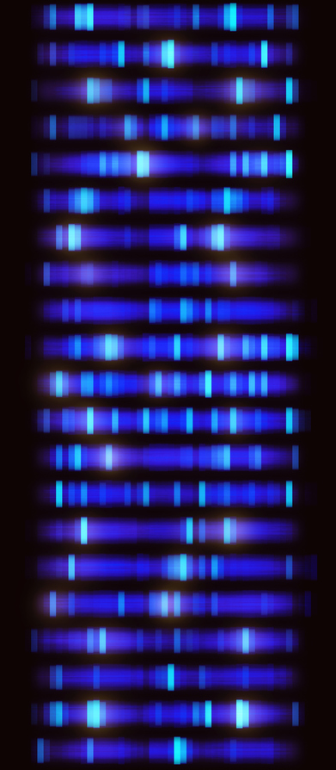
Genetics - Overview
  Advantages and disadvantages of sexual & asexual reproduction (biology)
  Meiosis
  DNA structure
  DNA and the genome
  Protein synthesis (biology HT)
  The work of Mendel (biology)
  Genetic inheritance
  Sex determination
  ABO blood group inheritance
  Inherited disorders (biology HT)
  Variation
  Human Genome Project
  Mutations

Slide 3
LearnIT!
KnowIT!
Genetics
Part 1
Advantages of sexual and asexual reproduction (biology)
Meiosis

Slide 4
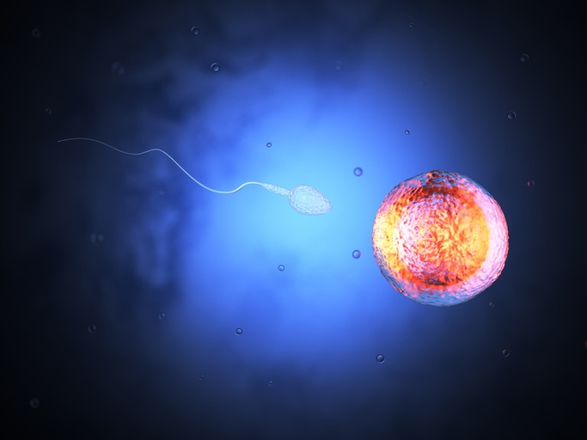
  Genetics part 1 – Sexual and asexual reproduction
Sexual reproduction involves the joining of male and female gametes.
A gamete is the scientific term for a sex cell.
In animals, the gametes are the sperm and the egg cells.
In flowering plants, the gametes are the pollen and the egg cells.
In sexual reproduction, mixing of genetic information occurs which leads to variety in the offspring.
Every new offspring formed is unique.
The gametes are produced by meiosis.
Asexual reproduction involves only one parent. There is no fusion of gametes. No mixing of genetic information occurs. All offspring are genetically identical (called clones). Only mitosis is involved.

Slide 5
  Genetics part 1 – Sexual and asexual reproduction
  (biology only)
There are advantages and disadvantages to both
sexual and asexual reproduction.
A
B
C
Sexual reproduction | Asexual reproduction
Variation occurs in the offspring and population but energy must be put into finding and courting a suitable mate. | Only one parent is required so it is a more efficient use of time and energy as do not need to find a mate.
If the environment changes, variation will give a survival advantage by natural selection. There is a better chance of at least some organisms surviving. | Many identical offspring can be produced if conditions are favourable however no variation in the population occurs making it susceptible to pathogens or environmental change.
Natural selection can be manipulated and sped up by humans, using selective breeding to increase food production. | Occurs faster than sexual reproduction.

Slide 6
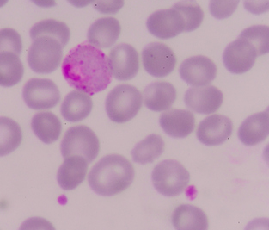
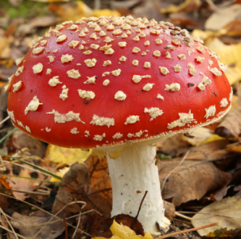
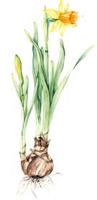
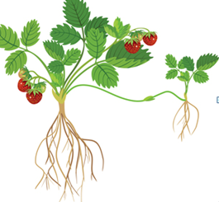
  Genetics part 1 Sexual and asexual reproduction (biology only)
There are advantages to sexual and asexual reproduction, so some organisms reproduce using both methods depending on the circumstances.
A
B
C
Malarial parasites |  | Reproduce asexually in the human host, but sexually inside a mosquito.
Fungi |  | Reproduce asexually by spores, and sexually to give variation.
Video
When daffodils flower
they produce seeds.
This is sexual reproduction.
Strawberry plants produce seeds sexually and reproduce asexually using runners. A genetically identical plant forms at the end of the runner.
Daffodils also reproduce asexually by bulb division.
Notes:
http://www.bbc.co.uk/education/clips/z7pf4wx

Slide 7

  Genetics part 1 – Meiosis
Meiosis leads to non identical cells being formed.
Mitosis leads to identical cells (clones) being formed.
Cells in the reproductive organs divide by meiosis to form gametes.
In animals, the reproductive organs are the ovaries and testes.
Meiosis is sometimes called reduction division because it halves the number of chromosomes in the gametes. When male and female gametes fuse during fertilisation, the number of chromosomes are restored.
This brother and sister have the same parents, but they look different. They show variation because of meiosis.

Slide 8
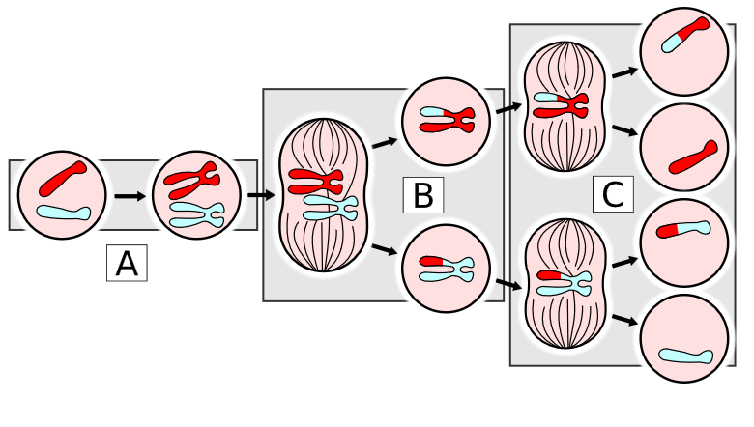
  Genetics part 1 – Meiosis
This is the process a cell goes through to produce gametes:
Meiosis
Copies of the genetic information are made.
The cell divides twice to form 4 gametes each with a single set of chromosomes. This is half the number of the original cell.
All 4 haploid gametes are genetically different from each other and the parent.

Slide 9
  Genetics part 1 –Meiosis
A cell in the testes has 46 chromosomes. When this cell undergoes meiosis it produces 4 gametes each with 23 chromosomes. The same process occurs in the ovary to produce egg cells.
The male and female gametes fuse during fertilisation to restore the normal number of chromosomes.
The fertilised egg cell now contains 46 chromosomes. It is called a zygote.
23
23
Sperm cell made by meiosis in the testes
Egg cell made by meiosis in the ovary
Zygote
46

Slide 10
QuestionIT!
Genetics
Part 1
Advantages and disadvantages of sexual and asexual reproduction (biology)
Meiosis

Slide 11
  Genetics part 1– QuestionIT
What is a gamete?
Name the male and female gametes in a) a human b) a daisy plant
3. For each row, tick one box to show which method of cell division is correct.
 | Meiosis | Mitosis
Genetic mixing happens
Gamete production occurs
New cells show variation
New cells have same number of chromosomes as parent
Happens in skin cells
Two divisions occur
Two new cells are formed as a result
Identical cells are formed

Slide 12
  Genetics part 1 – QuestionIT
What occurs at the point of fertilisation in humans?
How many chromosomes are found in the nucleus of a human:
a) ovary cell ?
b) egg cell ?
c) embryo cell ?
d) a cell just after fertilisation has occurred?
e) a testes cell ?
6. What happens to the DNA just before the first meiotic division?
7. What does the term ‘haploid’ mean?

Slide 13
  Genetics part 1 – QuestionIT
Biology ONLY
8. What are three advantages of sexual reproduction?
9. What are three advantages of asexual reproduction?
10. List three organisms which use both sexual and asexual reproduction methods.
11. Describe a disadvantage to an organism of i) using sexual reproduction and ii) asexual reproduction.

Slide 14

AnswerIT!
Genetics
Part 1
Advantages and disadvantages of sexual and asexual reproduction (biology only)
Meiosis

Slide 15
  Genetics part 1 – AnswerIT
What is a gamete?
A cell with half the number of chromosomes of the parent cell.
Name the male and female gametes in a) a human b) a daisy plant
a) Male = sperm Female = egg
b) Male = pollen Female = egg
3. For each row, tick one box to show which method of cell division is correct.
 | Meiosis | Mitosis
Genetic mixing happens | ✓
Gamete production occurs | ✓
New cells show variation | ✓
New cells have same no. of chromosomes as parent |  | ✓
Happens in skin cells |  | ✓
Two divisions occur | ✓
Two new cells are formed as a result |  | ✓
Identical cells are formed |  | ✓

Slide 16
  Genetics part 1 – QuestionIT
4. What occurs at the point of fertilisation?
The nucleus of the sperm and egg cell fuse.
5. How many chromosomes are found in the nucleus of a human:
a) ovary cell ? 46
b) egg cell ? 23
c) embryo cell ? 46
d) a cell just after fertilisation has occurred? 46
e) a testes cell ? 46
6. What happens to the DNA just before the first meiotic division?
The DNA is copied.
7. What does the term ‘haploid’ mean?
A single set of unpaired chromosomes.

Slide 17
  Genetics part 1 – QuestionIT
Biology ONLY
8. What are three advantages of sexual reproduction?
Produce variation in the offspring
If environment changes can give a survival advantage meaning some organisms are likely to survive
Humans can speed up natural selection by selective breeding to increase food production
9. What are three advantages of asexual reproduction?
Only one parent needed
More time and energy efficient as do not need to find a mate
Faster than sexual reproduction
Many identical offspring can be produced when conditions are favourable
10. List three organisms which use both sexual and asexual reproduction methods.
Malarial parasites
Fungi
Strawberry plants
Daffodils
11. Describe a disadvantage to an organism of i) using sexual reproduction and ii) asexual reproduction.
i) Energy must be put into finding and courting a suitable mate.
ii) No variation in the population occurs making it susceptible to pathogens

Slide 18
LearnIT!
KnowIT!
Genetics
Part 2
  DNA structure
  DNA and the genome
  Protein synthesis (biology HT)

Slide 19
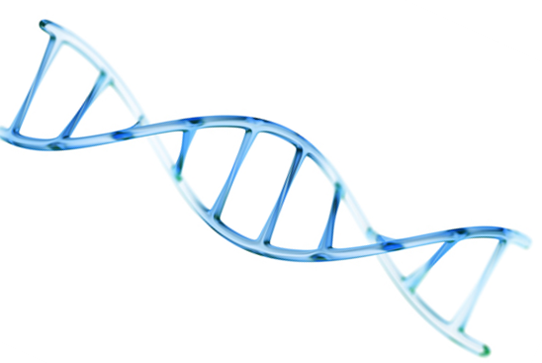
  Genetics part 2 – DNA structure
The genetic material in the nucleus of most cells is made from a chemical called DNA.
DNA is a polymer made from two strands which coil around each other making a spiral ladder.
A polymer is a large molecule made from many smaller molecules called monomers.
This shape is known as a double helix.
DNA stands for deoxyribonucleic
acid. You don’t need to remember this!

Slide 20

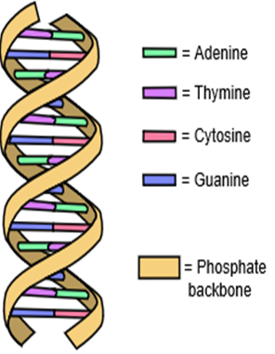
Genetics part 2 – DNA structure
DNA is made from repeating monomers called nucleotides. There are 4 different nucleotides. The long strands of DNA consist of alternating sugar and phosphate sections.
Each nucleotide is made from three components:
A phosphate group
A simple pentose sugar (this means it contains 5 carbon atoms)
A base
There are 4 bases in DNA.
Adenine (A), thymine (T)
guanine (G) and cytosine (C)
Notice in the diagram that adenine always pairs up with thymine or vice versa.
Cytosine always pairs up with guanine
or vice versa.
This is called complementary base pairing.
Weak hydrogen bonding holds the base pairs and the two strands together.
Alternating sugar and phosphate sections.

Slide 21
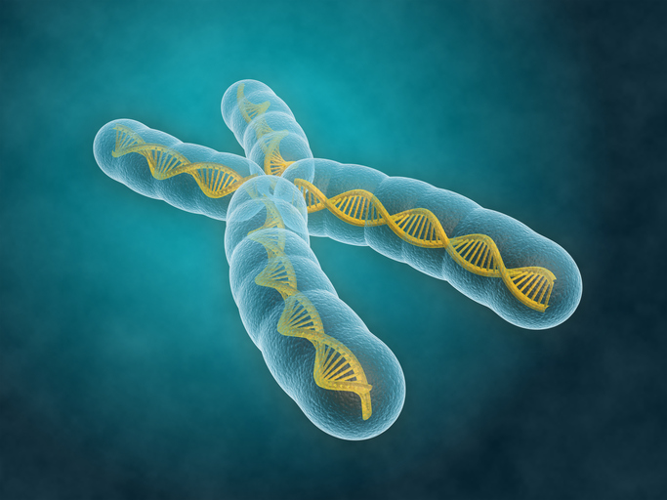
  Genetics part 2 – DNA and the genome
DNA is arranged in structures called chromosomes inside
a cell’s nucleus.
The genome is the entire DNA of an organism.
A gene is a small section on a chromosome. Each gene codes for a particular sequence of amino acids, to make a specific protein.
A human has approximately 24 000 genes in total. Each single chromosome is made up of about 2000 genes.
gene
A human chromosome
In human body cells the chromosomes are normally found in pairs. Each cell has 23 pairs of chromosomes.

Slide 22
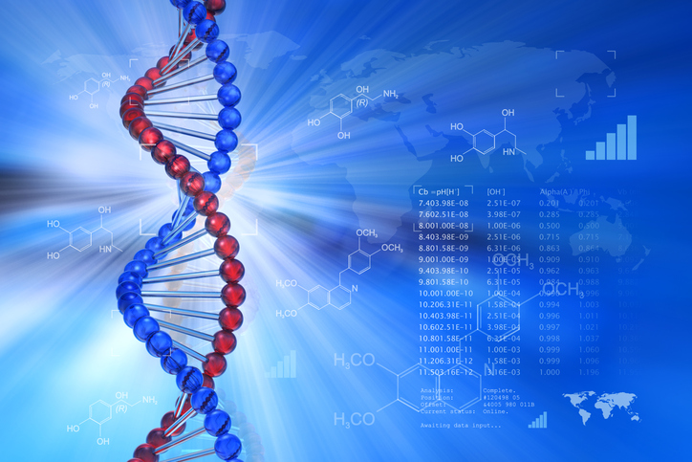
  Genetics part 2 – DNA and the genome
Extraction of DNA from fruit Video
gene
A human chromosome
Notes:
Open University video Extracting DNA from kiwi fruit https://www.youtube.com/watch?v=6q7xEjfnTZg

Slide 23
  Genetics part 2 – Protein synthesis (biology HT only)
Proteins have many different vital functions in our body.
Enzymes – all made from protein.
Hormones – all made from protein
Antibodies – all made from protein
Structural components such as muscle, hair and nail tissue.
Genes provide the instructions to make the required protein from amino acids.
It is estimated there are over 2 million proteins in a human body and all are made from combinations of just 20 different amino acids.
gene
A human chromosome
A sequence of three bases is the code for a particular amino acid. This is called a codon. The order of the bases controls the order in which amino acids are assembled to produce an individual protein.

Slide 24
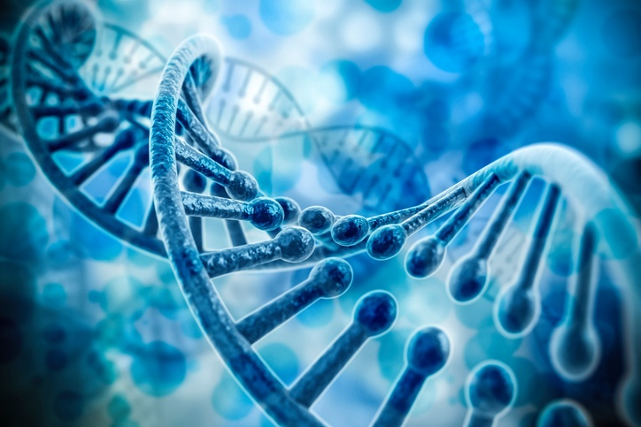
  Genetics part 2 – DNA structure (biology HT only)
Every cell in an organism (apart from a gamete) with a nucleus will have a complete set of chromosomes. This means cells possess every gene that is needed to make every protein the organism ever needs to produce.
Most cells in the body will only use a very small amount of the genes available. If a gene is activated to convert the DNA code into a certain protein then we say the gene has been expressed. A muscle cell will never be required to make the protein used in the iris of the eye. This gene will not be expressed in the muscle cell.
Most of the DNA does not actually code for proteins. Research is still ongoing to find out what the function of the non coding DNA is. Non coding parts can switch genes on or off in a cell. Mutations in the non coding DNA may affect how genes are expressed.
gene
A human chromosome

Slide 25
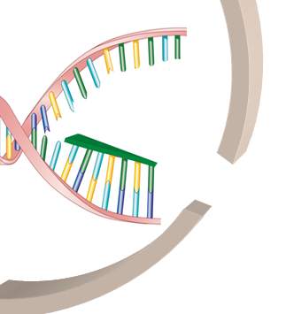
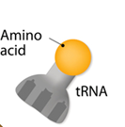
  Genetics part 2 – Protein synthesis (biology HT only)
Making new proteins: Transcription
Nucleus
Cytoplasm
RNA polymerase
Nuclear membrane
gene
mRNA
Ribosome
Part of the DNA unravels
mRNA leaves the nucleus
A human chromosome
RNA polymerase (an enzyme) binds to the non coding part of the DNA in front of a gene.
Part of the DNA unravels.
RNA polymerase makes a complementary copy of the coding DNA strand. This copy is called mRNA.
mRNA moves out of the nucleus into the cytoplasm. DNA is too large to leave the nucleus.

Slide 26
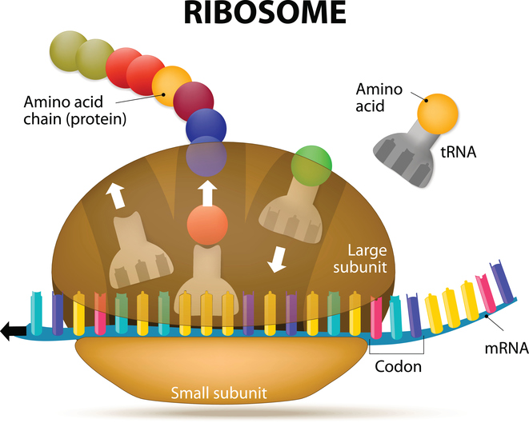
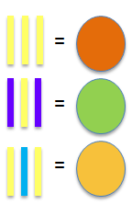
  Genetics part 2 – Protein synthesis(biology HT only)
Making new proteins: Translation
4. The mRNA travels to the ribosome in the cytoplasm and attaches to it.
5. Ribosomes translate each set of triplet bases into amino acids according to the
mRNA template.
6. Amino acids are found in the cytoplasm. The correct amino acid for each triplet is brought to the ribosome by a carrier molecule called tRNA.
7. A long chain of amino acids form and link to form polypeptides. Their specific order forms a specific protein.
gene
3 bases =
amino acid
A human chromosome
Ribosome
video
Triplet of bases codes for a specific amino acid
Notes:
Video of translation and transcription https://www.youtube.com/watch?v=x5ZXQo-xeMo

Slide 27
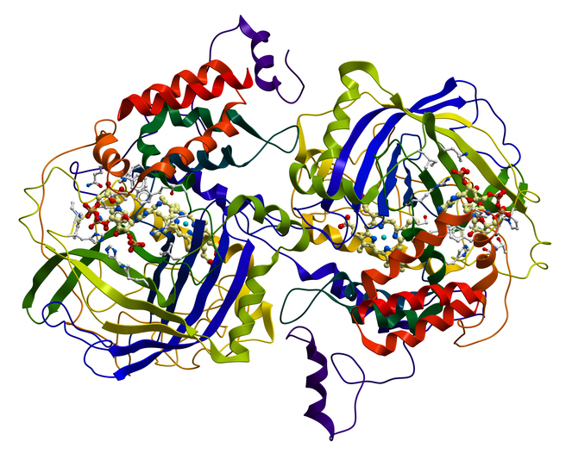
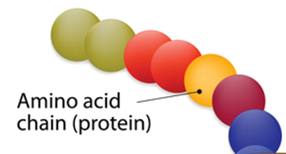
  Genetics part 2 – Protein synthesis (biology HT only)
When the protein chain is complete, it folds up to form a unique shape.
This unique shape allows the protein to carry out its role effectively.
This could be as an enzyme, hormone or structures in the body such as collagen.
gene
A human chromosome
An enzyme

Slide 28
  Genetics part 2 – Protein synthesis (biology HT only)
Mutations occur continuously producing genetic variants.
Prior to any transcription occurring, the RNA polymerase must bind to the non-coding part of the DNA in front of the gene.
If a mutation occurs in the non-coding part of the DNA then it may affect how well the RNA polymerase can bind to it.
If not all the mRNA is transcribed, then this can alter the quantity of protein produced. This may affect the function or phenotype of the organism.
Genetic variations in the non-coding DNA can affect the phenotype of the organism even though this part of the DNA does not actually code for the protein.
gene
A human chromosome

Slide 29
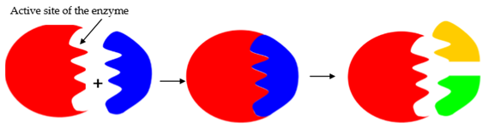

  Genetics part 2 – Protein synthesis (biology HT only)
Occasionally a genetic variant in the coding DNA of a gene results in an altered sequence of amino acids. This can produce an altered protein with a different shape which changes its activity.
Prior to a mutation
Following a mutation which results in an altered sequence of amino acids
gene
Active site binds with the substrate.
Mutated active site has a different shape and no longer binds with the substrate.
The active site of an enzyme may have a changed shape and the enzyme will not be able to bind to the substrate. The enzyme will no longer function.
Structural proteins such as keratin or collagen may also lose their strength if their shape was altered.
A human chromosome

Slide 30
QuestionIT!
Genetics
Part 2
  DNA structure
  DNA and the genome
  Protein synthesis (biology HT)

Slide 31
  Genetics part 2– QuestionIT
1. What is the definition of a polymer?
Name the shape which best describes the DNA polymer.
How is DNA organised inside the cell nucleus?
Which is larger, a chromosome or a gene?
What does a gene code for?
6. Where would you find a nucleotide?
7. What does a nucleotide consist of?
8. What are the symbols of the 4 bases found in DNA?
What does the code for an amino acid consist of?
a)Fill in the missing terms:
The long strands of DNA are made of alternating _____ and ______ sections. Attached to each ______ is one of the four bases.
The DNA polymer is made up of repeating ____________ units. The strands of DNA are held together by _____________ _________.
b) What is the purpose of adding detergent to fruit when trying to extract its DNA?

Slide 32
  Genetics part 2 – QuestionIT ( biology only)
Higher Tier biology only
11. In the complementary strands of DNA – which base is T always linked to?
12. What type of molecule is RNA polymerase?
13. What is the role of RNA polymerase?
14. Which organelle in the cytoplasm carries out protein synthesis?
15. What do carrier molecules bring to this organelle from the cytoplasm?
16. What is this carrier molecule called?
17. Describe a codon.
18. What happens in protein synthesis once the protein chain is complete?
19. What happens if a mutation codes for a slightly altered enzyme protein with a different shape?
20. What can the non-coding parts of DNA do?

Slide 33
AnswerIT!
Genetics
Part 2
  DNA structure
  DNA and the genome
  Protein synthesis (biology HT)

Slide 34
  Genetics part 2 – AnswerIT
What is the definition of a polymer?
A polymer is a large molecule made from many smaller molecules called monomers
2. Name the shape which best describes the DNA polymer.
Double helix
3. How is DNA organised inside the cell nucleus?
Arranged in chromosomes
4. Which is larger, a chromosome or a gene? Chromosome
5. What does a gene code for? A particular sequence of amino acids
6. Where would you find a nucleotide? DNA
7. What does a nucleotide consist of? Common sugar, phosphate group, base
8. What are the symbols of the 4 bases found in DNA? A T C G
What does the code for an amino acid consist of? A sequence of three bases
10a.Fill in the missing terms:
The long strands of DNA are made of alternating __sugar___ and __phosphate____ sections. Attached to each __sugar____ is one of the four bases.
The DNA polymer is made up of repeating _____nucleotide_______ units. The strands of DNA are held together by __hydrogen _bonds.

Slide 35
  Genetics part 2 – AnswerIT
Higher Tier biology only
11. In the complementary strands of DNA – which base is T always linked to? A
12. What type of molecule is RNA polymerase?
Enzyme or protein or polymer
13. What is the role of RNA polymerase?
To bind to non-coding DNA in front of the gene and produce a complementary mRNA strand from the coding DNA of the gene.
14. Which organelle in the cytoplasm carries out protein synthesis? Ribosome
15. What do carrier molecules bring to this organelle from the cytoplasm? Amino acids
16. What is this carrier molecule called? tRNA or transfer RNA
17. Describe a codon
A group of 3 nucleotides or bases which specifies the genetic code to synthesize a particular amino acid.
18. What happens in protein synthesis once the protein chain is complete?
The protein folds up into a unique shape.
19. What happens if a mutation codes for a slightly altered enzyme protein with a different
shape? An enzyme may no longer fit the substrate binding site .
20. What can non-coding parts of DNA do? Switch genes on or off and affect how genes are
expressed- the phenotype.
10b.What is the purpose of adding detergent to fruit when trying to extract its DNA?
To break down cell membranes and release the DNA.

Slide 36
LearnIT!
KnowIT!
Genetics
Part 3
  The work of Mendel (biology)
  Genetic inheritance
  Sex determination
  ABO blood group inheritance

Slide 37
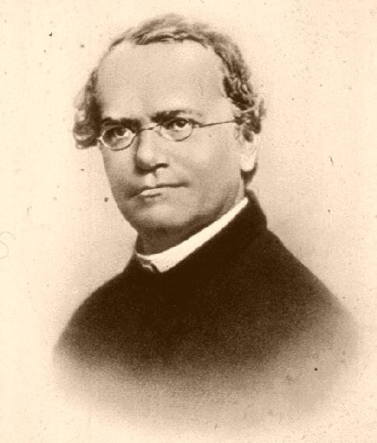
Genetics part 3 – The work of Mendel (biology)
Gregor Mendel was an Austrian Monk who was trained in mathematics and natural history. Whilst working in the monastery gardens, he studied the inheritance of different characteristics in pea plants.
Mendel observed that if he cross bred red flowering plants with white flowering plants, the majority of the offspring had red flowers but some were white.
He also cross bred tall plants with short plants, green and yellow peas, wrinkled and smooth peas and concluded there was a predictable pattern of results.
Gregor Mendel
(1822-1884)
“The father of modern genetics”
Notes:
https://www.bbc.co.uk/education/clips/zwx4wmn

Slide 38
Genetics part 3 – The work of Mendel (biology)
.
Mendel kept meticulous records of the results of each cross and finally published them in 1866 along with his hypothesis.
His hypothesis stated that:
characteristics are held as separate units of inheritance
the units of inheritance are passed on to offspring unchanged
each unit of inheritance exists in two forms – dominant and recessive.
At the time scientists did not know about the existence of chromosomes or DNA and did not understand Mendel’s work.
It was almost twenty years after his death that scientists realised the significance of his findings. His work was repeated and similar results were achieved. Chromosomes were seen under the microscope and Mendel was given credit for his work.
The units of inheritance he proposed are now recognised as genes.

Slide 39
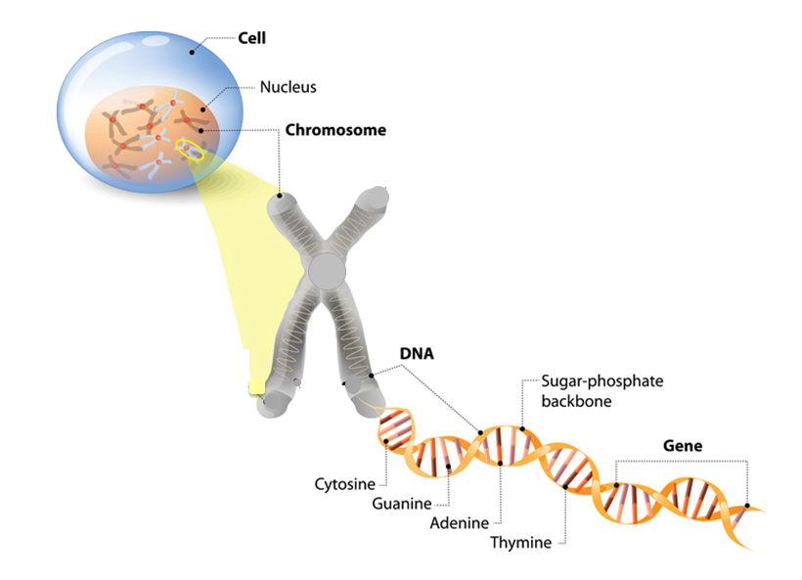
Genetics part 3 – Genetic Inheritance
The gene is a small section of DNA on a chromosome.
Some characteristics like hair colour or eye colour are controlled by a single gene. Each gene may have different forms called alleles.
Each allele codes for a different protein.
The characteristics an organism has, e.g. fur colour in mice or red-green colour blindness in humans, are due to the mix of alleles they possess.

Slide 40
  Genetics part 3 – Genetic Inheritance
Each gene has different forms of alleles. The alleles which are present are known as the genotype. These are often represented as letters such as BB. The genotype operates at a molecular level to develop the actual characteristics seen or the phenotype.
Most genes have two possible allele variations which are known as dominant or recessive.
Dominant alleles are represented by a capital letter e.g. B
Recessive alleles are represented by a lower case letter e.g. b
There are 3 possible combinations of alleles for each gene:
Two dominant alleles BB
Two recessive alleles bb
One dominant and one recessive allele Bb
(always place the dominant allele first and do not use bB)

Slide 41
Genetics part 3 – Genetic Inheritance
Homozygous
Homo means the same.
Two of the same alleles.
BB means homozygous dominant.
bb means homozygous recessive.
Genotype
This word describes the alleles which are present for a particular feature e.g. Bb.
You need to be able to use and explain these terms.
Phenotype
This word describes what can be physically seen - black fur, blonde hair, blue eyes.
Heterozygous
Hetero means different.
Two different alleles are present.
Bb means heterozygous.

Slide 42
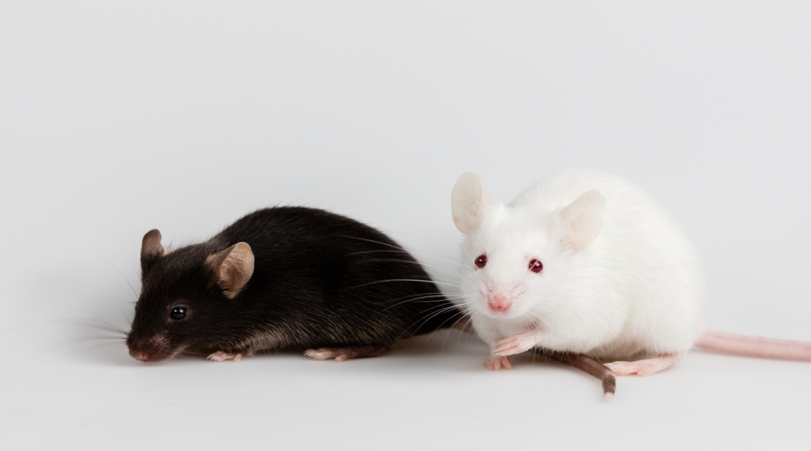
Genetics part 3 – Genetic Inheritance
In a particular species of mouse, the dominant allele operates at a molecular level to produce proteins that make the fur black. The recessive allele codes for white fur.
KEY
Use B and b to represent the dominant and recessive alleles.
B = allele for black fur
b = allele for white fur
Phenotype = white fur
Genotype = bb
We know there are no dominant alleles present because the fur is white.
Phenotype = black fur
Genotype = ?
At least one dominant allele (B) is present because the mouse has black fur.
The mouse could be genotype BB or Bb.
A recessive allele is only expressed if two copies are present and therefore no dominant allele present.

Slide 43

Genetics part 3 – Genetic Inheritance
Genetic cross
A genetic cross is a way of modelling the potential outcome from mating two parents where the phenotype and genotype are usually known. We use characteristics which are controlled by a single gene as it is easy to see the effect in the next generation and beyond.
A typical exam question might ask:
A female mouse which was homozygous dominant for black fur was mated with a male mouse which was homozygous recessive for white fur.
What are the possible outcomes for fur colour for their offspring?
What do we know?
Parent phenotype: Black fur White fur
Parent genotype: BB bb
What gametes will be present?
in each egg
in each sperm
B
B

Slide 44
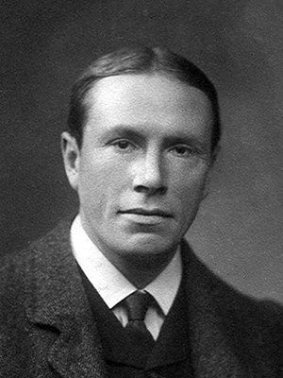
Genetics part 3 – Genetic Inheritance
The Punnett Square
Reginald Punnett was a British geneticist who is most famous for
creating the Punnett square diagram as a tool to predict the
probability of genotypes in future offspring.
Parent phenotype: Black fur White fur
Parent genotype: BB bb
B
B
Gametes | b | b
B
B

Slide 45
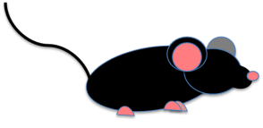
Genetics part 3 – Genetic Inheritance
If an egg containing a dominant allele (B) is fertilised by a sperm with a recessive allele (b) then the result is an offspring with genotype Bb.
Gametes | b | b
B | Bb | Bb
B | Bb | Bb
The possible offspring all have the genotype Bb.
This is described as heterozygous.
The phenotype of all offspring from these parents will be black fur because one dominant allele is always present.

Slide 46
Genetics part 3 – Genetic Inheritance
The characteristic of being a tall plant or a short pea plant is controlled by a single gene.
We will use the letter T to represent the gene for the purposes of a genetic diagram.
The allele which produces tall plants is dominant so we use T.
The allele for short plants is recessive so we use t.
Explain what would occur :
a) If two homozygous dominant plants were crossed.
The genotype of all the future offspring will be TT and their phenotype will be tall. These parent plants will never produce short plants when crossed.
The genotype for a homozygous tall plant is TT
Punnett square
Gamete | T | T
T | TT | TT
T | TT | TT
b) If two heterozygous plants were crossed.
The ratio of tall plants to short plants likely to be produced is 3:1.
In any four offspring, one would expect 1 homozygous dominant, 2 heterozygous and 1 homozygous recessive.
The genotype for a heterozygous plant is Tt
Punnett square
Gamete | T | t
T | TT | Tt
t | Tt | tt

Slide 47
Genetics part 3 – Genetic Inheritance
Explain what would occur :
c) If a homozygous dominant plant and a homozygous recessive plant were crossed.
The genotype for a homozygous dominant plant is TT.
The genotype for a homozygous recessive plant is tt.
Punnett square
The genotype of all the future offspring will be Tt and their phenotype will be tall. All offspring will be heterozygous. The probability of getting a tall plant is described as 1 or 100%.
Gamete | t | t
T | Tt | Tt
T | Tt | Tt
b) If two homozygous recessive plants were crossed.
The genotype for a homozygous recessive plant is tt.
Punnett square
All future offspring will be homozygous recessive.
Their phenotype will be short. These parents will never produce tall plants.
Gamete | t | t
t | tt | tt
t | tt | tt
video
Notes:
Dominant and recessive inheritance of genes https://www.bbc.co.uk/education/clips/zwx4wmn

Slide 48
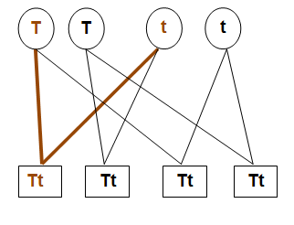
Genetics part 3 – Genetic Inheritance
Not all exam questions use the Punnett square layout to find out possible genotypes. The basic principle is always the same.
A genetic diagram could also look like this:
Gametes
Genotypes of potential offspring

Slide 49
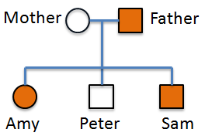
Genetics part 3 – Genetic Inheritance
A family tree can help to show how genetic disorders are inherited in a family. They can be used to work out the probability that a member of the family will inherit a disorder.
Read the key carefully to help you interpret a family tree accurately.
The family tree below shows the inheritance of a
disorder caused by a dominant allele.
What is the genotype of the mother? Homozygous recessive
What is the genotype of the father? Heterozygous
If the father was homozygous dominant then all the offspring would have the disorder. Peter does not have the disorder and is homozygous recessive.
Key
Female without disorder
Female with disorder
Male without disorder
Male with disorder

Slide 50
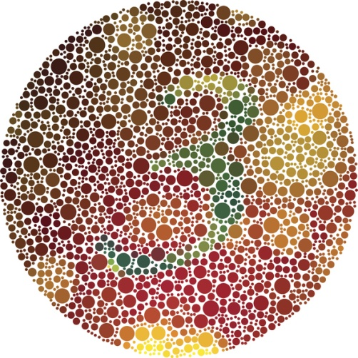
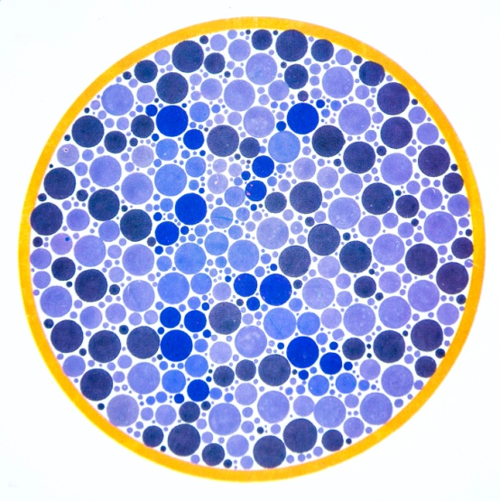
Genetics part 3 – Sex-Linked genetic disorder (biology HT)
Colour blindness is a sex-linked genetic disorder that a person is born with. It is caused by a faulty allele carried on the X chromosome.
This gene is not found on the much smaller Y chromosome.
Women need two copies of the faulty recessive allele to be colour blind, whilst men only need one copy.
More men than women are affected by the disorder.

Slide 51
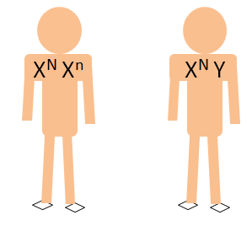
Genetics part 3 – Genetic Inheritance
A woman with only one copy of the recessive allele is a carrier of colour blindness but is not affected herself.
Key
The diagram shows a genetic cross between a female carrier and a male who has normal vision.
In a sex-linked genetic cross, we use the sex chromosomes (X or Y) with a super script symbol to represent the allele.
N= normal vision allele
n = colour blind allele
For this cross the ratio of normal vision to colour blind offspring is 3:1 . There is a 1 in 4 chance (25%) of a child from these parents being colour blind.
This increases to 50% if the child is a male.
Phenotype : female normal vision (carrier)
Phenotype : male
normal vision
Punnett square
Gamete | X^{N} | X^{n}
X^{N} | X^{N} X^{N} | X^{N} X^{n}
Y | X^{N} Y | X^{n} Y

Slide 52
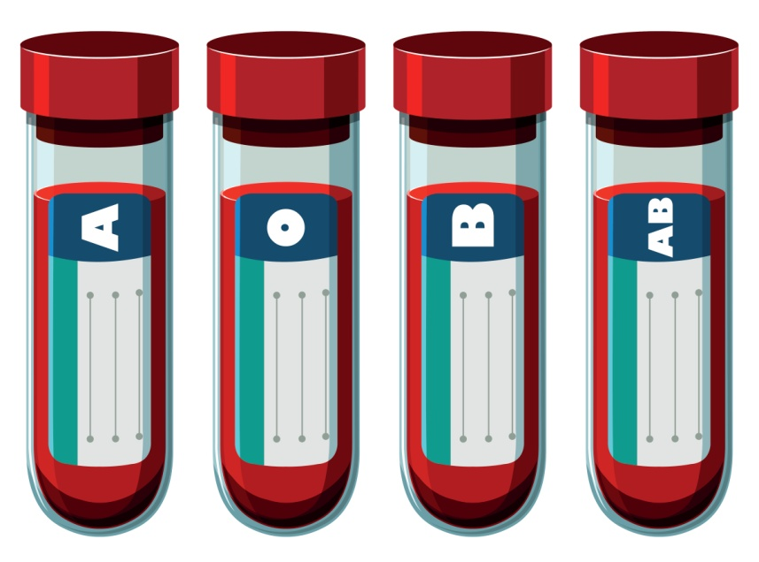
Genetics part 4 – ABO inheritance (biology)
Human blood group is inherited.
There are four possible blood groups:
A, B, AB or O.
The gene for blood group has three
different alleles: I^{A} , I^{B} and I^{O}
I^{A} and I^{B} alleles are co-dominant.
This means that if a person has the genotype I^{A} I^{B} then they are blood group AB. Both alleles are equally dominant.
I^{O} is recessive to both other alleles.
If a person has the genotype I^{A} I^{O} then the person has the blood group or phenotype A.
A person with two recessive alleles (I^{O} I^{O} ) is blood group O.

Slide 53
Genetics part 4 – ABO inheritance (biology)
Genetic diagrams for co-dominant alleles can look complicated.
A male with blood group B has a child with a woman with blood group A. What are the possible genotypes of the offspring?
Male Female
Phenotype: Blood group B Blood group A
Genotype: I^{B}I^{O} I^{A}I^{O}
Gametes: I^{B} I^{O} I^{A} I^{O}
Genetic Cross:
Offspring phenotypes: AB, A, B and O. From these parents, there is a 1 in 4 chance or 25% of the offspring being any of the four blood groups.
Gametes | I^{B} | I^{O}
I^{A} | I^{A}I^{B} | I^{A}I^{O}
I^{O} | I^{B}I^{O} | I^{O}I^{O}

Slide 54
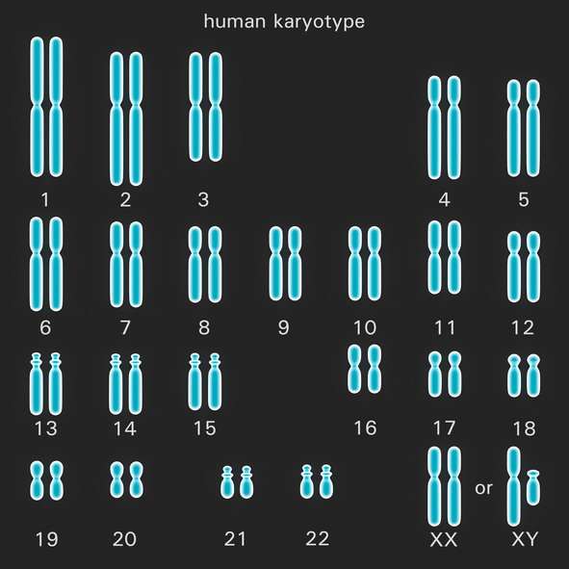
Genetics part 4 – Sex determination
An ordinary human body cell contains 23 pairs of chromosomes. One chromosome of each pair comes from the egg and one from the sperm.
22 pairs of chromosomes control characteristics.
The 23rd pair of chromosomes are called sex chromosomes. This pair carry the genes that determine sex. The sex chromosomes are not identical to each other and so are called X and Y. Sex is determined at fertilisation.
46
In females the sex chromosomes are the same -XX
In males the sex chromosomes are different-XY

Slide 55
Genetics part 4 – Sex determination
How is sex inherited?
The 23rd pair of chromosomes are responsible for determining the sex of a human.
The Punnett square is used to show the chances of an offspring being male or female.
A woman has the genotype XX and a man has the genotype XY.
There is a 1 in 2 chance of the offspring being male or female.
This can also be described as a ratio of 1:1, 50:50 or 50% or 0.5 of being male or female.
Gametes | X | X
X | XX | XX
Y | XY | XY

Slide 56


Genetics part 3 – Sex determination
A man and woman have three children – all boys.
The woman is pregnant with their fourth child.
What is the chance of the next child being a girl?
It is a 1 in 2 chance for every child, because it depends on whether a sperm containing an X chromosome or a Y chromosome fertilises the egg and there are equal numbers of these.
I think it is more likely to be a girl as they already have 3 boys .
I think there is more chance of the new baby being a boy because they have 3 boys already.

Slide 57
QuestionIT!
Genetics
Part 3
  The work of Mendel (biology)
  Genetic inheritance
  Sex determination
  ABO blood group inheritance

Slide 58
  Genetics part 3 – QuestionIT
1. Complete the sentences below using one of the following words:
genotype phenotype homozygous gamete chromosome
The same alleles for a particular characteristic are described as ..........................
Mice fur can be described by its colour. This is known as the ...............................
The alleles for a particular characteristic determine its ........................................
The pollen of a rose plant can also be described as a male ..................................
2. What are the different forms of a gene called ?
3. Why is it easy to describe an organisms phenotype for a particular characteristic but very difficult to state the genotype?
4. List the alternative ways of describing the following outcome of a genetic cross:
3 in every 4 crosses will have black fur.
5. If two heterozygous tall plants were crossed 75 times, what proportion of the offspring would you expect to be short?

Slide 59
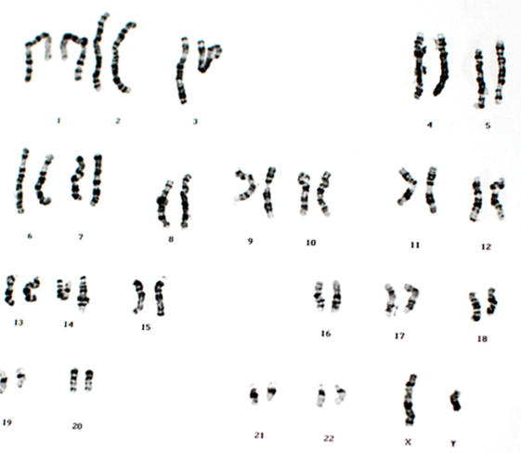
  Genetics part 3 – QuestionIT
Look at the following picture of a persons chromosomes.
6. How many chromosomes does this person have in a normal body cell?
7. What sex is the person and how do you know?

Slide 60
  Genetics part 3 – QuestionIT
8. Black fur is dominant to brown fur in mice.
Use B to represent black fur and b to represent brown fur.
a) Complete the Punnett square diagram to show the outcome of a genetic cross between two heterozygous mice.
b) What is the phenotype of the parent mice?
c) What are the chances of a homozygous recessive mouse being born to two heterozygous mice?
9. What is meant by the term zygote?
Gametes

Slide 61
  Genetics part 3 – QuestionIT
10. The family tree shows the inheritance of cystic fibrosis (CF). Cystic fibrosis is a condition
caused by a recessive allele. Let F = healthy allele and f = CF allele
What is the genotype of a female carrier?
Explain why person G inherited cystic fibrosis.
Explain why person J did not inherit cystic fibrosis.
What is the probability of a fifth child having cystic fibrosis?
Many people feel opposed to the screening of embryos to identify the CF allele.
Suggest two reasons why they may feel this way.
Female with CF
A
B
C
D
Female without CF
Female carrier
E
F
Male without CF
Male carrier
G
H
I
J
Male with CF

Slide 62
  Genetics part 3 – QuestionIT
11. The flower colour for pea plants is controlled by a single gene. Red flowers are
dominant to white flowers. A homozygous dominant plant and a heterozygous plant are crossed to produce offspring.
What is the phenotype of the homozygous dominant plant?
b) Draw a genetic diagram to show all the possible arrangements of alleles in the offspring.
c) What is the chance of producing homozygous dominant red flowering plants?
Biology only
12. What were the three conclusions Mendel proposed after his work on the inheritance in peas?
13. What made it hard for scientists at the time to understand Mendel’s ideas?
14. How many alleles exist for inheritance of blood group?
What is meant by co-dominance?
16. If someone has a blood group of A, what alleles do they possess?

Slide 63
  Genetics part 3 – QuestionIT (biology only)
A woman with the genotype X^{N} X^{N} for colour blindness (where N = the allele for normal vision) can be described as:
Tick all word/s that apply .
Colour blind |  | Normal vision |  | Carrier
Homozygous dominant |  | Heterozygous |  | Homozygous recessive

Slide 64
AnswerIT!
Genetics
Part 3
  The work of Mendel (biology)
  Genetic inheritance
  Sex determination
  ABO blood group inheritance

Slide 65
  Genetics part 3 – AnswerIT
Complete the sentences below using one of the following words:
genotype phenotype homozygous gamete chromosome
The same alleles for a particular characteristic are described as homozygous
Mice fur can be described by its colour. This is known as the phenotype
The alleles for a particular characteristic determine its genotype
The pollen of a rose plant can also be described as a male gamete
2. What are the different forms of a gene called ?
Alleles
3. Why is it easy to describe an organisms phenotype for a particular characteristic but very
difficult to state the genotype?
Most characteristics are a result of multiple genes interacting .
4. List the alternative ways of describing the following outcome of a genetic cross:
3 in every 4 crosses will have black fur.
75% 0.75 3/4
5. If two heterozygous tall plants were crossed 75 times, what proportion of the offspring
would you expect to be short?
25% or 19

Slide 66
  Genetics part 3 – AnswerIT
Look at the following picture of a persons chromosomes.
6. How many chromosomes does this person have in a normal body cell?
23 pairs or 46
7. What sex is the person and how do you know?
A male
Because the sex chromosomes are different (XY)

Slide 67
  Genetics part 3 –AnswerIT
8. Black fur is dominant to brown fur in mice.
Use B to represent black fur and b to represent brown fur.
a) Complete the Punnett square diagram to show the outcome of a genetic cross between
two heterozygous mice.
b) What is the phenotype of the parent mice?
Black fur
c) What are the chances of a homozygous recessive mouse being born to two
heterozygous mice?
1 in 4 or 25% or 0.25
9. What is meant by the term zygote?
A zygote is the single cell formed when the gametes fuse at fertilisation.
Gametes | B | b
B | BB | Bb
b | Bb | bb

Slide 68
  Genetics part 3 – AnswerIT
10. The family tree shows the inheritance of cystic fibrosis (CF). Cystic fibrosis is a condition
caused by a recessive allele. Let F = healthy allele and f = CF allele
What is the genotype of a female carrier? Ff
Explain why person G inherited cystic fibrosis
Inherited a recessive allele from both E and F.
As no dominant allele present, the CF alleles code for faulty cell membranes
c) Explain why person J did not inherit cystic fibrosis.
Inherited two dominant alleles from E and F
d) What is the probability of E and F having a fifth child with cystic fibrosis?
1 in 4, 25%, 0.25, 1:3 or ¼
Female with CF
A
B
C
D
Female without CF
Female carrier
E
F
Male without CF
Male carrier
G
H
I
J
Male with CF

Slide 69
  Genetics part 3 – AnswerIT
e) Many people feel opposed to the screening of embryos to identify the CF allele.
Suggest two reasons why they may feel this way.
Screening procedure may cause miscarriage or damage embryo/fetus
The embryo has a right to life
Screening is expensive and could be used for other purposes
Have to make moral/ethical or religious decisions as a result such as whether to terminate.

Slide 70
  Genetics part 3 – AnswerIT (HT only)
Higher tier question
11. The flower colour for pea plants is controlled by a single gene. Red flowers are
dominant to white flowers.
A homozygous dominant plant and a heterozygous plant are crossed to produce
offspring.
Let R represent the dominant allele.
What is the phenotype of the homozygous dominant plant?
Red flowers
b) Draw a genetic diagram to show all the possible arrangements of alleles in the offspring.
c) What is the chance of producing homozygous dominant red flowering plants?
1 in 2 50:50 50% or ½ or 1:1
Gamete | R | r
R | RR | Rr
R | RR | Rr

Slide 71
  Genetics part 3 – AnswerIT
Biology only
12. What were the three conclusions Mendel proposed after his work on the inheritance in peas?
that characteristics are held as separate units of inheritance
the units of inheritance are passed on to offspring unchanged
each unit of inheritance exists in two forms – dominant and recessive.
13. What made it hard for scientists at the time to understand Mendel’s ideas?
they did not know about the existence of chromosomes or DNA
14. How many alleles exist for inheritance of blood group?
Three different alleles: I^{A} , I^{B} and I^{O}
15. What is meant by co-dominance?
alleles are equally dominant.
16. If someone has a blood group of A, what alleles do they possess?
EITHER I^{A} I^{A} OR I^{A} I^{O}
A woman with the genotype X^{N} X^{N} for colour blindness (where N = the allele for normal vision) can be described as:
Tick all word/s that apply .
Colour blind |  | Normal vision | ✓ | Carrier
Homozygous dominant | ✓ | Heterozygous |  | Homozygous recessive

Slide 72
LearnIT!
KnowIT!
Genetics
Part 4
Variation
Human Genome Project
Mutations

Slide 73
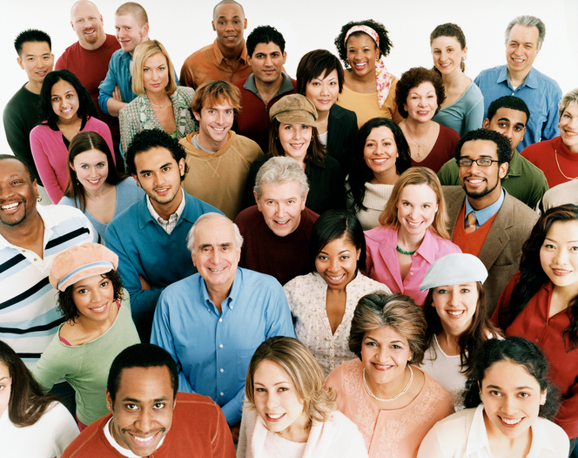
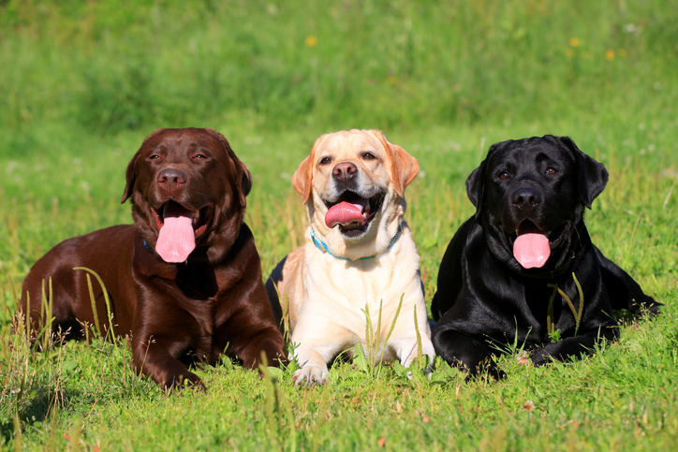
Genetics part 4 – Variation
Variation means that individuals in a population show differences in characteristics. Population is the number of one species in a habitat.
The genome and its interaction with the environment influence the development of a phenotype in an organism.
Variation within a population of a species is usually extensive, mostly arising from mutations.
Causes of variation may be:
differences in the genes individuals have inherited due to mutation and sexual reproduction.
differences in the environmental conditions have led to variation (acquired characteristics).
or a combination of both genetic and environmental causes.

Slide 74
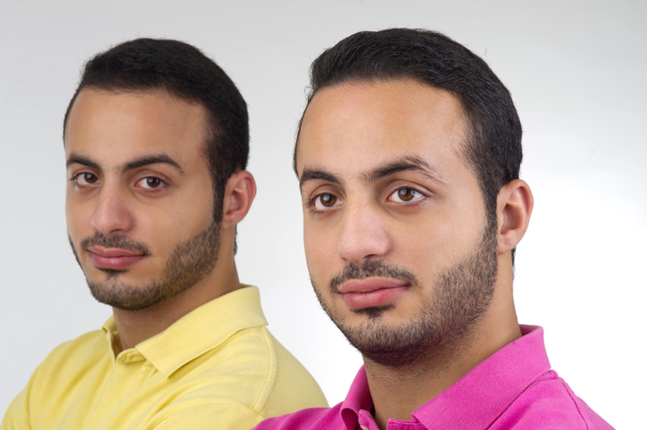
Genetics part 4 – Variation
Identical twins are produced from the same egg and sperm. They show very little or no genetic variation. One twin has a scar and this is environmental variation (an acquired characteristic)
Human phenotypes which are caused by genetic variation are:
Eye colour
Natural hair colour
Nose shape
Ear lobe shape
Blood group
Human phenotypes influenced by the environment are:
Hair length
Accents
Tattoos
Scars
Language spoken
Factors which are influenced by both genetic and environmental variation are:
skin colour (can be tanned),
weight (can be affected by food availability) or being athletic.

Slide 75
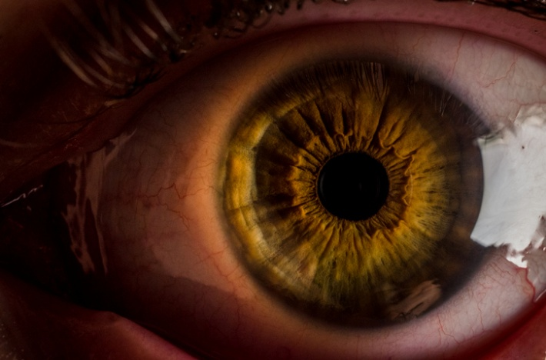

Genetics part 4 – Variation
Most phenotypic features are actually a result of multiple genes interacting, rather than single gene inheritance.
We are able to describe a phenotype for these features but cannot write down a genotype because more than one gene is involved.
Some characteristics in a species show continuous variation. There is a range of values and an individual can be anywhere in between the maximum and minimum. Height is an example.
Discontinuous variation is when there is a limited number of values that an individual can possess. There is no range. Blood group and gender are examples of discontinuous variation.
Human eye colour is an example of when multiple genes affect the phenotype.

Slide 76
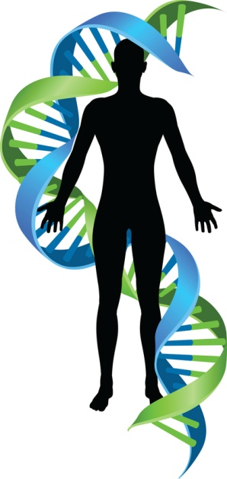
  Genetics part 4 –DNA and the genome
The genome of an organism is defined as the entire genetic material of that organism.
The Human Genome Project (HGP) was an international
scientific research project set up to map all the genetic
information in a human being.
It began in 1990 and was completed in 2003. The whole
human genome has now been studied and this will have great significance for medicine in the future. This work to understand
the human genome is important for several reasons:
To enable scientists to search for the genes linked to different
types of disease to look for possible treatment or correction.
To enable doctors to better understand and treat inherited disorders e.g. cystic fibrosis, sickle cell anaemia, thalassemia.
To be able to trace historic human migration patterns. video
A human chromosome
Notes:
Video about DNA and the Human Genome project. Shows application for screening for genetic diseases such as sickle cell anaemia and thalassemia https://www.bbc.co.uk/education/clips/zg9swxs

Slide 77
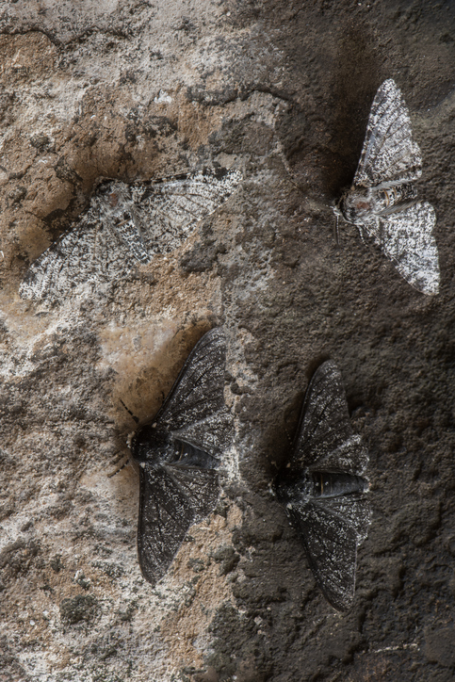
Genetics part 4 – Mutations
All genetic variations arise from mutations.
A mutation is a change in the DNA sequence of an organism. Mutations are occurring continuously during cell division. Most genetic mutations do not alter the phenotype. Some mutations will have a small effect on the phenotype, and rarely a single mutation will significantly affect the phenotype.
If a new phenotype is suited to an environmental change, it can lead to a relatively rapid change in the species. An example is seen below:
The peppered moth is camouflaged against tree bark. Birds cannot see it easily. The peppered moth lives long enough to breed and pass on its genetic information. This phenotype is found mainly in the countryside now.
During the industrial revolution, tree bark and buildings in cities and towns became blackened. The peppered moth became easy prey for the birds. A mutation occurred which changed the colour of the moth to black. The black phenotype is now found in large numbers in cities.

Slide 78
QuestionIT!
Genetics
Part 4
Variation
Human Genome Project
Mutations

Slide 79
  Genetics part 4 – AnswerIT
1. Write down the definition of the genome of a horse.
List two reasons why it is important to understand more about the human genome.
3. What can bring about genetic variation in a species?
What is meant by ‘an acquired characteristic’?
What is the chance of most genetic mutations having an effect on the phenotype? High, Medium or Low
What is meant by discontinuous variation?

Slide 80
AnswerIT!
Genetics
Part 4
Variation
Human Genome Project
Mutations

Slide 81
  Genetics part 4 – AnswerIT
1. Write down the definition of the genome of a horse.
All the genetic material of the horse.
2. List two reasons why it is important to understand more about the human genome.
To be able to identify the genes which are linked to different diseases.
To understand and be able to treat inherited disorders.
Useful in tracing human migration patterns from the past.
What can bring about genetic variation in a species?
Mutations
What is an acquired characteristic?
A characteristic caused by the organisms environment e.g. a scar
What is the chance of most genetic mutations having an effect on the phenotype? High, Medium or Low
Low – very few mutations have an effect on the phenotype
What is meant by discontinuous variation?
A feature has a limited number of possible values. e.g. gender

