Slide 1


The PiXL Club The PiXL Club The PiXL Club The PiXL Club The PiXL Club The PiXL Club The PiXL Club The PiXL Club The PiXL Club The PiXL Club The PiXL Club The PiXL Club The PiXL Club The PiXL Club The PiXL Club The PiXL Club The PiXL Club The PiXL Club The PiXL Club The PiXL Club The PiXL Club The PiXL Club The PiXL Club The PiXL Club The PiXL Club The PiXL Club The PiXL Club The PiXL Club The PiXL Club The PiXL Club The PiXL Club The PiXL Club The PiXL Club The PiXL Club The PiXL Club The PiXL Club The PiXL Club The PiXL Club The PiXL Club The PiXL Club The PiXL Club The PiXL Club The PiXL Club The PiXL Club The PiXL Club XL Club The PiXL Club The PiXL Club The PiXL Club The PiXL Club The PiXL Club The PiXL Club The PiXL Club The PiXL Club The PiXL Club The PiXL Club The PiXL Club The PiXL Club The PiXL Club The PiXL Club The PiXL Club The PiXL Club The PiXL Club The PiXL Club The PiXL Club The PiXL Club The PiXL Club The PiXL Club The PiXL Club The PiXL Club The PiXL Club The PiXL Club The PiXL Club The PiXL Club The PiXL Club The PiXL Club The PiXL Club The PiXL Club The PiXL Club The PiXL Club The PiXL Club The PiXL Club The PiXL Club The PiXL Club The PiXL Club The PiXL Club The PiXL Club The PiXL Club The PiXL Club The PiXL Club The PiXL Club The PiXL Club The PiXL Club The PiXL Club The PiXL Club The PiXL Club The PiXL Club The PiXL Club The PiXL Club The PiXL Club The PiXL Club The PiXL Club The PiXL Club The PiXL Club The PiXL Club The PiXL Club The PiXL Club The PiXL Club The PiXL Club The PiXL Club The PiXL Club The PiXL Club The PiXL Club The PiXL Club The PiXL Club The PiXL Club The PiXL Club The PiXL Club The PiXL Club The PiXL Club The PiXL Club The PiXL Club The PiXL Club The PiXL Club The PiXL Club The PiXL Club The PiXL Club The PiXL Club The PiXL Club The PiXL Club The PiXL Club The PiXL Club The PiXL Club The PiXL Club The PiXL Club The PiXL Club The PiXL Club The PiXL Club The PiXL Club The PiXL Club The PiXL Club The PiXL Club The PiXL Club The PiXL Club The PiXL Club The PiXL Club The PiXL Club The PiXL Club The PiXL Club The PiXL Club The PiXL Club The PiXL Club The PiXL Club The PiXL Club The PiXL Club The PiXL Club The PiXL Club The PiXL Club The PiXL Club The PiXL Club The PiXL Club The PiXL Club The PiXL Club The PiXL Club The PiXL Club The PiXL Club The PiXL Club The PiXL Club The PiXL Club The PiXL Club The PiXL Club The PiXL Club The PiXL Club The PiXL Club The PiXL Club The PiXL Club The PiXL Club The PiXL Club The PiXL Club The PiXL Club The PiXL Club The PiXL Club The PiXL Club The PiXL Club The PiXL Club The PiXL Club The PiXL Club The PiXL Club The PiXL Club The PiXL Club The PiXL Club The PiXL Club The PiXL Club The PiXL Club The PiXL Club The PiXL Club The PiXL Club The PiXL Club The PiXL Club The PiXL Club The PiXL Club The PiXL Club The PiXL Club The PiXL Club The PiXL Club The PiXL Club The PiXL Club The PiXL Club The PiXL Club The PiXL Club The PiXL Club The PiXL Club The PiXL Club The PiXL Club The PiXL Club The PiXL Club The PiXL Club The PiXL Club The PiXL Club The PiXL Club The PiXL Club The PiXL Club The PiXL Club The PiXL Club The PiXL Club The PiXL Club The PiXL Club The PiXL Club The PiXL Club The PiXL Club The PiXL Club The PiXL Club The PiXL Club The PiXL Club The PiXL Club The PiXL Club The PiXL Club The PiXL Club The PiXL Club The PiXL Club The PiXL Club The PiXL Club The PiXL Club The PiXL Club The PiXL Club The PiXL Club The PiXL Club The PiXL Club The PiXL Club The PiXL Club The PiXL Club The PiXL Club The PiXL Club The PiXL Club The PiXL Club The PiXL Club The PiXL Club The PiXL Club The PiXL Club The PiXL Club The PiXL Club The PiXL Club The PiXL Club The PiXL Club The PiXL Club The PiXL Club The PiXL Club The PiXL Club The PiXL Club The PiXL Club The PiXL Club The PiXL Club The PiXL Club The PiXL Club The PiXL Club The PiXL Club The PiXL Club The PiXL Club The PiXL Club The PiXL Club The PiXL Club The PiXL Club The PiXL Club The PiXL Club The PiXL Club The PiXL Club The PiXL Club The PiXL Club The PiXL Club The PiXL Club The PiXL Club The PiXL Club The PiXL Club The PiXL Club The PiXL Club The PiXL Club The PiXL Club The PiXL Club The PiXL Club The PiXL Club The PiXL Club The PiXL Club The PiXL Club The PiXL Club The PiXL Club The PiXL Club The PiXL Club The PiXL Club The PiXL Club The PiXL Club The PiXL Club The PiXL Club The PiXL Club The PiXL Club The PiXL Club The PiXL Club The PiXL Club The PiXL Club The PiXL Club The PiXL Club The PiXL Club The PiXL Club The PiXL Club The PiXL Club The PiXL Club The PiXL Club The PiXL Club The PiXL Club The PiXL Club The PiXL Club The PiXL Club The PiXL Club The PiXL Club The PiXL Club The PiXL Club The PiXL Club The PiXL Club The PiXL Club The PiXL Club The PiXL Club The PiXL Club The PiXL Club The PiXL Club The PiXL Club The PiXL Club The PiXL Club The PiXL Club The PiXL Club The PiXL Club The PiXL Club The PiXL Club The PiXL Club The PiXL Club The PiXL Club The PiXL Club The PiXL Club The PiXL Club The PiXL Club The PiXL Club The PiXL Club The PiXL Club The PiXL Club The PiXL Club The PiXL Club The PiXL Club The PiXL Club The PiXL Club The PiXL Club The PiXL Club The PiXL Club The PiXL Club The PiXL Club The PiXL Club The PiXL Club The PiXL Club The PiXL Club The PiXL Club The PiXL Club The PiXL Club The PiXL Club The PiXL Club The PiXL Club The PiXL Club The PiXL Club The PiXL Club The PiXL Club The PiXL Club The PiXL Club The PiXL Club The PiXL Club The PiXL Club The PiXL Club The PiXL Club The PiXL Club The PiXL Club The PiXL Club The PiXL Club The PiXL Club The PiXL Club The PiXL Club The PiXL Club The PiXL Club The PiXL Club The PiXL Club The PiXL Club The PiXL Club The PiXL Club The PiXL Club The PiXL Club The PiXL Club The PiXL Club The PiXL Club The PiXL Club The PiXL Club The PiXL Club The PiXL Club The PiXL Club The PiXL Club The PiXL Club The PiXL Club The PiXL Club The PiXL Club The PiXL Club The PiXL Club The PiXL Club The PiXL Club The PiXL Club The PiXL Club The PiXL Club The PiXL Club The PiXL Club The PiXL Club The PiXL Club The PiXL Club The PiXL Club The PiXL Club The PiXL Club The PiXL Club The PiXL Club The PiXL Club The PiXL Club The PiXL Club The PiXL Club The PiXL Club The PiXL Club The PiXL Club The PiXL Club The PiXL Club The PiXL Club The PiXL Club The PiXL Club The PiXL Club The PiXL Club The PiXL Club The PiXL Club The PiXL Club The PiXL Club The PiXL Club The PiXL Club The PiXL Club The PiXL Club The PiXL Club The PiXL Club The PiXL Club The PiXL Club The PiXL Club The PiXL Club The PiXL Club The PiXL Club The PiXL Club The PiXL Club The PiXL Club The PiXL Club The PiXL Club The PiXL Club The PiXL Club The PiXL Club The PiXL Club The PiXL Club The PiXL Club The PiXL Club The PiXL Club The PiXL Club The PiXL Club The PiXL Club The PiXL Club The PiXL Club The PiXL Club The PiXL Club The PiXL Club The PiXL Club The PiXL Club The PiXL Club The PiXL Club The PiXL Club The PiXL Club The PiXL Club The PiXL Club The PiXL Club The PiXL Club The PiXL Club The PiXL Club The PiXL Club The PiXL Club The PiXL Club The PiXL Club The PiXL Club The PiXL Club The PiXL Club The PiXL Club The PiXL Club The PiXL Club The PiXL Club The PiXL Club The PiXL Club The PiXL Club The PiXL Club The PiXL Club The PiXL Club The PiXL Club The PiXL Club The PiXL Club The PiXL Club The PiXL Club The PiXL Club The PiXL Club The PiXL Club The PiXL Club The PiXL Club The PiXL Club The PiXL Club The PiXL Club The PiXL Club The PiXL Club The PiXL Club The PiXL Club The PiXL Club The PiXL Club The PiXL Club The PiXL Club The PiXL Club The PiXL Club The PiXL Club The PiXL Club The PiXL Club The PiXL Club The PiXL Club The PiXL Club The PiXL Club The PiXL Club The PiXL Club The PiXL Club The PiXL Club The PiXL Club The PiXL Club The PiXL Club The PiXL Club The PiXL Club The PiXL Club The PiXL Club The PiXL Club The PiXL Club The PiXL Club The PiXL Club The PiXL Club The PiXL Club The PiXL Club The PiXL Club The PiXL Club The PiXL Club The PiXL Club The PiXL Club The PiXL Club The PiXL Club The PiXL Club The PiXL Club The PiXL Club The PiXL Club The PiXL Club The PiXL Club The PiXL Club The PiXL Club The PiXL Club The PiXL Club The PiXL Club The PiXL Club The PiXL Club The PiXL Club The PiXL Club The PiXL Club The PiXL Club The PiXL Club The PiXL Club The PiXL Club The PiXL Club The PiXL Club The PiXL Club The PiXL Club The PiXL Club The PiXL Club The PiXL Club The PiXL Club The PiXL Club The PiXL Club The PiXL Club The PiXL Club The PiXL Club The PiXL Club The PiXL Club The PiXL Club The PiXL Club The PiXL Club The PiXL Club The PiXL Club The PiXL Club The PiXL Club The PiXL Club The PiXL Club The PiXL Club The PiXL Club The PiXL Club The PiXL Club The PiXL Club The PiXL Club The PiXL Club The PiXL Club The PiXL Club The PiXL Club The PiXL Club The PiXL Club The PiXL Club The PiXL Club The PiXL Club The PiXL Club The PiXL Club The PiXL Club The PiXL Club The PiXL Club The PiXL Club The PiXL Club The PiXL Club The PiXL Club The PiXL Club The PiXL Club The PiXL Club The PiXL Club The PiXL Club The PiXL Club The PiXL Club The PiXL Club The PiXL Club The PiXL Club The PiXL Club The PiXL Club The PiXL Club The PiXL Club The PiXL Club The PiXL Club The PiXL Club The PiXL Club The PiXL Club The PiXL Club The PiXL Club The PiXL Club The PiXL Club The PiXL Club The PiXL Club The PiXL Club The PiXL Club The PiXL Club The PiXL Club The PiXL Club The PiXL Club The PiXL Club The PiXL Club The PiXL Club The PiXL Club The PiXL Club The PiXL Club The PiXL Club The PiXL Club The PiXL Club The PiXL Club The PiXL Club The PiXL Club The PiXL Club The PiXL Club The PiXL Club The PiXL Club The PiXL Club The PiXL Club The PiXL Club The PiXL Club The PiXL Club The PiXL Club The PiXL Club The PiXL Club The PiXL Club The PiXL Club The PiXL Club The PiXL Club The PiXL Club The PiXL Club The PiXL Club The PiXL Club The PiXL Club The PiXL Club The PiXL Club The PiXL Club The PiXL Club The PiXL Club The PiXL Club The PiXL Club The PiXL Club The PiXL Club The PiXL Club The PiXL Club The PiXL Club The PiXL Club The PiXL Club The PiXL Club The PiXL Club The PiXL Club The PiXL Club The PiXL Club The PiXL Club The PiXL Club The PiXL Club The PiXL Club The PiXL Club The PiXL Club The PiXL Club The PiXL Club The PiXL Club The PiXL Club The PiXL Club The PiXL Club The PiXL Club The PiXL Club The PiXL Club The PiXL Club The PiXL Club The PiXL Club The PiXL Club The PiXL Club The PiXL Club
PiXL KnowIT!
GCSE Biology
Edexcel Topic 4 – Natural Selection and genetic modification
© Copyright The PiXL Club Ltd, 2017
This resource is strictly for the use of member schools for as long as they remain members of The PiXL Club. It may not be copied, sold nor transferred to a third party or used by the school after membership ceases. Until such time it may be freely used within the member school.
All opinions and contributions are those of the authors. The contents of this resource are not connected with nor endorsed by any other company, organisation or institution.
www.pixl.org.uk The PiXL Club Ltd, Company number 07321607

Slide 2

Overview Natural selection and genetic modification
  Development of the understanding of evolution
  Darwin and Wallace (biology)
  Theory of evolution
  Resistant bacteria
  Fossils and evolution
  Pentadactyl limb
  Classification of living organisms
  Five Kingdom system
  Three domains
  Genetic Engineering
  Selective breeding
  Tissue culture
  Genetic engineering
  Fertilisers and biological control

Slide 3
LearnIT!
KnowIT!
Part 1
  Development of the understanding of evolution
  Darwin and Wallace
  Theory of evolution
  Resistant bacteria
  Fossils and evolution
  Pentadactyl limb (biology)

Slide 4
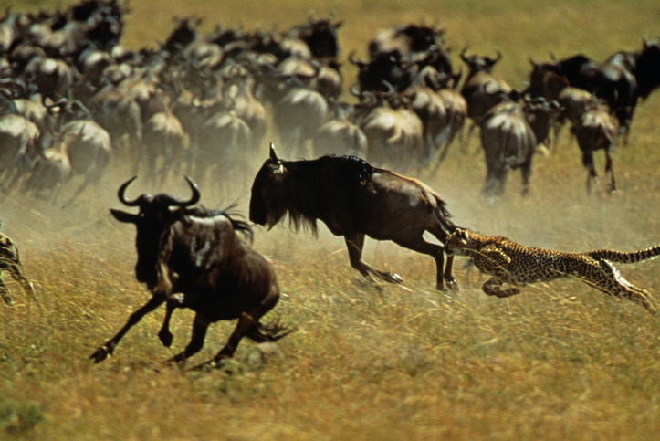
Development of the understanding of evolution part 1– Evolution
Evolution is a change in the inherited characteristics of a population over time. This occurs through a process called natural selection which may result in a new species being formed.
The theory of evolution by natural selection states that all living things have evolved from simple life forms that developed over 3 billion years ago.
Species is defined as a group of similar looking individuals which can breed and produce fertile offspring.
The differences in a population gives some
individuals an advantage. An individual may be more resistant to a disease, or better camouflaged, or stronger, faster or better able to attract a mate. This individual is more likely to survive for longer and be able to breed to pass on desirable genes.
Nature is selecting the individual with the phenotypes most suited to survival. This is called natural selection.

Slide 5
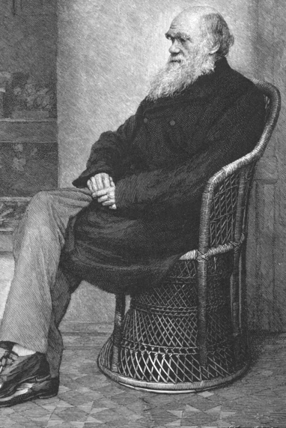
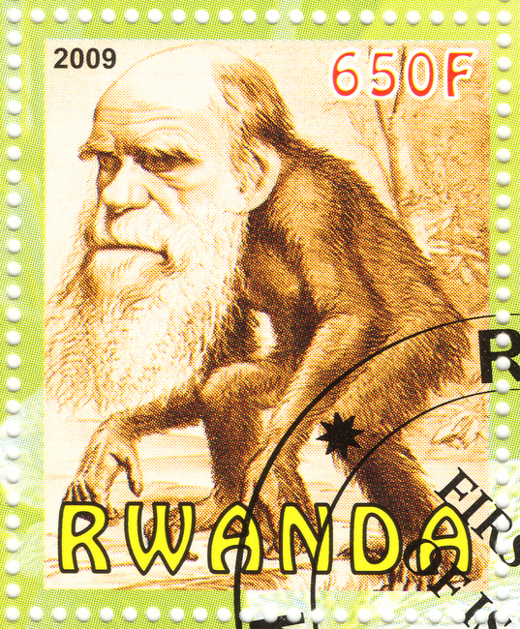
Development of the understanding of evolution part 1– Darwin and Wallace
In 1831, Charles Darwin had the opportunity to join an expedition around the world on the H.M.S Beagle.
As a result of years of experimentation, discussion with other scientists and the developing knowledge of geology and fossils, Darwin proposed the theory of evolution by natural selection.
His theory was based on three observations:
Individual organisms within a particular species show a wide range of variation for a characteristic.
Individuals with characteristics most suited to the environment are more likely to breed successfully.
The characteristics that have enabled these individuals to survive are passed on to the next generation.

Slide 6
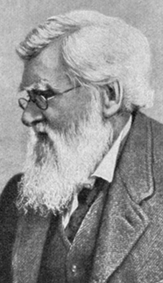
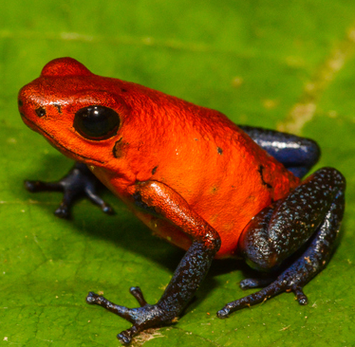
Development of the understanding of evolution part 1– Darwin and Wallace (biology)
Another scientist called Alfred Russel Wallace sent Darwin his ideas and asked for feedback. Darwin had kept his ideas secret for 20 years in fear of losing credibility amongst his peers.
Darwin knew he needed to publish his ideas quickly because Wallace was independently proposing the theory of evolution by natural selection. Wallace published joint writings with Darwin in 1858.
Darwin published ‘On the Origin of Species (1859)’ the following year causing a lot of controversy about these new ideas.
Wallace worked worldwide gathering evidence for evolutionary theory. He is best known for his work on warning colouration in animals and his theory of speciation. More evidence over time has led us to our current understanding of the theory of speciation.
Speciation = process by which new species are formed

Slide 7
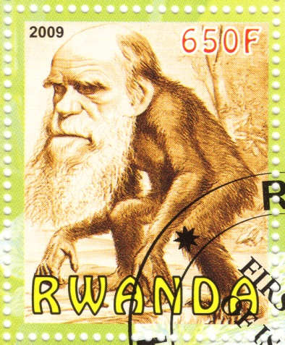
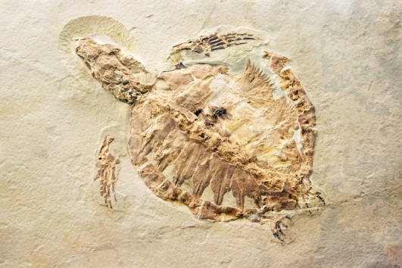

Development of the understanding of evolution part 1– theory of evolution
Darwin’s theory of evolution by natural selection was only gradually accepted because:
The theory challenged the idea that God made all the animals and
plants that live on Earth.
With insufficient evidence at the time the theory was
published, it failed to convince many scientists.
The mechanism of inheritance and variation was not known until
50 years after the theory of evolution was published.

Slide 8
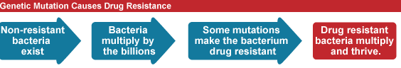
Development of the understanding of evolution part 1– Resistant bacteria
The theory of evolution by natural selection is now widely accepted.
Evidence for Darwin's theory is now available as it has been shown that characteristics are passed on to offspring in genes.
Darwin, Wallace and many more scientists had their credibility questioned in their lifetimes. We can now see their work was pioneering and valuable.
Our understanding of evolution has also been helped by the study of antibiotic resistance in bacteria. Bacteria multiply quickly in a short space of time. Advantageous mutations rapidly spread throughout the population until most are resistant. We can see evolution through the natural selection occurring in bacteria and are able to use this to do research.

Slide 9
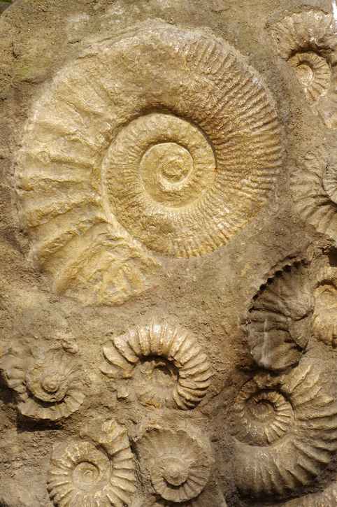
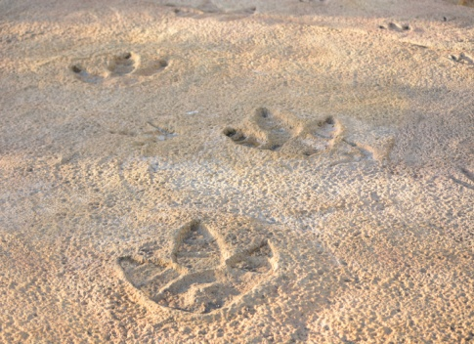
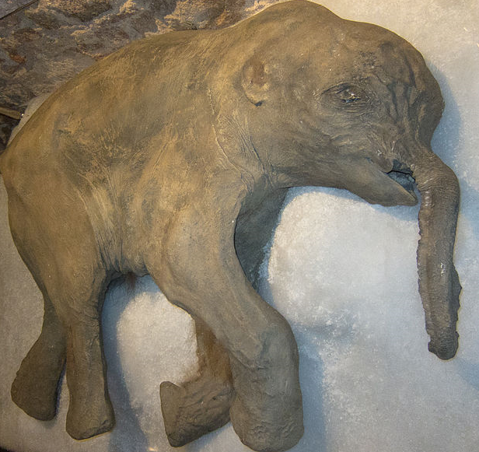
Development of the understanding of evolution part 1– Fossils
Fossils are the ‘remains’ of ancient organisms from millions of years ago, which are found in rocks. Scientists can learn how much or how little organisms have changed over time by arranging them in chronological order which is known as the fossil record.
Fossils may be formed:
From parts of organisms that have not yet decayed.
Usually because one or more of the conditions needed for decay is not present (oxygen, water or warmth).
When parts of the organism are replaced by minerals as they decay.
As preserved traces of organisms such as footprints, burrows and rootlet traces.

Slide 10
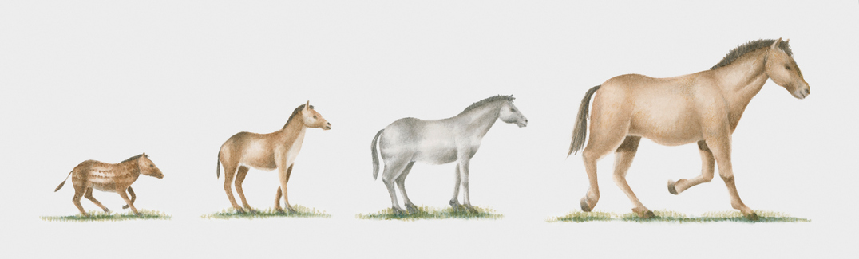
Development of the understanding of evolution part 1– Fossils
The fossil record is incomplete for many reasons:
1. Early life forms were often soft bodied and so few traces remain.
2. Most organisms do not become fossilised as conditions are rare.
3. We are still discovering fossils which give us more information.
4. Traces are often destroyed by geological activity like earthquakes, volcanic eruptions, formation of mountain ranges and erosion.
This is why scientists can never be certain about how life began on Earth.
The fossil record of the horse gives us a good idea of how the modern horse has evolved from a much smaller, dog like animal.

Slide 11
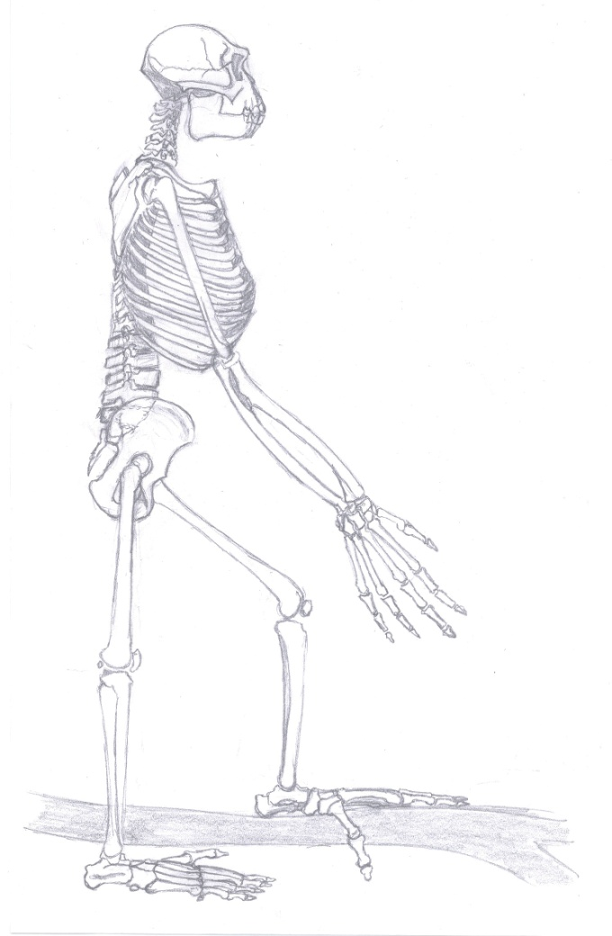
Development of the understanding of evolution part 1– Fossils
The evidence for human evolution can be seen in the human fossil record.
Ardipithecus ramidus (Ardi) lived 4.4million years ago.
The fossil was described as having a mix of human and ape like characteristics.
Large ape-like big toes for grasping branches suggest Ardi climbed trees.
The leg structure indicates that Ardi walked upright.
Long arms and short legs are more ape like.
Ardi’s hands show that she did not use them to help her walk as apes do.
The brain was a similar size to a chimpanzee.
Tobias Fluegel, Ardipithecus Gesamt, CC BY-SA 3.0

Slide 12
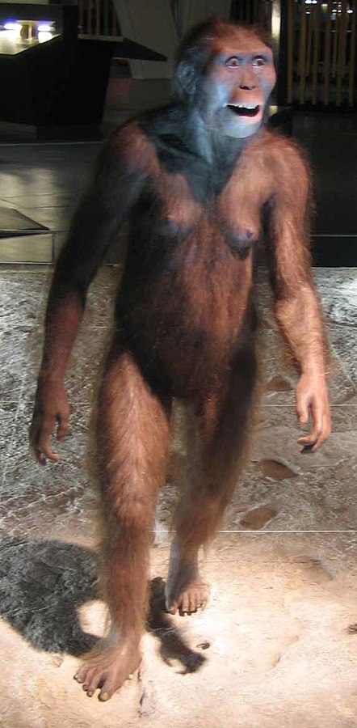
Development of the understanding of evolution part 1– Fossils
The evidence for human evolution can be seen in the human fossil record.
Australopithecus afarensis (Lucy) lived 3.2 million years ago. This fossil was also described as having a mix of human and ape like characteristics.
Lucy is more human like than Ardi.
The length of the arms and legs are in between an ape and human.
The feet have an arch and are adapted to walking rather than climbing.
The leg structure indicates that Lucy walked upright and more efficiently than Ardi.
The brain was a similar size to a chimpanzee but slightly larger than Ardi’s.

Slide 13
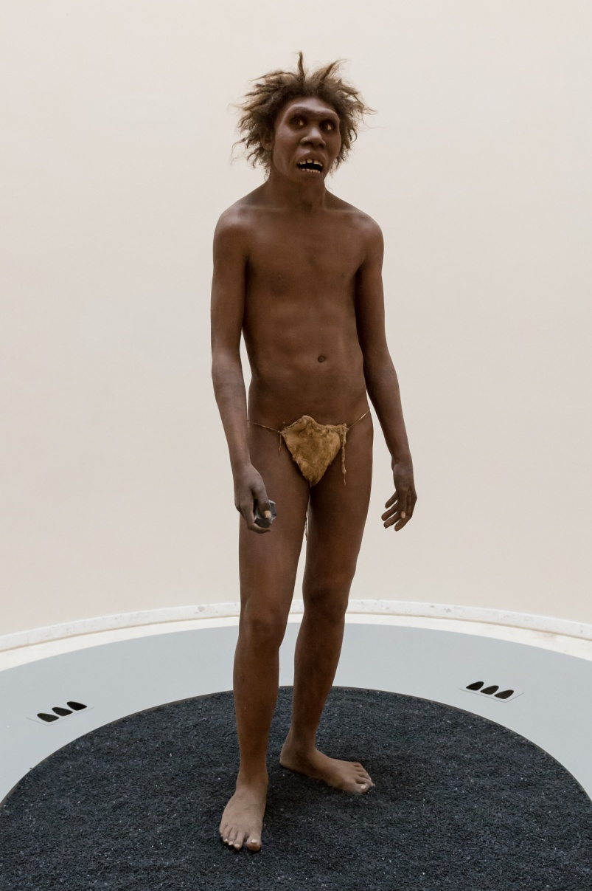
Development of the understanding of evolution part 1– Fossils
Richard Leakey is a Kenyan anthropologist who was responsible for the discovery of lots of fossils related to human evolution.
In 1984 his team discovered a 1.6 million year old fossil of the Homo erectus species.
The fossil was named Turkana boy after the region it was found in.
Turkana boy still has a mixture of human and ape like characteristics but is more human like than Lucy.
The feet and leg structure show he walked upright and was better suited to this than Lucy.
The length of the arms and legs were much more like humans than apes.
The brain was larger than Lucy’s and similar to that of a human.
Thilo Parg, Turkana Boy Nariokotome Boy, CC BY-SA 4.0

Slide 14
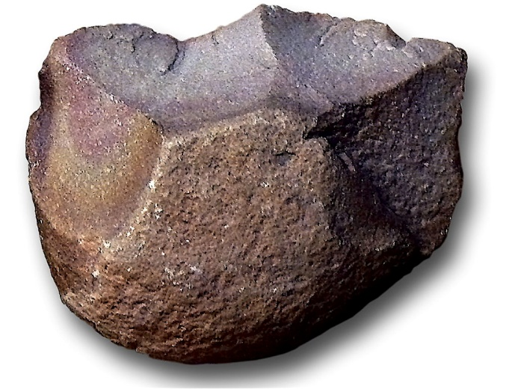
Development of the understanding of evolution part 1– Fossils
Evidence for human evolution can also be gained from looking at stone tools. Scientists use several ways of ageing the tools.
Simple tools are likely to be older than more complex shaped tools
Looking at rock layers in the tools. Older rock layers are found deeper in the ground.
c) If additional materials are found with the tool e.g. a wood handle then these can undergo carbon-14-dating. Surrounding silt and other carbon containing material may also be carbon dated.
Pebble tools were used by Homo habilis about 2.5-1.5 million years ago.
They were simple tools made by hitting rocks together to get sharp edges and flakes.
They were used to smash bones open or to scrape flesh from bones.

Slide 15
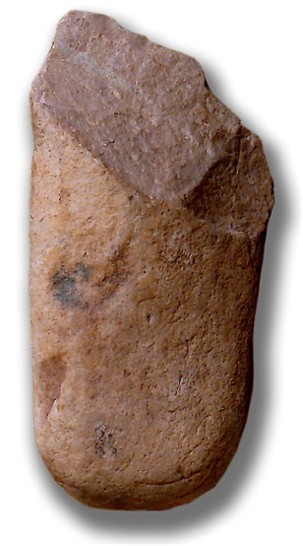
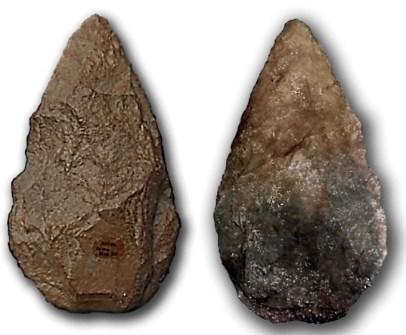
Development of the understanding of evolution part 1– Fossils
Evidence for human evolution can also be gained from looking at stone tools.
Homo erectus (2 - 0.3 million years ago) sculpted rocks into shapes that were like small hand axes.
These could be used to dig, chop, hunt and scrape food from bones.
Homo neanderthalensis (300 000 years ago) began to make more complex tools from flint. These were pointed and could be attached to wood to make spears.
Homo sapiens (200 000 - present day) made arrowheads, fish hooks and needles from flint.

Slide 16
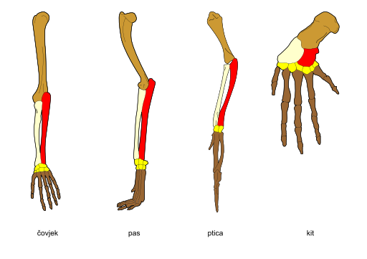
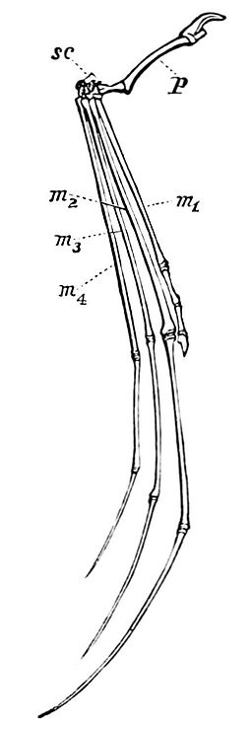
Development of the understanding of evolution part 1– Pentadactyl limb (biology)
The anatomy for the pentadactyl limb
provides scientists with evidence for
evolution.
The pentadactyl limb can be seen in many vertebrate species.
Pent = five
Pentadactyl limb = a limb with five digits
Human Dog Bird Whale Bat
This suggests that many different vertebrates had a common ancestor with a pentadactyl limb. It would be highly unlikely that they had all evolved from different ancestors and have a similar bone arrangement.

Slide 17
QuestionIT!
Part 1
  Development of the understanding of evolution
  Darwin and Wallace
  Theory of evolution
  Resistant bacteria
  Fossils and evolution
  Pentadactyl limb (biology)

Slide 18
  Development of the understanding of evolution part 1 – QuestionIT
What theory did Charles Darwin propose?
What was Charles Darwin’s book called?
Write a definition for evolution.
What does the theory of evolution by natural selection state?
What is the definition of the term species?
List three observations Darwin made which led him to propose his theory.
Name two pieces of evidence for Darwin's theory of evolution through natural selection which mean it is now largely accepted.
What are fossils and how are they formed?
9. List two reasons why there are not many traces of early life on Earth.
10. What can be learned from studying fossils?
11. Which species lived on Earth most recently: Ardi, Lucy or Turkana boy?
12. What feature indicates that Ardi used to climb trees, as well as walk upright?
13. Which fossil species had the smallest brain: Ardi, Lucy or Turkana boy?
14. Who was Leakey?
15. What type of tool did Homo habilis use?
What three methods do scientists use to age stone tools?
Why do bacteria evolve rapidly?

Slide 19
  Development of the understanding of evolution part 1 – QuestionIT
Biology
18. List three reasons why Charles Darwin’s theory was only partially accepted.
19. Alfred Wallace also put forward his theory of evolution by natural selection independently to Darwin but what work is he best known for?
20. What is a pentadactyl limb?
21. List three animals with a pentadactyl limb.
22. Why is the pentadactyl limb of interest to scientists?

Slide 20

AnswerIT!
  Development of the understanding of evolution
  Part 1
  Darwin and Wallace
  Theory of evolution
  Resistant bacteria
  Fossils and evolution
  Pentadactyl limb (biology)

Slide 21
  Development of the understanding of evolution part 1 – AnswerIT
What theory did Charles Darwin propose? The theory of evolution by natural selection.
What was Charles Darwin’s book called? On the Origin of Species
Write a definition for evolution. A change in the inherited characteristics of a population over time, through a process of natural selection.
What does the theory of evolution by natural selection state? All species of living things have evolved from simple life forms that first developed more than 3 billion years ago.
What is the definition of the term species? A group of similar looking individuals who can breed together and produce fertile offspring.
List three observations Darwin made which led him to propose his theory.
Individual organisms within a particular species show a wide range of variation for a characteristic
  Individuals with characteristics most suited to the environment are more likely to survive to breed successfully
  The characteristics that have enabled these individuals to survive are then passed on to the next generation
7. Name two pieces of evidence for Darwin's theory of evolution through natural selection which mean it is now largely accepted. Fossil records.
Knowledge of how resistance to antibiotics evolves in bacteria.
Knowledge of passing on of characteristics to offspring in genes.

Slide 22
  Development of the understanding of evolution part 1 – AnswerIT
What are fossils and how are they formed?
The remains of organisms from millions of years ago.
Formed from parts of organisms that have not decayed
when parts of organism are replaced by minerals
as preserved traces like footprints, burrows or rootlets.
9. List two reasons why there are not many traces of early life on Earth.
Organisms were mainly soft bodied so little trace left.
Any traces destroyed by geological activity.
10. What can be learned from studying fossils? Evidence of evolution
11. Which species lived on Earth most recently: Ardi, Lucy or Turkana boy?
12. What feature indicates that Ardi used to climb trees as well as walk upright? Big ape-like toe
13. Which fossil species had the smallest brain: Ardi, Lucy or Turkana boy?
Who was Leakey? Richard Leakey is a Kenyan anthropologist who was responsible for the discovery of lots of fossils related to human evolution.
What type of tool did Homo habilis use? Simple pebble tools
What three methods do scientists use to age stone tools?
Complexity of the tool – simple tools are earliest
Rock layers- oldest rock layers are the deepest down
Carbon-14-dating of any wood or carbon containing material found with the stone tool

Slide 23
  Development of the understanding of evolution part 1 – AnswerIT
17. Why do bacteria evolve rapidly? Because they reproduce at a rapid rate
Biology
18. List three reasons why Charles Darwin’s theory was only partially accepted.
The theory challenged the idea that God made all the animals and plants that lived on Earth.
There was insufficient evidence at the time the theory was published to convince many scientists.
The mechanism of inheritance and variation was not known until 50 years after the theory was published.
19. Alfred Wallace also put forward his theory of evolution by natural selection independently to Darwin but what work is he best known for? His work on warning colouration in animals and his theory of speciation
20. What is a pentadactyl limb? A limb with five digits
21. List three animals with a pentadactyl limb. Whale, human, dog, bat, bird,
22. Why is the pentadactyl limb of interest to scientists? As it is further evidence of evolution of many different types of vertebrate from a common ancestor with a pentadactyl limb. This is unlikely to have happened by chance.

Slide 24
LearnIT!
KnowIT!
  Part 2
  Classification of living organisms
  Classification
  The five kingdoms
  Three domains

Slide 25
Development of the understanding of evolution part 2– Classification
Evolutionary tree diagrams are used to represent the relationship between various species based on the similarity and differences in their physical and genetic characteristics. The pattern of branching reflects how scientists think the species has evolved from a common ancestor. Current classification data is used for living organisms and fossil data for extinct organisms.
A
Present Day
Species A – E all have the same common ancestor.
B
C
D
E
Species A and species 1 evolved from the common ancestor following speciation.
Species 1 was the ancestral species of species B,C and 2.
Species 2 gave rise to species D and E.
2
1
B and C, D and E share the same ancestor.
A is the present day species least closely related to all other species.
1 millions years ago
Common Ancestor

Slide 26
Development of the understanding of evolution part 2– Classification
The five kingdom system of classification
Organisms were initially grouped according to their similar observable characteristics.
Kingdom | Examples
Animal | All multi-cellular, no cell wall or chlorophyll: Vertebrates and invertebrates.
Plants | All multi-cellular with cell walls and chlorophyll: All green plants including algae, moss, ferns, conifers and flowering plants.
Fungi | Multi-cellular with a cell wall but no chlorophyll: Mushrooms, yeast and moulds.
Prokaryotes | All single celled organisms without a nucleus: Bacteria, blue-green algae.
Protists (protoctista) | All single celled with a true nucleus e.g. amoeba.

Slide 27
Development of the understanding of evolution part 2– Classification
Living things have been traditionally classified into groups, depending on the structures and characteristics they share, using a system designed by Swedish scientist Carl Linnaeus.
Group | Human classification
Kingdom | Animalia
Phylum | Chordate With a backbone
Class | Mammal Produce milk and live birth, warm blooded
Order | Primate Ape like
Family | Hominid Human like
Genus | Homo humans
Species | Sapiens Modern humans
The number of organisms in each group gets smaller, but they have more features in common.
Kingdom
Order
Species
Phylum
Class
Family
Genus

Slide 28
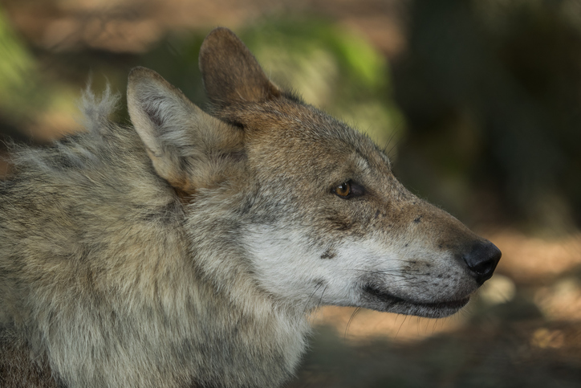
Development of the understanding of evolution part 2– Classification
Linnaeus recognised there was a problem in terms of naming organisms. Scientists spoke different languages and called the same organisms something different. He developed the binomial naming system. Each organism has a two word name – the genus and the species.
These are written in italics or underlined. The genus has a capital letter and the species is a lower case letter.
Here are some organisms, their Latin name (Genus and species) and common name.
Scientific name | Common name
Felis leo | Lion
Felis domesticus | Domestic cat
Canis lupus | Wolf
Canis familiaris | Domestic dog

Slide 29
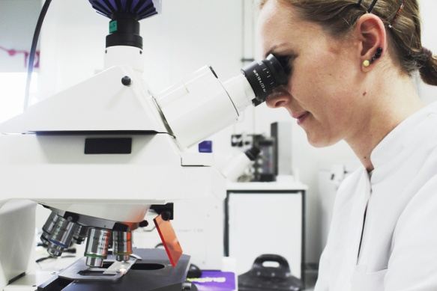
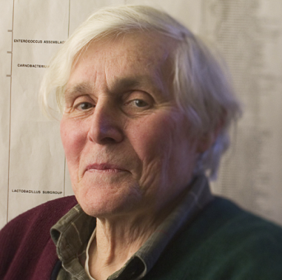
Development of the understanding of evolution part 2– Three Domains
As evidence of internal structures became more developed due to improvements in microscopes and the understanding of biochemical processes progressed, new models of classification were proposed.
In 1977, Carl Woese used evidence from RNA sequencing to put forward a three domain system. His work proved that some of the prokaryote kingdom were not as closely related as Linnaeus had thought. Woese split the kingdom into two: archaea and bacteria.
Domain name | Description
archaea | Primitive bacteria usually living in extreme places
bacteria | True bacteria
eukaryota | Includes protists, fungi, plants and animals

Slide 30
QuestionIT!
Part 2
Classification of living organisms
Classification
The five kingdom system
The three domains

Slide 31
  Classification part 2 – QuestionIT
What does an evolutionary tree show?
2. Name the seven groups that Linnaeus used to classify living organisms.
What is the binomial naming system?
List the five kingdoms.
How are organisms classified in the five kingdoms?
6. Carl Woese used information from chemical analysis to suggest a new method of classification. What is it called?
7. List the groups that organisms are divided into using Carl Woese’s method.

Slide 32
AnswerIT!
Part 2
Classification of living organisms
The five Kingdom system
The three domains

Slide 33
  Classification part 2 – AnswerIT
What does an evolutionary tree show? The relationship between various species based on the similarity and differences in their physical and genetic characteristics.
2. Name the seven groups that Linnaeus used to classify living organisms. Kingdom, phylum, class, order, family, genus, species.
What is the binomial naming system? A method of scientifically naming animals using the genus and species.
List the five kingdoms. Plants, animals, fungi, prokaryotes, protists (protoctista).
5. How are organisms classified in the five kingdoms? Based on observable similar features.
6. Carl Woese used information from chemical analysis to suggest a new method of classification. What is it called? The three domain system
7. List the groups that organisms are divided into using Carl Woese’s method.
Archaea
Bacteria
Eukaryota

Slide 34
LearnIT!
KnowIT!
Genetic Engineering
Part 3
  Selective breeding
  Tissue culture (biology)
  Genetic engineering
  Fertilisers and biological control

Slide 35
Genetic Engineering part 3 – Selective breeding
Selective breeding is also called artificial selection. Selective breeding is where humans breed plants and animals for particular chosen genetic characteristics which are either useful or for appearance.
1
  Parents chosen from a mixed population of variants
  Parents are bred together
2
  Offspring chosen with the desired characteristics
  They are bred together
3
  Offspring chosen from next generation with desired characteristics are bred together. This continues for many generations until all offspring have the desired characteristics.
video:
Notes:
http://www.bbc.co.uk/education/clips/z4p2tfr

Slide 36
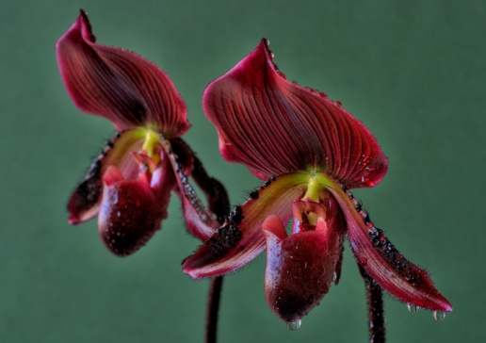

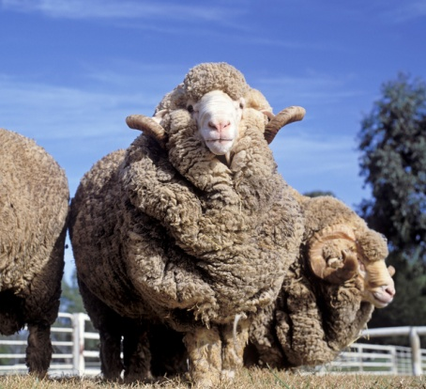
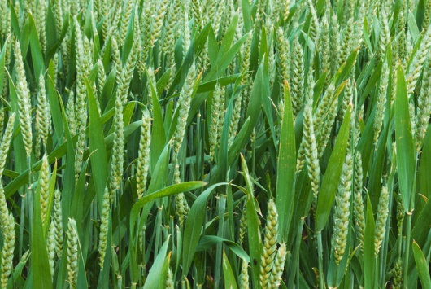
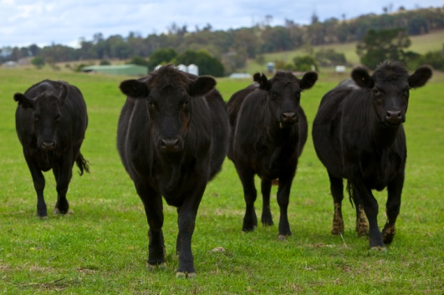

Genetic Engineering part 3 – Selective breeding
To produce plants with large or unusual flower shapes or colours
To produce animals with more meat or milk
To produce crops with better yields or disease resistance
Why do humans use selective breeding?
To produce domestic dogs with a gentle nature

Slide 37
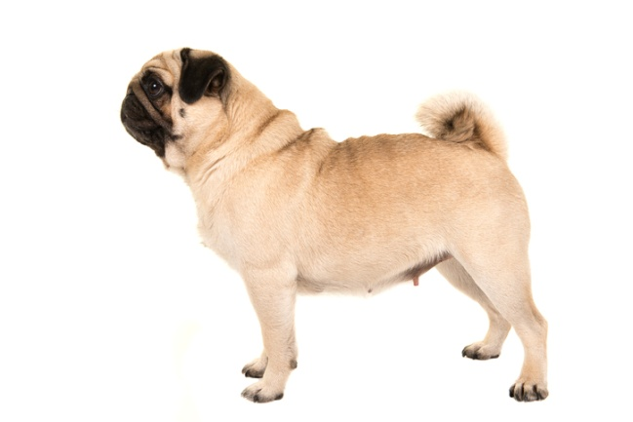
Genetic Engineering part 3 – Selective breeding
Selective breeding reduces variation and can lead to “inbreeding”.
The population will have the same strengths but also the same weaknesses. Infectious diseases are more likely to spread through a genetically similar population because of this vulnerability.
Some breeds are particularly prone to disease or inherited defects as a result of inbreeding.
The standards set for a pedigree Pug are :
Large dark eyes
Ears must be small and thin
Muzzle must be short and square.
Head is large with no indentations.
Wrinkles must be large and deep.
In order to maintain this standard breeders often mate closely related dogs with good characteristics together. A pedigree pug can be a result of 5-6 generations of inbreeding. Puppies which do not meet the standard may be illegally killed.
Many pugs will go on to develop painful crippling conditions:
Chronic joint problems
Severe breathing issues due to a deformed nose and short trachea
Chronic eye problems due to the wrinkles around the eye folding in and scratching the cornea.
Skin irritation due to bacteria infections in the deep wrinkles.

Slide 38
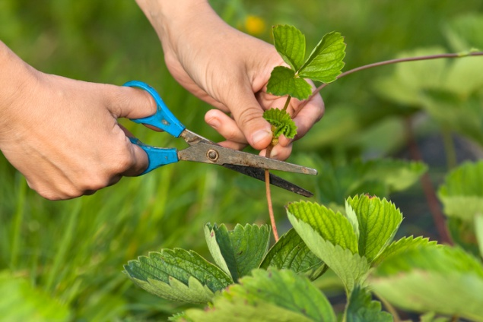
Genetic Engineering part 3 – Tissue culture (biology)
Offspring which have been produced by asexual reproduction are genetically identical to the parent and each other. They are called clones.
Animal and plant cells are often cloned because they possess a characteristic which is desirable, such as resistance to disease.
Tissue culture is one method of cloning plants. A small piece of tissue is taken from a plant and grown on agar which contains the right balance of nutrients and plant growth hormones. It must be done in sterile conditions to ensure that microbes do not infect the plants. It can be more expensive but can produce hundreds of identical plants. This method is often used to preserve rare plants or commercially in nurseries.
Cuttings: This method has been used for a long time
by gardeners. It is simple and cheap to do. A part of
the plant is removed and placed in moist soil. If the
conditions are suitable the plant piece will grow as a
new plant.

Slide 39
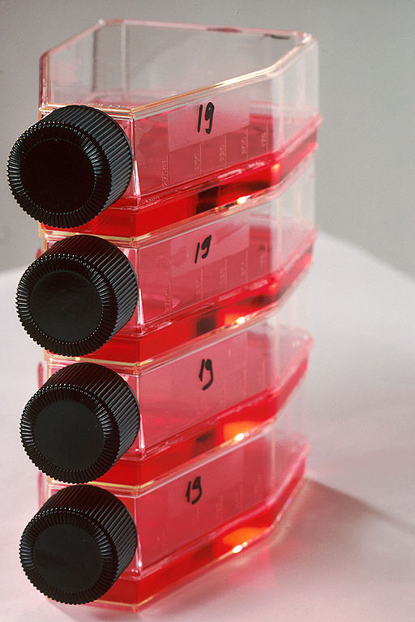
Genetic Engineering part 3 – Tissue culture (biology)
Tissue culture can also be used with animal cells to aid medical research or drug development.
Scientists can use animal tissue to investigate the effect of chemicals or environmental changes without causing harm to a whole animal. People are less concerned about the ethics of experimentation on tissues.
A sample of tissue is removed from the animal using
aseptic techniques.
The cells are separated using enzymes.
They are placed in a sterile culture vessel containing
growth medium which provides all the nutrients
that the cells require.
The cells grow and multiply.
After a period of time, the cells are divided into
separate vessels for further growth and multiplication.
The tissue culture can now be stored and is ready for
experimentation.

Slide 40
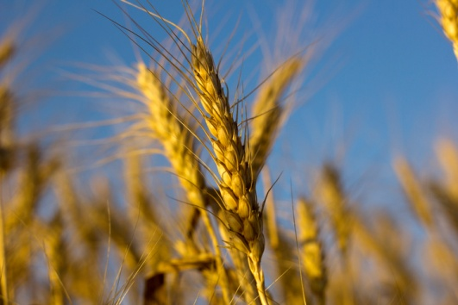
Genetic Engineering part 3 – Genetic engineering
Genetic engineering is a process which involves
modifying the genome of an organism by introducing
a gene from another organism to give a desired
characteristic.
Plant crops have been genetically engineered to be resistant to diseases, or be resistant to insect attack, resistant to herbicides or to produce bigger better fruits. These are known as genetically modified or GM crops. GM crops usually show an increased yield.
A herbicide is a chemical which kills plants (also called a weed-killer). If a crop plant is resistant to herbicide, the farmer can spray herbicide to kill all other plants in the field without affecting the crop.
Plants resistant to insect attack have been modified to produce their own pesticide.
All our food from plants and animals contains genes. A plant cell contains about 30 000 genes. GM involves adding about 1-10 extra genes. Video:
Notes:
http://www.bbc.co.uk/education/clips/zydvcdm

Slide 41
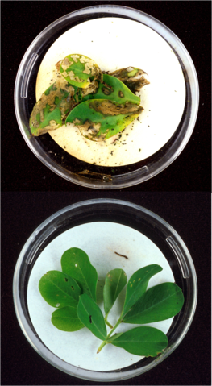
Genetic Engineering part 3 – Genetic engineering (biology)
In genetic engineering, genes from the chromosomes of humans and other organisms are cut out of the DNA using enzymes. The genes are then transferred to the cells of the organism to be genetically modified.
A bacteria called Bacillus thuringiensis lives in the soil. It produces a toxin that kills a variety of common insect pests.
The gene which produces the toxin in the bacteria has been isolated and transferred to the crop plant’s genome.
The crop plant now produces the toxin and insects which eat it are poisoned. This means there are less insects to eat the crop and so a bigger yield is produced. The farmer does not have to spray the crop with pesticide either so it makes economic sense as well.
Plant not genetically modified with the toxin producing gene after insect attack.
Plant which is genetically modified with the toxin producing gene after insect attack.

Slide 42
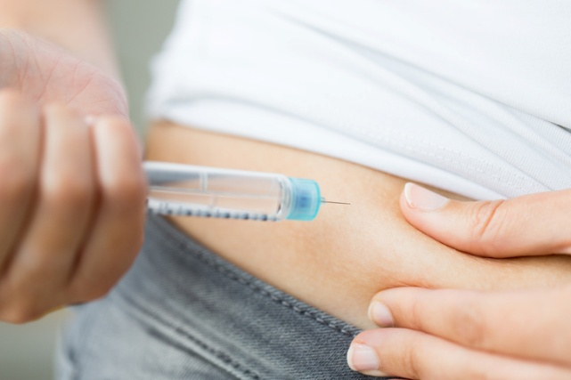




Genetic Engineering part 3 – Genetic engineering
Insulin is a naturally occurring hormone produced in the pancreas. In diabetes, a fault in the pancreas means insulin is not made effectively.
Diabetics can inject themselves with insulin. The insulin for injections used to be collected from a pig’s pancreas. Some diabetics had severe allergic reactions to pig insulin because it was not the same as human insulin.
Genetic engineering is now used to produce ‘human insulin’ from genetically modified bacteria. It is cheaper, safer and more ethically acceptable than using specially bred pigs which have to be killed.

Slide 43
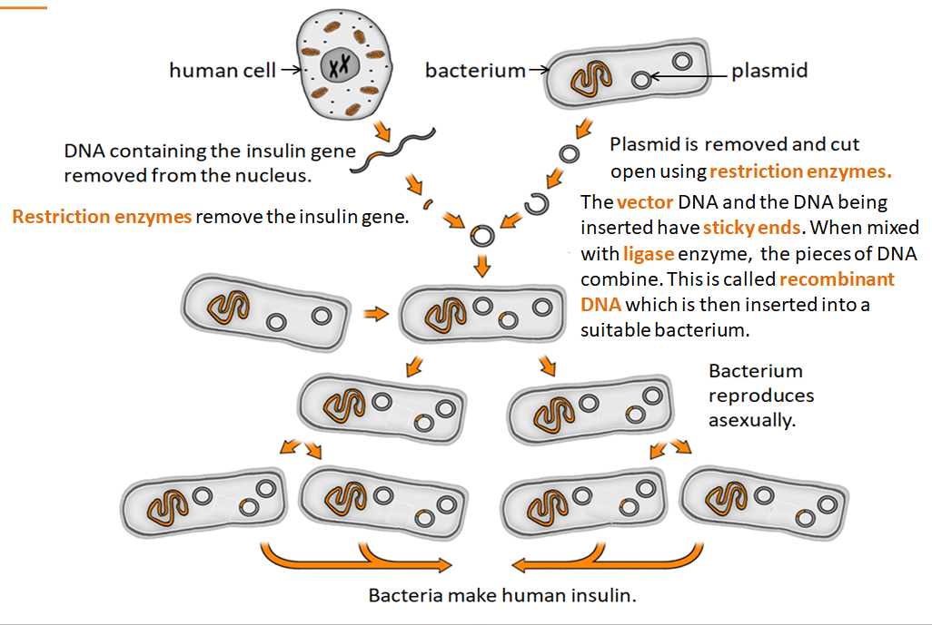
Inheritance part 3 – Genetic Engineering HT only

Slide 44
Inheritance part 3 – Genetic Engineering
Genetic engineering is a new technology that can be very useful but there are also ethical issues to consider.
Some benefits of genetic modification
Bigger crop yields or drought resistant/pest resistant crops may mean more food can be produced. This might solve the world food shortage.
Human insulin protein can be mass produced by genetically engineered bacteria meaning pigs do not have to be slaughtered and costs are reduced. Allergic reactions are reduced. Human genes that produce other useful proteins have been transferred to sheep and cows. These proteins have then been extracted from their milk.
Medical research is exploring the possibility of genetic modification to overcome conditions such as arthritis, cystic fibrosis, cancer and MS.
Some concerns regarding genetic modification
We do not know the effect of growing GM crops on nearby populations of wild flowers and insects.
GM crops which produce their own pesticide may kill insects which are needed to pollinate other plants.
Some people feel that the effects of eating GM crops on human health have not been fully explored.
Should humans be inserting genes from one organism into a totally different organism?
video

Slide 45
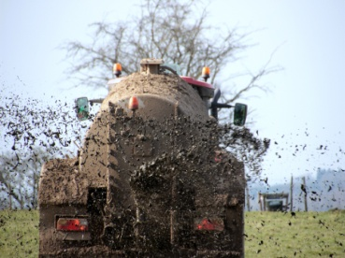
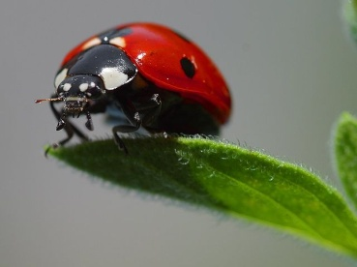
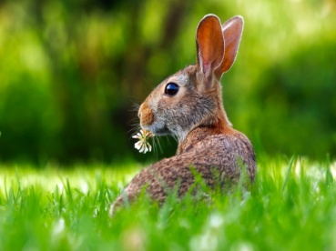
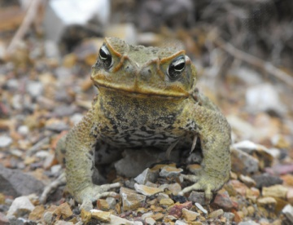
Genetic Engineering part 3 – Fertilisers and biological control
Some people feel there are other less harmful methods to increase food production which should be considered before genetic modification
Crop yields may improve if the soil is improved using fertilisers containing the minerals essential to healthy growth (nitrate and phosphate). There is a risk of eutrophication if the fertiliser is applied in excess amounts.
Biological control is an alternative to using pesticides or genetic modification. It is a method of controlling pests using other organisms which are predators or parasites. Ladybirds eat aphids and so gardeners buy ladybirds or their larvae to release on aphid infested plants.
The myxomatosis virus was released into the wild in Australia to control the crop destroying rabbit population. The population reduced from 600 to 100 million in two years however genetic resistance was observed and the disease only kills about 50% of infected rabbits now.
Biological control tends to have longer lasting effects than chemical pesticides but it can have undesirable effects. The Hawaiian Cane toad was introduced into Australia to control the cane beetle population as it was destroying sugar cane crops. The cane toads did not have much effect on the cane beetles but began to reproduce and spread across the country. They are poisonous and are reducing the native toad population.

Slide 46
QuestionIT!
Genetic engineering
Part 3
  Selective breeding
  Tissue culture (biology)
  Genetic engineering
  Fertilisers and biological control

Slide 47
  Genetic engineering part 3 – QuestionIT
1. Humans choose animals or plants to breed from based on usefulness or appearance.
List four characteristics which would be selected (two in plants and two in animals).
2. What is a major disadvantage caused by selective breeding?
3. What is the impact of selective breeding on food plants and domesticated animals?
4. What is genetic engineering?
5. What is a GMO?
6. What human product is made by genetically engineered bacteria to treat diabetes?
7. What are plants called which have had their genome modified?
Higher tier only
8. In genetic engineering, how are the required genes isolated from the host?
9. What is the biological definition of a vector ?
10. Name a common vector for inserting genes into the required cells.
11. What does a restriction enzyme do?
12. What does a ligase enzyme do?
Biology questions
13. List three concerns people have in relation to genetic engineering.
14. What is tissue culture?
15. Why is tissue culture important?
16. What type of organism is Bacillus thuringiensis?
17. Why might people buy ladybirds for their greenhouses?
18. What is biological control?

Slide 48
AnswerIT!
Part 3
  Selective breeding
  Tissue culture (biology)
  Genetic engineering
  Fertilisers and biological control

Slide 49
  Genetic engineering part 3 – AnswerIT
1. Humans choose animals or plants to breed from based on usefulness or appearance.
List four characteristics which would be selected (two in plants and two in animals).
Disease resistance in crop plants.
Animals which produce more meat or milk.
Domestic dogs with a gentle nature.
Large or unusual flowers.
2. What is a major disadvantage caused by selective breeding? Can lead to inbreeding, where some breeds are particularly prone to disease or inherited defects.
3. What is the impact of selective breeding on food plants and domesticated animals?
Reduces the genetic variation in the population.
4. What is genetic engineering? A process which involves modifying the genome of an organism by introducing a gene from another organism to give a desired characteristic.
5. What is a GMO? Genetically modified organism
6. What human product is made by genetically engineered bacteria to treat diabetes? Insulin
7. What are plants called which have had their genome modified? GM crops
Higher tier only
8. In genetic engineering how are the required genes isolated from the host? Using a restriction enzyme

Slide 50
  Genetic engineering part 3 – AnswerIT
9. What is the biological definition of a vector? Used to insert the gene into the required cells
10. Name a common vector for inserting genes into the required cells. Bacterial plasmid / virus
11. What does a ligase enzyme do? Joins the sticky ends of the vector DNA and the DNA to be inserted together.
Biology questions
13. List three concerns people have in relation to genetic engineering. Do not know the effect of using GM crops on populations of wild flowers and insects.
May kill insects which are needed to pollinate other plants.
Some people feel that the effects of eating GM crops on human health have not been
fully explored.
For ethical reasons - should humans be inserting genes from one organism into a
totally different organism?
14. What is tissue culture? Using small groups of cells from a part of a plant to grow identical new plants.
15. Why is tissue culture important? To preserve rare plant species.
Commercially in nurseries to grow lots of new identical plants.
To produce animal tissue to carry out research without harming whole animals.

Slide 51
  Genetic engineering part 3 – AnswerIT
16. What type of organism is Bacillus thuringiensis? Bacteria
17. What is biological control? It is a method of controlling pests using other organisms which are predators or parasites.
18. Why might people buy ladybirds for their greenhouses? To control a population of aphids.

