Slide 1


The PiXL Club The PiXL Club The PiXL Club The PiXL Club The PiXL Club The PiXL Club The PiXL Club The PiXL Club The PiXL Club The PiXL Club The PiXL Club The PiXL Club The PiXL Club The PiXL Club The PiXL Club The PiXL Club The PiXL Club The PiXL Club The PiXL Club The PiXL Club The PiXL Club The PiXL Club The PiXL Club The PiXL Club The PiXL Club The PiXL Club The PiXL Club The PiXL Club The PiXL Club The PiXL Club The PiXL Club The PiXL Club The PiXL Club The PiXL Club The PiXL Club The PiXL Club The PiXL Club The PiXL Club The PiXL Club The PiXL Club The PiXL Club The PiXL Club The PiXL Club The PiXL Club The PiXL Club XL Club The PiXL Club The PiXL Club The PiXL Club The PiXL Club The PiXL Club The PiXL Club The PiXL Club The PiXL Club The PiXL Club The PiXL Club The PiXL Club The PiXL Club The PiXL Club The PiXL Club The PiXL Club The PiXL Club The PiXL Club The PiXL Club The PiXL Club The PiXL Club The PiXL Club The PiXL Club The PiXL Club The PiXL Club The PiXL Club The PiXL Club The PiXL Club The PiXL Club The PiXL Club The PiXL Club The PiXL Club The PiXL Club The PiXL Club The PiXL Club The PiXL Club The PiXL Club The PiXL Club The PiXL Club The PiXL Club The PiXL Club The PiXL Club The PiXL Club The PiXL Club The PiXL Club The PiXL Club The PiXL Club The PiXL Club The PiXL Club The PiXL Club The PiXL Club The PiXL Club The PiXL Club The PiXL Club The PiXL Club The PiXL Club The PiXL Club The PiXL Club The PiXL Club The PiXL Club The PiXL Club The PiXL Club The PiXL Club The PiXL Club The PiXL Club The PiXL Club The PiXL Club The PiXL Club The PiXL Club The PiXL Club The PiXL Club The PiXL Club The PiXL Club The PiXL Club The PiXL Club The PiXL Club The PiXL Club The PiXL Club The PiXL Club The PiXL Club The PiXL Club The PiXL Club The PiXL Club The PiXL Club The PiXL Club The PiXL Club The PiXL Club The PiXL Club The PiXL Club The PiXL Club The PiXL Club The PiXL Club The PiXL Club The PiXL Club The PiXL Club The PiXL Club The PiXL Club The PiXL Club The PiXL Club The PiXL Club The PiXL Club The PiXL Club The PiXL Club The PiXL Club The PiXL Club The PiXL Club The PiXL Club The PiXL Club The PiXL Club The PiXL Club The PiXL Club The PiXL Club The PiXL Club The PiXL Club The PiXL Club The PiXL Club The PiXL Club The PiXL Club The PiXL Club The PiXL Club The PiXL Club The PiXL Club The PiXL Club The PiXL Club The PiXL Club The PiXL Club The PiXL Club The PiXL Club The PiXL Club The PiXL Club The PiXL Club The PiXL Club The PiXL Club The PiXL Club The PiXL Club The PiXL Club The PiXL Club The PiXL Club The PiXL Club The PiXL Club The PiXL Club The PiXL Club The PiXL Club The PiXL Club The PiXL Club The PiXL Club The PiXL Club The PiXL Club The PiXL Club The PiXL Club The PiXL Club The PiXL Club The PiXL Club The PiXL Club The PiXL Club The PiXL Club The PiXL Club The PiXL Club The PiXL Club The PiXL Club The PiXL Club The PiXL Club The PiXL Club The PiXL Club The PiXL Club The PiXL Club The PiXL Club The PiXL Club The PiXL Club The PiXL Club The PiXL Club The PiXL Club The PiXL Club The PiXL Club The PiXL Club The PiXL Club The PiXL Club The PiXL Club The PiXL Club The PiXL Club The PiXL Club The PiXL Club The PiXL Club The PiXL Club The PiXL Club The PiXL Club The PiXL Club The PiXL Club The PiXL Club The PiXL Club The PiXL Club The PiXL Club The PiXL Club The PiXL Club The PiXL Club The PiXL Club The PiXL Club The PiXL Club The PiXL Club The PiXL Club The PiXL Club The PiXL Club The PiXL Club The PiXL Club The PiXL Club The PiXL Club The PiXL Club The PiXL Club The PiXL Club The PiXL Club The PiXL Club The PiXL Club The PiXL Club The PiXL Club The PiXL Club The PiXL Club The PiXL Club The PiXL Club The PiXL Club The PiXL Club The PiXL Club The PiXL Club The PiXL Club The PiXL Club The PiXL Club The PiXL Club The PiXL Club The PiXL Club The PiXL Club The PiXL Club The PiXL Club The PiXL Club The PiXL Club The PiXL Club The PiXL Club The PiXL Club The PiXL Club The PiXL Club The PiXL Club The PiXL Club The PiXL Club The PiXL Club The PiXL Club The PiXL Club The PiXL Club The PiXL Club The PiXL Club The PiXL Club The PiXL Club The PiXL Club The PiXL Club The PiXL Club The PiXL Club The PiXL Club The PiXL Club The PiXL Club The PiXL Club The PiXL Club The PiXL Club The PiXL Club The PiXL Club The PiXL Club The PiXL Club The PiXL Club The PiXL Club The PiXL Club The PiXL Club The PiXL Club The PiXL Club The PiXL Club The PiXL Club The PiXL Club The PiXL Club The PiXL Club The PiXL Club The PiXL Club The PiXL Club The PiXL Club The PiXL Club The PiXL Club The PiXL Club The PiXL Club The PiXL Club The PiXL Club The PiXL Club The PiXL Club The PiXL Club The PiXL Club The PiXL Club The PiXL Club The PiXL Club The PiXL Club The PiXL Club The PiXL Club The PiXL Club The PiXL Club The PiXL Club The PiXL Club The PiXL Club The PiXL Club The PiXL Club The PiXL Club The PiXL Club The PiXL Club The PiXL Club The PiXL Club The PiXL Club The PiXL Club The PiXL Club The PiXL Club The PiXL Club The PiXL Club The PiXL Club The PiXL Club The PiXL Club The PiXL Club The PiXL Club The PiClub The PiXL Club The PiXL Club The PiXL Club The PiXL Club The PiXL Club The PiXL Club The PiXL Club The PiXL Club The PiXL Club The PiXL Club The PiXL Club The PiXL Club The PiXL Club The PiXL Club The PiXL Club The PiXL Club The PiXL Club The PiXL Club The PiXL Club The PiXL Club The PiXL Club The PiXL Club The PiXL Club The PiXL Club The PiXL Club The PiXL Club The PiXL Club The PiXL Club The PiXL Club The PiXL Club The PiXL Club The PiXL Club The PiXL Club The PiXL Club The PiXL Club The PiXL Club The PiXL Club The PiXL Club The PiXL Club The PiXL Club The PiXL Club The PiXL Club The PiXL Club The PiXL Club The PiXL Club The PiXL Club The PiXL Club The PiXL Club The PiXL Club The PiXL Club The PiXL Club The PiXL Club The PiXL Club The PiXL Club The PiXL Club The PiXL Club The PiXL Club The PiXL Club The PiXL Club The PiXL Club The PiXL Club The PiXL Club The PiXL Club The PiXL Club The PiXL Club The PiXL Club The PiXL Club The PiXL Club The PiXL Club The PiXL Club The PiXL Club The PiXL Club The PiXL Club The PiXL Club The PiXL Club The PiXL Club The PiXL Club The PiXL Club The PiXL Club The PiXL Club The PiXL Club The PiXL Club The PiXL Club The PiXL Club The PiXL Club The PiXL Club The PiXL Club The PiXL Club The PiXL Club The PiXL Club The PiXL Club The PiXL Club The PiXL Club The PiXL Club The PiXL Club The PiXL Club The PiXL Club The PiXL Club The PiXL Club The PiXL Club The PiXL Club The PiXL Club The PiXL Club The PiXL Club The PiXL Club The PiXL Club The PiXL Club The PiXL Club The PiXL Club The PiXL Club The PiXL Club The PiXL Club The PiXL Club The PiXL Club The PiXL Club The PiXL Club The PiXL Club The PiXL Club The PiXL Club The PiXL Club The PiXL Club The PiXL Club The PiXL Club The PiXL Club The PiXL Club The PiXL Club The PiXL Club The PiXL Club The PiXL Club The PiXL Club The PiXL Club The PiXL Club The PiXL Club The PiXL Club The PiXL Club The PiXL Club The PiXL Club The PiXL Club The PiXL Club The PiXL Club The PiXL Club The PiXL Club The PiXL Club The PiXL Club The PiXL Club The PiXL Club The PiXL Club The PiXL Club The PiXL Club The PiXL Club The PiXL Club The PiXL Club The PiXL Club The PiXL Club The PiXL Club The PiXL Club The PiXL Club The PiXL Club The PiXL Club The PiXL Club The PiXL Club The PiXL Club The PiXL Club The PiXL Club The PiXL Club The PiXL Club The PiXL Club The PiXL Club The PiXL Club The PiXL Club The PiXL Club The PiXL Club The PiXL Club The PiXL Club The PiXL Club The PiXL Club The PiXL Club The PiXL Club The PiXL Club The PiXL Club The PiXL Club The PiXL Club The PiXL Club The PiXL Club The PiXL Club The PiXL Club The PiXL Club The PiXL Club The PiXL Club The PiXL Club The PiXL Club The PiXL Club The PiXL Club The PiXL Club The PiXL Club The PiXL Club The PiXL Club The PiXL Club The PiXL Club The PiXL Club The PiXL Club The PiXL Club The PiXL Club The PiXL Club The PiXL Club The PiXL Club The PiXL Club The PiXL Club The PiXL Club The PiXL Club The PiXL Club The PiXL Club The PiXL Club The PiXL Club The PiXL Club The PiXL Club The PiXL Club The PiXL Club The PiXL Club The PiXL Club The PiXL Club The PiXL Club The PiXL Club The PiXL Club The PiXL Club The PiXL Club The PiXL Club The PiXL Club The PiXL Club The PiXL Club The PiXL Club The PiXL Club The PiXL Club The PiXL Club The PiXL Club The PiXL Club The PiXL Club The PiXL Club The PiXL Club The PiXL Club The PiXL Club The PiXL Club The PiXL Club The PiXL Club The PiXL Club The PiXL Club The PiXL Club The PiXL Club The PiXL Club The PiXL Club The PiXL Club The PiXL Club The PiXL Club The PiXL Club The PiXL Club The PiXL Club The PiXL Club The PiXL Club The PiXL Club The PiXL Club The PiXL Club The PiXL Club The PiXL Club The PiXL Club The PiXL Club The PiXL Club The PiXL Club The PiXL Club The PiXL Club The PiXL Club The PiXL Club The PiXL Club The PiXL Club The PiXL Club The PiXL Club The PiXL Club The PiXL Club The PiXL Club The PiXL Club The PiXL Club The PiXL Club The PiXL Club The PiXL Club The PiXL Club The PiXL Club The PiXL Club The PiXL Club The PiXL Club The PiXL Club The PiXL Club The PiXL Club The PiXL Club The PiXL Club The PiXL Club The PiXL Club The PiXL Club The PiXL Club The PiXL Club The PiXL Club The PiXL Club The PiXL Club The PiXL Club The PiXL Club The PiXL Club The PiXL Club The PiXL Club The PiXL Club The PiXL Club The PiXL Club The PiXL Club The PiXL Club The PiXL Club The PiXL Club The PiXL Club The PiXL Club The PiXL Club The PiXL Club The PiXL Club The PiXL Club The PiXL Club The PiXL Club The PiXL Club The PiXL Club The PiXL Club The PiXL Club The PiXL Club The PiXL Club The PiXL Club The PiXL Club The PiXL Club The PiXL Club The PiXL Club The PiXL Club The PiXL Club The PiXL Club The PiXL Club The PiXL Club The PiXL Club The PiXL Club The PiXL Club The PiXL Club The PiXL Club The PiXL Club The PiXL Club The PiXL Club The PiXL Club The PiXL Club The PiXL Club The PiXL Club The PiXL Club The PiXL Club The PiXL Club The PiXL Club The PiXL Club The PiXL Club The PiXL Club The PiXL Club The PiXL Club The PiXL Club The PiXL Club The PiXL Club The PiXL Club The PiXL Club The PiXL Club The PiXL Club The PiXL Club The PiXL Club The PiXL Club The PiXL Club The PiXL Club The PiXL Club The PiXL Club The PiXL Club The PiXL Club The PiXL Club The PiXL Club The PiXL Club The PiXL Club The PiXL Club The PiXL Club The PiXL Club The PiXL Club The PiXL Club
PiXL KnowIT!
GCSE Biology
Edexcel Topic –Plant structures and their functions
© Copyright The PiXL Club Ltd, 2017
This resource is strictly for the use of member schools for as long as they remain members of The PiXL Club. It may not be copied, sold nor transferred to a third party or used by the school after membership ceases. Until such time it may be freely used within the member school.
All opinions and contributions are those of the authors. The contents of this resource are not connected with nor endorsed by any other company, organisation or institution.
www.pixl.org.uk The PiXL Club Ltd, Company number 07321607

Slide 2

Plant structures and their functions- Overview
Photosynthesis
  Photosynthetic reaction
  Rate of photosynthesis
  Core practical
  Plant structures and functions
  Root hair cells, xylem and phloem
  Transpiration and translocation
  Leaf structure HT
  Environmental factors and adaptations
Plant hormones (Biology only)
  Role of auxins
  Phototropism and gravitropism
  Commercial uses of plant hormones HT

Slide 3
LearnIT!
KnowIT!
Photosynthesis
Part 1 (6.1-6.6)
Photosynthetic reaction
Rate of photosynthesis

Slide 4
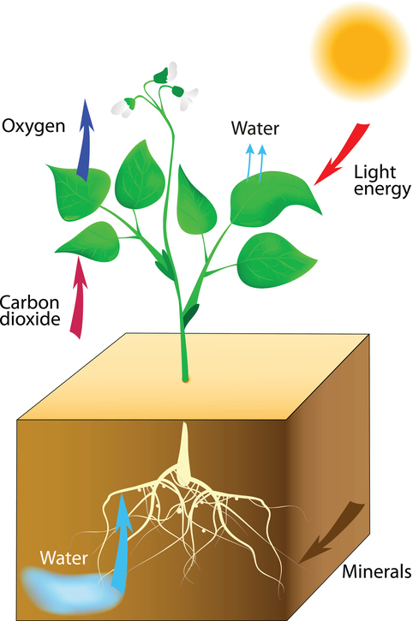
  Plant structures and their function part 1 – Photosynthetic reaction
Plants and algae make use of the Sun’s energy to make food (glucose). Photosynthetic organisms are the main producers of food and therefore biomass.
This process is called photosynthesis.
photo = light synthesis = to make
The plant manufactures glucose from carbon dioxide and water using energy transferred from the environment to the chloroplasts by light.
This is an endothermic reaction because photosynthesis needs an input of energy from the environment.

Slide 5
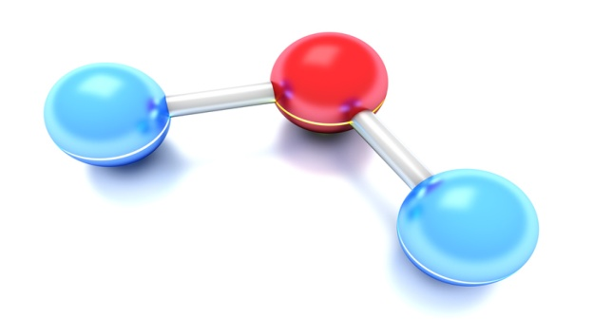
  Plant structures and their function part 1 – Photosynthetic reaction
The word equation which represents photosynthesis is:
carbon dioxide + water glucose + oxygen
light
The balanced symbol equation which represents photosynthesis is:
6CO₂ + 6H₂O C₆H₁₂O₆ + 6O₂
light
Molecule name | Chemical Symbol
Carbon dioxide | CO₂
Water | H₂O
Oxygen | O₂
Glucose | C₆H₁₂O₆
You need to be able to recognise the chemical symbols for these molecules.
Video - Van Helmont's experiments
Notes:
http://www.bbc.co.uk/programmes/p011mtyx

Slide 6
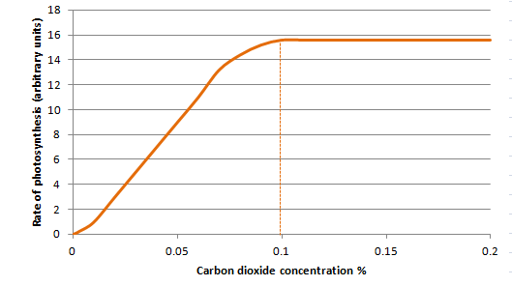
  Plant structures and their function part 1 – Photosynthetic reaction
Carbon dioxide is one of the reactants needed for plants to make glucose. The rate of photosynthesis will increase when a plant is given higher concentrations of carbon dioxide up to a point.
light
Carbon dioxide + Water
Oxygen + Glucose
For this plant, the maximum rate of photosynthesis is achieved at a concentration of 0.1% carbon dioxide.
Another factor is now preventing the rate of photosynthesis from increasing. This is called a limiting factor.
Possible limiting factors could be light intensity, temperature or amount of chlorophyll.

Slide 7


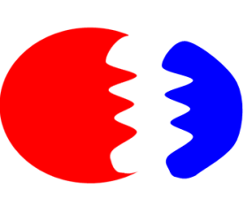



  Plant structures and their function part 1 – Photosynthetic reaction
Temperature affects the rate of all chemical reactions including photosynthesis. As the environment warms up, chemical reactions speed up. Photosynthesis is an enzyme controlled reaction. If the temperature increases too much, then the enzymes become denatured and the rate of reaction will decrease and stop.
Temperature is a limiting factor of photosynthesis.
Enzyme
new product
2 reactants
As temperature rises the enzyme is denatured. The active site is damaged so no reaction can occur.

Slide 8

  Plant structures and their function part 1 – Photosynthetic reaction
The amount of light a plant receives affects the rate of photosynthesis.
Plants found in areas of lower light do not tend to grow as tall.
Light intensity decreases as the distance between the plant and the light source increases.
The graph shows that as light intensity increases so does the rate of photosynthesis up to a point. At point X another factor is limiting the rate of photosynthesis. This could be carbon dioxide concentration, temperature or amount of chlorophyll.
Light intensity is a limiting factor.
Effect of light intensity on rate of photosynthesis
X

Slide 9
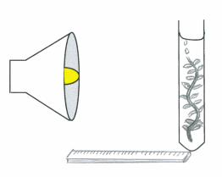
  Plant structures and their function part 1 – Rate of photosynthesis
Water plants produce bubbles of oxygen when they photosynthesise. The bubbles can be counted over time and used to calculate the rate of photosynthesis. video
Investigating the effect of light intensity on photosynthesis in pondweed.
Fill a boiling tube with 0.2% sodium hydrogen carbonate solution.
Freshly cut a 10 cm piece of pondweed and place it in the boiling tube with the cut end at the top.
Set up an LED lamp at a distance of 10 cm to the boiling tube and leave to settle for 5 minutes.
Start the stopwatch and count the number of bubbles released in one minute.
Repeat twice and calculate the mean number of bubbles.
6. Repeat steps 1-6, altering distance of the lamp so it is 30 cm, 40 cm and 50cm away from the boiling tube.
Why do we use sodium hydrogen carbonate solution?
This provides excess dissolved carbon dioxide for the plant to use in photosynthesis so it is not a limiting factor.
Why is an LED lamp used?
LED lamps produce less heat and this reduces the effect of temperature on the experiment.

Slide 10

  Plant structures and their function part 1 – Rate of photosynthesis HT
Light is a limiting factor when the light intensity is too low, but very high light intensities may slow the rate of photosynthesis too. This may be caused by:
saturation of the active sites in the enzymes
catalysing the reactions
b) bleaching of chlorophyll.
Light intensity obeys the inverse square law.
This means if you double the distance between the plant and the light source you quarter the light intensity.
To calculate light intensity use the formula:
Light Intensity = 1/distance²
Distance (d) of lamp from pond weed (m) | 0.4 | 0.2
Light Intensity 1/d² | d² = 0.4 x 0.4 =0.16 1/d² = 1/0.16 = 6.25 | 25
Notes:
Change graph

Slide 11
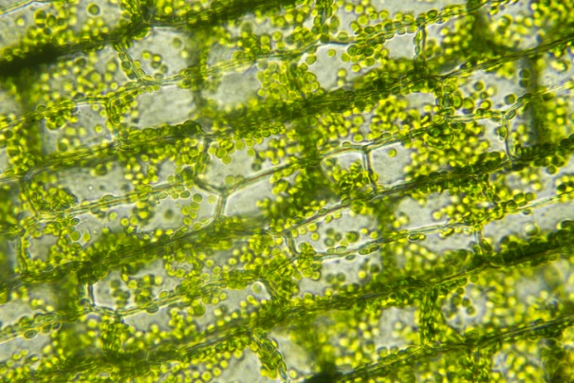
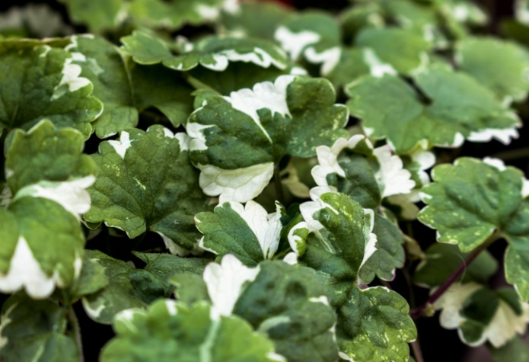
  Plant structures and their function part 1 – Rate of photosynthesis HT
If sunlight shines onto water and carbon dioxide, a reaction will not occur.
The energy must be transferred from the environment, to the chlorophyll, by light.
This energy is used to convert carbon dioxide and water into glucose and oxygen.
Chlorophyll is essential to the process of photosynthesis.
If there is a reduction in the amount of chlorophyll available to the plant then the amount of glucose made by photosynthesis will reduce. The plant will not grow as well.
Variegated leaves are white and green.
The white areas do not have any chlorophyll.

Slide 12
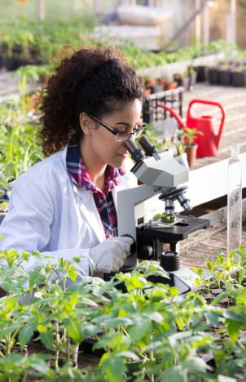
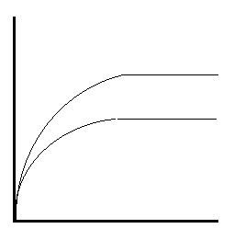
  Plant structures and their function part 1 – Rate of photosynthesis HT
In laboratory investigations, plants experience variation in only one environmental factor.
Normally in nature, more than one environmental factor will vary and the rate of photosynthesis is due to the interaction of these factors. Any one of the environmental factors may limit the rate of photosynthesis.
In this experiment temperature is controlled.
At low light intensity the photosynthetic reaction becomes limited at point X.
If the light intensity is increased the reaction rate also increases.
Light intensity is therefore the limiting factor at point X.
A different factor is now limiting the rate of photosynthesis at Y.
This could be environmental temperature or the amount of chlorophyll.
Rate of photosynthesis
Y
Y
30°C at high light intensity
X
30°C at low light intensity
Carbon dioxide concentration %
Carbon dioxide is not the limiting factor

Slide 13
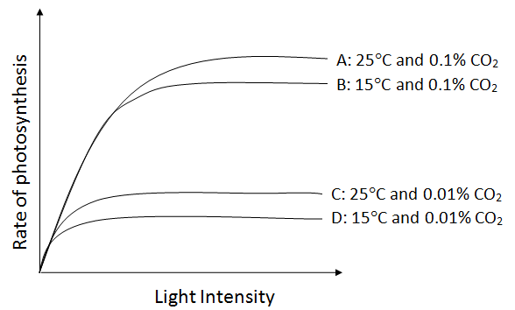
  Plant structures and their function part 1 – Rate of photosynthesis HT
Graph line A: Rate could be limited by temperature and/or amount of chlorophyll. Plant tissue can be damaged when carbon dioxide concentrations exceed 0.1%.
Graph lines A and D: If carbon dioxide concentration and temperature are increased the rate of photosynthesis increases significantly up to a point.
Graph Lines A and B: If carbon dioxide concentration is increased from 0.01% to 0.1%, then a large increase in rate occurs up to a point.
Graph lines C and D: If temperature is increased by 10°C then a slight increase in rate of photosynthesis occurs.
Light intensity is not a limiting factor
Notes:
Change graph

Slide 14
QuestionIT!
Photosynthesis
Part 1
Photosynthetic reaction
Rate of photosynthesis

Slide 15
  Plant structures and their function part 1 – QuestionIT
Write down the word equation for photosynthesis.
2. Copy and complete this table
3. Photosynthesis is affected by limiting factors.
What is meant by the term ‘limiting factor’?
4. Name the raw materials needed by a plant for photosynthesis?
Name of molecule | Chemical Symbol
Water
Oxygen
Carbon dioxide
Glucose

Slide 16
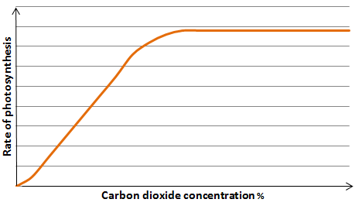
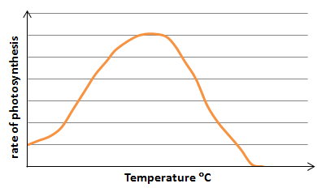
  Plant structures and their function part 1 – QuestionIT
5. Name the green pigment present in plant cells.
6. What is the role of this green pigment?
7. For the graphs below - identify what the limiting factor(s) might be in the experiments.
8. Sketch a line onto Graph A showing what might occur if the experiment was repeated at a lower light intensity.
Graph A
Graph B

Slide 17
  Plant structures and their function part 1 – QuestionIT
Higher Tier Questions
HT 9. Calculate the light intensity for the following student data.
Use the formula:
α 1/ distanc
²
Light Intensity = 1/distance²
Distance (d) of lamp from pond weed (m) | 0.3 | 0.5
Light Intensity 1/d²

Slide 18
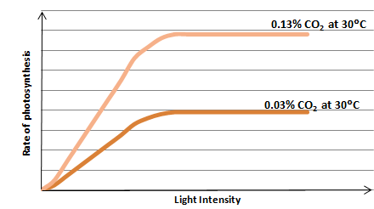
  Plant structures and their function part 1 – QuestionIT
HT 10. a) What is the limiting factor at A?
b) What might the limiting factor(s) be at point B?
B
A

Slide 19

AnswerIT!
Bioenergetics
Part 1
Photosynthetic reaction
Rate of photosynthesis

Slide 20
  Plant structures and their function part 1 – AnswerIT
Write down the word equation for photosynthesis.
Carbon dioxide + Water Oxygen + Glucose
2. Copy and complete this table
3.Photosynthesis is affected by limiting factors.
What is meant by the term ‘limiting factor’?
A factor which is not at an optimum level to enable maximum rate
of photosynthesis e.g. temperature
light
Name of molecule | Chemical Symbol
Water | H₂O
Oxygen | O₂
Carbon dioxide | CO₂
Glucose | C₆H₁₂O₆

Slide 21
  Plant structures and their function part 1 – AnswerIT
4. Name the raw materials needed by a plant for photosynthesis?
Carbon dioxide and water
5. Name the green pigment present in plant cells.
Chlorophyll
6. What is the role of this green pigment?
To transfer energy from the environment and use it to synthesise glucose from carbon dioxide and water.
For the graphs below - identify what the limiting factor/s might be in each experiment.
Number of active sites on the enzymes up to point of enzymes being denatured
Temperature and/or light intensity/and/or amount of chlorophyll
Graph A
Graph B

Slide 22
  Plant structures and their function part 1 – AnswerIT
8. Sketch a line onto graph A showing what might occur if the experiment was repeated at a higher light intensity.
Line drawn below that in Graph A but mirroring shape.

Slide 23
  Plant structures and their function part 1 – AnswerIT
Higher Tier Questions
HT 9. Calculate the light intensity for the following student data.
Use the formula:
Light Intensity α 1/ distance²
Distance of lamp from pond weed (m) | 0.3 | 0.5
Light Intensity | 11.11 | 4

Slide 24
  Plant structures and their function part 1 – AnswerIT
HT 10. a) What is the limiting factor at A?
Carbon dioxide
b) What might be the limiting factor(s) be at point B? Temperature/ amount of chlorophyll
B
A

Slide 25
LearnIT!
KnowIT!
Plant structures & functions
Part 2 (6.7- 6.14)
  Root hair cells, xylem and phloem
  Transpiration and translocation
  Leaf structure
  Environmental factors and adaptations

Slide 26
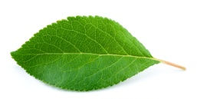
  Plant structures and functions Part 2 - Plant tissues
Like animals, plants are organised into tissues made of similar cells that carry out a particular function.
Epidermal
Covers the surfaces of the plant
Palisade mesophyll
The cells are packed with chloroplasts; it is the site of most of the photosynthesis
Spongy mesophyll
Photosynthesis also occurs in the cells here
Large air spaces for gas exchange
Xylem and phloem
Form vascular bundles and transport water and glucose around the plant
Meristem
Found at the tips of roots and shoots
Where cell differentiation occurs
organism | oak tree
organ system | root system
organ | leaf
tissue | palisade mesophyll
cell | palisade cell
smallest largest

Slide 27
  Plant structures and functions Part 2 – Root hair cells
Adaptations of the roots:
The root surface is covered in millions of root hair cells.
Root hair cells increase the surface area.
Present on the mature parts of the roots.
Absorb water and mineral ions from the soil.
No chloroplasts because they are found in the soil.

Slide 28
  Plant structures and functions Part 2 – Root hair cells
Active transport moves substances from a more dilute solution to a more concentrated solution (against a concentration gradient). The energy is provided by respiration.

Slide 29
  Plant structures and functions Part 2 – Root hair cells
Active transport occurs in root hair cells.
The minerals are at a higher concentration in the root hair cell than in the soil. So the minerals move into the cell against the concentration gradient.

Slide 30
  Plant structures and functions Part 2 – Xylem
Xylem | Function is to carry water and mineral ions in plants. Form hollow tubes made of dead tissue. Long cells with walls toughened by waterproof lignin. Water and minerals flow from the roots towards the leaves in one direction in a process called TRANSPIRATION. Xylem vessels also provide support to the stem of the plant.

Slide 31
  Plant structures and functions Part 2 – Phloem vessels
Phloem | Function is to carry sucrose around the plant. Form tubes made of living tissue. Cells have end plates with holes in them. Sucrose in solution move from the leaves to growing tips and storage tissues in both directions. This process is called TRANSLOCATION. There are no forces causing translocation to occur and so the sucrose is moved along using active uptake which requires energy.
sucrose solution

Slide 32
  Plant structures and functions Part 2 – Leaf Structure (Biology)
Adaptations of the leaves:
Large surface area to absorb more light energy.
Thin so short distance for carbon dioxide to diffuse into cells.
Chlorophyll absorbs sunlight energy for photosynthesis.
Xylem and phloem to support the leaf and transport water, mineral ions and products of photosynthesis around the plant.
Stomata on the lower side of the leaf to allow gases to diffuse into and out of the leaf.

Slide 33
  Plant structures and functions Part 2 – Leaf structure
Most leaves (except for those on aquatic plants) have guard cells on their lower epidermis. These cells open and close depending on the water content of the cells. The stoma (stomata) open and close to let gases diffuse in and out and control water loss. If there is a lack of water in the guard cells they go ‘flaccid’ and close, this prevents water vapour from leaving through the stomata.
Water vapour
Chloroplast
Carbon dioxide

Slide 34
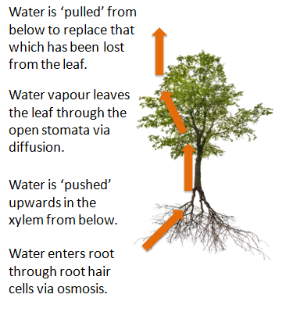
  Plant structures and functions Part 2 – Transpiration
Transpiration
The rate of transpiration is increased as the temperature, humidity, air movement and light intensity increase.

Slide 35
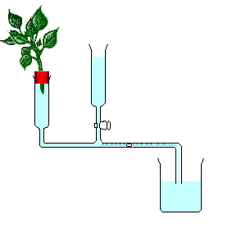
  Plant structures and functions Part 2 – Transpiration
A potometer is used to measure the rate of water uptake by a plant. Transpiration is not measured directly as some of the water will be used for photosynthesis.
All the joints are sealed with petroleum jelly to make them airtight.
A woody stem of a plant is cut underwater with a sharp knife to avoid entry of air bubbles into the xylem vessels.
The plant is inserted into the potometer underwater.
An air bubble is introduced into the capillary tubing.
The experiment is left for 5 minutes.
The distance the air bubble has moved is measured.
The experiment can be repeated using different conditions e.g. using a fan to represent wind.
air bubble
Rate of water uptake (mm s⁻¹ ) =
Distance travelled by bubble
Time taken to travel

Slide 36
  Plant structures and functions Part 2 – Environmental factors
Factor affecting transpiration | How transpiration is affected | Reason
Light intensity | As light intensity increases, transpiration will increase. | The stomata open to allow more carbon dioxide to diffuse in for photosynthesis.
Air movement (wind) | The windier the conditions the higher the rate of transpiration. | Water vapour moves away from the stomata faster and more water is drawn up into the leaf faster.
Temperature | Transpiration is more rapid in higher temperatures. | Evaporation of water from the leaf occurs faster.
Humidity | More humid conditions reduce the rate of transpiration. | The leaf is surrounded by moist air and so less water will evaporate from the leaf.

Slide 37

  Plant structures and functions Part 2 – Adaptations (Biology)
Cacti have stems which can store water.
They have a widespread root system that collects water from a large area. Cacti have spines instead of leaves and a reduced number of stomata. This reduces the area from which water can be lost by transpiration. The cactus has an impermeable waxy cuticle which prevents evaporation.
Some plants live in extreme environments.
Cacti are well adapted to survive in hot climates.

Slide 38
QuestionIT!
Plant structures & functions
Part 2
  Root hair cells, xylem and phloem
  Transpiration and translocation
  Leaf structure
  Environmental factors and adaptations

Slide 39
  Plant structures and their functions part 2 – QuestionIT
1. Name plant cells A, B and C and describe their structure and function.
Name of plant cell | Diagram | Structure and function
A.
B.
C.

Slide 40
  Plant structures and their functions part 2 – QuestionIT
2. What is the role of the root hair cell?
3. How does the structure of the root hair cell help it carry out its job?
4. Define ‘active transport’.
5. Why does active transport need to occur in root hair cells?
6. What vessel transports water and minerals around the plant?
7. What vessel transports sucrose around the plant?
8. Which vessel is made from dead cells?
9. What is transpiration?
10. What is a stoma?
11. What factors increase the rate of transpiration?

Slide 41
  Plant structures and their functions part 2 – QuestionIT
12. What factor reduces the rate of transpiration?
13. Where does water vapour leave the plant by transpiration?
14. What is a potometer?
15. What is the benefit of needle shaped leaves to a cactus?
16. What is translocation?
17. A potometer was set up with a woody stem to estimate the rate of transpiration. An air bubble moved 30mm in 9 minutes. Estimate the rate of transpiration and show your working.

Slide 42
AnswerIT!
Plant structures & functions
Part 2
  Root hair cells, xylem and phloem
  Transpiration and translocation
  Leaf structure
  Environmental factors and adaptations

Slide 43
  – AnswerIT
Plant structures and their functions part 2
1. Name plant cells A,B and C and describe their structure and function.
Name of plant cell | Diagram | Structure and function
A. Root hair |  | Function is to absorb water and minerals from the soil. Hair like projections to increase the surface area. (Note that root hair cells have no chloroplasts. This is because they do not need them as they are in the soil.)
B. Xylem |  | Function is to carry water and minerals in plants. Form hollow xylem tubes made of dead tissue. Long cells with walls toughened by lignin. Water and minerals flow from the roots towards the leaves only in one direction in a process called TRANSPIRATION.
C. Phloem |  | Function is to carry glucose around the plant. Form phloem tubes made of living tissue. Cells have end plates with holes in them. Glucose in solution moves from the leaves to growth and storage tissues in a process called TRANSLOCATION.

Slide 44
  Plant structures and their functions part 2 – AnswerIT
2. What is the role of the root hair cell?
To absorb water and minerals from the soil
3. How does the structure of the root hair cell help it carry out its job?
Large surface area enables it to absorb more water
4. Define ‘active transport’.
Active transport moves substances from a more dilute solution to a more concentrated solution (against a concentration gradient) using energy from respiration.
5. Why does active transport need to occur in root hair cells?
The minerals are at a higher concentration in the roots than in the soil.

Slide 45
  – AnswerIT
Plant structures and their functions part 2
6. What vessel transports water and minerals around the plant?
Xylem
7. What vessel transports sucrose around the plant? Phloem
8. Which vessel is made from dead cells? Xylem
9. What is transpiration? Loss of water vapour from leaves by evaporation from the leaf and diffusion from the stomata.
10. What is a stoma? Pore on underside of a leaf which can be opened or closed by guard cells.
11. What factors increase the rate of transpiration? Increase in light intensity, temperature and air movement.

Slide 46
  Plant structures and their functions part 2 – AnswerIT
12. What factor reduces the rate of transpiration? Humidity
13. Where does water vapour leave the plant by transpiration? Stomata
14. What is a potometer? Equipment used to measure the rate of water uptake by a plant which gives an indication of the rate of transpiration.
15. What is the benefit of needle shaped leaves to a cactus? Reduced surface area for water loss.
Stops animals eating it.
16. What is translocation? The movement of dissolved sugars from the leaves to the rest of the plant for immediate use or storage.
17. A potometer was set up with a woody stem to estimate the rate of transpiration. An air bubble moved 30mm in 9 minutes.
Estimate the rate of transpiration and show your working.
Distance moved ÷ time taken
30 ÷ 9 = 3.33 mm min⁻¹

Slide 47
LearnIT!
KnowIT!
Plant structures & functions
Part 3
(6.15- 6.16 biology only)
  Role of auxins
  Phototropism and gravitropism
  Commercial uses of plant hormones (HT)

Slide 48
  Plant structures and their functions - Part 3 Plant hormones (biology only)
Plants produce hormones to coordinate and control growth and responses to light and gravity.
Tropism – plant growth response to a stimulus
Phototropism – plant growth response to light
Gravitropism – plant growth response to gravity
Positive Tropism – growth towards the stimulus
Negative Tropism – growth away from the stimulus
Auxin - plant hormone that causes unequal growth rates in plant roots and shoots.
Phototropism
Auxin produced in the tip of the shoot.
Auxin moves to shaded side of the stem.
Auxin causes cell elongation and so growth
towards the light source.

Slide 49
  Plant structures and their functions - Part 3 Plant hormones (biology only)
Gravitropism
Auxin is produced in the tip of the root and moves to the side of the root that is towards gravity.
Auxins have opposite effect in the root compared to shoots.
In roots auxins stop cell elongation and the roots grow downwards.
Shoots negatively gravitropic.
Roots positively gravitropic.

Slide 50
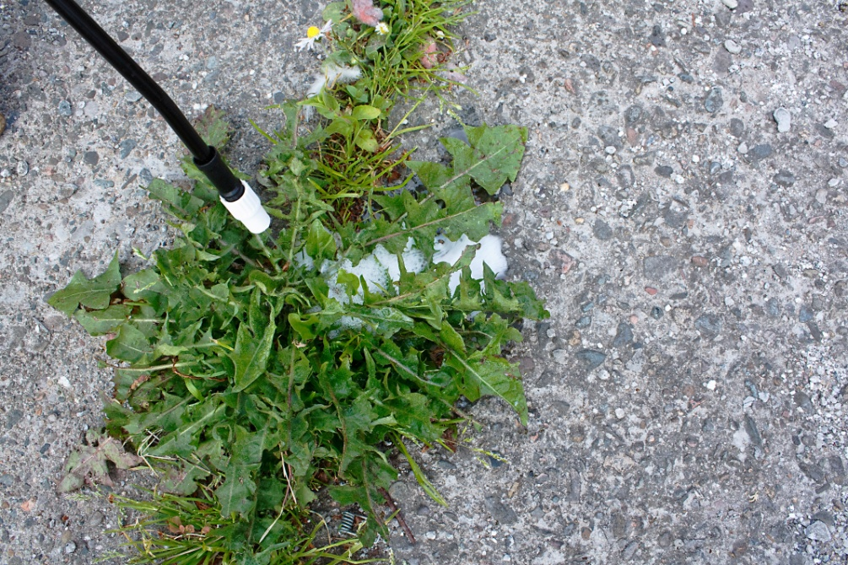
  Plant structures and their functions - Part 3 Plant hormones (biology HT only)
Plant hormones have commercial uses too.
Auxins can be used as selective weedkillers for plants with broad leaves. Grass, wheat and corn have narrow leaves and so auxins can be sprayed on these crops to kill any weeds.
Auxins speed up the metabolic rate of the weed plant which eventually kills it.

Slide 51
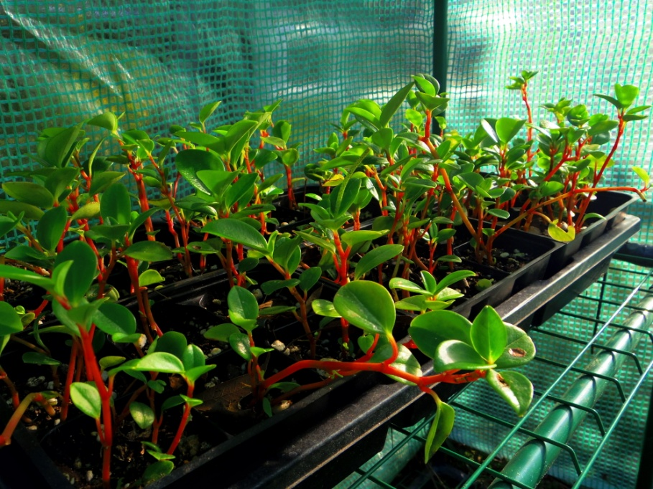
  Plant structures and their functions - Part 3 Plant hormones (biology HT only)
Commercial plant growers often clone high quality plants to quickly produce lots of new plants with the same genetic material.
A cutting is taken from the plant and then dipped into rooting powder which contains auxin.
The auxin stimulates the cut end of the stem to produce roots.
Video
Notes:
Taking a root cutting https://www.youtube.com/watch?v=NG--aDZ_wX0

Slide 52
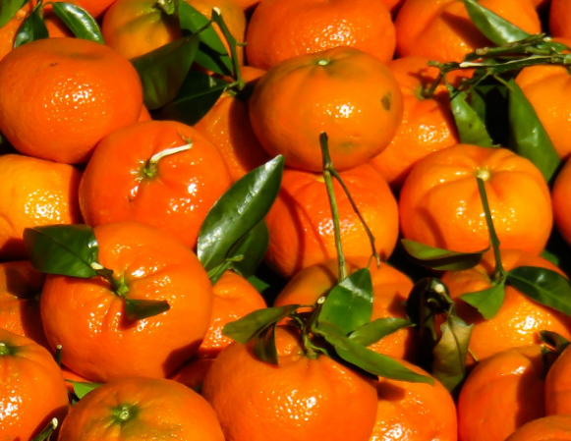
  Plant structures and their functions - Part 3 Plant hormones (biology HT only)
Gibberellins:
initiate seed germination (growth of a seed into a plant). Batches of seeds sprayed with this hormone will all germinate together.
make plants flower in less favourable environmental conditions or earlier than normal.
can reduce flower formation so that less fruit is produced but they are of better quality and bigger.
can be used to produce seedless fruit when it is applied to unpollinated flowers of some plants e.g. grapes.

Slide 53
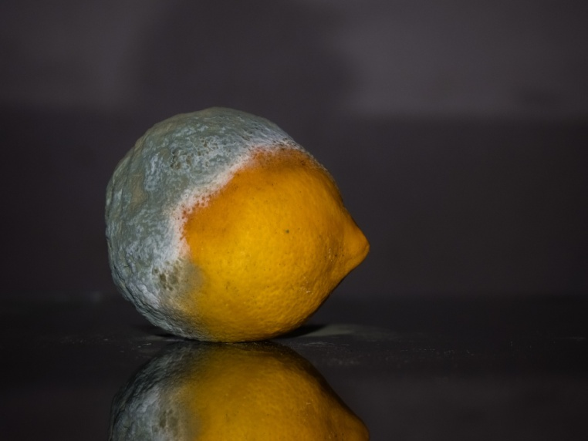
  Plant structures and their functions - Part 3 Plant hormones (biology HT only)
Ethene:
Controls the ripening of fruits. Unripe fruit can be picked and then sprayed with ethene during transport.
This reduces damage to the fruit as it is picked. Ripe fruit is quite soft.
The fruit lasts longer in the shop as it has only just ripened on arrival.
Helps flowers to open.
Involved in the dropping of leaves
from plants.
Rotting fruit gives off high concentrations of ethene.

Slide 54
QuestionIT!
Plant structures & functions
Part 3 (biology only)
  Role of auxins
  Phototropism and gravitropism
  Commercial uses of plant hormones (HT)

Slide 55
  Plant hormones (biology only)
  - Question IT
1. What is the role of plant hormones?
2. What is a positive tropism? Give an example of a positive tropism.
3. What is a negative tropism? Give an example of a negative tropism.
4. Where is auxin produced in the shoot?
5. If a light is shining on the side of a shoot where will the auxin move to?
6. What effect does auxin have on the cells in a shoot?
7. Where is auxin produced in the root?
8. What effect do auxins have on the cells in the roots?
9. HT: How are gibberellins used in agriculture and horticulture?
10. HT: How is ethene used in agriculture and horticulture?
11. HT: How are auxins used in agriculture and horticulture?

Slide 56
AnswerIT!
Plant structures & functions
Part 3 (biology only)
  Role of auxins
  Phototropism and gravitropism
  Commercial uses of plant hormones (HT)

Slide 57
  Plant hormones (biology only) AnswerIT
1. What is the role of plant hormones? To coordinate and control growth and responses to light and gravity
2. What is a positive tropism? Give an example of a positive tropism. Where a plant grows towards a stimulus e.g. shoots and light
3. What is a negative tropism? Give an example of a negative tropism. Where a plant grows away from a stimulus e.g. roots and light
4. Where is auxin produced in the shoot? The tip
5. If a light is shining on the side of a shoot where will the auxin move to?
The shaded side
6. What effect does auxin have on the cells in a shoot? They cause cell elongation
7. Where is auxin produced in the root? The tip
8. What effect do auxins have on the cells in the roots? They stop cell elongation

Slide 58
  Plant hormones (biology only) AnswerIT
9. HT: How are gibberellins used in agriculture and horticulture?
Stimulate seeds to germinate all at once.
Stimulate flowering.
Reduce flower formation so get bigger and better fruit.
Produce seedless fruits.
10. HT: How is ethene used in agriculture and horticulture?
Used in the food industry to control ripening of fruit during storage and transport.
11. HT: How are auxins used in agriculture and horticulture?
Used as weed killers.
As rooting powders for commercial plant growers to produce lots of new plants rapidly.

