Slide 1


The PiXL Club The PiXL Club The PiXL Club The PiXL Club The PiXL Club The PiXL Club The PiXL Club The PiXL Club The PiXL Club The PiXL Club The PiXL Club The PiXL Club The PiXL Club The PiXL Club The PiXL Club The PiXL Club The PiXL Club The PiXL Club The PiXL Club The PiXL Club The PiXL Club The PiXL Club The PiXL Club The PiXL Club The PiXL Club The PiXL Club The PiXL Club The PiXL Club The PiXL Club The PiXL Club The PiXL Club The PiXL Club The PiXL Club The PiXL Club The PiXL Club The PiXL Club The PiXL Club The PiXL Club The PiXL Club The PiXL Club The PiXL Club The PiXL Club The PiXL Club The PiXL Club The PiXL Club XL Club The PiXL Club The PiXL Club The PiXL Club The PiXL Club The PiXL Club The PiXL Club The PiXL Club The PiXL Club The PiXL Club The PiXL Club The PiXL Club The PiXL Club The PiXL Club The PiXL Club The PiXL Club The PiXL Club The PiXL Club The PiXL Club The PiXL Club The PiXL Club The PiXL Club The PiXL Club The PiXL Club The PiXL Club The PiXL Club The PiXL Club The PiXL Club The PiXL Club The PiXL Club The PiXL Club The PiXL Club The PiXL Club The PiXL Club The PiXL Club The PiXL Club The PiXL Club The PiXL Club The PiXL Club The PiXL Club The PiXL Club The PiXL Club The PiXL Club The PiXL Club The PiXL Club The PiXL Club The PiXL Club The PiXL Club The PiXL Club The PiXL Club The PiXL Club The PiXL Club The PiXL Club The PiXL Club The PiXL Club The PiXL Club The PiXL Club The PiXL Club The PiXL Club The PiXL Club The PiXL Club The PiXL Club The PiXL Club The PiXL Club The PiXL Club The PiXL Club The PiXL Club The PiXL Club The PiXL Club The PiXL Club The PiXL Club The PiXL Club The PiXL Club The PiXL Club The PiXL Club The PiXL Club The PiXL Club The PiXL Club The PiXL Club The PiXL Club The PiXL Club The PiXL Club The PiXL Club The PiXL Club The PiXL Club The PiXL Club The PiXL Club The PiXL Club The PiXL Club The PiXL Club The PiXL Club The PiXL Club The PiXL Club The PiXL Club The PiXL Club The PiXL Club The PiXL Club The PiXL Club The PiXL Club The PiXL Club The PiXL Club The PiXL Club The PiXL Club The PiXL Club The PiXL Club The PiXL Club The PiXL Club The PiXL Club The PiXL Club The PiXL Club The PiXL Club The PiXL Club The PiXL Club The PiXL Club The PiXL Club The PiXL Club The PiXL Club The PiXL Club The PiXL Club The PiXL Club The PiXL Club The PiXL Club The PiXL Club The PiXL Club The PiXL Club The PiXL Club The PiXL Club The PiXL Club The PiXL Club The PiXL Club The PiXL Club The PiXL Club The PiXL Club The PiXL Club The PiXL Club The PiXL Club The PiXL Club The PiXL Club The PiXL Club The PiXL Club The PiXL Club The PiXL Club The PiXL Club The PiXL Club The PiXL Club The PiXL Club The PiXL Club The PiXL Club The PiXL Club The PiXL Club The PiXL Club The PiXL Club The PiXL Club The PiXL Club The PiXL Club The PiXL Club The PiXL Club The PiXL Club The PiXL Club The PiXL Club The PiXL Club The PiXL Club The PiXL Club The PiXL Club The PiXL Club The PiXL Club The PiXL Club The PiXL Club The PiXL Club The PiXL Club The PiXL Club The PiXL Club The PiXL Club The PiXL Club The PiXL Club The PiXL Club The PiXL Club The PiXL Club The PiXL Club The PiXL Club The PiXL Club The PiXL Club The PiXL Club The PiXL Club The PiXL Club The PiXL Club The PiXL Club The PiXL Club The PiXL Club The PiXL Club The PiXL Club The PiXL Club The PiXL Club The PiXL Club The PiXL Club The PiXL Club The PiXL Club The PiXL Club The PiXL Club The PiXL Club The PiXL Club The PiXL Club The PiXL Club The PiXL Club The PiXL Club The PiXL Club The PiXL Club The PiXL Club The PiXL Club The PiXL Club The PiXL Club The PiXL Club The PiXL Club The PiXL Club The PiXL Club The PiXL Club The PiXL Club The PiXL Club The PiXL Club The PiXL Club The PiXL Club The PiXL Club The PiXL Club The PiXL Club The PiXL Club The PiXL Club The PiXL Club The PiXL Club The PiXL Club The PiXL Club The PiXL Club The PiXL Club The PiXL Club The PiXL Club The PiXL Club The PiXL Club The PiXL Club The PiXL Club The PiXL Club The PiXL Club The PiXL Club The PiXL Club The PiXL Club The PiXL Club The PiXL Club The PiXL Club The PiXL Club The PiXL Club The PiXL Club The PiXL Club The PiXL Club The PiXL Club The PiXL Club The PiXL Club The PiXL Club The PiXL Club The PiXL Club The PiXL Club The PiXL Club The PiXL Club The PiXL Club The PiXL Club The PiXL Club The PiXL Club The PiXL Club The PiXL Club The PiXL Club The PiXL Club The PiXL Club The PiXL Club The PiXL Club The PiXL Club The PiXL Club The PiXL Club The PiXL Club The PiXL Club The PiXL Club The PiXL Club The PiXL Club The PiXL Club The PiXL Club The PiXL Club The PiXL Club The PiXL Club The PiXL Club The PiXL Club The PiXL Club The PiXL Club The PiXL Club The PiXL Club The PiXL Club The PiXL Club The PiXL Club The PiXL Club The PiXL Club The PiXL Club The PiXL Club The PiXL Club The PiXL Club The PiXL Club The PiXL Club The PiXL Club The PiXL Club The PiXL Club The PiXL Club The PiXL Club The PiXL Club The PiXL Club The PiXL Club The PiXL Club The PiXL Club The PiXL Club The PiXL Club The PiXL Club The PiXL Club The PiXL Club The PiXL Club The PiXL Club The PiXL Club The PiXL Club The PiXL Club The PiXL Club The PiXL Club The PiXL Club The PiXL Club The PiXL Club The PiXL Club The PiXL Club The PiXL Club The PiXL Club The PiXL Club The PiXL Club The PiXL Club The PiXL Club The PiXL Club The PiXL Club The PiXL Club The PiXL Club The PiXL Club The PiXL Club The PiXL Club The PiXL Club The PiXL Club The PiXL Club The PiXL Club The PiXL Club The PiXL Club The PiXL Club The PiXL Club The PiXL Club The PiXL Club The PiXL Club The PiXL Club The PiXL Club The PiXL Club The PiXL Club The PiXL Club The PiXL Club The PiXL Club The PiXL Club The PiXL Club The PiXL Club The PiXL Club The PiXL Club The PiXL Club The PiXL Club The PiXL Club The PiXL Club The PiXL Club The PiXL Club The PiXL Club The PiXL Club The PiXL Club The PiXL Club The PiXL Club The PiXL Club The PiXL Club The PiXL Club The PiXL Club The PiXL Club The PiXL Club The PiXL Club The PiXL Club The PiXL Club The PiXL Club The PiXL Club The PiXL Club The PiXL Club The PiXL Club The PiXL Club The PiXL Club The PiXL Club The PiXL Club The PiXL Club The PiXL Club The PiXL Club The PiXL Club The PiXL Club The PiXL Club The PiXL Club The PiXL Club The PiXL Club The PiXL Club The PiXL Club The PiXL Club The PiXL Club The PiXL Club The PiXL Club The PiXL Club The PiXL Club The PiXL Club The PiXL Club The PiXL Club The PiXL Club The PiXL Club The PiXL Club The PiXL Club The PiXL Club The PiXL Club The PiXL Club The PiXL Club The PiXL Club The PiXL Club The PiXL Club The PiXL Club The PiXL Club The PiXL Club The PiXL Club The PiXL Club The PiXL Club The PiXL Club The PiXL Club The PiXL Club The PiXL Club The PiXL Club The PiXL Club The PiXL Club The PiXL Club The PiXL Club The PiXL Club The PiXL Club The PiXL Club The PiXL Club The PiXL Club The PiXL Club The PiXL Club The PiXL Club The PiXL Club The PiXL Club The PiXL Club The PiXL Club The PiXL Club The PiXL Club The PiXL Club The PiXL Club The PiXL Club The PiXL Club The PiXL Club The PiXL Club The PiXL Club The PiXL Club The PiXL Club The PiXL Club The PiXL Club The PiXL Club The PiXL Club The PiXL Club The PiXL Club The PiXL Club The PiXL Club The PiXL Club The PiXL Club The PiXL Club The PiXL Club The PiXL Club The PiXL Club The PiXL Club The PiXL Club The PiXL Club The PiXL Club The PiXL Club The PiXL Club The PiXL Club The PiXL Club The PiXL Club The PiXL Club The PiXL Club The PiXL Club The PiXL Club The PiXL Club The PiXL Club The PiXL Club The PiXL Club The PiXL Club The PiXL Club The PiXL Club The PiXL Club The PiXL Club The PiXL Club The PiXL Club The PiXL Club The PiXL Club The PiXL Club The PiXL Club The PiXL Club The PiXL Club The PiXL Club The PiXL Club The PiXL Club The PiXL Club The PiXL Club The PiXL Club The PiXL Club The PiXL Club The PiXL Club The PiXL Club The PiXL Club The PiXL Club The PiXL Club The PiXL Club The PiXL Club The PiXL Club The PiXL Club The PiXL Club The PiXL Club The PiXL Club The PiXL Club The PiXL Club The PiXL Club The PiXL Club The PiXL Club The PiXL Club The PiXL Club The PiXL Club The PiXL Club The PiXL Club The PiXL Club The PiXL Club The PiXL Club The PiXL Club The PiXL Club The PiXL Club The PiXL Club The PiXL Club The PiXL Club The PiXL Club The PiXL Club The PiXL Club The PiXL Club The PiXL Club The PiXL Club The PiXL Club The PiXL Club The PiXL Club The PiXL Club The PiXL Club The PiXL Club The PiXL Club The PiXL Club The PiXL Club The PiXL Club The PiXL Club The PiXL Club The PiXL Club The PiXL Club The PiXL Club The PiXL Club The PiXL Club The PiXL Club The PiXL Club The PiXL Club The PiXL Club The PiXL Club The PiXL Club The PiXL Club The PiXL Club The PiXL Club The PiXL Club The PiXL Club The PiXL Club The PiXL Club The PiXL Club The PiXL Club The PiXL Club The PiXL Club The PiXL Club The PiXL Club The PiXL Club The PiXL Club The PiXL Club The PiXL Club The PiXL Club The PiXL Club The PiXL Club The PiXL Club The PiXL Club The PiXL Club The PiXL Club The PiXL Club The PiXL Club The PiXL Club The PiXL Club The PiXL Club The PiXL Club The PiXL Club The PiXL Club The PiXL Club The PiXL Club The PiXL Club The PiXL Club The PiXL Club The PiXL Club The PiXL Club The PiXL Club The PiXL Club The PiXL Club The PiXL Club The PiXL Club The PiXL Club The PiXL Club The PiXL Club The PiXL Club The PiXL Club The PiXL Club The PiXL Club The PiXL Club The PiXL Club The PiXL Club The PiXL Club The PiXL Club The PiXL Club The PiXL Club The PiXL Club The PiXL Club The PiXL Club The PiXL Club The PiXL Club The PiXL Club The PiXL Club The PiXL Club The PiXL Club The PiXL Club The PiXL Club The PiXL Club The PiXL Club The PiXL Club The PiXL Club The PiXL Club The PiXL Club The PiXL Club The PiXL Club The PiXL Club The PiXL Club The PiXL Club The PiXL Club The PiXL Club The PiXL Club The PiXL Club The PiXL Club The PiXL Club The PiXL Club The PiXL Club The PiXL Club The PiXL Club The PiXL Club The PiXL Club The PiXL Club The PiXL Club The PiXL Club The PiXL Club The PiXL Club The PiXL Club The PiXL Club The PiXL Club The PiXL Club The PiXL Club The PiXL Club The PiXL Club The PiXL Club The PiXL Club The PiXL Club The PiXL Club The PiXL Club The PiXL Club The PiXL Club The PiXL Club The PiXL Club The PiXL Club The PiXL Club The PiXL Club The PiXL Club The PiXL Club The PiXL Club The PiXL Club The PiXL Club The PiXL Club The PiXL Club The PiXL Club The PiXL Club The PiXL Club The PiXL Club
PiXL KnowIT!
GCSE Biology
Edexcel Topic – Exchange and transport in animals
© Copyright The PiXL Club Ltd, 2017
This resource is strictly for the use of member schools for as long as they remain members of The PiXL Club. It may not be copied, sold nor transferred to a third party or used by the school after membership ceases. Until such time it may be freely used within the member school.
All opinions and contributions are those of the authors. The contents of this resource are not connected with nor endorsed by any other company, organisation or institution.
www.pixl.org.uk The PiXL Club Ltd, Company number 07321607

Slide 2
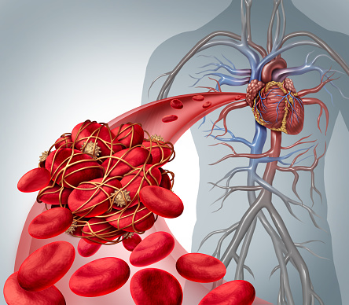
Overview
Exchange and transport in animals
Transport in cells
  Diffusion
  Calculation of
  surface area : volume ratio
  Gas Exchange
  Factors affecting the rate of diffusion and Fick’s Law
  The Circulatory System
  Blood
  Blood vessels
  Heart and circulation
  Heart rate, stroke volume and cardiac output
  Respiration
Aerobic respiration
Anaerobic respiration
Core practical

Slide 3
LearnIT!
KnowIT!
Exchange and transport in animals Part 1
  Diffusion
  Calculation of
  surface area : volume ratio
  Gas Exchange
  Factors affecting the rate of diffusion and Fick’s Law

Slide 4
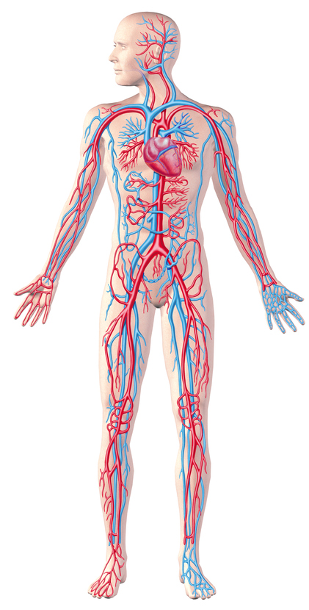
  Exchange and transport in animals
  Part 1- Diffusion
Living organisms obtain many of the substances they require for life by diffusion e.g. Oxygen, minerals and dissolved food. They also get rid of waste products by diffusion as well such as carbon dioxide and urea.
Single celled organisms do not need transport systems to bring materials to the cell or take waste away. They are able to receive enough substances through their cell membrane by diffusion alone due to a large surface area to volume ratio.
Larger multi cellular organisms need a mass transport system because they have a relatively small surface area to volume ratio.
Cells towards the centre of the organism would not receive enough oxygen by diffusion alone without a transport system and gas exchange surface. In humans, the mass transport system is the blood and the gas exchange surface is the lungs.

Slide 5
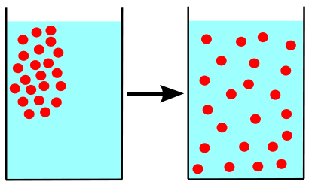
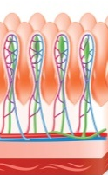
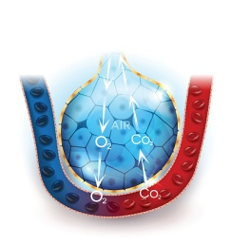
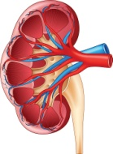
  Exchange and transport in animals
  Part 1- Diffusion
Diffusion is the spreading of the particles of a gas or substances in solution, resulting in a net movement of particles from a region where they are of a higher concentration to an area of lower concentration.
Diffusion can occur in: Air – smells from perfume etc.
Solution – tea from a tea bag, dye in water etc.
Through membranes – small intestines, blood cells etc.
Substances that are transported in and out of cells in humans
Location | Particles transported | From | To
Small Intestine | Digested food e.g. glucose, amino acids | Small intestine | Blood in capillary of villus
Lungs | Oxygen | Alveolar air space | Blood circulating around the lungs
Kidneys | Urea | Cells | Blood plasma

Slide 6
  Exchange and transport in animals
  Part 1- Diffusion (Biology)
The larger the difference in concentration the faster the rate of diffusion.
Factors which affect the rate of diffusion:
The concentration gradient:
A difference in concentration between
two areas next to each other. Particles
will move down the concentration
gradient from high to low.
The surface area of the membrane:
A single-celled organism has a
large surface area compared to its
volume. This allows sufficient transport of
molecules into and out of the cell
to meet the needs of the organism.
The diffusion distance
Substances will diffuse faster if the distance they have to move across is smaller.
Respiratory surfaces are usually only one cell thick for this reason. Capillary walls are also only one cell thick (5-10µm) to make diffusion faster into and out of the blood.

Slide 7

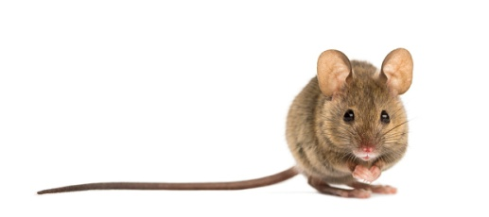
  Exchange and transport in animals
  Part 1- Surface area to volume ratio (biology)
The surface area to volume ratio can be calculated by dividing an object’s surface area (SA) by its volume
B
Cube A represents a small animal
like a mouse the sides are 1 cm
each and there are 6 sides.
To calculate the volume:
volume A = length x width x height
volume A = 1 x 1 x 1
volume A = 1cm ³
To calculate the area of one surface:
area = height x width
area = 1 x 1 = 1cm²
To calculate the SA of A:
area of one surface x the number of surfaces
surface area = 1 x 6 = 6cm²
SA:V ratio = 6/1 = 6
Cube B represents a larger
animal like a dog the sides are
6cm each and there are 6 sides.
To calculate the volume:
volume B = length x width x height
volume B = 6 x 6 x 6
volume A = 216cm ³
To calculate the area of one surface:
area = height x width
area = 6 x 6 = 36cm²
To calculate the surface area of B:
area of one surface x the number of surfaces
surface area = 36 x 6 = 216cm²
SA:V ratio = 216/216 = 1
A
So as you can see the mouse has a much larger surface area compared to its volume.

Slide 8
  Animal tissues, organs and organ systems Part 3 - The lungs and gas exchange
Video - Lungs
The heart pumps low oxygen/high carbon dioxide containing blood to the lungs.
In the lungs, oxygen and carbon dioxide are exchanged in the tiny air sacs (alveoli) at the end of the bronchial tubes. The alveoli are surrounded by capillaries.
Notes:
https://www.youtube.com/watch?v=8NUxvJS-_0k

Slide 9
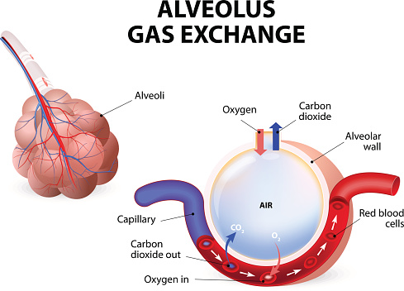
  Exchange and transport in animals
  Part 1- Gas exchange (biology)
Adaptations of the lungs:
Lungs contain millions of tiny air sacs called alveoli.
Alveoli increase the surface area.
Alveoli have a very good blood supply. This maintains the concentration gradient.
Membranes of the alveoli are very thin to allow for a short diffusion distance.

Slide 10
  Exchange and transport in animals
  Part 1- Fick’s Law (biology)
Fick’s Law is used to calculate the relative rate of diffusion across a membrane it is represented by the equation.
surface area x concentration difference
thickness of membrane
The symbol α means ‘is proportional to’.
The rate of diffusion will double if:
the surface area or concentration difference is doubled OR
the thickness of the exchange membrane is halved.
Example:
A cell membrane has a thickness of 5nm. What will happen to the rate of diffusion if the cell membrane thickness changes to 10nm?
The rate of diffusion will halve because it will take the substance longer to pass through the membrane. So the rate of diffusion is inversely proportional to membrane thickness.
rate of diffusion α

Slide 11
QuestionIT!
Exchange and transport
in animals
Part 1
  Diffusion
  Calculation of
  surface area : volume ratio
  Gas Exchange
  Factors affecting the rate of diffusion and Fick’s Law

Slide 12
  Exchange and transport in animal
  Part 1– QuestionIT
1. Define ‘diffusion’.
2. State three places where diffusion occurs in the body.
3. What is surface area to volume ratio?
4. Which has the largest surface area to volume ratio, an elephant or a meerkat?
5. State how the lungs are adapted for diffusion.
Biology
6. What is a concentration gradient?
7. What three factors affect the concentration gradient?

Slide 13
  Exchange and transport in animals
  Part 1– QuestionIT
  Calculate the relative rate of diffusion and record in the table below.
  What happens if the concentration difference is doubled?
Rate of diffusion Ms⁻¹ | Surface area/ m² | Concentration difference/ M | Membrane thickness /µm
 | 25 | 0.2 | 0.01
 | 25 | 0.4 | 0.01

Slide 14

AnswerIT!
Exchange and transport
in animals
Part 1
  Diffusion
  Calculation of
  surface area : volume ratio
  Gas Exchange
  Factors affecting the rate of diffusion and Fick’s Law

Slide 15
  Exchange and transport in animals
  Part 1– AnswerIT
Define ‘diffusion’?
The spreading of the particles from a region where they are of a higher concentration to an area of lower concentration.
2. State three places where diffusion occurs in the body. Small intestines, lungs, kidneys
3. What is surface area to volume ratio? The size of a surface compared to its volume.
4. Which has the largest surface area to volume ratio an elephant or a meerkat? The meerkat.
What is a concentration gradient? The difference in concentration between two areas next to each other.
5. What three factors affect rate of diffusion? Concentration gradient, diffusion distance, surface area, temperature

Slide 16
  Exchange and transport in animals
  Part 1– AnswerIT
7. State how the lungs are adapted for diffusion:
  Have alveoli to increase surface area, good blood supply, thin membranes, they are well ventilated.
  Calculate the rate of diffusion and record in the table below.
  What happens if the concentration difference is doubled?
  The rate of diffusion doubles.
Rate of diffusion Ms⁻¹ | Surface area/ m² | Concentration difference/ M | Membrane thickness /µm
500 | 25 | 0.2 | 0.01
1000 | 25 | 0.4 | 0.01

Slide 17
LearnIT!
KnowIT!
Exchange and transport in animals Part 2
  Blood
  Blood vessels
  Heart and circulation
  Heart rate, stroke volume and cardiac output

Slide 18
  Exchange and transport in animals Part 2 - Blood
Plasma – Pale yellow fluid part of blood, transports cells, CO₂, hormones and waste.
Red blood cells (erythrocytes)
- have no nucleus (more room to carry O₂)
- contain the red pigment haemoglobin which carries O₂
oxygen + haemoglobin → oxyhaemoglobin
they have a large surface area to volume ratio for faster diffusion of oxygen
White blood cells - An important part of the immune system. One type called lymphocytes produce antibodies (proteins that bind to microbes and destroy them) and others called phagocytes surround and engulf foreign cells, all have a nucleus.
Platelets - Tiny fragments of cells (no nuclei), clump together to help form clots, protect the body by stopping/reducing bleeding.
Blood is a tissue consisting of plasma, in which the red blood cells, white blood cells and platelets are suspended.

Slide 19
Exchange and transport in animals
Part 2 – Blood vessels
Thick elastic tissue and muscle layer
Thin elastic tissue and muscle layer
Video - Blood Vessels
Arteries
Carry blood away from the heart
Thick layers of muscle to withstand the high pressure generated by left ventricle.
Elastic tissue to stretch and recoil as blood enters.
Small lumen (internal hole) which maintains pressure.
All carry oxygenated blood except pulmonary artery.
Veins
Carry blood to the heart
Thin walls
Thin layers of muscle and elastic tissue
Large lumen (internal hole)
One way valves to keep blood moving back to heart.
Carry blood under low pressure
All carry deoxygenated blood except pulmonary vein.
Capillaries
Connect arteries and veins
Site of exchange between blood and body tissues
One cell thick to enable rapid diffusion to occur.
Blood under low pressure and travels slowly maximising time for exchange. Video
Notes:
https://www.youtube.com/watch?v=e29I6zIq79A
https://www.youtube.com/watch?v=mQc9mf6w0Tw

Slide 20
  Exchange and transport in animals Part 2 - The heart
Video - The heart
The heart is an organ that pumps blood around the body in a
double circulatory system
1. The right ventricle pumps blood to the lungs where gas exchange takes place.
2. The left ventricle pumps blood under high pressure around the rest of the body and back to the right side of the heart.
Coronary arteries supply oxygen rich blood to the heart muscle.
(thick wall)
The natural resting heart rate is controlled by a group of cells in the right atrium (pacemaker). Artificial electrical pacemakers are used to correct irregularities in the heart rate.
Notes:
http://www.bbc.co.uk/education/clips/z627sbk

Slide 21
  Animal tissues, organs and organ systems Part 2 – Faulty valves
Heart valves prevent the blood in the heart from flowing in the wrong direction. In some people heart valves may become faulty, preventing the valve from opening fully or the heart valve might develop a leak because
it does not close fully.
Valves in the Heart
Faulty heart valves can be replaced by biological or mechanical valves.
biological
mechanical
Video - Heart valve Replacement Animation
Notes:
Heart valve replacement animation https://www.youtube.com/watch?v=Te-JZftquOM

Slide 22
Exchange and transport in animals
Part 2- Cardiac output
In order to calculate how much blood is pumped every minute by the heart the following equation is used:
Cardiac output = heart rate x stroke volume
Cardiac output is the volume of blood pumped by a ventricle per minute. The units are cm³ min⁻¹
Heart rate is the number of beats per minute (bpm)
Stroke volume is the volume of blood pumped by one ventricle per contraction (cm³).
If a person has a heart rate of 72 bpm and a stroke volume of 85 cm³ what is their cardiac output?
cardiac output = 72 x 85
= 6120 cm³ min⁻¹

Slide 23
QuestionIT!
Exchange and transport in animals Part 2
  Blood
  Blood vessels
  Heart and circulation
  Heart rate, stroke volume and cardiac output

Slide 24
  Exchange and transport in animals Part 2 – QuestionIT
1. Name parts A - H of the heart from the diagram below:

Slide 25
  Exchange and transport in animals Part 2 – QuestionIT
2. What is a double circulatory system?
3. What is a pacemaker?
4. What is the role of the coronary arteries?
5. Where does the left atrium pump blood to?
6. Name the blood vessels that carry blood away from the heart.
7. Which blood vessels are only one cell thick?
8. Which blood vessels have thick muscular walls?
9. Which blood vessels have valves?
10. What is plasma?
11. What is the role of a red blood cell?

Slide 26
  Exchange and transport in animals Part 2 – QuestionIT
12. In what two ways can white blood cells fight infection?
13. What is the role of platelets?
14. What is the role of heart valves?
15. What does stroke volume mean?
16. What is the equation to find out the stroke volume?

Slide 27
AnswerIT!
Exchange and transport in animals Part 2
  Blood
  Blood vessels
  Heart and circulation
  Heart rate, stroke volume and cardiac output

Slide 28
  Exchange and transport in animals Part 2 – AnswerIT
1. Name parts A - H of the heart from the diagram below:

Slide 29
  Exchange and transport in animals Part 2 – AnswerIT
2. What is a double circulatory system? Where blood from the heart is pumped to the lungs and the body at the same time.
3. What is a pacemaker? A group of cells in the right atrium that controls the heart rate.
4. What is the role of the coronary arteries? To supply oxygenated blood to the heart muscle.
5. Where does the left atrium pump blood to? To the left ventricle.
6. Name the blood vessels that carry blood away from the heart Arteries.
7. Which blood vessels are only one cell thick? Capillaries.
8. Which blood vessels have thick muscular walls? Arteries.
9. Which blood vessels have valves? Veins.

Slide 30
  Exchange and transport in animals Part 2 – AnswerIT
10. What is plasma? The pale yellow fluid part of blood, it transports cells, CO₂, hormones and waste.
11. What is the role of a red blood cell? To carry oxygen around the body.
12. In what two ways can white blood cells fight infection? They can produce antibodies that destroy microbes or they can engulf microbes.
13. What is the role of platelets? They form clots to reduce bleeding. 14. What is the role of heart valves? To stop the blood in the heart from flowing in the wrong direction.
15. What does stroke volume mean? The volume of blood pumped out by a ventricle in one contraction.
16. What is the equation to find out the stroke volume?
Stroke volume = cardiac output ÷ heart rate

Slide 31
LearnIT!
KnowIT!
Exchange and transport
in animals
Part 3
Aerobic respiration
Anaerobic respiration
Metabolism
Core practical

Slide 32


  Exchange and transport in animals part 3 – Aerobic respiration
.
Respiration is also sometimes called cellular respiration. This is because the reactions of respiration occur inside cells.
Every living cell needs energy and this energy is released from food (glucose) by a series of chemical reactions called respiration.
Respiration is an exothermic reaction which means energy is transferred to the environment. Some of the energy is used inside cells for metabolic processes including aerobic and anaerobic respiration.
An organism will receive all the energy it needs for living processes as a result of the energy transferred from respiration.
The reactions of respiration occur 24 hours a day,
continuously, in all living cells.

Slide 33
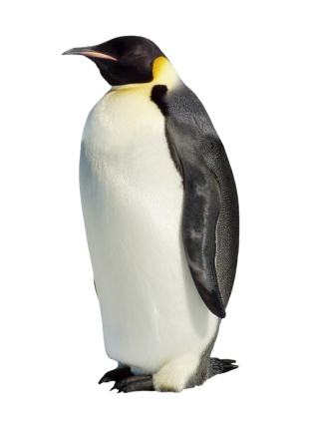
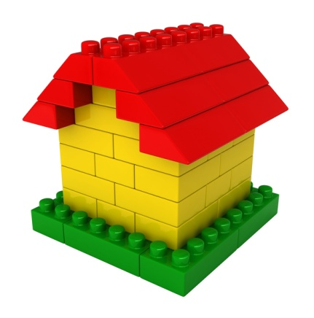
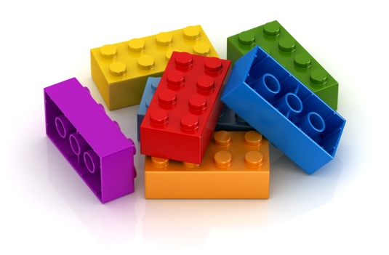
Exchange and transport in animals part 3 – Aerobic respiration
For movement
To enable muscles to contract in animals.
For keeping warm
To keep a steady body temperature in a cold environment
Why do living organisms need energy?
For chemical reactions
To build larger molecules from smaller ones

Slide 34




Exchange and transport in animals part 3 – Aerobic respiration
Respiration can transfer energy in cells aerobically (with oxygen).
Aerobic respiration occurs inside mitochondria continuously.
Glucose is oxidised by oxygen to transfer the energy the organism
needs to perform its functions.
Aerobic respiration releases a large amount of energy from each glucose molecule.
The word equation which represents aerobic respiration is:
glucose + oxygen carbon dioxide + water
The balanced symbol equation which represents aerobic respiration is:
C₆H₁₂O₆ + 6O₂ 6CO₂ + 6H₂O
Animal cell
Electron micrograph of a mitochondrion
Plant cell

Slide 35
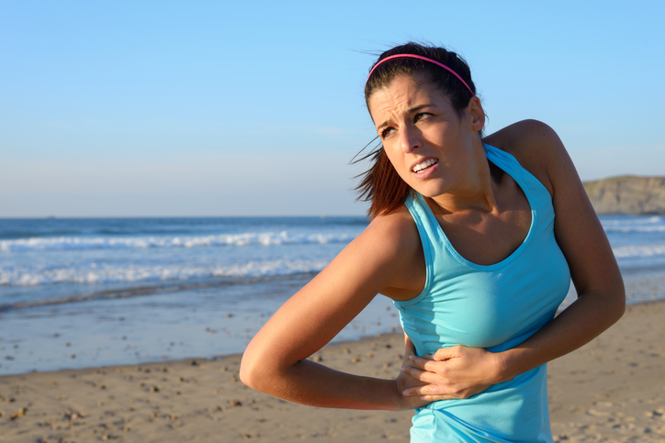
Exchange and transport in animals part 3 – Anaerobic respiration
Respiration can transfer energy in cells anaerobically (without oxygen).
During hard exercise, muscles cells are respiring so fast that the blood cannot
transport enough oxygen to meet their needs.
The muscle cells switch to use ANAEROBIC RESPIRATION to transfer energy.
Glucose is not completely broken down to carbon dioxide and water, so less
energy is transferred. An end product called lactic acid is formed. This builds
up in the muscle cells.
glucose lactic acid
After exercise the lactic acid must be combined with oxygen to convert it to carbon dioxide. The amount of oxygen which must be taken in to convert all the lactic acid to carbon dioxide is called the oxygen debt.
During long periods of vigorous exercise the muscles become fatigued and stop contracting efficiently.

Slide 36
Exchange and transport in animals part 3 – Respiration summary
 | Aerobic respiration | Anaerobic respiration in animal cells
Oxygen | Required | Not required
End products | Carbon dioxide and water | Lactic acid
Oxidation of glucose | Complete | Incomplete
Efficiency of energy transfer | High | Low
Video - Respiration summary
Notes:
http://www.bbc.co.uk/education/guides/zm6rd2p/video

Slide 37
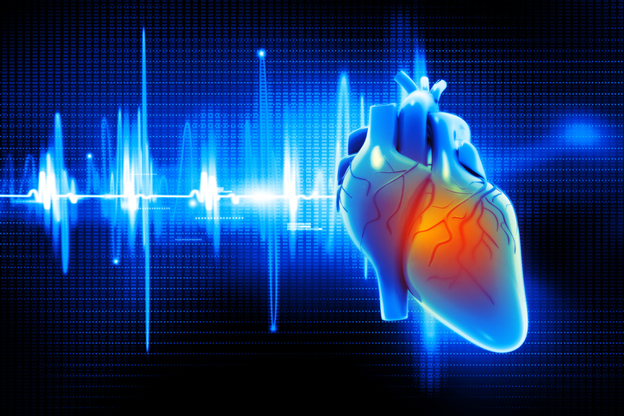
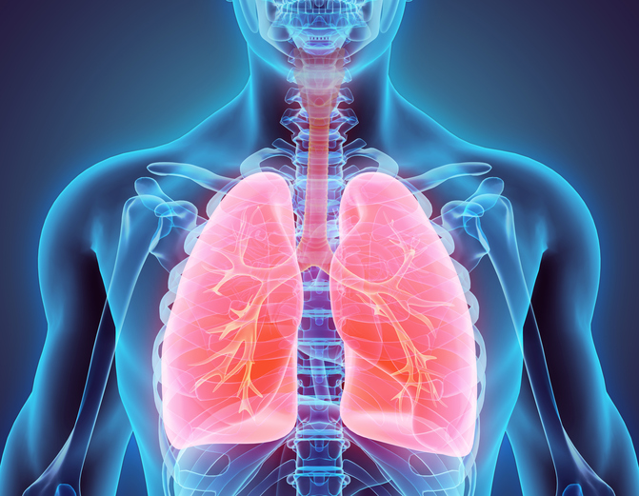
  Exchange and transport in animals part 3 – Anaerobic respiration
During exercise the human body reacts to the increased demand for energy. If insufficient oxygen is supplied to the muscle cells then anaerobic respiration occurs.
The heart rate increases to pump oxygenated blood faster through the muscle cells.
Breathing rate and breath volume increase. This increases the amount of oxygen entering the bloodstream.

Slide 38

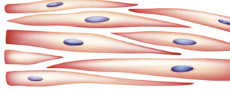
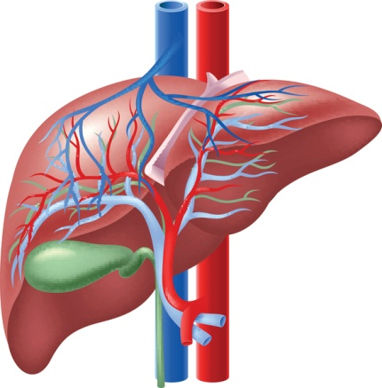
  Exchange and transport in animals part 3 – Anaerobic respiration
Blood flows through the muscle cells and transports the lactic acid to the liver.
Lactic acid builds up in the muscle cells during exercise.
Glucose is used in aerobic respiration or it is converted to glycogen and stored in the liver for later use.
The liver oxidises the lactic acid and converts it back to glucose.
The extra amount of oxygen required to remove all lactic acid from the cells is called the oxygen debt.

Slide 39



Exchange and transport in animals part 3 – Metabolism
Organisms use the energy released by respiration for the continual enzyme controlled processes of metabolism.
The conversion of glucose to starch is a metabolic reaction.
Metabolism = the sum of all reactions in a cell or body
Glucose and nitrate ions from the soil form amino acids. Amino acids are used to synthesise proteins. These are metabolic reactions.

Slide 40
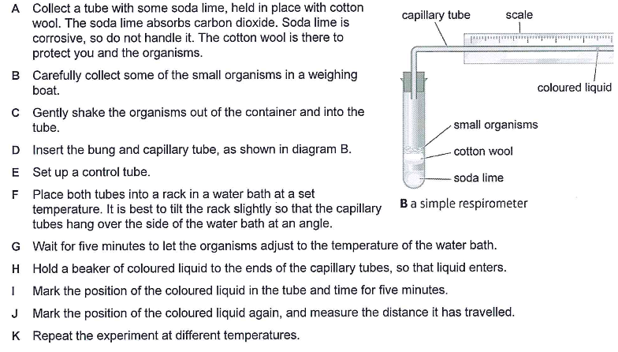
Exchange and transport in animals part 3 – Core practical
Core practical: Investigate the rate of respiration in living organisms.
Video
Taken from the cross board practical guide.

Slide 41
QuestionIT!
Exchange and transport in animals
Part 3
Aerobic respiration
Anaerobic respiration
Metabolism
Core practical

Slide 42
  Exchange and transport in animals
  Part 3 – QuestionIT
When does respiration occur in cells?
Copy and complete the table below:
 | Aerobic respiration | Anaerobic respiration in animal cells
Oxygen required?
End products
Oxidation of glucose complete/incomplete?
Efficiency of energy transfer is high or low?

Slide 43
  Exchange and transport in animals
  Part 3 – QuestionIT
3. Name three processes that organisms require energy for.
4. What does the chemical formula C₆H₁₂O₆ represent?
5. Write down the word equation for aerobic respiration in a plant cell.
6. Describe three ways in which the body responds to vigorous exercise
in order to ensure sufficient oxygen reaches the muscle cells.
7. If exercise carries on for a long time, what happens to the muscles?
8. Why is respiration described as an exothermic reaction?
9. What is the definition of metabolism?
10. Describe the process for removing lactic acid from the body.
11. What is meant by the term ‘oxygen debt’?
12. What is the soda lime used for in the core practical?

Slide 44
AnswerIT!
Exchange and transport in animals
Part 3
Aerobic respiration
Anaerobic respiration
Metabolism
Core practical

Slide 45
  Exchange and transport in animals
  Part 3 – AnswerIT
When does respiration occur in cells? Continuously
Copy and complete the table below:
 | Aerobic respiration | Anaerobic respiration in animal cells
Oxygen required? | Yes | No
End products | Carbon dioxide and water | Lactic acid
Oxidation of glucose complete/incomplete? | complete | incomplete
Efficiency of energy transfer is high or low? | high | low

Slide 46
Exchange and transport in animals
Part 3 – AnswerIT
3. Name three processes that organisms require energy for.
Chemical reactions to build larger molecules, keeping warm and movement.
4. What does the chemical formula C₆H₁₂O₆ represent? Glucose
5. Write down the word equation for aerobic respiration in a plant cell.
glucose + oxygen carbon dioxide + water
6. Describe three ways in which the body responds to vigorous exercise in order to ensure sufficient oxygen reaches the muscle cells.
Increase in heart rate; increase in breathing rate and increase in breath volume.
7. If exercise carries on for a long time, what happens to the muscles?
Muscles become fatigued and stop contracting efficiently.

Slide 47
Exchange and transport in animals
Part 3 – AnswerIT
8. Why is respiration described as an exothermic reaction?
Respiration is an exothermic reaction because it transfers energy to the environment.
9. What is the definition of metabolism?
Metabolism is the sum of all reactions which occur in a cell or body.
10. Describe the process for removing lactic acid from the body.
Blood flows through the muscle cells and transports the lactic acid
to the liver where it is converted back into glucose. The glucose is
then used in aerobic respiration or stored as glycogen.
11. What is meant by the oxygen debt?
The amount of extra oxygen which is needed to remove all lactic
acid from the body is known as the oxygen debt.
12. What is the soda lime used for in the core practical? To absorb carbon dioxide produced by the small organisms. The experiment is measuring the amount of oxygen uptake and this will not be possible if the carbon dioxide levels increase.

