Slide 1


The PiXL Club The PiXL Club The PiXL Club The PiXL Club The PiXL Club The PiXL Club The PiXL Club The PiXL Club The PiXL Club The PiXL Club The PiXL Club The PiXL Club The PiXL Club The PiXL Club The PiXL Club The PiXL Club The PiXL Club The PiXL Club The PiXL Club The PiXL Club The PiXL Club The PiXL Club The PiXL Club The PiXL Club The PiXL Club The PiXL Club The PiXL Club The PiXL Club The PiXL Club The PiXL Club The PiXL Club The PiXL Club The PiXL Club The PiXL Club The PiXL Club The PiXL Club The PiXL Club The PiXL Club The PiXL Club The PiXL Club The PiXL Club The PiXL Club The PiXL Club The PiXL Club The PiXL Club XL Club The PiXL Club The PiXL Club The PiXL Club The PiXL Club The PiXL Club The PiXL Club The PiXL Club The PiXL Club The PiXL Club The PiXL Club The PiXL Club The PiXL Club The PiXL Club The PiXL Club The PiXL Club The PiXL Club The PiXL Club The PiXL Club The PiXL Club The PiXL Club The PiXL Club The PiXL Club The PiXL Club The PiXL Club The PiXL Club The PiXL Club The PiXL Club The PiXL Club The PiXL Club The PiXL Club The PiXL Club The PiXL Club The PiXL Club The PiXL Club The PiXL Club The PiXL Club The PiXL Club The PiXL Club The PiXL Club The PiXL Club The PiXL Club The PiXL Club The PiXL Club The PiXL Club The PiXL Club The PiXL Club The PiXL Club The PiXL Club The PiXL Club The PiXL Club The PiXL Club The PiXL Club The PiXL Club The PiXL Club The PiXL Club The PiXL Club The PiXL Club The PiXL Club The PiXL Club The PiXL Club The PiXL Club The PiXL Club The PiXL Club The PiXL Club The PiXL Club The PiXL Club The PiXL Club The PiXL Club The PiXL Club The PiXL Club The PiXL Club The PiXL Club The PiXL Club The PiXL Club The PiXL Club The PiXL Club The PiXL Club The PiXL Club The PiXL Club The PiXL Club The PiXL Club The PiXL Club The PiXL Club The PiXL Club The PiXL Club The PiXL Club The PiXL Club The PiXL Club The PiXL Club The PiXL Club The PiXL Club The PiXL Club The PiXL Club The PiXL Club The PiXL Club The PiXL Club The PiXL Club The PiXL Club The PiXL Club The PiXL Club The PiXL Club The PiXL Club The PiXL Club The PiXL Club The PiXL Club The PiXL Club The PiXL Club The PiXL Club The PiXL Club The PiXL Club The PiXL Club The PiXL Club The PiXL Club The PiXL Club The PiXL Club The PiXL Club The PiXL Club The PiXL Club The PiXL Club The PiXL Club The PiXL Club The PiXL Club The PiXL Club The PiXL Club The PiXL Club The PiXL Club The PiXL Club The PiXL Club The PiXL Club The PiXL Club The PiXL Club The PiXL Club The PiXL Club The PiXL Club The PiXL Club The PiXL Club The PiXL Club The PiXL Club The PiXL Club The PiXL Club The PiXL Club The PiXL Club The PiXL Club The PiXL Club The PiXL Club The PiXL Club The PiXL Club The PiXL Club The PiXL Club The PiXL Club The PiXL Club The PiXL Club The PiXL Club The PiXL Club The PiXL Club The PiXL Club The PiXL Club The PiXL Club The PiXL Club The PiXL Club The PiXL Club The PiXL Club The PiXL Club The PiXL Club The PiXL Club The PiXL Club The PiXL Club The PiXL Club The PiXL Club The PiXL Club The PiXL Club The PiXL Club The PiXL Club The PiXL Club The PiXL Club The PiXL Club The PiXL Club The PiXL Club The PiXL Club The PiXL Club The PiXL Club The PiXL Club The PiXL Club The PiXL Club The PiXL Club The PiXL Club The PiXL Club The PiXL Club The PiXL Club The PiXL Club The PiXL Club The PiXL Club The PiXL Club The PiXL Club The PiXL Club The PiXL Club The PiXL Club The PiXL Club The PiXL Club The PiXL Club The PiXL Club The PiXL Club The PiXL Club The PiXL Club The PiXL Club The PiXL Club The PiXL Club The PiXL Club The PiXL Club The PiXL Club The PiXL Club The PiXL Club The PiXL Club The PiXL Club The PiXL Club The PiXL Club The PiXL Club The PiXL Club The PiXL Club The PiXL Club The PiXL Club The PiXL Club The PiXL Club The PiXL Club The PiXL Club The PiXL Club The PiXL Club The PiXL Club The PiXL Club The PiXL Club The PiXL Club The PiXL Club The PiXL Club The PiXL Club The PiXL Club The PiXL Club The PiXL Club The PiXL Club The PiXL Club The PiXL Club The PiXL Club The PiXL Club The PiXL Club The PiXL Club The PiXL Club The PiXL Club The PiXL Club The PiXL Club The PiXL Club The PiXL Club The PiXL Club The PiXL Club The PiXL Club The PiXL Club The PiXL Club The PiXL Club The PiXL Club The PiXL Club The PiXL Club The PiXL Club The PiXL Club The PiXL Club The PiXL Club The PiXL Club The PiXL Club The PiXL Club The PiXL Club The PiXL Club The PiXL Club The PiXL Club The PiXL Club The PiXL Club The PiXL Club The PiXL Club The PiXL Club The PiXL Club The PiXL Club The PiXL Club The PiXL Club The PiXL Club The PiXL Club The PiXL Club The PiXL Club The PiXL Club The PiXL Club The PiXL Club The PiXL Club The PiXL Club The PiXL Club The PiXL Club The PiXL Club The PiXL Club The PiXL Club The PiXL Club The PiXL Club The PiXL Club The PiXL Club The PiXL Club The PiXL Club The PiXL Club The PiXL Club The PiXL Club The PiXL Club The PiXL Club The PiXL Club The PiXL Club The PiXL Club The PiXL Club The PiXL Club The PiXL Club The PiXL Club The PiXL Club The PiXL Club The PiXL Club The PiXL Club The PiXL Club The PiXL Club The PiXL Club The PiXL Club The PiXL Club The PiXL Club The PiXL Club The PiXL Club The PiXL Club The PiXL Club The PiXL Club The PiXL Club The PiXL Club The PiXL Club The PiXL Club The PiXL Club The PiXL Club The PiXL Club The PiXL Club The PiXL Club The PiXL Club The PiXL Club The PiXL Club The PiXL Club The PiXL Club The PiXL Club The PiXL Club The PiXL Club The PiXL Club The PiXL Club The PiXL Club The PiXL Club The PiXL Club The PiXL Club The PiXL Club The PiXL Club The PiXL Club The PiXL Club The PiXL Club The PiXL Club The PiXL Club The PiXL Club The PiXL Club The PiXL Club The PiXL Club The PiXL Club The PiXL Club The PiXL Club The PiXL Club The PiXL Club The PiXL Club The PiXL Club The PiXL Club The PiXL Club The PiXL Club The PiXL Club The PiXL Club The PiXL Club The PiXL Club The PiXL Club The PiXL Club The PiXL Club The PiXL Club The PiXL Club The PiXL Club The PiXL Club The PiXL Club The PiXL Club The PiXL Club The PiXL Club The PiXL Club The PiXL Club The PiXL Club The PiXL Club The PiXL Club The PiXL Club The PiXL Club The PiXL Club The PiXL Club The PiXL Club The PiXL Club The PiXL Club The PiXL Club The PiXL Club The PiXL Club The PiXL Club The PiXL Club The PiXL Club The PiXL Club The PiXL Club The PiXL Club The PiXL Club The PiXL Club The PiXL Club The PiXL Club The PiXL Club The PiXL Club The PiXL Club The PiXL Club The PiXL Club The PiXL Club The PiXL Club The PiXL Club The PiXL Club The PiXL Club The PiXL Club The PiXL Club The PiXL Club The PiXL Club The PiXL Club The PiXL Club The PiXL Club The PiXL Club The PiXL Club The PiXL Club The PiXL Club The PiXL Club The PiXL Club The PiXL Club The PiXL Club The PiXL Club The PiXL Club The PiXL Club The PiXL Club The PiXL Club The PiXL Club The PiXL Club The PiXL Club The PiXL Club The PiXL Club The PiXL Club The PiXL Club The PiXL Club The PiXL Club The PiXL Club The PiXL Club The PiXL Club The PiXL Club The PiXL Club The PiXL Club The PiXL Club The PiXL Club The PiXL Club The PiXL Club The PiXL Club The PiXL Club The PiXL Club The PiXL Club The PiXL Club The PiXL Club The PiXL Club The PiXL Club The PiXL Club The PiXL Club The PiXL Club The PiXL Club The PiXL Club The PiXL Club The PiXL Club The PiXL Club The PiXL Club The PiXL Club The PiXL Club The PiXL Club The PiXL Club The PiXL Club The PiXL Club The PiXL Club The PiXL Club The PiXL Club The PiXL Club The PiXL Club The PiXL Club The PiXL Club The PiXL Club The PiXL Club The PiXL Club The PiXL Club The PiXL Club The PiXL Club The PiXL Club The PiXL Club The PiXL Club The PiXL Club The PiXL Club The PiXL Club The PiXL Club The PiXL Club The PiXL Club The PiXL Club The PiXL Club The PiXL Club The PiXL Club The PiXL Club The PiXL Club The PiXL Club The PiXL Club The PiXL Club The PiXL Club The PiXL Club The PiXL Club The PiXL Club The PiXL Club The PiXL Club The PiXL Club The PiXL Club The PiXL Club The PiXL Club The PiXL Club The PiXL Club The PiXL Club The PiXL Club The PiXL Club The PiXL Club The PiXL Club The PiXL Club The PiXL Club The PiXL Club The PiXL Club The PiXL Club The PiXL Club The PiXL Club The PiXL Club The PiXL Club The PiXL Club The PiXL Club The PiXL Club The PiXL Club The PiXL Club The PiXL Club The PiXL Club The PiXL Club The PiXL Club The PiXL Club The PiXL Club The PiXL Club The PiXL Club The PiXL Club The PiXL Club The PiXL Club The PiXL Club The PiXL Club The PiXL Club The PiXL Club The PiXL Club The PiXL Club The PiXL Club The PiXL Club The PiXL Club The PiXL Club The PiXL Club The PiXL Club The PiXL Club The PiXL Club The PiXL Club The PiXL Club The PiXL Club The PiXL Club The PiXL Club The PiXL Club The PiXL Club The PiXL Club The PiXL Club The PiXL Club The PiXL Club The PiXL Club The PiXL Club The PiXL Club The PiXL Club The PiXL Club The PiXL Club The PiXL Club The PiXL Club The PiXL Club The PiXL Club The PiXL Club The PiXL Club The PiXL Club The PiXL Club The PiXL Club The PiXL Club The PiXL Club The PiXL Club The PiXL Club The PiXL Club The PiXL Club The PiXL Club The PiXL Club The PiXL Club The PiXL Club The PiXL Club The PiXL Club The PiXL Club The PiXL Club The PiXL Club The PiXL Club The PiXL Club The PiXL Club The PiXL Club The PiXL Club The PiXL Club The PiXL Club The PiXL Club The PiXL Club The PiXL Club The PiXL Club The PiXL Club The PiXL Club The PiXL Club The PiXL Club The PiXL Club The PiXL Club The PiXL Club The PiXL Club The PiXL Club The PiXL Club The PiXL Club The PiXL Club The PiXL Club The PiXL Club The PiXL Club The PiXL Club The PiXL Club The PiXL Club The PiXL Club The PiXL Club The PiXL Club The PiXL Club The PiXL Club The PiXL Club The PiXL Club The PiXL Club The PiXL Club The PiXL Club The PiXL Club The PiXL Club The PiXL Club The PiXL Club The PiXL Club The PiXL Club The PiXL Club The PiXL Club The PiXL Club The PiXL Club The PiXL Club The PiXL Club The PiXL Club The PiXL Club The PiXL Club The PiXL Club The PiXL Club The PiXL Club The PiXL Club The PiXL Club The PiXL Club The PiXL Club The PiXL Club The PiXL Club The PiXL Club The PiXL Club The PiXL Club The PiXL Club The PiXL Club The PiXL Club The PiXL Club The PiXL Club The PiXL Club The PiXL Club The PiXL Club The PiXL Club The PiXL Club The PiXL Club The PiXL Club The PiXL Club The PiXL Club The PiXL Club The PiXL Club The PiXL Club The PiXL Club The PiXL Club The PiXL Club The PiXL Club The PiXL Club The PiXL Club The PiXL Club
PiXL KnowIT!
GCSE Biology
Edexcel Topic 9 – Ecosystems and material cycles
© Copyright The PiXL Club Ltd, 2017
This resource is strictly for the use of member schools for as long as they remain members of The PiXL Club. It may not be copied, sold nor transferred to a third party or used by the school after membership ceases. Until such time it may be freely used within the member school.
All opinions and contributions are those of the authors. The contents of this resource are not connected with nor endorsed by any other company, organisation or institution.
www.pixl.org.uk The PiXL Club Ltd, Company number 07321607

Slide 2
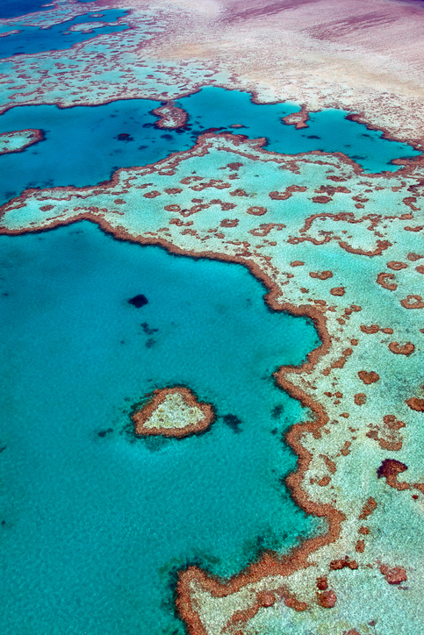
Overview
Ecosystems and material cycles
Levels of organisation in ecosystems and interactions between organisms
Trophic levels, biomass and energy transfers (biology only)
Biodiversity and the effect of human interaction within ecosystems
Food security (biology only)
Material Cycles and pollution
Decomposition

Slide 3
LearnIT!
KnowIT!
Levels of organisation in ecosystems and interactions between organisms
Part 1 (9.1-9.6)
Levels of organisation
Abiotic and biotic factors
Interdependence
Core Practical

Slide 4
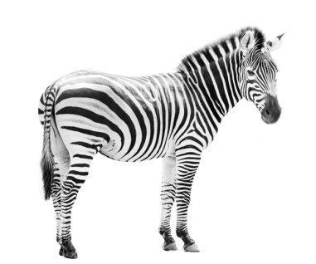
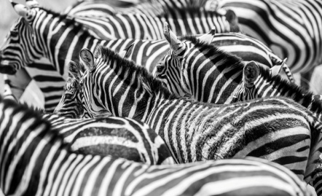
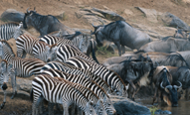
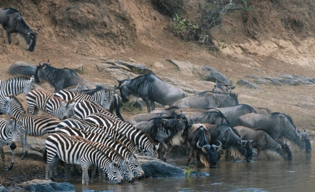
  Ecosystems and material cycles part 1 – Levels of organisation
The different levels of organisation in an ecosystem are:
Organism (an individual living thing)
Community (lots of different populations living in the area)
Population (the number of a particular species living in a habitat)
Ecosystem (the interaction of a community of living organisms with the non-living parts of their environment)
1 zebra
zebra herd
zebra buffalo
Everything

Slide 5
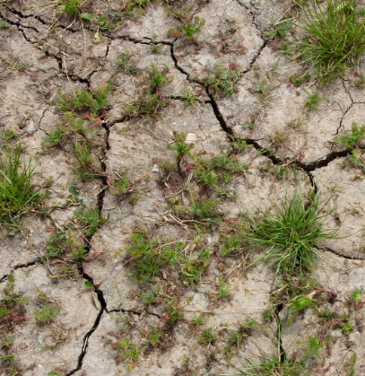
  Ecosystems and material cycles part 1 – Abiotic factors
‘Bio’ means life in Greek.
Biology is the study of living organisms
A biography is an account of someone’s life
The prefix ‘a’ in front of a science word often means ‘not’ or ‘non’.
Examples of abiotic factors which may affect a community are:
Light Intensity
Temperature
Moisture levels
Pollutants
Soil pH and mineral content
Carbon dioxide levels for plants
Oxygen levels for aquatic animals (living in water)
An abiotic factor is a non-living or physical factor.

Slide 6
  Ecosystems and material cycles part 1 – Abiotic factors
Abiotic Factor | Potential effects on a community
Temperature | A rise in environmental temperature can change the distribution of organisms e.g. Mediterranean species of birds and insects have started to be found in the UK. An increase in sea temperature is a major factor in the bleaching of corals.
Light Intensity | As trees increase in height more shade is produced which alters the species which can live there.
Water availability | Plants which are adapted to live in dry soil will not grow as well if the soil becomes too damp.
Pollutants | Certain lichens will not survive if the level of sulfur dioxide in the air is too high.

Slide 7
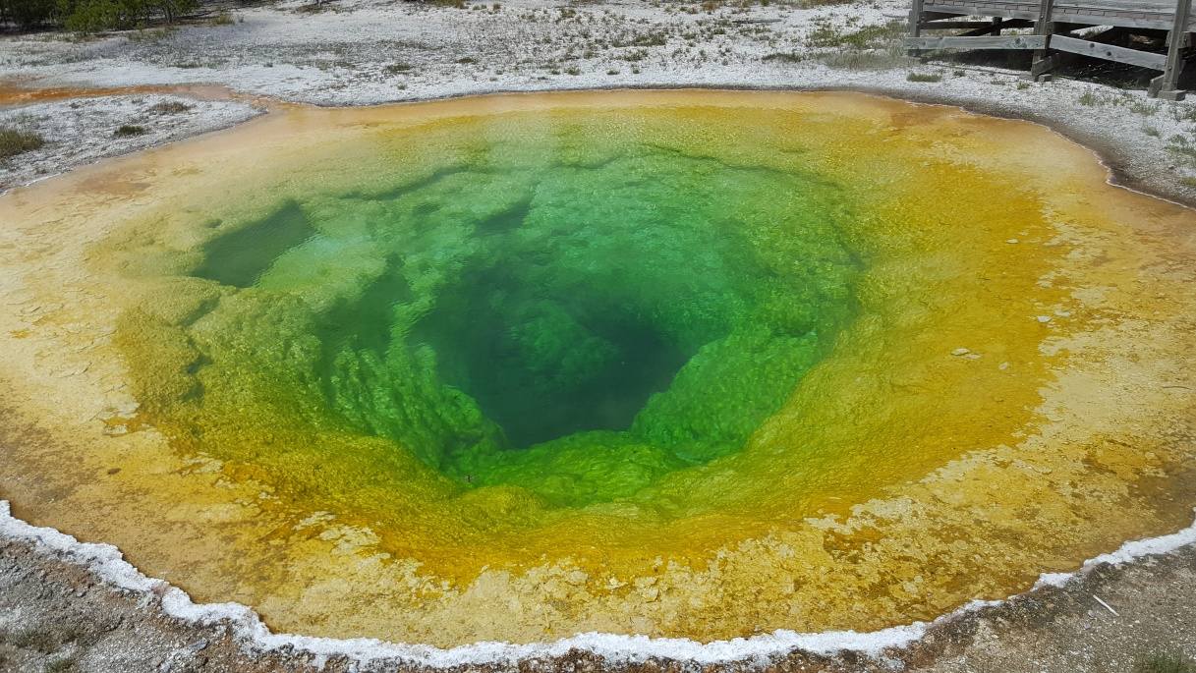
  Ecosystems and material cycles part 1 –Abiotic factors
Some organisms live in environments which are very extreme, such as at high temperature, pressure or salt concentration.
These organisms are called extremophiles.
-phile means ‘a strong liking for’.
Acidophile - describes an organism that lives in acidic conditions.
Hydrophilic means water loving.
The vivid colours in this hot spring in Yellowstone National Park are the results of micro organisms living in this extreme environment.

Slide 8
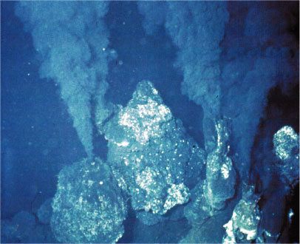
  Ecosystems and material cycles part 1 – Abiotic factors
A particular species of bacteria has been found living 2500m below the surface of the sea in hydrothermal ocean vents. Temperatures are over 100°C , it is very acidic and pressures are very high. These conditions are very extreme.
These bacteria are extremophiles.
In order to survive, the enzymes found in these bacteria are specially adapted so they do not denature at high temperature.

Slide 9
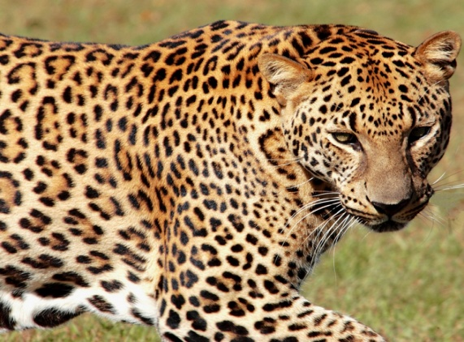
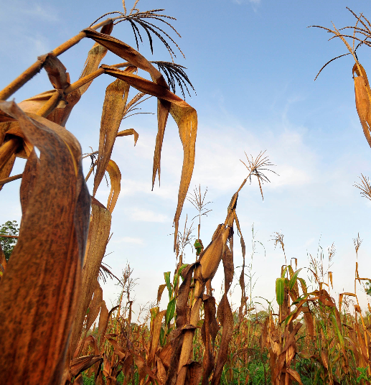
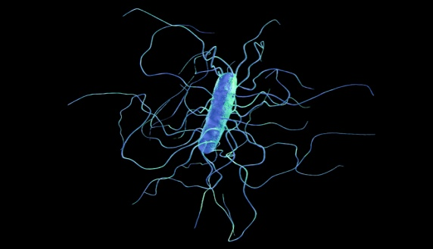
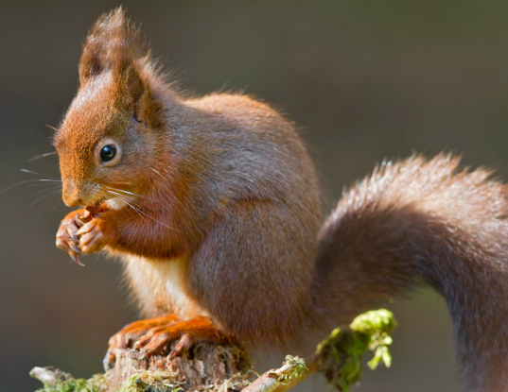
  Ecosystems and material cycles part 1 – Biotic factors
Biotic factors means living factors.
Low food availability means organisms find it harder to survive and breed.
Biotic factors which can affect a community are:
New predators which organisms might not be able to defend against.
One species outcompeting another so the numbers are no longer sufficient to breed. In most of the UK, grey squirrels have outcompeted red squirrels.
New pathogens being introduced and organisms having no resistance.

Slide 10
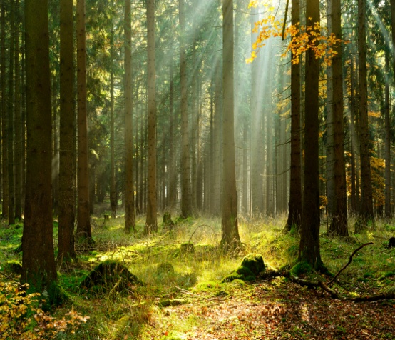
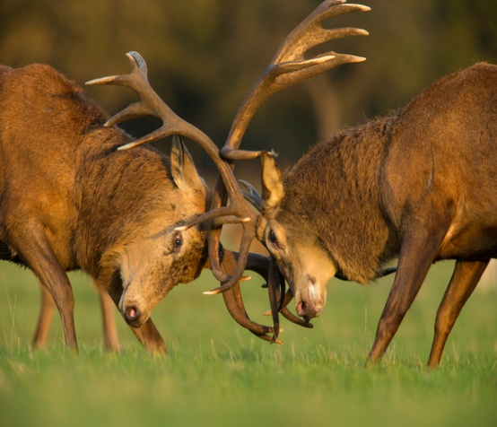
  Ecosystems and material cycles part 1 - Interdependence
To survive and reproduce, organisms require a supply of materials from their surroundings and from other living organisms there.
Plants in a community or habitat compete with each other for:
Light
Space
Water and mineral
ions from the soil
Animals in a community often compete with each other for:
Food
Mates
Territory

Slide 11
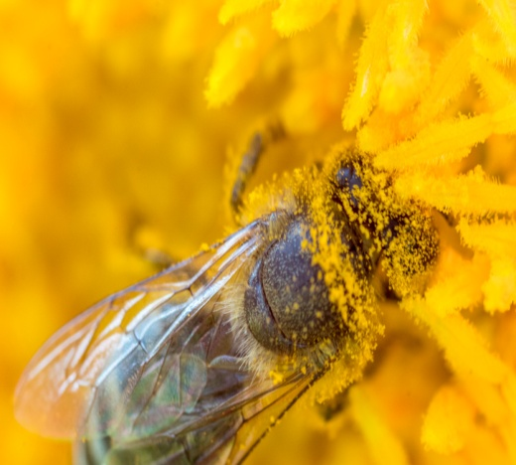
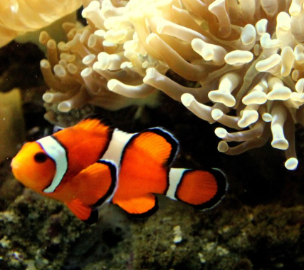
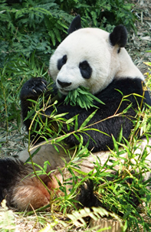
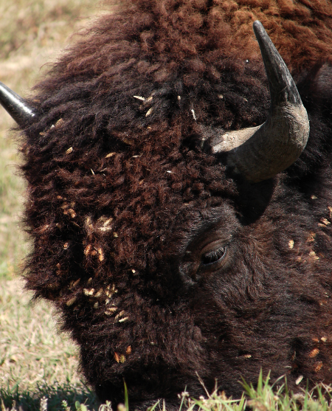
  Ecosystems and material cycles part 1 - Interdependence
Within a community each species depends on other species for their survival. This is called interdependence. If one species is removed it can affect the whole community.
pollination
Many flowering plants rely on insects like bees or butterflies for pollination.
Pandas rely on bamboo for food.
food
Shelter
Seed dispersal
Animals or birds may carry plant seeds away from the parent plant to reduce competition.
Clown fish are protected from predators by the stinging tentacles of the anemone.

Slide 12
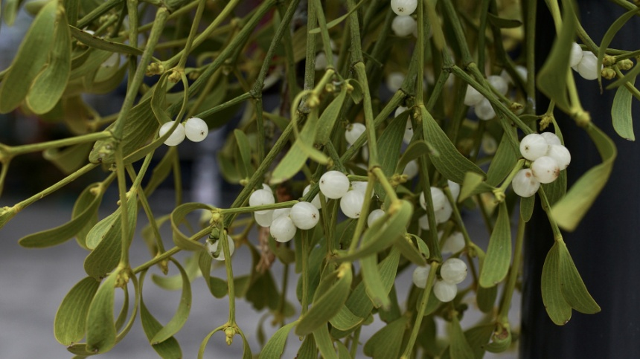
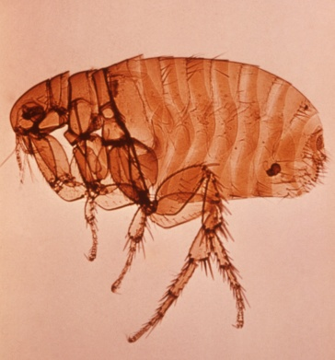
  Ecosystems and material cycles part 1 - Interdependence
Parasitism
A parasite lives on or in a host organism. The parasite gains benefit from the relationship but this may weaken or even kill the host organism. The host gets no benefit from this arrangement.
pollination
Mistletoe plants grow on a wide variety of host trees. The roots grow into the xylem and phloem tissue of the tree. The mistletoe gains water and nutrients from the host tree. Side effects for the tree include reduced growth.
food
Shelter
Fleas live on the skin of their host. They bite and feed off the blood of the host.
Seed dispersal

Slide 13
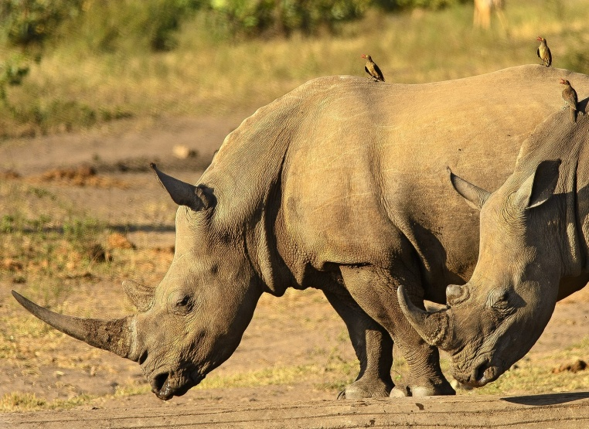
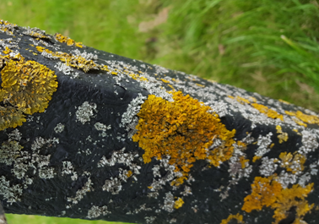
  Ecosystems and material cycles part 1 - Interdependence
Mutualism
A mutualistic relationship is one in which two different species live closely with each other and both gain benefit from this.
pollination
food
Shelter
Seed dispersal
Oxpecker birds eat ticks and larvae which infect the skin of animals like rhinos and buffalo. They are known as cleaner species.
Lichen is a mutual relationship between algae and fungi. The algae photosynthesise and produce food for both species. Fungi provide a protective sheltered environment.

Slide 14
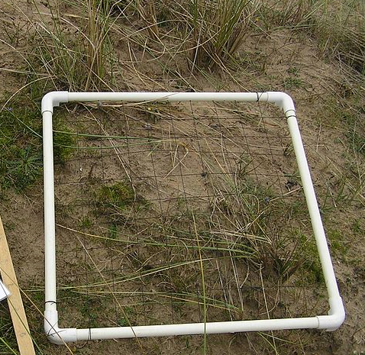
  Ecosystems and material cycles part 1 – Core practical
It is important for ecologists to be able to determine the distribution and abundance (how many) of a species in an ecosystem. If one species is in decline, it can affect the whole ecosystem.
Sampling techniques are used to estimate the size of a population.
Quadrats are often used to do this and they can be used in a random way or by placing them along a line through an area called a belt transect.
Quadrats are frames usually with an area of 0.25m². They are placed on the ground and the organisms (usually plants) inside the frame are counted.
Quadrats are used to calculate population density, population frequency or percentage cover in an area.
video
You need to be able to understand and calculate the mean, mode and median.
Notes:
https://www.youtube.com/watch?v=UDp3I07Wcrg
Link to required practicals: https://pixl.huddle.net/workspace/32293326/files/#/54013727

Slide 15
  Ecosystems and material cycles part 1 –Core Practical
How to determine the number of organisms in a given area.
Measure the area of the land to be sampled in m²
Place a quadrat of known area on the ground randomly. Count the number of organisms of the species being measured which fall within the quadrat.
Use a random number generator to give the coordinates for the next quadrat.
Continue so that at least 10% of the chosen land area is sampled randomly. If the area was 100m² then at least 10 quadrats of 1m² should be completed.
Calculate the mean number of organisms per quadrat.
  Mean = total number of organisms
number of quadrats
6. Work out the mean number of organisms per m² if the quadrat is not 1m².
7. Multiple the mean number of organisms per m² by the total area of the land sampled.
pollination
food
Shelter
Seed dispersal

Slide 16
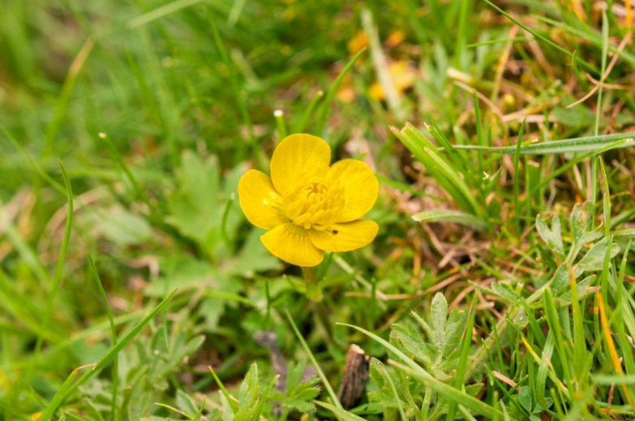
  Ecosystems and material cycles part 1 – Core Practical
A conservation group has been concerned about the recent lack of buttercups in an area. The buttercup is important as a food source for moth larvae. They estimated the population and will compare it with data gathered over 5 years to see if it was a valid concern.
pollination
The conservationists sampled a field with an area of 900m².
They used a quadrat with an area of 0.25m² and took 20 samples.
The mean number of buttercups per 0.25 m² quadrat was calculated as 8.
The mean number of buttercups per m² is calculated:
1 ÷ 0.25 = 4
8 X 4 = 32 buttercups per m²
The estimated population of buttercups in the field was calculated as follows:
Mean number of buttercups (m² ) x total area of the field (m² ) 32 x 900 = 28 800 buttercups in the field for year 1.
food
Shelter
Seed dispersal

Slide 17
QuestionIT!
Levels of organisation in ecosystems and interactions between organisms
Part 1 (9.1-9.6)
Levels of organisation
Abiotic and biotic factors
Interdependence
Core Practical

Slide 18
  Ecosystems and material cycles part 1 – QuestionIT
1. What is the definition of an ecosystem?
2. What is the definition of an abiotic factor?
3. List three abiotic factors which can affect an aquatic organism.
4. List three abiotic factors which can affect a plant.
5. What is the definition of a biotic factor?
6. List three biotic factors which can affect a community.
7. Complete the table:
Level of organisation | Definition
Organism
 | Number of a particular species in a habitat
Community
Ecosystem

Slide 19
  Ecosystems and material cycles part 1 – QuestionIT
8. List two ways a daisy plant may depend on another species for its survival.
9. Define the term interdependence.
What is the definition of a parasitic relationship?
Name two parasitic organisms and their hosts.
What type of relationship exists between a bee and a flowering plant?
What is a quadrat used for?
If a quadrat has sides of 0.5m, what is the area of the quadrat?
What is the equation for calculating the mean number of organisms of a species in a specific area?
What equipment would be needed to measure how species distribution changes from an area of high light intensity to a shaded area?

Slide 20

AnswerIT!
Ecosystems and material cycles
Part 1 (9.1-9.6)
Communities
Abiotic factors
Biotic Factors
Adaptations

Slide 21
  Ecosystems and material cycles part 1 – AnswerIT
What is the definition of an ecosystem?
The interaction of a community of living organisms with the non-living parts of their environment.
2. What is the definition of an abiotic factor? A non living factor
3. List three abiotic factors which can affect an aquatic organism.
Oxygen levels
Temperature
Carbon dioxide levels
Light intensity

Slide 22
  Ecosystems and material cycles part 1 – AnswerIT
4. List three abiotic factors which can affect a plant.
Light intensity
Temperature
Carbon dioxide levels
Oxygen levels
Pollutants
5. What is the definition of a biotic factor?
A living factor which may affect a community
6. List three biotic factors which can affect a community.
Food availability
A new predator or pathogen
One species outcompeting another

Slide 23
  Ecosystems and material cycles part 1 – AnswerIT
7. Complete the table:
Level of organisation | Definition
Organism | An individual living thing
Population | Number of a particular species in a habitat
Community | Lots of different populations living in an area or habitat.
Ecosystem | The interaction of a community of living organisms with the non-living parts of their environment.
8. List two ways a daisy plant may depend on another species for its survival.
Pollination
Seed dispersal

Slide 24
  Ecosystems and material cycles part 1 – AnswerIT
9. Define the term interdependence.
Organisms depend on each other for survival. A change in the population of one species can have a large effect on other species in the same community.
10. What is the definition of a parasitic relationship?
Parasites are organisms that live on or in a host organism. The parasite benefits from this arrangement, but the host suffers as a result.
11. Name two parasitic organisms and their hosts.
Tapeworm and human
Flea and dog
What type of relationship exists between a bee and a flowering plant?
Mutualism

Slide 25
  Ecosystems and material cycles part 1 – AnswerIT
13. What is a quadrat used for?
It is a square frame of a known area which is used to measure abundance or distribution of organisms.
14. If a quadrat has sides of 0.5m, what is the area of the quadrat?
0.5 x 0.5 = 0.25m²
What is the equation for calculating the mean number of organisms of a species in a specific area?
mean number of organisms per m² x total area of the land m²
What equipment would be needed to measure how species distribution changes from an area of high light intensity to a shaded area?
quadrat
tape measure marked in meters
light meter

Slide 26
LearnIT!
KnowIT!
Trophic levels,
biomass and energy
transfers
Part 2 (9.7B-9.8B)
Food chains and trophic levels (biology only)
Pyramid of biomass (biology only)
Energy Transfers (biology only)

Slide 27
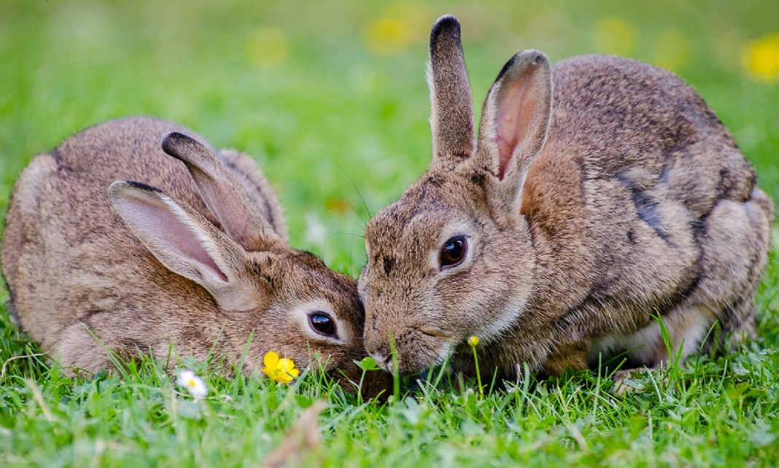
  Ecosystem and material cycles part 2 – Food chains and trophic levels
Food chains are used to represent the feeding relationships within a community. All food chains begin with a producer which synthesises molecules. Molecules are made when atoms are joined by chemical bonds. This is usually a green plant or alga which makes glucose molecules by photosynthesis.
Photosynthetic organisms are the producers of biomass for life on Earth.
Biomass is the mass of living material in an organism.
Producers are eaten by primary consumers which in turn may be eaten by secondary consumers which may be eaten by tertiary consumers.

Slide 28
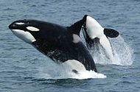
  Ecosystem and material cycles part 2 –Food chains and trophic levels
Level 4: Carnivores that eat other carnivores are called tertiary consumers.
Level 3: Carnivores that eat herbivores are called secondary consumers
Level 1: Plants and alga make their own food and are called producers.
Level 2: Herbivores eat plants/alga and are called primary consumers.
Trophic levels are defined as the feeding levels within an ecosystem. Trophic levels can be represented by numbers.
Carne = meat
Herb = plant
Omni = plant & meat
vore = eater

Slide 29
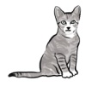


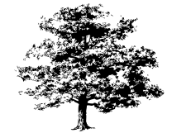
  Ecosystem and material cycles part 2 – Pyramids of biomass
  (biology only)
Biomass is defined as the amount of living material at each trophic (feeding) level.
Pyramids of biomass can be constructed to represent the relative amount of biomass in each level of a food chain.
Trophic level 1 (plant or alga) is always at the bottom of the pyramid.
Cat (level 4)
Sparrow (level 3)
Caterpillar (level 2)
Oak tree (Trophic level 1)
The diagram is a pyramid shape because the amount of biomass and energy available at each trophic level decreases. This is why the length of a food chain is limited.
Oak tree → caterpillars → sparrows → cat

Slide 30
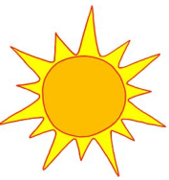
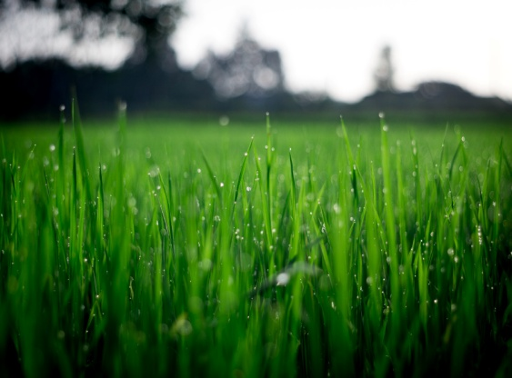
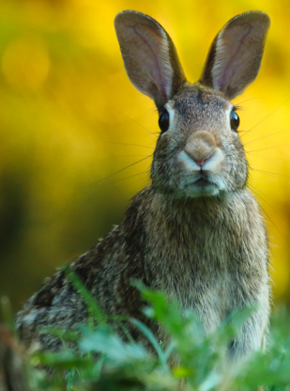
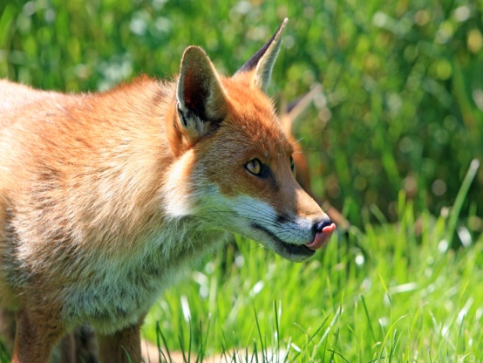
Ecosystem and material cycles part 2 – Energy Transfers (biology only)
Producers are mostly plants and algae. They transfer about 1% of the incident energy from light for photosynthesis.
Incident light is the light which shines on the producer.
Only 10% of the biomass from each trophic level is transferred into useful forms for the next level.
Loss of useful forms of energy are due to:
Not all ingested material (food taken in) being absorbed into the body.
Some is egested as faeces.
Not all the absorbed material being used to make new biomass. Some is lost as waste such as carbon dioxide and water in respiration and water and urea in urine.
Large amounts of glucose are used up in respiration and provide energy
for movement, growth and keeping a constant body temperature.

Slide 31
Ecosystem and material cycles part 2 – Energy Transfers( biology only)
Calculating efficiency of biomass transfer
Biomass available at each trophic level
6000g
500g
170g
The rabbit population has 6000g of biomass from the grass available.
The fox population has 500g of biomass available from the rabbits.
170g is the amount of biomass that has been used by the fox.
The following equation can be used to find out the efficiency of biomass transfer between two trophic levels as a percentage:
Efficiency of biomass transfer = biomass transferred to the next level x 100
biomass available at the previous level

Slide 32
Ecosystem and material cycles part 2 – Energy Transfers (biology only)
Biomass available at each trophic level
6000g
500g
170g
Calculate the efficiency of biomass transfer between the grass and the rabbit .
Efficiency of biomass transfer = 500 x 100 = 8.3%
6000

Slide 33
QuestionIT!
Trophic levels, biomass and energy transfers
Part 2 (9.7B- 9.8B)
Food chains and trophic levels
Pyramid of biomass
Energy Transfers

Slide 34
  Organisation of an ecosystem part 2 – QuestionIT
Biology Only
What is biomass?
What does a food chain show?
What do all food chains begin with?
Name two different types of organism which would be found at the start of a food chain.
What is meant by the terms mode and median?
Define the term trophic level.
What does a pyramid of biomass represent?

Slide 35
  Trophic levels in an ecosystem part 4– QuestionIT
8. How much energy as a percentage is transferred by producers from incident light for photosynthesis ?
Approximately how much biomass, as a percentage, is transferred from a trophic level to the one above it?
List two ways in which biomass can be lost at each stage of a food chain.
What is the equation which should be used to calculate the efficiency of biomass transfer between trophic levels as a percentage?

Slide 36
AnswerIT!
Trophic levels, biomass and energy transfers
Part 2
Food chains and trophic levels
Pyramid of biomass
Energy Transfers

Slide 37
  Ecosystems and material cycles part 2 – AnswerIT
What is biomass? Amount of living material in an organism
What does a food chain show? Feeding relationships within a community
What do all food chains begin with? A producer
Name two different types of organism which would be found at the start of a food chain. Green plant
Alga
5. What is meant by the terms mode and median?
Mode = number which occurs most often in a set of data.
Median = middle value in a set of data

Slide 38
  Ecosystems and material cycles part 2 – AnswerIT
6. Define the term trophic level. Feeding level within an ecosystem
What does the pyramid of biomass represent? The relative amounts of biomass at each level of a food chain.
8. How much energy as a percentage is transferred by producers from incident light for photosynthesis ? Approximately 1%
How much biomass as a percentage is transferred approximately from a trophic level to the one above it? 10%

Slide 39
  Ecosystems and material cycles part 2 – AnswerIT
10. List 2 ways in which biomass can be lost at each stage of a food chain.
  Not all ingested food is absorbed- some is lost as faeces.
  Not all absorbed food is converted into biomass – some used for keeping constant body temperature or movement.
11. What is the equation which should be used to calculate the efficiency of biomass transfer between trophic levels as a percentage?
Efficiency of biomass transfer = biomass transferred to the next level x 100
biomass available at the previous level

Slide 40
LearnIT!
KnowIT!
Biodiversity and the
effects of human
interaction
within ecosystems.
Part 3 (9.9 – 9.10)
Positive and negative human interactions within ecosystems.
Benefits of global and local biodiversity

Slide 41
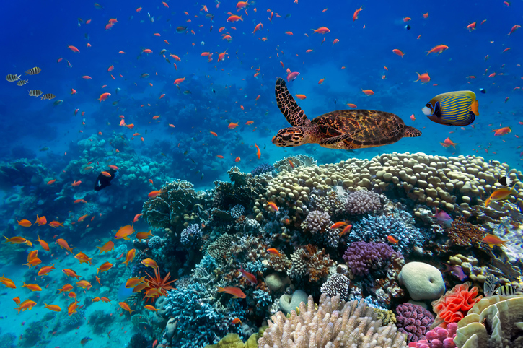
  Ecosystems and material cycles part 3 –biodiversity
Biodiversity is the variety of all the different species of organisms on Earth, or within an ecosystem.
A high biodiversity ensures the stability of ecosystems by reducing the dependence of one species on another for food, shelter and the maintenance of the physical environment.
Coral reefs have a high diversity. The animals shown have a wide variety of food available, lots of space and plenty of places to shelter from predators and when there is poor weather.
The physical environment includes abiotic factors such as the availability of water, soil quality and climate.

Slide 42
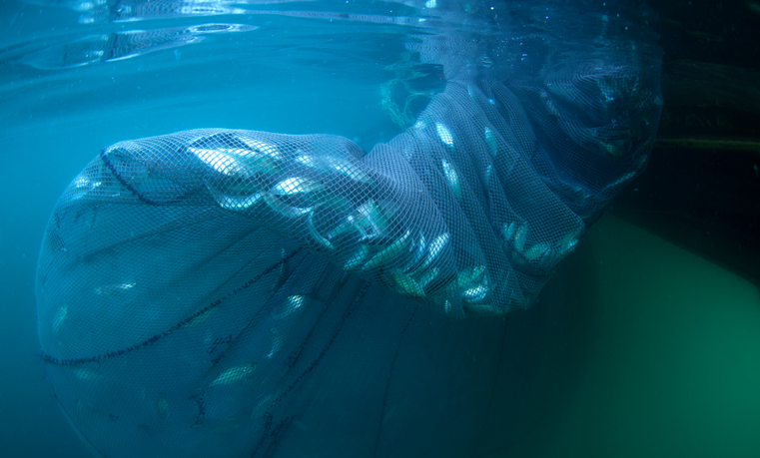
  Ecosystems and material cycles part 3 – Biodiversity
Fishing has been a way of life for humans throughout history, however the natural fish stocks in the oceans are declining.
It is important to maintain fish stocks at a sustainable level where breeding occurs. If this does not occur, certain species may disappear altogether in local areas and reduce local biodiversity.
In some areas, fishing quotas are in place for the amount and type of fish which can be caught. However once a fish has been caught it is usually dead and so quotas do not always work.
Controls over the size of holes in fishing nets are important. Larger holes mean that young fish can swim out of the net and live longer to breed and increase in size so they can be a viable future food source.

Slide 43
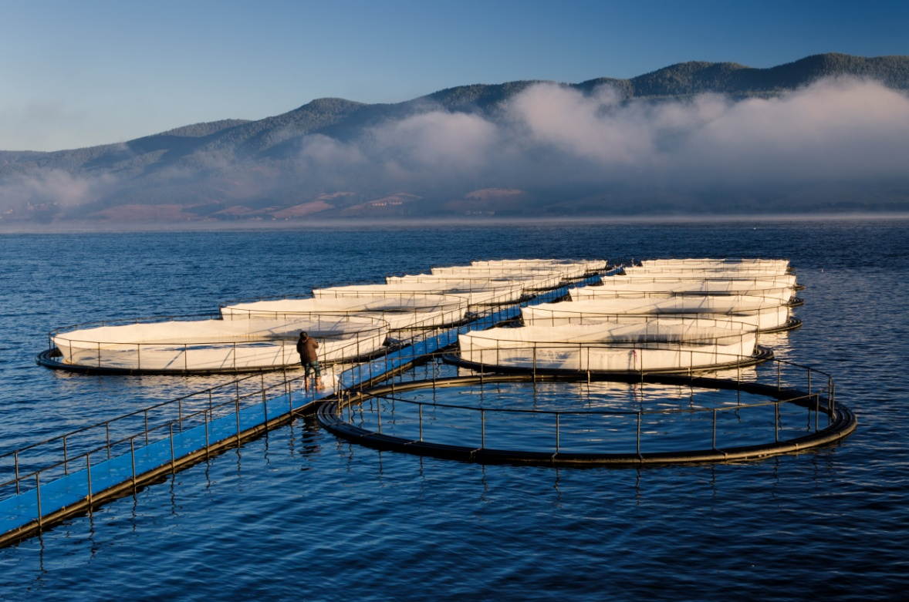
  Ecosystems and material cycles part 3– Biodiversity
Open water fish farming can reduce biodiversity in an area.
Food added to the nets can leak into the open water. There is a lot of waste which can cause eutrophication.
It may attract predators e.g. seals which become trapped in the netting and die.
Large concentrations of fish in a small area will encourage parasites to breed which can also infect wild fish or animals weakening or killing them.
If fish escape from the nets into the open sea they may be non indigenous and cause issues for the native indigenous species.

Slide 44
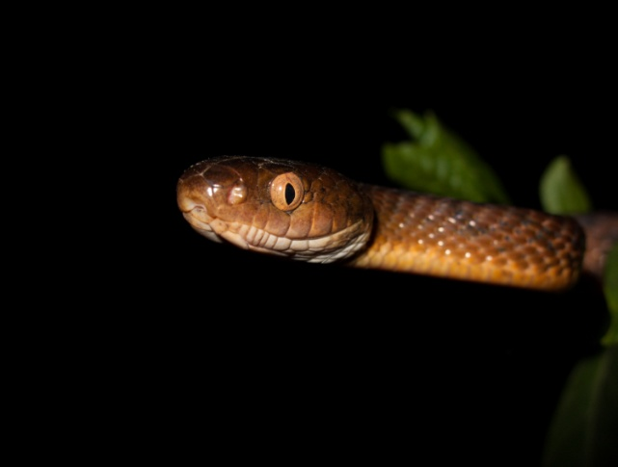
  Ecosystems and material cycles part 3 – Biodiversity
Non-indigenous species are ones which do not naturally occur in that particular ecosystem.
Humans may introduce non-indigenous species deliberately as a food source for example. If non-indigenous species are released, escape or are carried by other animals, birds or vehicles across countries they may disrupt the stability of an ecosystem by competing with the native indigenous species. They can also bring new pathogens which kill the native species and so reduce diversity.
The brown tree snake was accidentally released on the island of Guam from Papua New Guinea. This led to the local extinction of most of the native birds and lizard species. Native plant species fell into decline as there were few pollinators left. Neighbouring Pacific islands are concerned about the spread of the snake to their fragile habitats.
Brown tree snake
Notes:
http://www.bbc.co.uk/news/science-environment-17992053 article on the brown tree snake

Slide 45
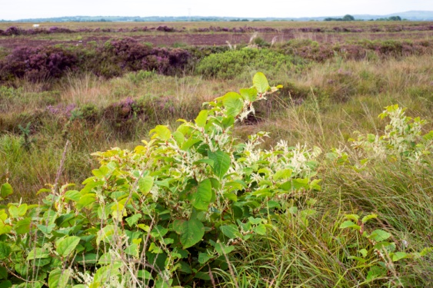
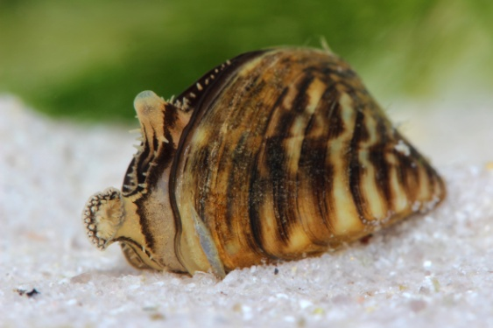
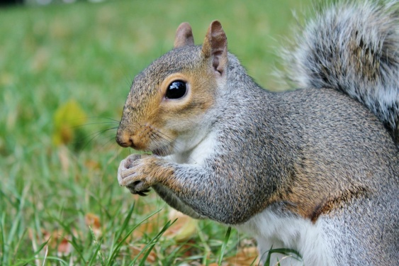
  Ecosystems and material cycles part 3 –Biodiversity
Japanese knotweed is initially from Eastern Asia. The Victorians brought the plant to the UK as an ornamental garden plant. It is widely established across the UK and forms very dense patches which are difficult to get rid of. It is also capable of breaking through concrete and costs the economy £166 million a year.
Japanese Knotweed
Zebra mussels are causing problems both to the UK’s native fresh water mussel but also our drinking water. The zebra mussels block the water pipes in the water treatment plants. video
Zebra mussel
The grey squirrel is native to North America. It was brought to Britain as a fashionable addition to local landowners collections in 1876. It outcompetes the native red squirrel and carries a pox virus which has wiped out large populations of red squirrels.
Notes:
http://www.bbc.co.uk/news/av/uk-england-28970957/zebra-mussels-a-threat-to-the-water-system

Slide 46
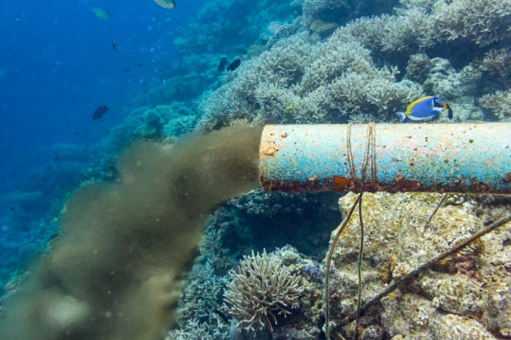
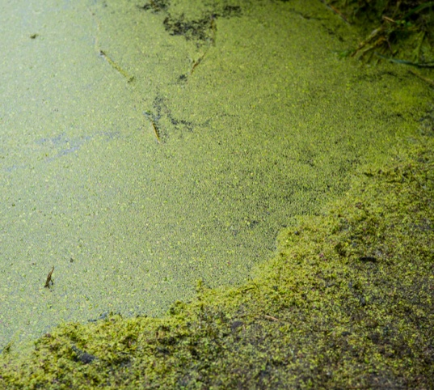
  Ecosystems and material cycles part 3 –Biodiversity
Water pollution can occur as a result of human activities.
Sewage or toxic chemicals may enter lakes,
rivers or the sea.
The use of artificial fertiliser to improve
plant growth in farming may enter
waterways via run off from the fields.
This can lead to eutrophication.
Algae in the water grow rapidly due to the
excess nitrates in the fertiliser. The algae reduce
The amount of light available for plants and they
die. Micro organisms that feed on decomposing
plants multiply. The decay process uses up
oxygen and so other living organisms such as fish die as well.

Slide 47
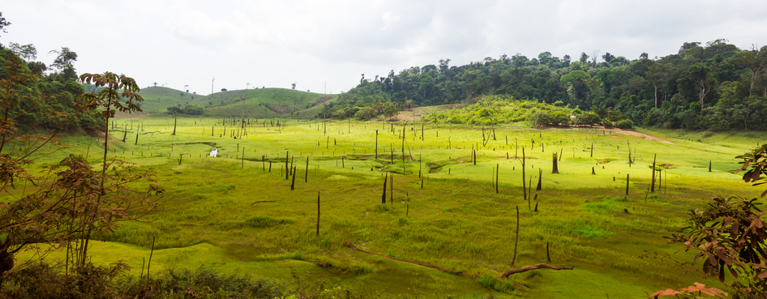
  Ecosystems and material cycles part 3 – Biodiversity
In some wooded areas, the land is more in demand than timber. The forest is cut down and the wood burned to get rid of it. No new trees are planted. The removal of the forest habitat is called deforestation.
Deforestation reduces biodiversity in the area and it can impact on a species directly if the species is unable to move to a new area.
Large scale deforestation has happened in tropical areas to :
Provide land for farming cattle which can provide food
Provide land for rice fields to provide food
Provide land to grow crops for producing biofuel (fuel produced
by living organisms) such as bioethanol, wood and biogas.

Slide 48
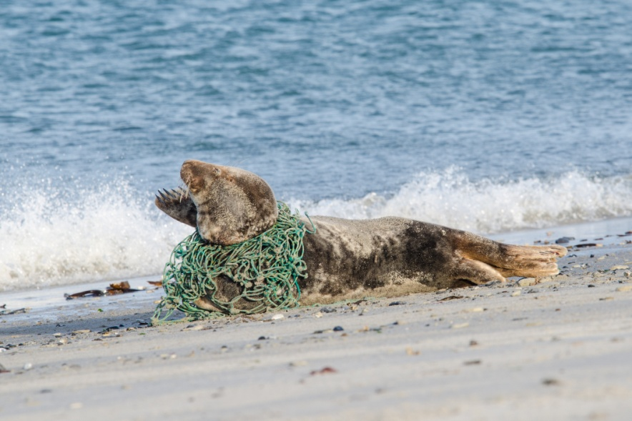
  Ecosystems and material cycles part 3 –biodiversity
The future of the human species rely on us maintaining a good level of diversity. Many human activities have reduced the biodiversity in particular places. It is only very recently that measures have been taken to try and stop this reduction.
The following activities are having a negative effect on biodiversity:
  How we manage waste
  How we use land
  Deforestation
  Global warming
Pollution kills plants and animals which can reduce diversity.
A seal caught in a ghost net.

Slide 49
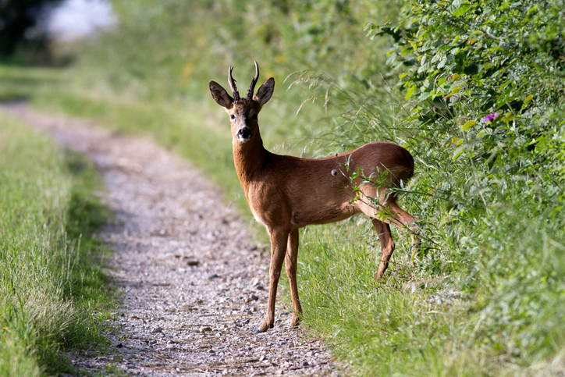
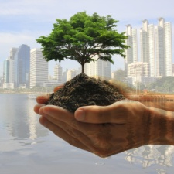

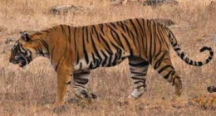
  Ecosystems and material cycles part 3 –Biodiversity
Scientists and concerned citizens have put in place programmes to reduce the negative effects of humans on biodiversity and ecosystems. These include:
Reintroduction of field margins (the land between the crop and the field boundary) and hedgerows in agricultural areas where farmers grow one type of crop. This encourages diversity of wildlife as there is a variety of food.
Protection and regeneration of rare habitats. These are often designated as SSSI and managed by conservation organisations.
SSSI = site of special
scientific interest.
Breeding programmes for endangered species to guard against extinction and be able to increase numbers in the wild.
endangered list
Recycling resources instead of dumping waste in landfill.
Reduction of deforestation and carbon dioxide emissions by some governments across the world. Almost 200 governments have signed the Kyoto protocol.
Notes:
https://www.worldwildlife.org/species/directory

Slide 50
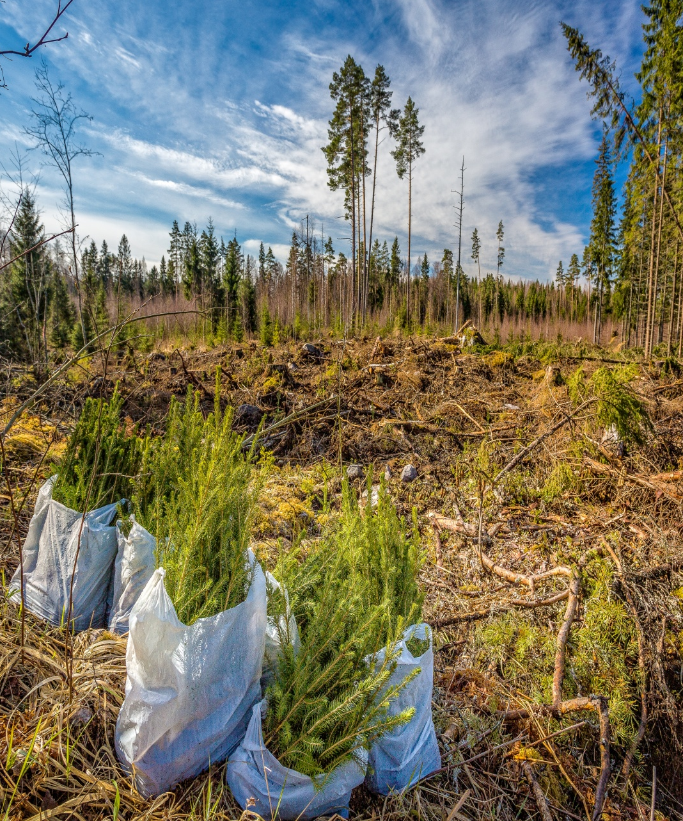
  Ecosystems and material cycles part 3 –Biodiversity
Some countries have developed ways to reduce the impact of deforestation on biodiversity through sustainable forestry.
A limited number of large trees are cut down at once. Young trees are planted to replace those cut down. This is called reforestation.
Trees are not cut down in the area until medium sized trees have become large trees. This can take 25 years.
Using a variety of tree species would further increase the biodiversity of the area.

Slide 51
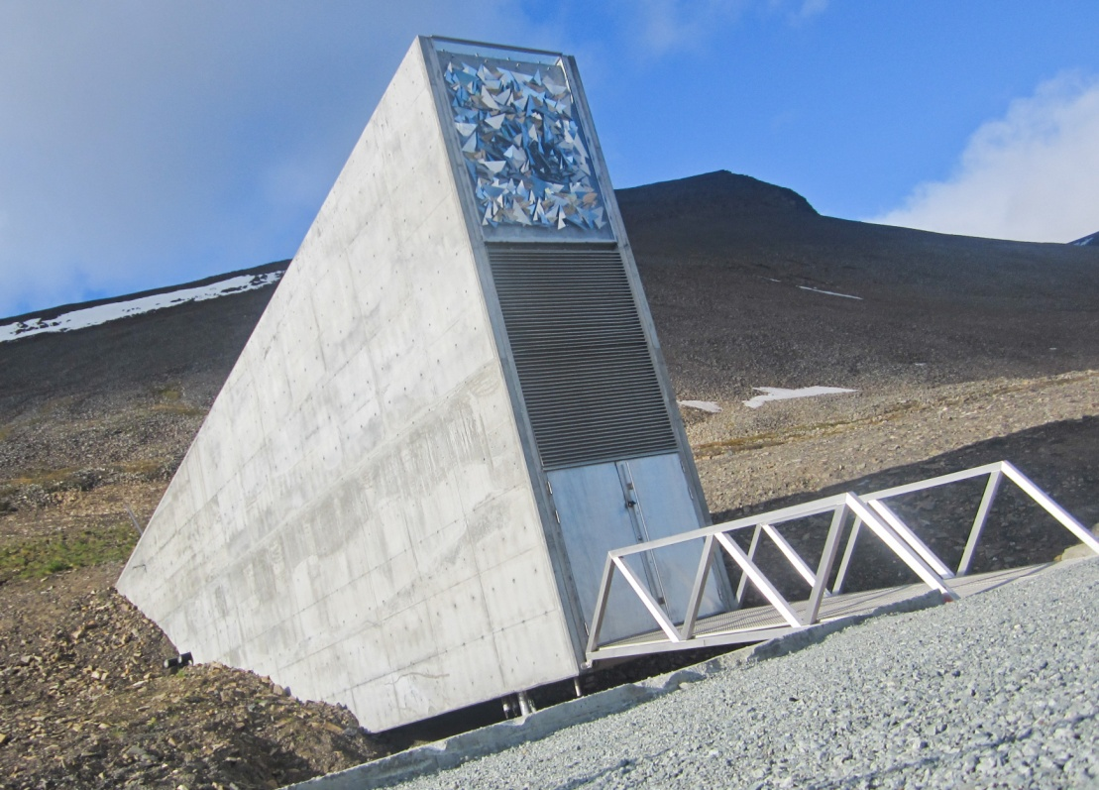
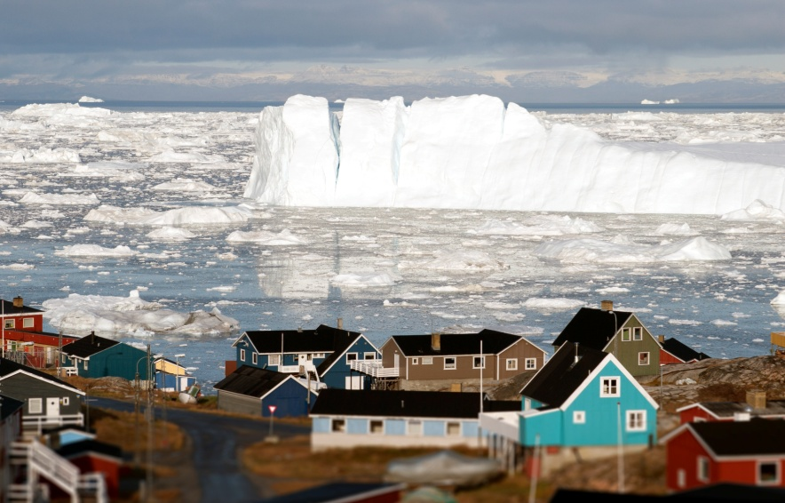
  Ecosystems and material cycles part 3 – Biodiversity
Svalbard is located in the Arctic circle.
It is home to the Global Seed Vault and contains the worlds largest collection of seeds. The seeds are important for food and agriculture and are of importance in genetic research, plant breeding and education. It is important in maintaining biodiversity.
The Global Seed vault is kept at -18°C, low humidity and limited oxygen.
This helps ensure the seeds have a low metabolic activity and slows ageing.
Notes:
https://www.croptrust.org/our-work/svalbard-global-seed-vault/interactive-visit/360-seed-vault-tour/#

Slide 52
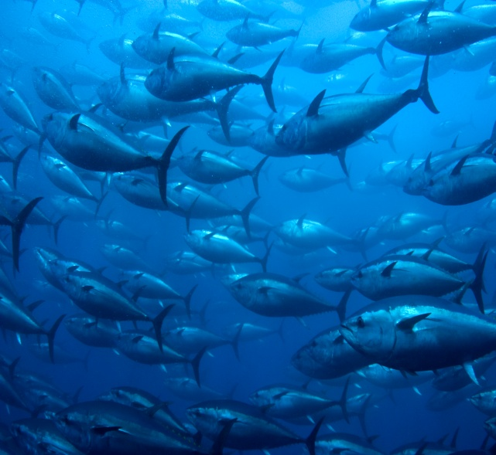


  Ecosystems and material cycles part 3 –Biodiversity
What are the benefits of maintaining local and global biodiversity?
Ecotourism
People often choose to visit unspoilt places with a variety of animals and plants. This boosts the local economy. People are often interested in conservation work and visit or volunteer to work there. It also provides local employment.
New Medicines
The majority of medicines we use today originated from plants. Undiscovered plants may contain new chemicals which can be beneficial. If rainforests continue to be destroyed then potentially new plants and chemicals may become extinct.
Protection of the food supply for humans.
Fish stocks declined but conservation measures may mean that there are still fish in the sea for future generations to eat.
Notes:
https://www.croptrust.org/our-work/svalbard-global-seed-vault/interactive-visit/360-seed-vault-tour/#

Slide 53
QuestionIT!
Biodiversity and the
effects of human
interaction
within ecosystems.
Part 3 (9.9-9.10)
Positive and negative human interactions within ecosystems.
Benefits of global and local biodiversity

Slide 54
  Ecosystems and material cycles part 3 – QuestionIT
Define the term biodiversity.
List one positive impact that humans can have on biodiversity within an ecosystem.
What causes eutrophication?
List three ways that fish farming can reduce biodiversity.
What is a non-indigenous species?
List 3 benefits to humans of maintaining local biodiversity.
List 1 benefit to the wildlife of maintaining local biodiversity.
What is a biofuel?
Why do humans undertake large scale deforestation in tropical areas?

Slide 55
  Ecosystems and material cycles part 3 – QuestionIT
10. Consider the negative aspects of how humans interact with
ecosystems. What could be done positively to counteract this
effect?
Negative effects of human interaction on an ecosystem | Positive effects of human interaction on an ecosystem
Global warming and deforestation
Animals and plants becoming in danger of extinction due to reduction in habitat
Large 40 acre fields growing one crop
Dumping waste in landfill sites

Slide 56
AnswerIT!
Biodiversity and the
effects of human
interaction
within ecosystems.
Part 3
Positive and negative human interactions within ecosystems.
Benefits of global and local biodiversity

Slide 57
  Biodiversity and the effect of human interaction on ecosystems part 3 – AnswerIT
Define the term biodiversity. The variety of all the different species or organisms on Earth or within an ecosystem.
List one positive impact that humans can have on biodiversity within an ecosystem. Conservation/breeding programmes or Reforestation
What causes eutrophication? Increase of nitrate or phosphate in water caused by the use of excess fertilisers.
List three ways that fish farming can reduce biodiversity.
Only one type of fish grown in an area
Food waste causes eutrophication in open water killing indigenous species
Encourages growth of parasites which can affect indigenous species
Attracts predators to the area and then they get trapped in nets and die
If non-indigenous species escape they may out compete the indigenous species.

Slide 58
  Biodiversity and the effect of human interaction on ecosystems part 3 – AnswerIT
5. What is a non-indigenous species? A species which is not native to the area
List 3 benefits to humans of maintaining local biodiversity. Ecotourism
Employment opportunities
Protecting the food supply
Sourcing of new medicines
List 1 benefit to the wildlife of maintaining local biodiversity.
Not disrupting food chains

Slide 59
  Biodiversity and the effect of human interaction on ecosystems part 3 – AnswerIT
8. What is a biofuel? A fuel made by living organisms.
9. Why do humans undertake large scale deforestation in tropical areas?
To provide land for cattle farming
To provide land for rice fields
To grow crops for biofuels

Slide 60
  Biodiversity and the effect of human interaction on ecosystems part 3 – AnswerIT
10. Consider the negative aspects of how humans interact with
ecosystems. What could be done positively to counteract this effect?
Negative effects of human interaction on an ecosystem | Positive effects of human interaction on an ecosystem
Global warming and deforestation | Agreement by governments to reduce carbon dioxide emissions and deforestation
Animals and plants becoming in danger of extinction due to reduction in habitat | Introducing breeding programmes/ seed vault and protection of habitats by conservation trusts
Large 40 acre fields growing one crop | Reintroduce smaller fields and replant hedgerows and leave edges of field to grow wild.
Dumping waste in landfill sites | Recycle resources more effectively

Slide 61
LearnIT!
KnowIT!
Food Security
(biology only)
Part 4 (9.11B)
Biological factors affecting
food security.

Slide 62
  Ecosystems and material cycles part 4 –
  Factors affecting food security (biology only)
Food security is defined as having enough food to feed a population.
Biological factors which threaten food security :
Increasing human population mean it is challenging to feed everyone.
Increasing animal farming and meat and fish consumption means more land/water is repurposed for livestock food production. This increases deforestation and overfishing, reduces diversity and the amount of energy available as biomass decreases as the food chain progresses.
New pests and pathogens that affect farming e.g. Bird flu
Environmental changes due to global warming affect food production e.g. famine if rains fail as crops do not grow.
The cost of agricultural inputs such as irrigation systems, fertilisers and quality seed are high and so threaten food security.
Sustainability issues arise as sources of fossil fuel decline. More land is used to grow biofuels which means less land is available for crop growth.

Slide 63
  Ecosystems and material cycles part 4 –
  Factors affecting food security (biology only)
An estimated 868 million people between 2010 and 2012 were classed by the Food and Agricultural Organisation of the United Nations (FAO) as being undernourished. They would be described as being food insecure. This means there was limited or uncertain availability of nutritionally adequate and safe foods OR there was limited or uncertain ability to acquire food in a socially acceptable way.

Slide 64





  Ecosystems and material cycles part 4 –
  Factors affecting food security (biology only)
Humans affect food security by reducing the amount of land available for other animals and plants by actions such as:
Quarrying
Building
Crop growing
Farming
Waste dumping

Slide 65


  Ecosystems and material cycles part 4 –
  Factors affecting food security (biology only)
The levels of carbon dioxide and methane in the atmosphere are increasing. These gases contribute to global warming which is a type of climate change. Other climate changes such as a change in rainfall patterns may affect the rate of crop growth and yield.
Global warming has biological consequences such as:
Changes in weather which include flooding and drought
Melting of ice caps and increase in sea levels
Habitat loss which can lead to species becoming extinct or critically
endangered.

Slide 66

  Ecosystems and material cycles part 4 –
  Factors affecting food security (biology only)
The jackfruit is native to Southern India. It is said to taste a bit like pulled pork and smells like fruit gums.
The jackfruit is being suggested as a possible solution to food insecurity.
A jackfruit can grow up to 35kg.
Why is the jackfruit a potential solution?
The tree requires relatively little care once it is established.
It is a perennial so does not require regular replanting.
It requires very little irrigation or use of pesticide unlike rice.
The fruit is high in protein, potassium and vitamin B.
It is versatile and can be dried, boiled, roasted or ground to make flour.

Slide 67

  Ecosystems and material cycles part 4 –
  Factors affecting food security (biology only)
Sustainable methods must be found to feed all the people on Earth.
The efficiency of food production can be improved by restricting wasted energy transfer from food animals to the environment. This means more energy will be available to humans from their food.
These pigs are kept in a temperature controlled building. This means that less heat will be transferred to the environment from the pigs. The pigs will expend less energy in maintaining a constant body temperature and so more energy will be available to the humans in their food.
These pigs cannot move much and so less energy is transferred to the muscles for movement. They are fed high protein food to increase growth.

Slide 68
QuestionIT!
Food Security
(biology only)
Part 4
Biological factors affecting
food security.

Slide 69
  Ecosystems and material cycles part 4– QuestionIT
What is meant by the term food security?
What does sustainability mean in relation to food security.
List four biological factors which threaten food security.
Give two ways in which energy transfer to the environment can be restricted in food animals.
Some farmers feed their animals high protein food. Why?
List two things which can be done to conserve fish stocks in the ocean at a sustainable level.
What are agricultural inputs and how can these affect sustainability of food production?

Slide 70
  Ecosystems and material cycles part 4 – QuestionIT
7. Name two gases which are increasing in the atmosphere and
contribute to global warming.
List two biological consequences of global warming.
9. Name four processes which humans carry out that reduces the land available to other animals , plants and microorganisms.

Slide 71
AnswerIT!
Food Security
(biology only)
Part 4
Biological factors affecting
food security.

Slide 72
  Ecosystems and material cycles part 4 – AnswerIT
What is meant by the term food security?
Having enough food to feed a population.
2. What does sustainability mean in relation to food security? Meeting the needs of the current population without affecting the needs of future generations.
3. List four biological factors which threaten food security.
Increasing birth rate
Changing diets in developed countries leading to food being shipped around the world
New pests and pathogens affecting farming
Environmental changes
Costs of agricultural inputs
Conflicts which have reduced access to food and water

Slide 73
  Ecosystems and material cycles part 4 – AnswerIT
4. Give two ways in which energy transfer to the environment can be restricted in food animals. Restrict movement
Control the temperature of the surroundings
5. Some farmers feed their animals high protein food. Why?
Increase growth
6. List two things which can be done to conserve fish stocks in the ocean at a sustainable level. Control size of holes in net
Introduce fishing quotas

Slide 74
  Ecosystems and material cycles part 4 – AnswerIT
7. Name two gases which are increasing in the atmosphere and
contribute to global warming. Methane and Carbon dioxide
List two biological consequences of global warming.
Changes in weather which include flooding and drought so affecting animal and plant life.
Melting of ice caps and increase in sea levels
Habitat loss which can lead to species becoming extinct or critically endangered.
9. Name four processes which humans carry out that reduces the land available to other animals, plants and microorganisms.
Quarrying
Waste dumping/landfill
Building
Crop growing

Slide 75
LearnIT!
KnowIT!
Material Cycles,
pollution and
decomposition.
Part 5 (9.12- 9.19B)
Carbon, water and nitrogen cycles
Indicator species (biology only)
Factors affecting rate of decomposition in food preservation
and composting. (biology only)
Calculate rate changes in decay (biology only)

Slide 76

Ecosystems and material cycles Part 5 – Carbon Cycle
All materials in the living world are recycled through the abiotic and biotic parts of an ecosystem to provide the building blocks for future organisms.
The carbon cycle returns carbon from organisms to the atmosphere as carbon dioxide.
Plants use carbon dioxide
in photosynthesis.
Microorganisms return carbon to the atmosphere as carbon dioxide and mineral ions to the soil by decomposition.
Decomposers

Slide 77

Ecosystems and material cycles Part 5 – Water Cycle
The water cycle provides fresh water for plants and animals on land before draining into the seas.
Water is continuously evaporated and precipitated.

Slide 78
Ecosystems and material cycles Part 5 – Water Cycle
Potable water is water that is suitable for drinking.
In times of drought getting sufficient fresh water can be problematic.
Desalination is a technique where potable water is produced from sea water. In order to be drinkable mineral ions (salts) must be removed from the sea water.
One simple method to remove mineral ions is to use distillation.
Sea water is boiled in a large vessel. Water evaporates and steam rises to the top of the vessel and travels down a pipe and condenses to form pure water.

Slide 79

Ecosystems and material cycles Part 5 – Water Cycle
A commonly used and more efficient method of desalination is reverse osmosis.
Osmosis is the movement of water from an area of high water concentration to one of lower water concentration over a partially permeable membrane.
In high concentrations of water, the salt concentration will be lower. Water will move from an area of low salt to one of higher salt concentration during osmosis.
In reverse osmosis the opposite occurs:
Salt water is filtered to remove solids and forced under high pressure into a container divided by a partially permeable membrane.
2. The pressure causes water molecules to pass through the partially permeable membrane. The salts are too large to pass through the partially permeable membrane. The pure water is collected.

Slide 80

Ecosystems and material cycles Part 5 – Water Cycle

Slide 81

Ecosystems and material cycles Part 5 – Nitrogen Cycle
Very un-reactive gas
Makes up 78% of the atmosphere
Cannot be used by animals and plants in this form.
Must be converted into mineral ions such as nitrate before animals and plants can use it.
Needed by all animals and plants to make protein
Converted into mineral ions by lightning or the actions of bacteria living in the soil or inside particular plant roots.
Artificial fertilisers usually contain nitrate ions.
Finite amounts available so must be recycled.

Slide 82

Ecosystems and material cycles Part 5 – Nitrogen Cycle
The energy in lightning brings about a reaction between nitrogen and oxygen to form nitrates.
Denitrifying bacteria convert nitrates back into nitrogen gas. They are the unhelpful bacteria as this process does not benefit plants or animals.
Decomposers break down animal waste and dead plants and animals to release ammonium ions which plants can use to make protein.
Nitrogen fixing bacteria convert or ‘fix’ nitrogen into ammonia which forms ammonium ions.
Nitrifying bacteria convert ammonia into nitrites and then into nitrates which can be used by plants to make protein

Slide 83




Ecosystems and material cycles Part 5 – Nitrogen Cycle
Legume plants have a mutualistic relationship with nitrogen-fixing bacteria. The bacteria live in nodules (swellings) in the roots and the plant benefits by receiving nitrates which it can convert into plant protein.
Plants in the legume group include peas, beans and clover.

Slide 84

Ecosystems and material cycles Part 5 – Nitrogen Cycle
When a crop is grown on a field the plants will take in nitrate from the soil and convert it to protein. This depletes the soil over time.
Farmers often spread artificial fertiliser or
animal waste onto their fields to help crop
growth because it contains nitrate and
other important mineral ions. Decomposers
living in the soil or in plant roots break
down the waste material and release
ammonia.
Artificial fertiliser is expensive and can cause eutrophication. Animal waste is not as easy to spread or to calculate how much is required.
Farmers use crop rotation to ensure the soil maintains a good level of nitrate and other mineral ions. A nitrogen-fixing legume crop is often grown every few years to help boost the level of nitrate ions.

Slide 85

Ecosystems and material cycles Part 5 – Pollution (HT Biology)
Air pollution can occur as a result of human activities. Without careful management, air pollution can cause serious harm to humans and other living organisms.
Burning fossil fuel produces smoke and acidic gases. As the population has grown and standards of living increased more fossil fuels are being used in industry, transport and in homes. Fossil fuels contain impurities such as sulfur, which reacts with oxygen to form sulfur dioxide. High concentrations can cause breathing difficulties.

Slide 86

Ecosystems and material cycles Part 5 – Pollution (HT Biology)
The human population has been growing rapidly along with the standards of living.
More resources are used to produce materials for humans and so more waste is also produced.
The amount of pollution caused also increases unless the waste and chemical materials are properly handled.
Land pollution from human waste and toxic chemicals is a concern.
Notes:
Population Graph- created by User:Clevercapybara, CC BY 3.0, https://en.wikipedia.org/w/index.php?curid=47597905

Slide 87


Ecosystems and material cycles Part 5 – Pollution (HT Biology)
Pollution levels can be assessed by the presence or absence of certain species called indicator species.
The following organisms are only found in clean water.
They are very sensitive to the levels of dissolved oxygen present:
Stonefly larvae
Freshwater shrimp

Slide 88


Ecosystems and material cycles Part 5 – Pollution (HT Biology)
The following organisms are found in polluted water.
The sludgeworm is commonly called the sewage worm. These species can survive in sediment with very little oxygen.
The bloodworm is often used as fishing bait. It gets its name from its red colour.
Blood worm
Bloodworm
Sludgeworm

Slide 89



Ecosystems and material cycles Part 5 – Pollution (HT Biology)
Certain species of lichens are used as an indicator of levels of sulfur dioxide in the air. High levels of sulfur dioxide are usually found in areas where there are lots of cars and industry.
Lichen type | Air quality | Photograph
Bushy lichen | Very clean
Leafy lichen | Can survive a small amount of pollution
Crusty lichen | Can survive in more polluted air

Slide 90

Ecosystems and material cycles Part 5 – Pollution (HT biology)
Evaluate the use of indicator species to assess the levels of pollution.
Investigations in an area will show if an indicator species is found or not.
This gives a quick inexpensive idea of whether sulfur dioxide is present or not.
Samples can be taken to count how many of a species is present so a numerical value can be gained. This means two or more locations can be compared.
Neither of these methods give an accurate measurement of how polluted an area is.
Digital meters and chemical tests are required to measure the levels of pollution with any accuracy.
Blackspot fungus is found on roses.
It is sensitive to air pollution and is killed by sulfur dioxide.
The presence of blackspot fungus indicates that the air is unpolluted.

Slide 91

Ecosystems and material cycles Part 5 – Decomposition (biology)
Decomposers play an important part in the carbon and nitrogen cycles. They break down dead plant and animal matter by secreting enzymes into the environment.
Small soluble food molecules then diffuse into the microorganism.
A variety of nutrients will also be released into the soil and these can be absorbed by plants.
Decomposers are usually bacteria or fungi.
The rate of decomposition depends upon three factors:
Temperature
Oxygen
Water
3

Slide 92
Ecosystems and material cycles Part 5 – Decomposition(biology)
In order to preserve food for longer the rate of decomposition must be reduced. This can be done using the following methods:
Method of food preservation | Explanation
Chilling or freezing food | Reduction in temperature slows enzyme controlled reactions including reproduction of bacteria and fungi. Freezing stops reproduction because water is solid.
Drying (desiccation) | Removing water prevents the bacteria and fungi from digesting food, carrying out reactions and reproducing.
Canning | Food is heated to a high temperature which denatures enzymes and proteins killing the microorganisms. The can is sealed so no more microorganisms can enter. A lack of oxygen prevents aerobic respiration occurring.
Adding sugar or salt | Water is lost from the microorganisms by osmosis which kills them.

Slide 93

Ecosystems and material cycles Part 5 – Decomposition (biology)
Gardeners and farmers try to provide optimum (the best) conditions for rapid decay of waste biological material. Biological materials have once been living or part of a living organism.
Compost is produced and this is used as
a natural fertiliser for growing garden
plants or crops.
The key factors required for optimising
decay are the presence of:
Water (needed to transport enzymes and products of digestion)
Oxygen (needed for aerobic respiration to transfer energy)
Warmth (needed to increase the rate of reaction of enzymes)
Microorganisms called decomposers. These are bacteria or fungi.

Slide 94


Ecosystems and material cycles Part 5 – Decomposition (biology)
A punnet of strawberries was left on a sunny window sill. The amount of fungus which grew on the strawberries was measured each day and this is equivalent to the amount of decomposition occurring.
A graph was drawn of the results.
Calculate the change in rate of decomposition between
days 3 and 7 in units per day.
Draw a line on the graph at 3 days and 7 days and read off the corresponding amount of fungus.
3 days = 25 units of fungus
7 days = 89 units of fungus
Calculate the rate of fungal growth between
day 3 and day 7
89 – 25 = 64
64 ÷ 4 days = 16
Rate of fungal growth = 16 units per day.

Slide 95
QuestionIT!
Material Cycles,
pollution and
decomposition.
Part 5 (9.12- 9.19B)
Carbon, water and nitrogen cycles
Indicator species (HT biology only)
Factors affecting rate of decomposition in food preservation and composting. (biology only)
Calculate rate changes in decay (biology only)

Slide 96
Ecosystems and material cycles Part 5 – QuestionIT
1. Why is it essential that materials are recycled in the living world?
2. What is precipitation in the water cycle?
3. List three main processes in the carbon cycle.
4. Name the four types of bacteria involved in the recycling of nitrogen.
5. What do plants use the nitrates they take in from the soil for?
6. Name three methods a farmer may use to increase the amount of nitrate ions in the soil.
7. Give an advantage and a disadvantage to a farmer of using animal waste as a fertiliser.

Slide 97
  Organisation of an ecosystem part 2 – QuestionIT
8. Match the correct bacteria to their function in the Nitrogen cycle.
Bacteria | Function in the Nitrogen cycle
Decomposer | Turn atmospheric nitrogen into ammonia
Nitrogen fixing | Turn nitrates into nitrogen gas
Nitrifying | Turn ammonia into nitrites and nitrates
Denitrifying
Turn protein and urea into ammonia
9. What is potable water?
10. What needs to occur to enable seawater to be potable?
11. Name two methods of removing the excess mineral ions from seawater.

Slide 98
Ecosystems and material cycles Part 5 – QuestionIT
Biology only
12. Name three factors which must be present for the rapid decay of waste biological material to occur.
13. What do gardeners call the end product after waste biological material has decayed?
14. What is this end product then used for?
15. What might cause anaerobic decay to occur?

Slide 99
Ecosystems and material cycles Part 5 – QuestionIT
Higher tier Biology only
16. What is an indicator species
17. Name an indicator species which is only found in clean water.
18. Name an indicator species which may be found in polluted water.
19. Name two indicator species which can be used to assess the level of pollution in air.
20. Give an advantage of using dissolved oxygen meters to measure water pollution instead of an indicator species.
21. Give a disadvantage of using dissolved oxygen meters to measure water pollution instead of an indicator species.

Slide 100
AnswerIT!
Material Cycles, pollution and decomposition.
Part 5
Carbon, water and nitrogen cycles
Indicator species (biology only)
Factors affecting rate of decomposition in food preservation
and composting. (biology only)
Calculate rate changes in decay (biology only)

Slide 101
Ecosystems and material cycles Part 5 – AnswerIT
1. Why is it essential that materials are recycled in the living world?
There is a finite amount of carbon and nitrogen so these elements must be returned to the environment once an organism dies to enable new organisms to be produced.
2. What is precipitation in the water cycle? Rain
3. List three main processes in the carbon cycle.
Photosynthesis
Respiration
Combustion
Decay
4. Name the four types of bacteria involved in the recycling of nitrogen.
1. Nitrogen fixing 2.Denitrifying 3.Nitrifying 4. Decomposers
5. What do plants use the nitrates they take in from the soil for? Making protein

Slide 102
Ecosystems and material cycles Part 5 – AnswerIT
6. Name three methods a farmer may use to increase the amount of nitrate ions in the soil.
Add artificial or natural fertiliser
Crop rotation
Plant a legume crop
7. Give an advantage and a disadvantage to a farmer of using animal waste as a fertiliser.
Advantage: Cheap, readily available and natural
Disadvantage: Difficult to transport, hard to know how much is required, must decompose first of all and so takes longer to have an effect.

Slide 103
  Organisation of an ecosystem part 2 – AnswerIT
8. Match the correct bacteria to their function in the Nitrogen cycle.
Bacteria | Function in the Nitrogen cycle
Decomposer | Turn protein and urea into ammonia
Nitrogen fixing | Turn atmospheric nitrogen into ammonia
Nitrifying | Turn ammonia into nitrites and nitrates
Denitrifying | Turn nitrates into nitrogen gas
9. What is potable water? Drinkable water
10. What needs to occur to enable seawater to be potable? Remove mineral ions /salts
11. Name two methods of removing the excess mineral ions from seawater.
Distillation or thermal desalination
Reverse osmosis

Slide 104
Ecosystems and material cycles Part 5 – AnswerIT
Biology only
12. Name three factors which must be present for the rapid decay of waste biological material to occur.
Warmth
Oxygen
Water/Moisture
Microorganisms (decomposers)
13. What do gardeners call the end product after waste biological material has decayed? Compost
14. What is this end product then used for? As a natural fertiliser for garden plants or crops.
15. What might cause anaerobic decay to occur? A lack of oxygen

Slide 105
Ecosystems and material cycles Part 5 – AnswerIT
Higher tier Biology only
16. What is an indicator species? An organism which is sensitive to changes in the environment which can be used to assess levels of pollution.
17. Name an indicator species which is only found in clean water.
Stonefly larvae
Freshwater shrimp
18. Name an indicator species which is found in polluted water.
Sludgeworm
Bloodworm
19. Name two indicator species which can be used to assess the level of pollution in air.
Lichen
Blackspot fungus on roses

Slide 106
Ecosystems and material cycles Part 5 – AnswerIT
20. Give an advantage of using dissolved oxygen meters to measure water pollution instead of an indicator species. Can accurately measure the concentration of dissolved oxygen in the water and repeat over time.
21. Give a disadvantage of using dissolved oxygen meters to measure water pollution instead of an indicator species.
Cheaper and simpler to carry out.

