Slide 1


The PiXL Club The PiXL Club The PiXL Club The PiXL Club The PiXL Club The PiXL Club The PiXL Club The PiXL Club The PiXL Club The PiXL Club The PiXL Club The PiXL Club The PiXL Club The PiXL Club The PiXL Club The PiXL Club The PiXL Club The PiXL Club The PiXL Club The PiXL Club The PiXL Club The PiXL Club The PiXL Club The PiXL Club The PiXL Club The PiXL Club The PiXL Club The PiXL Club The PiXL Club The PiXL Club The PiXL Club The PiXL Club The PiXL Club The PiXL Club The PiXL Club The PiXL Club The PiXL Club The PiXL Club The PiXL Club The PiXL Club The PiXL Club The PiXL Club The PiXL Club The PiXL Club The PiXL Club XL Club The PiXL Club The PiXL Club The PiXL Club The PiXL Club The PiXL Club The PiXL Club The PiXL Club The PiXL Club The PiXL Club The PiXL Club The PiXL Club The PiXL Club The PiXL Club The PiXL Club The PiXL Club The PiXL Club The PiXL Club The PiXL Club The PiXL Club The PiXL Club The PiXL Club The PiXL Club The PiXL Club The PiXL Club The PiXL Club The PiXL Club The PiXL Club The PiXL Club The PiXL Club The PiXL Club The PiXL Club The PiXL Club The PiXL Club The PiXL Club The PiXL Club The PiXL Club The PiXL Club The PiXL Club The PiXL Club The PiXL Club The PiXL Club The PiXL Club The PiXL Club The PiXL Club The PiXL Club The PiXL Club The PiXL Club The PiXL Club The PiXL Club The PiXL Club The PiXL Club The PiXL Club The PiXL Club The PiXL Club The PiXL Club The PiXL Club The PiXL Club The PiXL Club The PiXL Club The PiXL Club The PiXL Club The PiXL Club The PiXL Club The PiXL Club The PiXL Club The PiXL Club The PiXL Club The PiXL Club The PiXL Club The PiXL Club The PiXL Club The PiXL Club The PiXL Club The PiXL Club The PiXL Club The PiXL Club The PiXL Club The PiXL Club The PiXL Club The PiXL Club The PiXL Club The PiXL Club The PiXL Club The PiXL Club The PiXL Club The PiXL Club The PiXL Club The PiXL Club The PiXL Club The PiXL Club The PiXL Club The PiXL Club The PiXL Club The PiXL Club The PiXL Club The PiXL Club The PiXL Club The PiXL Club The PiXL Club The PiXL Club The PiXL Club The PiXL Club The PiXL Club The PiXL Club The PiXL Club The PiXL Club The PiXL Club The PiXL Club The PiXL Club The PiXL Club The PiXL Club The PiXL Club The PiXL Club The PiXL Club The PiXL Club The PiXL Club The PiXL Club The PiXL Club The PiXL Club The PiXL Club The PiXL Club The PiXL Club The PiXL Club The PiXL Club The PiXL Club The PiXL Club The PiXL Club The PiXL Club The PiXL Club The PiXL Club The PiXL Club The PiXL Club The PiXL Club The PiXL Club The PiXL Club The PiXL Club The PiXL Club The PiXL Club The PiXL Club The PiXL Club The PiXL Club The PiXL Club The PiXL Club The PiXL Club The PiXL Club The PiXL Club The PiXL Club The PiXL Club The PiXL Club The PiXL Club The PiXL Club The PiXL Club The PiXL Club The PiXL Club The PiXL Club The PiXL Club The PiXL Club The PiXL Club The PiXL Club The PiXL Club The PiXL Club The PiXL Club The PiXL Club The PiXL Club The PiXL Club The PiXL Club The PiXL Club The PiXL Club The PiXL Club The PiXL Club The PiXL Club The PiXL Club The PiXL Club The PiXL Club The PiXL Club The PiXL Club The PiXL Club The PiXL Club The PiXL Club The PiXL Club The PiXL Club The PiXL Club The PiXL Club The PiXL Club The PiXL Club The PiXL Club The PiXL Club The PiXL Club The PiXL Club The PiXL Club The PiXL Club The PiXL Club The PiXL Club The PiXL Club The PiXL Club The PiXL Club The PiXL Club The PiXL Club The PiXL Club The PiXL Club The PiXL Club The PiXL Club The PiXL Club The PiXL Club The PiXL Club The PiXL Club The PiXL Club The PiXL Club The PiXL Club The PiXL Club The PiXL Club The PiXL Club The PiXL Club The PiXL Club The PiXL Club The PiXL Club The PiXL Club The PiXL Club The PiXL Club The PiXL Club The PiXL Club The PiXL Club The PiXL Club The PiXL Club The PiXL Club The PiXL Club The PiXL Club The PiXL Club The PiXL Club The PiXL Club The PiXL Club The PiXL Club The PiXL Club The PiXL Club The PiXL Club The PiXL Club The PiXL Club The PiXL Club The PiXL Club The PiXL Club The PiXL Club The PiXL Club The PiXL Club The PiXL Club The PiXL Club The PiXL Club The PiXL Club The PiXL Club The PiXL Club The PiXL Club The PiXL Club The PiXL Club The PiXL Club The PiXL Club The PiXL Club The PiXL Club The PiXL Club The PiXL Club The PiXL Club The PiXL Club The PiXL Club The PiXL Club The PiXL Club The PiXL Club The PiXL Club The PiXL Club The PiXL Club The PiXL Club The PiXL Club The PiXL Club The PiXL Club The PiXL Club The PiXL Club The PiXL Club The PiXL Club The PiXL Club The PiXL Club The PiXL Club The PiXL Club The PiXL Club The PiXL Club The PiXL Club The PiXL Club The PiXL Club The PiXL Club The PiXL Club The PiXL Club The PiXL Club The PiXL Club The PiXL Club The PiXL Club The PiXL Club The PiXL Club The PiXL Club The PiXL Club The PiXL Club The PiXL Club The PiXL Club The PiXL Club The PiXL Club The PiXL Club The PiXL Club The PiXL Club The PiXL Club The PiXL Club The PiXL Club The PiXL Club The PiXL Club The PiXL Club The PiXL Club The PiXL Club The PiXL Club The PiXL Club The PiXL Club The PiXL Club The PiXL Club The PiXL Club The PiXL Club The PiXL Club The PiXL Club The PiXL Club The PiXL Club The PiXL Club The PiXL Club The PiXL Club The PiXL Club The PiXL Club The PiXL Club The PiXL Club The PiXL Club The PiXL Club The PiXL Club The PiXL Club The PiXL Club The PiXL Club The PiXL Club The PiXL Club The PiXL Club The PiXL Club The PiXL Club The PiXL Club The PiXL Club The PiXL Club The PiXL Club The PiXL Club The PiXL Club The PiXL Club The PiXL Club The PiXL Club The PiXL Club The PiXL Club The PiXL Club The PiXL Club The PiXL Club The PiXL Club The PiXL Club The PiXL Club The PiXL Club The PiXL Club The PiXL Club The PiXL Club The PiXL Club The PiXL Club The PiXL Club The PiXL Club The PiXL Club The PiXL Club The PiXL Club The PiXL Club The PiXL Club The PiXL Club The PiXL Club The PiXL Club The PiXL Club The PiXL Club The PiXL Club The PiXL Club The PiXL Club The PiXL Club The PiXL Club The PiXL Club The PiXL Club The PiXL Club The PiXL Club The PiXL Club The PiXL Club The PiXL Club The PiXL Club The PiXL Club The PiXL Club The PiXL Club The PiXL Club The PiXL Club The PiXL Club The PiXL Club The PiXL Club The PiXL Club The PiXL Club The PiXL Club The PiXL Club The PiXL Club The PiXL Club The PiXL Club The PiXL Club The PiXL Club The PiXL Club The PiXL Club The PiXL Club The PiXL Club The PiXL Club The PiXL Club The PiXL Club The PiXL Club The PiXL Club The PiXL Club The PiXL Club The PiXL Club The PiXL Club The PiXL Club The PiXL Club The PiXL Club The PiXL Club The PiXL Club The PiXL Club The PiXL Club The PiXL Club The PiXL Club The PiXL Club The PiXL Club The PiXL Club The PiXL Club The PiXL Club The PiXL Club The PiXL Club The PiXL Club The PiXL Club The PiXL Club The PiXL Club The PiXL Club The PiXL Club The PiXL Club The PiXL Club The PiXL Club The PiXL Club The PiXL Club The PiXL Club The PiXL Club The PiXL Club The PiXL Club The PiXL Club The PiXL Club The PiXL Club The PiXL Club The PiXL Club The PiXL Club The PiXL Club The PiXL Club The PiXL Club The PiXL Club The PiXL Club The PiXL Club The PiXL Club The PiXL Club The PiXL Club The PiXL Club The PiXL Club The PiXL Club The PiXL Club The PiXL Club The PiXL Club The PiXL Club The PiXL Club The PiXL Club The PiXL Club The PiXL Club The PiXL Club The PiXL Club The PiXL Club The PiXL Club The PiXL Club The PiXL Club The PiXL Club The PiXL Club The PiXL Club The PiXL Club The PiXL Club The PiXL Club The PiXL Club The PiXL Club The PiXL Club The PiXL Club The PiXL Club The PiXL Club The PiXL Club The PiXL Club The PiXL Club The PiXL Club The PiXL Club The PiXL Club The PiXL Club The PiXL Club The PiXL Club The PiXL Club The PiXL Club The PiXL Club The PiXL Club The PiXL Club The PiXL Club The PiXL Club The PiXL Club The PiXL Club The PiXL Club The PiXL Club The PiXL Club The PiXL Club The PiXL Club The PiXL Club The PiXL Club The PiXL Club The PiXL Club The PiXL Club The PiXL Club The PiXL Club The PiXL Club The PiXL Club The PiXL Club The PiXL Club The PiXL Club The PiXL Club The PiXL Club The PiXL Club The PiXL Club The PiXL Club The PiXL Club The PiXL Club The PiXL Club The PiXL Club The PiXL Club The PiXL Club The PiXL Club The PiXL Club The PiXL Club The PiXL Club The PiXL Club The PiXL Club The PiXL Club The PiXL Club The PiXL Club The PiXL Club The PiXL Club The PiXL Club The PiXL Club The PiXL Club The PiXL Club The PiXL Club The PiXL Club The PiXL Club The PiXL Club The PiXL Club The PiXL Club The PiXL Club The PiXL Club The PiXL Club The PiXL Club The PiXL Club The PiXL Club The PiXL Club The PiXL Club The PiXL Club The PiXL Club The PiXL Club The PiXL Club The PiXL Club The PiXL Club The PiXL Club The PiXL Club The PiXL Club The PiXL Club The PiXL Club The PiXL Club The PiXL Club The PiXL Club The PiXL Club The PiXL Club The PiXL Club The PiXL Club The PiXL Club The PiXL Club The PiXL Club The PiXL Club The PiXL Club The PiXL Club The PiXL Club The PiXL Club The PiXL Club The PiXL Club The PiXL Club The PiXL Club The PiXL Club The PiXL Club The PiXL Club The PiXL Club The PiXL Club The PiXL Club The PiXL Club The PiXL Club The PiXL Club The PiXL Club The PiXL Club The PiXL Club The PiXL Club The PiXL Club The PiXL Club The PiXL Club The PiXL Club The PiXL Club The PiXL Club The PiXL Club The PiXL Club The PiXL Club The PiXL Club The PiXL Club The PiXL Club The PiXL Club The PiXL Club The PiXL Club The PiXL Club The PiXL Club The PiXL Club The PiXL Club The PiXL Club The PiXL Club The PiXL Club The PiXL Club The PiXL Club The PiXL Club The PiXL Club The PiXL Club The PiXL Club The PiXL Club The PiXL Club The PiXL Club The PiXL Club The PiXL Club The PiXL Club The PiXL Club The PiXL Club The PiXL Club The PiXL Club The PiXL Club The PiXL Club The PiXL Club The PiXL Club The PiXL Club The PiXL Club The PiXL Club The PiXL Club The PiXL Club The PiXL Club The PiXL Club The PiXL Club The PiXL Club The PiXL Club The PiXL Club The PiXL Club The PiXL Club The PiXL Club The PiXL Club The PiXL Club The PiXL Club The PiXL Club The PiXL Club The PiXL Club The PiXL Club The PiXL Club The PiXL Club The PiXL Club The PiXL Club The PiXL Club The PiXL Club The PiXL Club The PiXL Club The PiXL Club The PiXL Club The PiXL Club The PiXL Club The PiXL Club The PiXL Club The PiXL Club The PiXL Club The PiXL Club The PiXL Club The PiXL Club The PiXL Club The PiXL Club The PiXL Club The PiXL Club The PiXL Club The PiXL Club The PiXL Club
PiXL KnowIT!
GCSE Physics
Edexcel Key concepts of physics
© Copyright The PiXL Club Ltd, 2017
This resource is strictly for the use of member schools for as long as they remain members of The PiXL Club. It may not be copied, sold nor transferred to a third party or used by the school after membership ceases. Until such time it may be freely used within the member school.
All opinions and contributions are those of the authors. The contents of this resource are not connected with nor endorsed by any other company, organisation or institution.
www.pixl.org.uk The PiXL Club Ltd, Company number 07321607

Slide 2
Overview
Edexcel Key concepts of physics
SI Units
Multiples and submultiples of units
Converting between different units
Significant figures
Standard form

Slide 3
LearnIT!
KnowIT!
SI Units
Multiples and submultiples of units
Converting between different units

Slide 4
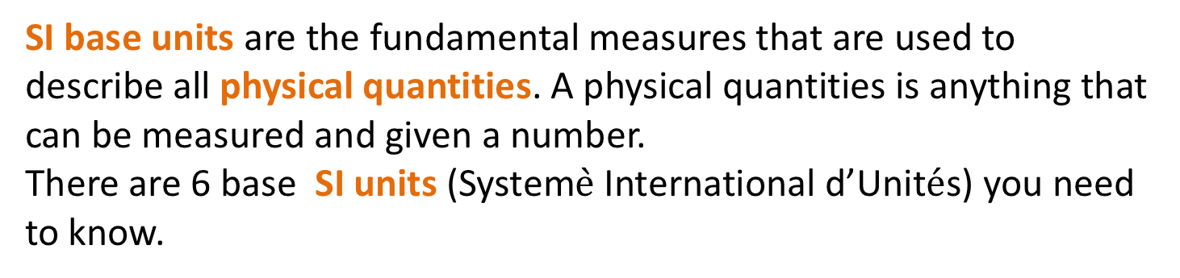
  SI units
SI base units are the fundamental measures that are used to describe all physical quantities. A physical quantities is anything that can be measured and given a number.
There are 6 base SI units (System$\grave{e}$ International d’Unit$\acute{e}$s) you need to know.
physical quantity | unit name | unit symbol
length | metre | m
mass | kilogram | kg
time | second | s
electric current | ampere | A
temperature | kelvin | K
amount of substance | mole | mol

Slide 5
  Derived units
Other physical quantities are represented by combinations of base units. These are called derived units.
physical quantity | derived unit | abbreviation
frequency | hertz | Hz
force | newton | N
energy | joule | J
power | watt | W
pressure | pascal | Pa
Electric charge | coulomb | C
Electric potential difference | volt | V
Electric resisitance | ohm | Ω
Magnetic flux density | tesla | T

Slide 6
  SI prefixes
SI prefixes tell you the order of magnitude of large or small objects. You need to know the ones listed below.
prefix | symbol | multiple
giga | G | x10⁹
mega | M | x10⁶
kilo | k | x10³
centi | c | x10⁻²
milli | m | x10⁻³
micro | μ | x10⁻⁶
nano | n | x10⁻⁹
Note – the SI unit kilogram already has a prefix

Slide 7






  Converting between different units
Length:
10 mm = 1 cm 100 cm = 1 m 1000 m = 1 km
$$× 1000$$
$$× 100$$
$$× 10$$
km
m
cm
mm
$$÷1000$$
$$÷100$$
$$÷10$$
Remember the SI base unit of length is a METRE (m)

Slide 8




  Converting between different units
Mass:
1000 mg = 1 g 1000 g = 1 kg
$$× 1000$$
$$× 1000$$
kg
g
mg
$$÷1000$$
$$÷1000$$
Remember the SI base unit of length is a KILOGRAM (kg)

Slide 9




  Converting between different units
Time:
60 s = 1 min 60 min = 1 hr 24 hrs in 1 day
$$× 60$$
$$× 60$$
hr
min
s
$$÷60$$
$$÷60$$
Remember the SI base unit of length is a second (s)

Slide 10

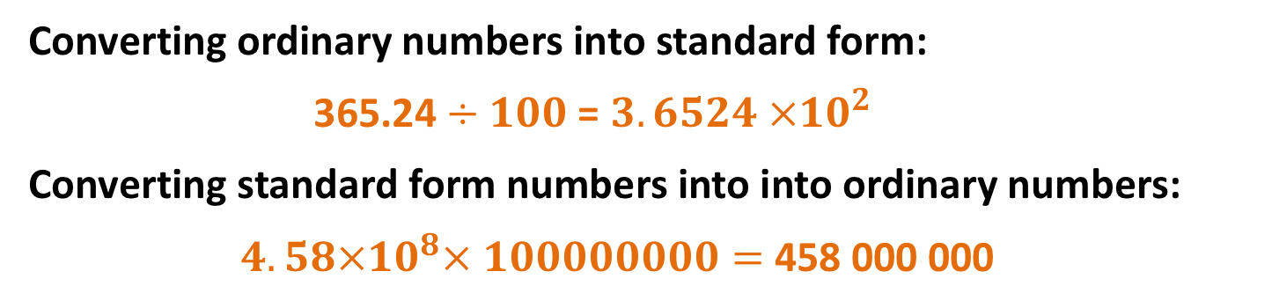
  Standard form
Standard form numbers are often used for very large measurements (for example distances in astronomy) or very small ones (for example the mass of a grain of sand).
A number in standard form looks like this:
$$a×{10}^{n}$$
where $1≤a<10$ and n is an integer (a “whole number”)
Multiplying a number by a power of 10 changes the place value of each of its digits. It can make the number bigger or smaller.
Converting ordinary numbers into standard form:
365.24 $÷100$ = $3.6524 ×{10}^{2}$
Converting standard form numbers into into ordinary numbers:
    $4.58×{10}^{8}× 100000000=$ 458 000 000
Notice that the decimal point appears to move by the same number of places as the index on the power of 10 (in fact the digits move and the decimal point stays put).

Slide 11
QuestionIT!
SI Units
Multiples and submultiples of units
Converting between different units

Slide 12
  Key concepts – QuestionIT
1. What is the SI base unit for current?
2. What is the SI base unit for time?
3. What is the SI base unit for temperature?
4. What is the derived unit for electric charge
5. What is the derived unit for pressure?

Slide 13
  Key concepts – QuestionIT
6. Convert 3560g into kg
7. Convert 2.5mm into m
8. Convert 3.2 km into mm
9. Convert 45 min into s.
10. Convert 3.5 hrs into s.

Slide 14
  Key concepts – QuestionIT
11. Write 56 300 in standard form.
12. Write 345 063 000 000 in standard form.
13. Write 0.0005 in standard form.
14. Write 3.46 x 10⁵ in ordinary numbers.
15. Write 2.67 x 10⁻⁶ in ordinary numbers.

Slide 15

AnswerIT!
SI Units
Multiples and submultiples
of units
Converting between different units

Slide 16
  Key concepts – AnswerIT
1.What is the SI base unit for current?
Ampere or A
2. What is the SI base unit for time?
Second or s
3. What is the SI base unit for temperature?
Kelvin
4. What is the derived unit for electric charge
Coulomb
5. What is the derived unit for pressure?
Pascal

Slide 17
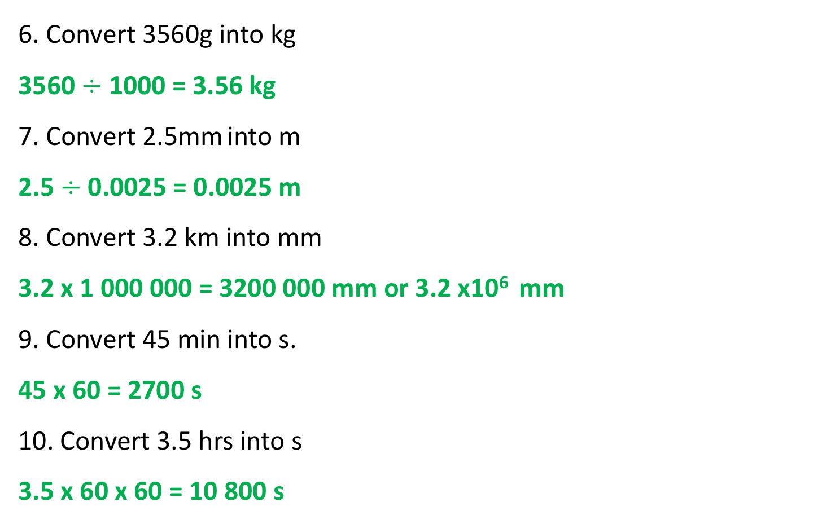
  Key concepts – AnswerIT
6. Convert 3560g into kg
3560 $÷$1000 = 3.56 kg
7. Convert 2.5mm into m
2.5 $÷$0.0025 = 0.0025 m
8. Convert 3.2 km into mm
3.2 x 1 000 000 = 3200 000 mm or 3.2 x10⁶ mm
9. Convert 45 min into s.
45 x 60 = 2700 s
10. Convert 3.5 hrs into s
3.5 x 60 x 60 = 10 800 s

Slide 18
  Key concepts – AnswerIT
11. Write 56 300 in standard form.
5.6 x 10⁴
12. Write 345 063 000 000 in standard form.
3.45063 x 10¹¹
13. Write 0.0005 in standard form.
5.0 x 10⁻⁴
14. Write 3.46 x 10⁵ in ordinary numbers.
346 000
15. Write 2.67 x 10⁻⁶ in ordinary numbers.
0.00000267

