Slide 1


The PiXL Club The PiXL Club The PiXL Club The PiXL Club The PiXL Club The PiXL Club The PiXL Club The PiXL Club The PiXL Club The PiXL Club The PiXL Club The PiXL Club The PiXL Club The PiXL Club The PiXL Club The PiXL Club The PiXL Club The PiXL Club The PiXL Club The PiXL Club The PiXL Club The PiXL Club The PiXL Club The PiXL Club The PiXL Club The PiXL Club The PiXL Club The PiXL Club The PiXL Club The PiXL Club The PiXL Club The PiXL Club The PiXL Club The PiXL Club The PiXL Club The PiXL Club The PiXL Club The PiXL Club The PiXL Club The PiXL Club The PiXL Club The PiXL Club The PiXL Club The PiXL Club The PiXL Club XL Club The PiXL Club The PiXL Club The PiXL Club The PiXL Club The PiXL Club The PiXL Club The PiXL Club The PiXL Club The PiXL Club The PiXL Club The PiXL Club The PiXL Club The PiXL Club The PiXL Club The PiXL Club The PiXL Club The PiXL Club The PiXL Club The PiXL Club The PiXL Club The PiXL Club The PiXL Club The PiXL Club The PiXL Club The PiXL Club The PiXL Club The PiXL Club The PiXL Club The PiXL Club The PiXL Club The PiXL Club The PiXL Club The PiXL Club The PiXL Club The PiXL Club The PiXL Club The PiXL Club The PiXL Club The PiXL Club The PiXL Club The PiXL Club The PiXL Club The PiXL Club The PiXL Club The PiXL Club The PiXL Club The PiXL Club The PiXL Club The PiXL Club The PiXL Club The PiXL Club The PiXL Club The PiXL Club The PiXL Club The PiXL Club The PiXL Club The PiXL Club The PiXL Club The PiXL Club The PiXL Club The PiXL Club The PiXL Club The PiXL Club The PiXL Club The PiXL Club The PiXL Club The PiXL Club The PiXL Club The PiXL Club The PiXL Club The PiXL Club The PiXL Club The PiXL Club The PiXL Club The PiXL Club The PiXL Club The PiXL Club The PiXL Club The PiXL Club The PiXL Club The PiXL Club The PiXL Club The PiXL Club The PiXL Club The PiXL Club The PiXL Club The PiXL Club The PiXL Club The PiXL Club The PiXL Club The PiXL Club The PiXL Club The PiXL Club The PiXL Club The PiXL Club The PiXL Club The PiXL Club The PiXL Club The PiXL Club The PiXL Club The PiXL Club The PiXL Club The PiXL Club The PiXL Club The PiXL Club The PiXL Club The PiXL Club The PiXL Club The PiXL Club The PiXL Club The PiXL Club The PiXL Club The PiXL Club The PiXL Club The PiXL Club The PiXL Club The PiXL Club The PiXL Club The PiXL Club The PiXL Club The PiXL Club The PiXL Club The PiXL Club The PiXL Club The PiXL Club The PiXL Club The PiXL Club The PiXL Club The PiXL Club The PiXL Club The PiXL Club The PiXL Club The PiXL Club The PiXL Club The PiXL Club The PiXL Club The PiXL Club The PiXL Club The PiXL Club The PiXL Club The PiXL Club The PiXL Club The PiXL Club The PiXL Club The PiXL Club The PiXL Club The PiXL Club The PiXL Club The PiXL Club The PiXL Club The PiXL Club The PiXL Club The PiXL Club The PiXL Club The PiXL Club The PiXL Club The PiXL Club The PiXL Club The PiXL Club The PiXL Club The PiXL Club The PiXL Club The PiXL Club The PiXL Club The PiXL Club The PiXL Club The PiXL Club The PiXL Club The PiXL Club The PiXL Club The PiXL Club The PiXL Club The PiXL Club The PiXL Club The PiXL Club The PiXL Club The PiXL Club The PiXL Club The PiXL Club The PiXL Club The PiXL Club The PiXL Club The PiXL Club The PiXL Club The PiXL Club The PiXL Club The PiXL Club The PiXL Club The PiXL Club The PiXL Club The PiXL Club The PiXL Club The PiXL Club The PiXL Club The PiXL Club The PiXL Club The PiXL Club The PiXL Club The PiXL Club The PiXL Club The PiXL Club The PiXL Club The PiXL Club The PiXL Club The PiXL Club The PiXL Club The PiXL Club The PiXL Club The PiXL Club The PiXL Club The PiXL Club The PiXL Club The PiXL Club The PiXL Club The PiXL Club The PiXL Club The PiXL Club The PiXL Club The PiXL Club The PiXL Club The PiXL Club The PiXL Club The PiXL Club The PiXL Club The PiXL Club The PiXL Club The PiXL Club The PiXL Club The PiXL Club The PiXL Club The PiXL Club The PiXL Club The PiXL Club The PiXL Club The PiXL Club The PiXL Club The PiXL Club The PiXL Club The PiXL Club The PiXL Club The PiXL Club The PiXL Club The PiXL Club The PiXL Club The PiXL Club The PiXL Club The PiXL Club The PiXL Club The PiXL Club The PiXL Club The PiXL Club The PiXL Club The PiXL Club The PiXL Club The PiXL Club The PiXL Club The PiXL Club The PiXL Club The PiXL Club The PiXL Club The PiXL Club The PiXL Club The PiXL Club The PiXL Club The PiXL Club The PiXL Club The PiXL Club The PiXL Club The PiXL Club The PiXL Club The PiXL Club The PiXL Club The PiXL Club The PiXL Club The PiXL Club The PiXL Club The PiXL Club The PiXL Club The PiXL Club The PiXL Club The PiXL Club The PiXL Club The PiXL Club The PiXL Club The PiXL Club The PiXL Club The PiXL Club The PiXL Club The PiXL Club The PiXL Club The PiXL Club The PiXL Club The PiXL Club The PiXL Club The PiXL Club The PiXL Club The PiXL Club The PiXL Club The PiXL Club The PiXL Club The PiXL Club The PiXL Club The PiXL Club The PiXL Club The PiXL Club The PiXL Club The PiXL Club The PiXL Club The PiXL Club The PiXL Club The PiXL Club The PiXL Club The PiXL Club The PiXL Club The PiXL Club The PiXL Club The PiXL Club The PiXL Club The PiXL Club The PiXL Club The PiXL Club The PiXL Club The PiXL Club The PiXL Club The PiXL Club The PiXL Club The PiXL Club The PiXL Club The PiXL Club The PiXL Club The PiXL Club The PiXL Club The PiXL Club The PiXL Club The PiXL Club The PiXL Club The PiXL Club The PiXL Club The PiXL Club The PiXL Club The PiXL Club The PiXL Club The PiXL Club The PiXL Club The PiXL Club The PiXL Club The PiXL Club The PiXL Club The PiXL Club The PiXL Club The PiXL Club The PiXL Club The PiXL Club The PiXL Club The PiXL Club The PiXL Club The PiXL Club The PiXL Club The PiXL Club The PiXL Club The PiXL Club The PiXL Club The PiXL Club The PiXL Club The PiXL Club The PiXL Club The PiXL Club The PiXL Club The PiXL Club The PiXL Club The PiXL Club The PiXL Club The PiXL Club The PiXL Club The PiXL Club The PiXL Club The PiXL Club The PiXL Club The PiXL Club The PiXL Club The PiXL Club The PiXL Club The PiXL Club The PiXL Club The PiXL Club The PiXL Club The PiXL Club The PiXL Club The PiXL Club The PiXL Club The PiXL Club The PiXL Club The PiXL Club The PiXL Club The PiXL Club The PiXL Club The PiXL Club The PiXL Club The PiXL Club The PiXL Club The PiXL Club The PiXL Club The PiXL Club The PiXL Club The PiXL Club The PiXL Club The PiXL Club The PiXL Club The PiXL Club The PiXL Club The PiXL Club The PiXL Club The PiXL Club The PiXL Club The PiXL Club The PiXL Club The PiXL Club The PiXL Club The PiXL Club The PiXL Club The PiXL Club The PiXL Club The PiXL Club The PiXL Club The PiXL Club The PiXL Club The PiXL Club The PiXL Club The PiXL Club The PiXL Club The PiXL Club The PiXL Club The PiXL Club The PiXL Club The PiXL Club The PiXL Club The PiXL Club The PiXL Club The PiXL Club The PiXL Club The PiXL Club The PiXL Club The PiXL Club The PiXL Club The PiXL Club The PiXL Club The PiXL Club The PiXL Club The PiXL Club The PiXL Club The PiXL Club The PiXL Club The PiXL Club The PiXL Club The PiXL Club The PiXL Club The PiXL Club The PiXL Club The PiXL Club The PiXL Club The PiXL Club The PiXL Club The PiXL Club The PiXL Club The PiXL Club The PiXL Club The PiXL Club The PiXL Club The PiXL Club The PiXL Club The PiXL Club The PiXL Club The PiXL Club The PiXL Club The PiXL Club The PiXL Club The PiXL Club The PiXL Club The PiXL Club The PiXL Club The PiXL Club The PiXL Club The PiXL Club The PiXL Club The PiXL Club The PiXL Club The PiXL Club The PiXL Club The PiXL Club The PiXL Club The PiXL Club The PiXL Club The PiXL Club The PiXL Club The PiXL Club The PiXL Club The PiXL Club The PiXL Club The PiXL Club The PiXL Club The PiXL Club The PiXL Club The PiXL Club The PiXL Club The PiXL Club The PiXL Club The PiXL Club The PiXL Club The PiXL Club The PiXL Club The PiXL Club The PiXL Club The PiXL Club The PiXL Club The PiXL Club The PiXL Club The PiXL Club The PiXL Club The PiXL Club The PiXL Club The PiXL Club The PiXL Club The PiXL Club The PiXL Club The PiXL Club The PiXL Club The PiXL Club The PiXL Club The PiXL Club The PiXL Club The PiXL Club The PiXL Club The PiXL Club The PiXL Club The PiXL Club The PiXL Club The PiXL Club The PiXL Club The PiXL Club The PiXL Club The PiXL Club The PiXL Club The PiXL Club The PiXL Club The PiXL Club The PiXL Club The PiXL Club The PiXL Club The PiXL Club The PiXL Club The PiXL Club The PiXL Club The PiXL Club The PiXL Club The PiXL Club The PiXL Club The PiXL Club The PiXL Club The PiXL Club The PiXL Club The PiXL Club The PiXL Club The PiXL Club The PiXL Club The PiXL Club The PiXL Club The PiXL Club The PiXL Club The PiXL Club The PiXL Club The PiXL Club The PiXL Club The PiXL Club The PiXL Club The PiXL Club The PiXL Club The PiXL Club The PiXL Club The PiXL Club The PiXL Club The PiXL Club The PiXL Club The PiXL Club The PiXL Club The PiXL Club The PiXL Club The PiXL Club The PiXL Club The PiXL Club The PiXL Club The PiXL Club The PiXL Club The PiXL Club The PiXL Club The PiXL Club The PiXL Club The PiXL Club The PiXL Club The PiXL Club The PiXL Club The PiXL Club The PiXL Club The PiXL Club The PiXL Club The PiXL Club The PiXL Club The PiXL Club The PiXL Club The PiXL Club The PiXL Club The PiXL Club The PiXL Club The PiXL Club The PiXL Club The PiXL Club The PiXL Club The PiXL Club The PiXL Club The PiXL Club The PiXL Club The PiXL Club The PiXL Club The PiXL Club The PiXL Club The PiXL Club The PiXL Club The PiXL Club The PiXL Club The PiXL Club The PiXL Club The PiXL Club The PiXL Club The PiXL Club The PiXL Club The PiXL Club The PiXL Club The PiXL Club The PiXL Club The PiXL Club The PiXL Club The PiXL Club The PiXL Club The PiXL Club The PiXL Club The PiXL Club The PiXL Club The PiXL Club The PiXL Club The PiXL Club The PiXL Club The PiXL Club The PiXL Club The PiXL Club The PiXL Club The PiXL Club The PiXL Club The PiXL Club The PiXL Club The PiXL Club The PiXL Club The PiXL Club The PiXL Club The PiXL Club The PiXL Club The PiXL Club The PiXL Club The PiXL Club The PiXL Club The PiXL Club The PiXL Club The PiXL Club The PiXL Club The PiXL Club The PiXL Club The PiXL Club The PiXL Club The PiXL Club The PiXL Club The PiXL Club The PiXL Club The PiXL Club The PiXL Club The PiXL Club The PiXL Club The PiXL Club The PiXL Club The PiXL Club The PiXL Club The PiXL Club The PiXL Club The PiXL Club The PiXL Club The PiXL Club The PiXL Club The PiXL Club The PiXL Club The PiXL Club The PiXL Club The PiXL Club The PiXL Club
PiXL KnowIT!
GCSE Physics
Edexcel Conservation of energy
© Copyright The PiXL Club Ltd, 2017
This resource is strictly for the use of member schools for as long as they remain members of The PiXL Club. It may not be copied, sold nor transferred to a third party or used by the school after membership ceases. Until such time it may be freely used within the member school.
All opinions and contributions are those of the authors. The contents of this resource are not connected with nor endorsed by any other company, organisation or institution.
www.pixl.org.uk The PiXL Club Ltd, Company number 07321607

Slide 2

Overview
Edexcel Topic 3
  Conservation of energy
  Part 1
  Energy stores
  Gravitational potential energy
  Kinetic energy
  Energy stores and transfers
  Part 2
  Energy transfers in a system
  Energy efficiency
  Reducing unwanted energy transfers
  Part 3
  Energy resources

Slide 3
LearnIT!
KnowIT!
Conservation of energy
Part 1
  Energy stores
  Gravitational potential energy
  Kinetic energy
  Energy stores and transfers

Slide 4
  Energy stores and systems
Energy stores | Examples
Chemical | In food, fuel and electric batteries
Kinetic | In moving objects
Gravitational potential | In objects raised above a planets surface
Elastic potential | In a stretched, compressed or twisted object
Internal (thermal) | In any heated object
Magnetic | In any object with a magnetic field
Electrostatic | In electrostatic forces between charges
Nuclear | The forces acting between atomic nuclei
Force pathways include: Mechanically – when a force acts and an object moves Electrically – when an electric current flows Heating – a temperature difference between objects Radiation – electromagnetic waves or sound

Slide 5

Gravitational potential energy
When an object is raised above ground level it gains gravitational potential energy (GPE). This stored energy can be released if the object is allowed to fall.
A pile driver is a machine that lifts a heavy weight then drops it on a post to drive it into the ground.
Recall and use the equation to calculate the change in
gravitational PE when an object is raised above the ground:
change in G.P.E (J) = mass (kg) × gravitational field strength (N/kg) × change in height (m)
ΔGPE = m× g ×Δh
The pile driver hammer has a mass of 120 kg and it is raised to a height of 4 m above the ground. How much G.P.E will it have?
ΔGPE = m× g ×Δh
ΔGPE = 120 x 10 x 4
The G.P.E gained is: ΔGPE = 4800 J
Click to reveal answer

Slide 6

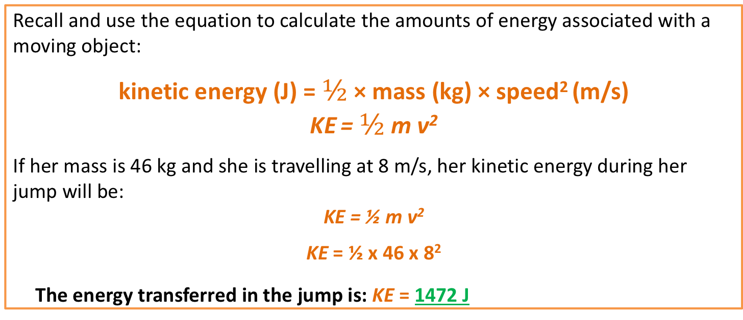
Kinetic Energy
Moving objects have kinetic energy.
The long-jumper is using her kinetic energy to
carry her body as far as possible. The more
kinetic energy she has, the longer her jump will
be. Her kinetic energy depends on her mass
(which she can not change) and her velocity (she can run faster!).
Recall and use the equation to calculate the amounts of energy associated with a moving object:
kinetic energy (J) = $½$ × mass (kg) × speed² (m/s)
KE = $½$ m v²
If her mass is 46 kg and she is travelling at 8 m/s, her kinetic energy during her jump will be:
KE = ½ m v²
KE = ½ x 46 x 8²
The energy transferred in the jump is: KE = 1472 J
Click to reveal answer

Slide 7
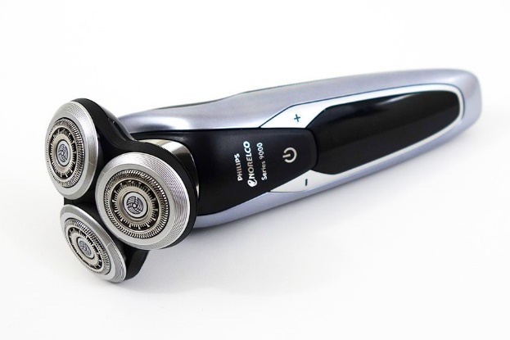
  Energy stores and systems
An energy system is a group of objects that have the ability to do work.
Remember: energy can not be created or destroyed so when work is done, energy from one store is carried along a pathway to another energy store.
Consider the energy flow diagram for an electric shaver.
The battery has a store of chemical energy.
The current flows through an electrical pathway to the motor.
Energy from the motor follows a mechanical pathway to a kinetic store of the moving blades, a heat pathway to a thermal store and a radiation pathway to a sound store.
mechanical Kinetic
electrical
Chemical heat Thermal
radiation Sound
Motor

Slide 8

  Energy stores and systems
Examples of energy changes in a system:
An object thrown (projected) upwards e.g. You throw a tennis ball upwards.
As the ball leaves your hand it has a store of kinetic energy.
At its highest point it has a store of gravitational potential energy (G.P.E).
As you are about to catch it just before it hits your hand it has a
store of kinetic energy.

Slide 9

  Energy stores and systems
Examples of energy changes in a system:
A moving object hitting an obstacle e.g. A bowling ball hitting a pin
As you move the muscles of your arm to throw the ball the chemical energy store in your muscles decreases and the kinetic energy store of the bowling ball increases.
At the ball hits a pin some of the kinetic energy has been transferred to a store of internal (thermal) energy this causes the ball and its surroundings to warm up a little.
You will hear a sound when the ball hits the pin, the energy of the sound is also transferred to the internal energy store of the surroundings.

Slide 10
  Energy stores and systems
Examples of energy changes in a system:
An object being accelerated by a constant force e.g. A bowling ball being dropped off a sky scraper
At its highest point the ball has a store of gravitational potential energy (G.P.E).
As it is dropped gravity does work on the ball (assuming there is no air resisitance).
The ball then constantly accelerates towards the ground.
Just before the ball hits the ground it has a
store of kinetic energy.

Slide 11
  Energy stores and systems
Examples of energy changes in a system:
A vehicle slowing down e.g. When you apply the brakes in a lorry
The moving lorry has a store of kinetic energy.
At the brakes are applied the kinetic energy store decreases the energy is transferred to the internal (thermal) energy store in the brakes and the brakes get hot.
You will hear a sound when the brakes of the lorry are applied, the energy of the sound is also transferred to the internal energy store of the surroundings.
When the lorry stops its kinetic energy store is zero.

Slide 12
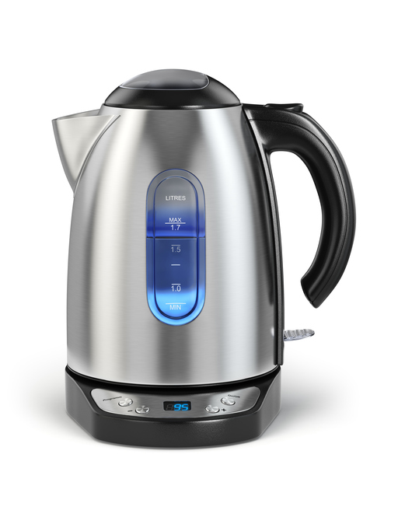
  Energy stores and systems
Examples of energy changes in a system:
Bringing water to a boil in an electric kettle.
Energy is transferred electrically from the mains to the heating element in the kettle.
The internal (thermal) energy store of the water increases.
The temperature of the water increases and as bubbles form the kinetic energy store of the water increases.
Energy is measured in Joules (J)
1 kilojoule (kJ) = 1000 J (10³J) 1 megajoule = 1000 000 J (10⁶J)

Slide 13
QuestionIT!
Conservation of energy
Part 1
  Energy stores
  Gravitational potential energy
  Kinetic energy
  Energy stores and transfers

Slide 14

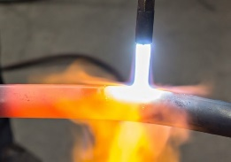

  Part 1– QuestionIT
What sort of energy store do the following examples have?
a. b. c.
2. Name and describe the four force pathways.
3. Write down the correct answer to complete the statement.
Energy can not…..
be transferred from one source to another.
be created or destroyed.
travel along a pathway to another store.

Slide 15

  Part 1– QuestionIT
4. A pole vaulter just clears the bar which is 5.1 m high. His mass is
62 kg. (g = 10N/kg)
a. What type of stored energy does he have
as he clears the bar?
b. Work out how much stored energy the
pole vaulter has due to his position
above the ground.
c. As he falls back to the ground, this energy store will be
transferred into a new energy store. Name this new energy store.

Slide 16
  Part 1– QuestionIT
5. When a football is kicked it gains kinetic energy.
a. What is the formula used to calculate kinetic energy?
b. The football has a mass of 0.4 kg and when kicked has a velocity
of 15 m/s. Work out the kinetic energy of the moving ball?

Slide 17
  Part 1– QuestionIT
6. Copy and Complete the energy store and pathway diagrams for the objects described.
a. A moving car braking to a stop.
CAR i ii iii
b. Bringing water to the boil on a gas hob.
i GAS HOB ii iii

Slide 18
  Part 1– QuestionIT
7. Describes the main change in energy stores for:
a. A bowling ball hitting a pin
8. Describes the main change in energy stores for:
b. Boiling water in an electric kettle

Slide 19

AnswerIT!
Conservation of energy
Part 1
  Energy stores
  Gravitational potential energy
  Kinetic energy
  Energy stores and transfers

Slide 20

  Part 1– AnswerIT
What sort of energy store do the following examples have?
a. b. c.
Chemical Elastic potential Thermal
2. Name and describe the four force pathways.
Mechanically – when a force acts and an object moves
Electrically – when an electric current flows
Heating – a temperature difference between objects
Radiation – electromagnetic waves or sound
3. Write down the correct answer to complete the statement.
Energy can not…..
be transferred from one source to another.
be created or destroyed.
travel along a pathway to another store.

Slide 21
  Part 1– AnswerIT
4. A pole vaulter just clears the bar which is 5.1 m high. His mass is
62 kg. (g = 10N/kg)
a. What type of stored energy does he have
as he clears the bar?
gravitational potential energy
b. Work out how much stored energy the
pole vaulter has due to his position
above the ground.
ΔGPE = m× g ×Δh = 62 x 10 x 5.1 = 3162 J
c. As he falls back to the ground, this energy store will be
transferred into a new energy store. Name this new energy store.
kinetic energy

Slide 22
  Part 1– AnswerIT
5. When a football is kicked it gains kinetic energy.
a. What is the formula used to calculate kinetic energy?
KE = ½ m v²
b. The football has a mass of 0.4 kg and when kicked has a velocity
of 15 m/s. Work out the kinetic energy of the moving ball?
KE = ½ x 0.4 x 15²
KE = 45 J

Slide 23
  Part 1– AnswerIT
6. Copy and Complete the energy store and pathway diagrams for the objects described.
a. A moving car braking to a stop.
CAR i Kinetic ii Mechanical iii Thermal
b. Bringing water to the boil on a gas hob.
i Chemical GAS HOB ii Heating iii Thermal

Slide 24
  Part 1– AnswerIT
7. Describes the main change in energy stores for:
a. A bowling ball hitting a pin
As you move the muscles of your arm to throw the ball the chemical energy store in your muscles decreases and the kinetic energy store of the bowling ball increases.
At the ball hits a pin some of the kinetic energy has been transferred to a store of internal (thermal) energy this causes the ball and its surroundings to warm up a little.
You will hear a sound when the ball hits the pin, the energy of the sound is also transferred to the internal energy store of the surroundings.

Slide 25
  Part 1– AnswerIT
8. Describes the main change in energy stores for:
b. Boiling water in an electric kettle
Energy is transferred electrically from the mains to the heating element in the kettle.
The internal (thermal) energy store of the water increases.
The temperature of the water increases and as bubbles form the kinetic energy store of the water increases.

Slide 26
LearnIT!
KnowIT!
Conservation of energy
Part 2
  Energy transfers in a system
  Energy efficiency
  Reducing unwanted energy transfers

Slide 27
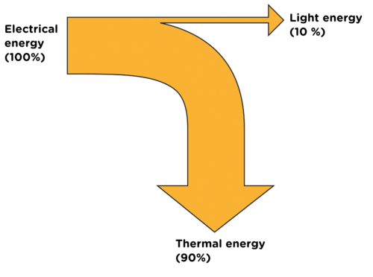
  Energy transfers in a system
Energy can be stored, transferred or dissipated - but can not be created or destroyed.
In a closed energy system there can be transfer of energy but not mass. There is no change to the total energy in the system.
No mass change
In a closed energy system all the energy can be accounted for even when energy stores change.
Closed
Energy
system
E in
E out
The diagram shows the energy transfer for a light
bulb. All the electrical energy store can be accounted
for as light energy and thermal energy.
The thermal energy is not useful in this case and can be
considered to be dissipated or “waste” energy.

Slide 28

  Energy transfers in a system
Unwanted energy transfers result in energy stores that are not useful.
The F1 car below shows that eventually all the chemical energy (fuel) put in the car ends up as unwanted thermal energy which is dissipated to the surroundings. Unwanted energy is often described as being ‘wasted’
Kinetic energy is dissipated by the tyres, brakes and air resistance to become unwanted thermal energy stores.
Sound energy is absorbed by materials and becomes thermal energy.
Thermal energy is produced by the engine as fuel is burnt.
Oil is used in the engine, gearbox and other moving parts as a lubricant to reduce friction and reduce unwanted thermal energy in these parts.
Kinetic
Thermal
Chemical
Sound
Thermal
Thermal

Slide 29
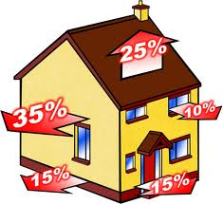
  Energy transfers in a system
Thermal insulation is often used to reduce unwanted energy transfers.
All the energy used to heat a home is eventually transferred as thermal energy to the surroundings.
The diagram, shows the percentage energy lost through different parts of the building.
Material | Thermal Conductivity W/m C
Air | 0.03
Polyurethane foam | 0.03
Fibreglass | 0.04
Wool felt | 0.05
Wood | 0.15
Plaster | 0.50
Glass | 0.80
Brick | 1.00
Concrete | 1.04
The higher the thermal conductivity, the quicker heat is transferred through the material.
Houses are often built from brick, concrete, wood and glass. All have quite high thermal conductivity values. Insulation uses materials with low thermal conductivity, such as fibreglass in the loft, foam in wall cavities and trapped gases in double glazing.

Slide 30
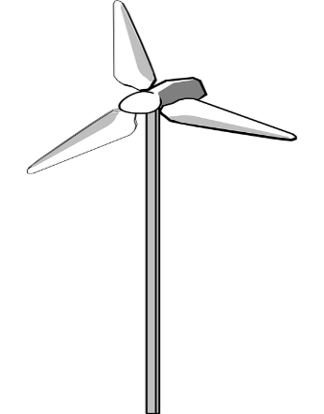
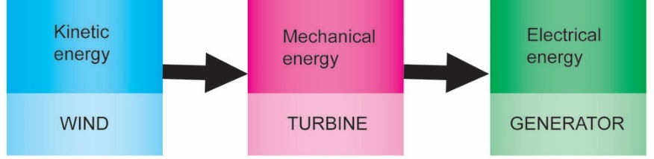
  Efficiency
The amount of useful energy you get from an energy transfer, compared to the energy put in, is called the EFFICIENCY
Efficiency = (useful energy transferred by the device)
(total energy supplied to the device)
This calculation will result in a decimal value which can be multiplied by 100 to give a percentage efficiency.
A wind turbine energy transfer
The wind turbine produces 120 MW of electrical energy for every 500 MW of kinetic energy provided by the wind.
Efficiency = (useful energy transferred by the device)
(total energy supplied to the device)
= 120 = 0.24 efficient
500
or 0.24 x 100 = 24 % efficient

Slide 31
  Reducing unwanted energy transfers (Higher tier)
Different devices have different efficiency values. No device can be more 100% efficient.
Devices can waste in many ways, for example:
Friction (thermal energy) between the moving part of a car or motorbike
Sound energy when a hair drier is being used
Electrical circuits heating (thermal energy) up due to resisitance
Thermal energy being lost from the roof or wall of a house
Mechanical devices can be made more efficient by lubrication this reduces energy transferred by friction
e.g. engine oil
Having good insulation reduces the rate of thermal energy transfers
e.g. loft insulation

Slide 32
QuestionIT!
Conservation of energy
Part 2
  Energy transfers in a system
  Energy efficiency
  Reducing unwanted energy transfers

Slide 33
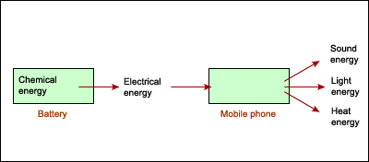
  Part 2 - QuestionIT
In a “closed” system …..........
  energy can be transferred but there is no net energy loss.
  energy and mass are transferred in and out of the system.
  energy cannot be transferred between different energy stores.
2. The energy transfer diagram for a mobile phone shows that 100 J of electrical energy produces 45 J of light energy and 36 J of sound energy.
How much thermal energy will be dissipated by the phone?

Slide 34
  Part 2 - QuestionIT
3. Describe how the thermal energy produced by a bus driving along a road is dissipated.
4. a. The diagram shows the main energy transfers for an electric fan. Complete boxes A to D showing the energy stores involved. Use the size of the arrows to help you.
B
A
C
D
b. State why the total energy supplied to an electric fan must always equal the total energy transferred by the electric fan.

Slide 35
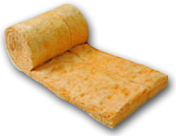

  Part 2 - QuestionIT
5. a. The diagrams show two different types of loft insulation.
Fiberglass insulation Wool insulation
The wool needs to be thicker to have the same insulating properties. Explain which material has the highest thermal conductivity?
b. Explain how trapped air reduces the rate of heat loss, in terms of thermal conductivity.

Slide 36
AnswerIT!
Conservation of energy
Part 2
  Energy transfers in a system
  Energy efficiency
  Reducing unwanted energy transfers

Slide 37
  Part 2 - AnswerIT
In a “closed” system …..........
  energy can be transferred but there is no net energy loss.
  energy and mass are transferred in and out of the system.
  energy cannot be transferred between different energy stores.
2. The energy transfer diagram for a mobile phone shows that 100 J of electrical energy produces 45 J of light energy and 36 J of sound energy.
How much thermal energy will be dissipated by the phone?
45 J + 36 J = 81 J
100 J – 81 J = 19 J
19 J of thermal energy will be dissipated

Slide 38
  Part 2 - AnswerIT
3. Describe how the thermal energy produced by a bus driving along a road is dissipated.
The thermal energy increases the kinetic energy of the air particles therefore warming up the surroundings.
4. a. The diagram shows the main energy transfers for an electric fan. Complete boxes A to D showing the energy stores involved. Use the size of the arrows to help you.
B
A - Electrical energy
B - Thermal energy
C - Kinetic energy
D - Sound energy
A
C
D
b. State why the total energy supplied to an electric fan must always equal the total energy transferred by the electric fan.
Energy can not be created or destroyed so:
total energy in = total energy out

Slide 39
  Part 2 - AnswerIT
5. a. The diagrams show two different types of loft insulation.
Fiberglass insulation Wool insulation
The wool needs to be thicker to have the same insulating properties. Explain which material has the highest thermal conductivity?
Wool has the highest thermal conductivity as it lets thermal energy through at a faster rate so a thicker layer is needed for the same insulation as the fiberglass.
b. Explain how trapped air reduces the rate of heat loss, in terms of thermal conductivity.
The air trapped inside the fiberglass acts as an insulator because air has a very low thermal conductivity and thermal energy can not pass through it easily.

Slide 40
LearnIT!
KnowIT!
Conservation of energy
Part 3
  Energy resources

Slide 41
Energy resources
ENERGY RESOURCES
Non-renewable
Coal | Fossil fuels They are becoming more difficult to find and extract
Oil
Gas
Nuclear | Plentiful but difficult to extract / purify
Renewable
Bio-fuel | Plant matter usually used as a fuel
Wind | Turbines spin a generator to produce electricity
Hydro-electric | Falling water spins a turbine to produce electricity
Tides | Rise and fall of the tide can be used to turn a turbine
Sun | To directly heat things or produce electricity

Slide 42
Energy resources
Non-renewable energy sources are those which will eventually run out – there is a finite supply. New supplies are more difficult to find and extract.
Renewable energy sources are those which can replenish themselves in the short term, and so will never run out.
Nuclear energy resources are technically non-renewable but they can be produced on an almost indefinite basis.
How energy resources are used.
Transport – cars, trains, buses, planes etc.
Electricity generation – industry, homes, commerce, lighting etc.
Heating – homes, industrial processes, schools and hospitals etc.
Energy use is usually divided between the four economic sectors - residential, commercial, transportation, and industrial.

Slide 43
Energy resources – Non-renewable
Coal | Coal is mined then burnt to provide heat or used to generate electricity. | Large reserves of coal which are relatively inexpensive to mine. All major coal mines have now closed in the UK. | Coal mining is dangerous and burning coal contributes to global warming.
Oil | Frequently burnt to produce electricity. Large quantities of oil are refined to provide fuels for transport. | Large reserves becoming more difficult to find and extract. Transport and refinement are relatively easy. | Oil reserves becoming more difficult to find and extract. The need for oil in developed countries means supplies are politically sensitive. Releases greenhouse gases when burnt.

Slide 44
Energy resources – Non-renewable
Gas | Extracted from underground gas fields sometimes alongside oil extraction. Mainly used for electricity production, domestic heating and industrial processes that require heat. | Cleaner than burning oil or coal. Relatively easy to transport and store. | UK has good gas reserves but extraction is expensive (often under the sea) and becoming more difficult to reach.
Nuclear | Nuclear supplies (Uranium) are mined and purified. The nuclear fission releases heat which is used to produce steam. This spins a turbine and generator to make electricity | Potentially in-exhaustable energy supply even though it is extracted form resources in the ground.Very efficient process which produces lots of electricity from little nuclear fuel. | Danger of nuclear accidents releasing radioactive materials into the air or water. Security of nuclear sites can be a problem.Start-up costs and decommissioning are very expensive and no real solution to managing radioactive waste has been found.

Slide 45
Energy resources – Renewable
Solar | Energy from sunlight is captured in photovoltaic cells and converted into electricity. Hot water from solar panels | Renewable energy resource. Individual houses can have their own electricity/hot water supply. | Manufacture and installation of solar panels/cells can be costly.
Wind | Wind turbines turn wind energy into electricity by turning a generator. | Renewable energy resource and can be used as individual units. | Manufacture and installation of wind farms can be costly. Some consider an eyesore.
Tidal | The movement of tides drives turbines. A tidal barrage is built across estuaries to trap water. | Ideal for an island such as the UK to potentially generate a lot of energy. Tidal barrage can help prevent flooding. | Construction of barrage is very costly and can impact on wildlife. Only a few estuaries are suitable.

Slide 46
Energy resources – Renewable
Hydroelectric Power (HEP) | Energy harnessed from the movement of water through rivers, lakes and dams. Used to turn turbines for electricity production. | Creates water reserves as well as energy supplies. | Costly to build. Can cause the flooding of surrounding communities and landscapes.
Biomass | An organic material, which can be burned to provide energy, eg heat or electricity. After treatment with chemicals it can be used as a fuel in vehicle engines. | It is a cheap and readily available source of energy. If replaced, biomass can be a long-term, sustainable energy source. | When burned, it gives off greenhouse gases. Growing takes up large amounts of arable land..

Slide 47

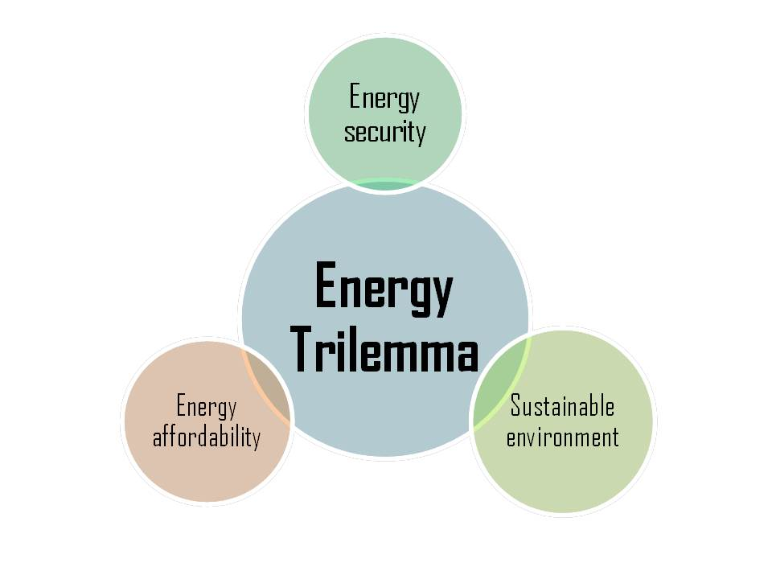
Energy resources
Security and reliability of energy supplies
In the UK a mix of energy supplies are used so should one supply become unavailable, others can be used without disruption to supplies.
Some energy sources are more reliable than others. Coal, oil, gas and nuclear are reliable sources as they can supply a continuous flow of electricity.
The Energy mix
Electricity from wind turbines relies on the wind blowing, solar power does not work at night and hydro-electric requires a continuous supply of water. These are considered unreliable sources.

Slide 48
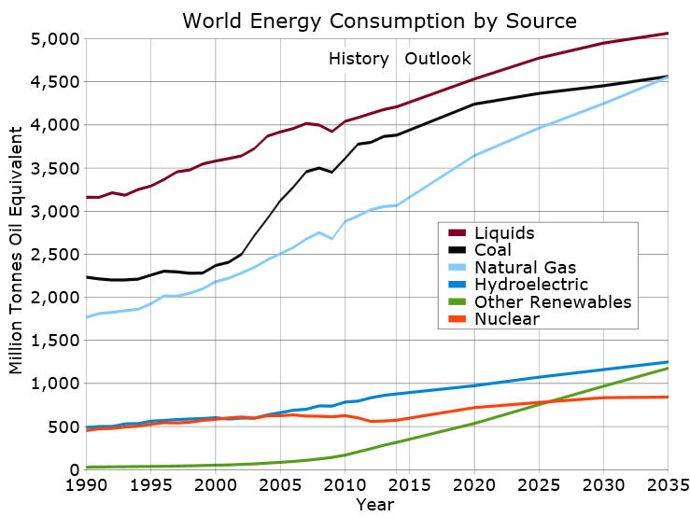
Energy resources – Trends in energy use
World energy use trends and predictions
The total amount of energy used in the world is increasing as the population increases and each person is using more energy.
Renewable energies only make up around 20% of total energy consumption and this trend is unlikely to change until after 2035.
Future world agreements on emissions are likely to determine the trend of using fossil fuels.
As reserves of coal, oil and gas dwindle, an increase in the use of renewable energies is likely.

Slide 49
QuestionIT!
Conservation of energy
Part 3
  Energy resources

Slide 50
  Part 3 – QuestionIT
What is a fossil fuel?
2. Copy and complete the table below by ticking the correct box for
each energy source.
3. What is a renewable energy source?
Energy source | Renewable | Non-renewable
Bio-fuels
Oil
Nuclear
Hydro-electricity
Wind turbines
Coal
Solar power
Natural gas

Slide 51
  Part 3 – QuestionIT
4. Why are fossil fuels considered to be a more reliable energy
resource than renewable energy resources?
5. Despite a large investment by the UK government in wind power,
the amount of fossil fuel used has not seen a decline. Give a
possible explanation for this.
6. The UK government is committed to investing in a "blend" of energy
supply types to provide the UK’s energy needs for the next 100
years. Give an advantage of this rather than using just coal.

Slide 52
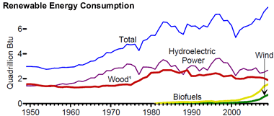
  Part 3 – QuestionIT
7. The graph shows the world use of renewable energies over the past sixty years.
a. Why has the use of wood increased very little over this time?
b. A lot of money has been invested in wind turbines. Why does this energy source not produce as much as any other renewable resource?

Slide 53
  Part 3 – QuestionIT
8. Copy and complete the table to give energy sources that could
be used in each situation.
9. Describe how human activities have contributed to the greenhouse
effect?
Energy use | Energy source 1 | Energy source 2
Running a car
Producing electricity
Heating the home
Powering a train

Slide 54
  Part 3 – QuestionIT
10. Explain how burning coal in power stations contributes to global
warming.
11. Describe two problems associated with the storage of waste from
nuclear power stations.
12. State two reasons why people might object to having a wind farm
built close to their homes.

Slide 55
AnswerIT!
Conservation of energy
Part 3
  Energy resources

Slide 56
  Part 3 – AnswerIT
What is a fossil fuel? A fuel formed in the geological past from the remains of living organisms.
2. Copy and complete the table below by ticking the correct box for
each energy source.
3. What is a renewable energy source?
An energy source that can be replenished as it is used.
Energy source | Renewable | Non-renewable
Bio-fuels
Oil
Nuclear
Hydro-electricity
Wind turbines
Coal
Solar power
Natural gas

Slide 57
  Part 3 – AnswerIT
4. Why are fossil fuels considered to be a more reliable energy
resource than renewable energy sources?
Produce a consistent energy supply with no gaps in energy delivery.
5. Despite a large investment by the UK government in wind power,
the amount of fossil fuel used has not seen a decline. Give a
possible explanation for this.
UK is using more energy and wind power can not meet this rise in
demand.
6. The UK government is committed to investing in a "blend" of energy
supply types to provide the UK’s energy needs for the next 100
years. Give an advantage of this rather than using just coal.
Evens out any variations in supply or cost of the energy source.
Using only coal, if supplies stopped or the cost went up greatly,
this would have a great impact on the consumer.

Slide 58
  Part 3 – AnswerIT
7. The graph shows the world use of renewable energies over the past sixty years.
a. Why has the use of wood increased very little over this time?
Limited supplies of wood and it takes a long time to grow new supplies. Also, pressure and legislation to prevent many trees from being cut down.
b. A lot of money has been invested in wind turbines. Why does this energy source not produce as much as any other renewable resource?
Each wind turbine only produces a small amount of electricity and not enough have been installed to match production from other renewable resources.

Slide 59
  Part 3 – AnswerIT
8. Copy and complete the table to give energy sources that could
be used in each situation.
9. Describe how human activities have contributed to the greenhouse
effect.?
Burning fossil fuels for heating, transport and industry has led to a
build up of carbon dioxide in the atmosphere (along with other
greenhouse gases).
Energy use | Energy source 1 | Energy source 2
Running a car | Petrol, Diesel, LPG | Any electricity producing source
Producing electricity | Coal, oil, gas | Renewable source
Heating the home | Coal, gas, wood | Any electricity producing source
Powering a train | Coal, Diesel, oil | Any electricity producing source

Slide 60
  Part 3 – AnswerIT
10. Explain how burning coal in power stations contributes to global
warming.
Carbon dioxide produced. Carbon dioxide absorbs and reflects
infrared radiation leading to additional warming.
11. Describe two problems associated with the storage of waste from
nuclear power stations.
Waste is radioactive can cause cells to mutate.
Radioactivity lasts for thousands of yeas so needs long term
storage.
12. State two reasons why people might object to having a wind farm
built close to their homes.
Considered unsightly by some. Can be noisy.
Disruption whilst installing and maintaining.
Produce little energy for their environmental impact.

