Slide 1


The PiXL Club The PiXL Club The PiXL Club The PiXL Club The PiXL Club The PiXL Club The PiXL Club The PiXL Club The PiXL Club The PiXL Club The PiXL Club The PiXL Club The PiXL Club The PiXL Club The PiXL Club The PiXL Club The PiXL Club The PiXL Club The PiXL Club The PiXL Club The PiXL Club The PiXL Club The PiXL Club The PiXL Club The PiXL Club The PiXL Club The PiXL Club The PiXL Club The PiXL Club The PiXL Club The PiXL Club The PiXL Club The PiXL Club The PiXL Club The PiXL Club The PiXL Club The PiXL Club The PiXL Club The PiXL Club The PiXL Club The PiXL Club The PiXL Club The PiXL Club The PiXL Club The PiXL Club XL Club The PiXL Club The PiXL Club The PiXL Club The PiXL Club The PiXL Club The PiXL Club The PiXL Club The PiXL Club The PiXL Club The PiXL Club The PiXL Club The PiXL Club The PiXL Club The PiXL Club The PiXL Club The PiXL Club The PiXL Club The PiXL Club The PiXL Club The PiXL Club The PiXL Club The PiXL Club The PiXL Club The PiXL Club The PiXL Club The PiXL Club The PiXL Club The PiXL Club The PiXL Club The PiXL Club The PiXL Club The PiXL Club The PiXL Club The PiXL Club The PiXL Club The PiXL Club The PiXL Club The PiXL Club The PiXL Club The PiXL Club The PiXL Club The PiXL Club The PiXL Club The PiXL Club The PiXL Club The PiXL Club The PiXL Club The PiXL Club The PiXL Club The PiXL Club The PiXL Club The PiXL Club The PiXL Club The PiXL Club The PiXL Club The PiXL Club The PiXL Club The PiXL Club The PiXL Club The PiXL Club The PiXL Club The PiXL Club The PiXL Club The PiXL Club The PiXL Club The PiXL Club The PiXL Club The PiXL Club The PiXL Club The PiXL Club The PiXL Club The PiXL Club The PiXL Club The PiXL Club The PiXL Club The PiXL Club The PiXL Club The PiXL Club The PiXL Club The PiXL Club The PiXL Club The PiXL Club The PiXL Club The PiXL Club The PiXL Club The PiXL Club The PiXL Club The PiXL Club The PiXL Club The PiXL Club The PiXL Club The PiXL Club The PiXL Club The PiXL Club The PiXL Club The PiXL Club The PiXL Club The PiXL Club The PiXL Club The PiXL Club The PiXL Club The PiXL Club The PiXL Club The PiXL Club The PiXL Club The PiXL Club The PiXL Club The PiXL Club The PiXL Club The PiXL Club The PiXL Club The PiXL Club The PiXL Club The PiXL Club The PiXL Club The PiXL Club The PiXL Club The PiXL Club The PiXL Club The PiXL Club The PiXL Club The PiXL Club The PiXL Club The PiXL Club The PiXL Club The PiXL Club The PiXL Club The PiXL Club The PiXL Club The PiXL Club The PiXL Club The PiXL Club The PiXL Club The PiXL Club The PiXL Club The PiXL Club The PiXL Club The PiXL Club The PiXL Club The PiXL Club The PiXL Club The PiXL Club The PiXL Club The PiXL Club The PiXL Club The PiXL Club The PiXL Club The PiXL Club The PiXL Club The PiXL Club The PiXL Club The PiXL Club The PiXL Club The PiXL Club The PiXL Club The PiXL Club The PiXL Club The PiXL Club The PiXL Club The PiXL Club The PiXL Club The PiXL Club The PiXL Club The PiXL Club The PiXL Club The PiXL Club The PiXL Club The PiXL Club The PiXL Club The PiXL Club The PiXL Club The PiXL Club The PiXL Club The PiXL Club The PiXL Club The PiXL Club The PiXL Club The PiXL Club The PiXL Club The PiXL Club The PiXL Club The PiXL Club The PiXL Club The PiXL Club The PiXL Club The PiXL Club The PiXL Club The PiXL Club The PiXL Club The PiXL Club The PiXL Club The PiXL Club The PiXL Club The PiXL Club The PiXL Club The PiXL Club The PiXL Club The PiXL Club The PiXL Club The PiXL Club The PiXL Club The PiXL Club The PiXL Club The PiXL Club The PiXL Club The PiXL Club The PiXL Club The PiXL Club The PiXL Club The PiXL Club The PiXL Club The PiXL Club The PiXL Club The PiXL Club The PiXL Club The PiXL Club The PiXL Club The PiXL Club The PiXL Club The PiXL Club The PiXL Club The PiXL Club The PiXL Club The PiXL Club The PiXL Club The PiXL Club The PiXL Club The PiXL Club The PiXL Club The PiXL Club The PiXL Club The PiXL Club The PiXL Club The PiXL Club The PiXL Club The PiXL Club The PiXL Club The PiXL Club The PiXL Club The PiXL Club The PiXL Club The PiXL Club The PiXL Club The PiXL Club The PiXL Club The PiXL Club The PiXL Club The PiXL Club The PiXL Club The PiXL Club The PiXL Club The PiXL Club The PiXL Club The PiXL Club The PiXL Club The PiXL Club The PiXL Club The PiXL Club The PiXL Club The PiXL Club The PiXL Club The PiXL Club The PiXL Club The PiXL Club The PiXL Club The PiXL Club The PiXL Club The PiXL Club The PiXL Club The PiXL Club The PiXL Club The PiXL Club The PiXL Club The PiXL Club The PiXL Club The PiXL Club The PiXL Club The PiXL Club The PiXL Club The PiXL Club The PiXL Club The PiXL Club The PiXL Club The PiXL Club The PiXL Club The PiXL Club The PiXL Club The PiXL Club The PiXL Club The PiXL Club The PiXL Club The PiXL Club The PiXL Club The PiXL Club The PiXL Club The PiXL Club The PiXL Club The PiXL Club The PiXL Club The PiXL Club The PiXL Club The PiXL Club The PiXL Club The PiXL Club The PiXL Club The PiXL Club The PiXL Club The PiXL Club The PiXL Club The PiXL Club The PiXL Club The PiXL Club The PiXL Club The PiXL Club The PiXL Club The PiXL Club The PiXL Club The PiXL Club The PiXL Club The PiXL Club The PiXL Club The PiXL Club The PiXL Club The PiXL Club The PiXL Club The PiXL Club The PiXL Club The PiXL Club The PiXL Club The PiXL Club The PiXL Club The PiXL Club The PiXL Club The PiXL Club The PiXL Club The PiXL Club The PiXL Club The PiXL Club The PiXL Club The PiXL Club The PiXL Club The PiXL Club The PiXL Club The PiXL Club The PiXL Club The PiXL Club The PiXL Club The PiXL Club The PiXL Club The PiXL Club The PiXL Club The PiXL Club The PiXL Club The PiXL Club The PiXL Club The PiXL Club The PiXL Club The PiXL Club The PiXL Club The PiXL Club The PiXL Club The PiXL Club The PiXL Club The PiXL Club The PiXL Club The PiXL Club The PiXL Club The PiXL Club The PiXL Club The PiXL Club The PiXL Club The PiXL Club The PiXL Club The PiXL Club The PiXL Club The PiXL Club The PiXL Club The PiXL Club The PiXL Club The PiXL Club The PiXL Club The PiXL Club The PiXL Club The PiXL Club The PiXL Club The PiXL Club The PiXL Club The PiXL Club The PiXL Club The PiXL Club The PiXL Club The PiXL Club The PiXL Club The PiXL Club The PiXL Club The PiXL Club The PiXL Club The PiXL Club The PiXL Club The PiXL Club The PiXL Club The PiXL Club The PiXL Club The PiXL Club The PiXL Club The PiXL Club The PiXL Club The PiXL Club The PiXL Club The PiXL Club The PiXL Club The PiXL Club The PiXL Club The PiXL Club The PiXL Club The PiXL Club The PiXL Club The PiXL Club The PiXL Club The PiXL Club The PiXL Club The PiXL Club The PiXL Club The PiXL Club The PiXL Club The PiXL Club The PiXL Club The PiXL Club The PiXL Club The PiXL Club The PiXL Club The PiXL Club The PiXL Club The PiXL Club The PiXL Club The PiXL Club The PiXL Club The PiXL Club The PiXL Club The PiXL Club The PiXL Club The PiXL Club The PiXL Club The PiXL Club The PiXL Club The PiXL Club The PiXL Club The PiXL Club The PiXL Club The PiXL Club The PiXL Club The PiXL Club The PiXL Club The PiXL Club The PiXL Club The PiXL Club The PiXL Club The PiXL Club The PiXL Club The PiXL Club The PiXL Club The PiXL Club The PiXL Club The PiXL Club The PiXL Club The PiXL Club The PiXL Club The PiXL Club The PiXL Club The PiXL Club The PiXL Club The PiXL Club The PiXL Club The PiXL Club The PiXL Club The PiXL Club The PiXL Club The PiXL Club The PiXL Club The PiXL Club The PiXL Club The PiXL Club The PiXL Club The PiXL Club The PiXL Club The PiXL Club The PiXL Club The PiXL Club The PiXL Club The PiXL Club The PiXL Club The PiXL Club The PiXL Club The PiXL Club The PiXL Club The PiXL Club The PiXL Club The PiXL Club The PiXL Club The PiXL Club The PiXL Club The PiXL Club The PiXL Club The PiXL Club The PiXL Club The PiXL Club The PiXL Club The PiXL Club The PiXL Club The PiXL Club The PiXL Club The PiXL Club The PiXL Club The PiXL Club The PiXL Club The PiXL Club The PiXL Club The PiXL Club The PiXL Club The PiXL Club The PiXL Club The PiXL Club The PiXL Club The PiXL Club The PiXL Club The PiXL Club The PiXL Club The PiXL Club The PiXL Club The PiXL Club The PiXL Club The PiXL Club The PiXL Club The PiXL Club The PiXL Club The PiXL Club The PiXL Club The PiXL Club The PiXL Club The PiXL Club The PiXL Club The PiXL Club The PiXL Club The PiXL Club The PiXL Club The PiXL Club The PiXL Club The PiXL Club The PiXL Club The PiXL Club The PiXL Club The PiXL Club The PiXL Club The PiXL Club The PiXL Club The PiXL Club The PiXL Club The PiXL Club The PiXL Club The PiXL Club The PiXL Club The PiXL Club The PiXL Club The PiXL Club The PiXL Club The PiXL Club The PiXL Club The PiXL Club The PiXL Club The PiXL Club The PiXL Club The PiXL Club The PiXL Club The PiXL Club The PiXL Club The PiXL Club The PiXL Club The PiXL Club The PiXL Club The PiXL Club The PiXL Club The PiXL Club The PiXL Club The PiXL Club The PiXL Club The PiXL Club The PiXL Club The PiXL Club The PiXL Club The PiXL Club The PiXL Club The PiXL Club The PiXL Club The PiXL Club The PiXL Club The PiXL Club The PiXL Club The PiXL Club The PiXL Club The PiXL Club The PiXL Club The PiXL Club The PiXL Club The PiXL Club The PiXL Club The PiXL Club The PiXL Club The PiXL Club The PiXL Club The PiXL Club The PiXL Club The PiXL Club The PiXL Club The PiXL Club The PiXL Club The PiXL Club The PiXL Club The PiXL Club The PiXL Club The PiXL Club The PiXL Club The PiXL Club The PiXL Club The PiXL Club The PiXL Club The PiXL Club The PiXL Club The PiXL Club The PiXL Club The PiXL Club The PiXL Club The PiXL Club The PiXL Club The PiXL Club The PiXL Club The PiXL Club The PiXL Club The PiXL Club The PiXL Club The PiXL Club The PiXL Club The PiXL Club The PiXL Club The PiXL Club The PiXL Club The PiXL Club The PiXL Club The PiXL Club The PiXL Club The PiXL Club The PiXL Club The PiXL Club The PiXL Club The PiXL Club The PiXL Club The PiXL Club The PiXL Club The PiXL Club The PiXL Club The PiXL Club The PiXL Club The PiXL Club The PiXL Club The PiXL Club The PiXL Club The PiXL Club The PiXL Club The PiXL Club The PiXL Club The PiXL Club The PiXL Club The PiXL Club The PiXL Club The PiXL Club The PiXL Club The PiXL Club The PiXL Club The PiXL Club The PiXL Club The PiXL Club The PiXL Club The PiXL Club The PiXL Club The PiXL Club The PiXL Club The PiXL Club The PiXL Club The PiXL Club The PiXL Club The PiXL Club The PiXL Club The PiXL Club The PiXL Club The PiXL Club The PiXL Club The PiXL Club The PiXL Club The PiXL Club The PiXL Club The PiXL Club
PiXL KnowIT!
GCSE Physics
Edexcel Waves
© Copyright The PiXL Club Ltd, 2017
This resource is strictly for the use of member schools for as long as they remain members of The PiXL Club. It may not be copied, sold nor transferred to a third party or used by the school after membership ceases. Until such time it may be freely used within the member school.
All opinions and contributions are those of the authors. The contents of this resource are not connected with nor endorsed by any other company, organisation or institution.
www.pixl.org.uk The PiXL Club Ltd, Company number 07321607

Slide 2

Overview
Edexcel Topic 4
  Waves
  Wave basics
  Wave speed/velocity
  Effects of waves (physics only)

Slide 3
LearnIT!
KnowIT!
Waves
  Wave basics
  Wave speed/velocity
  Effects of waves (physics only)

Slide 4
  Wave basics
Waves transfer energy and information in the direction of travel without transferring matter.
Waves are often described as vibrations or oscillations.
It is energy, NOT the particles, that move from one place to another!
Evidence that it is the wave and not the water or air itself of this can be seen in sound waves and water waves.

Slide 5

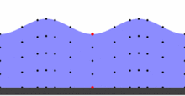
  Wave basics
Water Waves
If you throw a small rock into a duck pond (obviously avoiding the ducks)
You will see ripples form and move across the waters surface
The ripples cause water particles to vibrate up and down
The duck does not get carried to the edge of the pond it just bobs up and down
In this GIF the red dot represents the duck

Slide 6

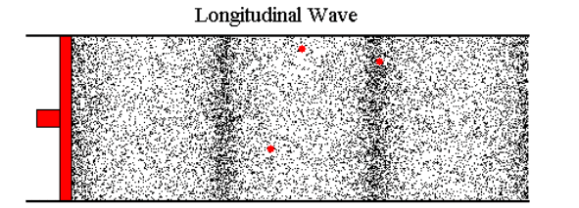
  Wave basics
Sound waves
If you hit a drum you will create a sound wave
The sound wave travels to your ear and you hear the drum sound
Sound waves cause air particles to vibrate back and forth
The air particles do not travel from the drum to your ear
Only energy is transferred and not the particles
Sound wave
In this GIF the red dots represents air particles

Slide 7
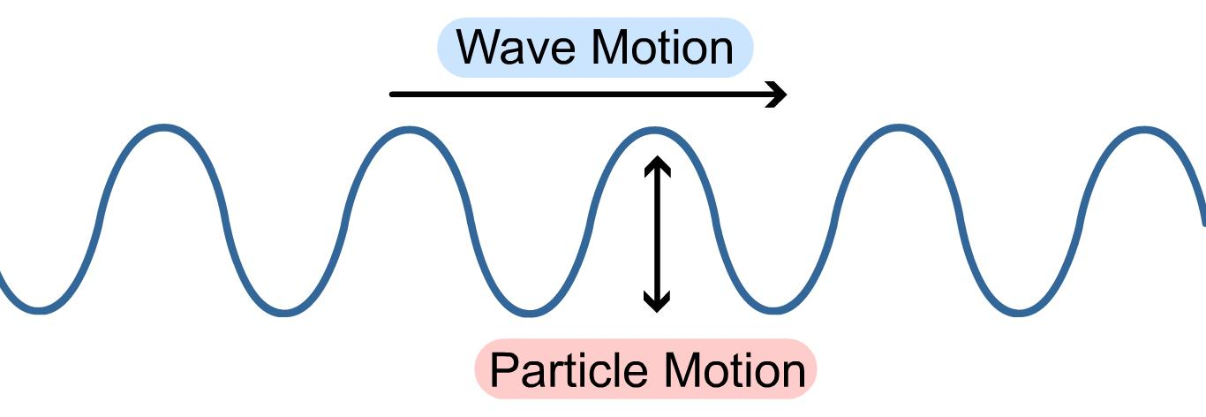
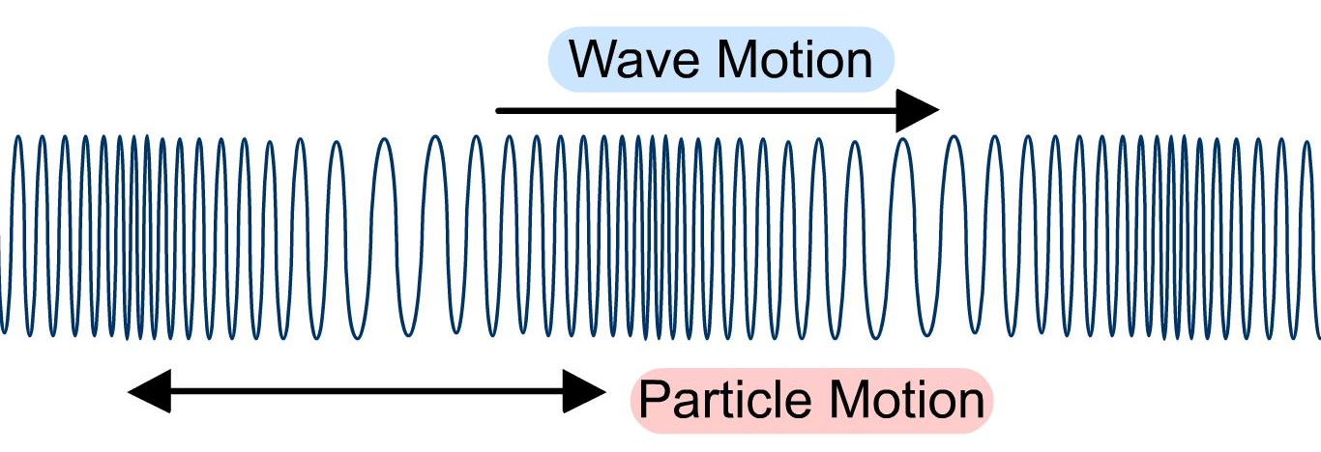
  Transverse and Longitudinal Waves
Transverse Wave
In a transverse wave the particles within the wave move perpendicular (at 90º) to the direction the wave is travelling.
This is the wave produced in a rope when it is flicked up and down.
Examples of transverse waves are:
Water waves, electromagnetic (light) waves and guitar strings.
Longitudinal waves are compression (squash) waves where the particles are vibrating in the same direction as the wave movement.
This is the wave produced when a spring is squashed and released.
Examples of longitudinal waves are:
Sound waves and a type of seismic (P) wave.
Longitudinal Wave
Remember, the particles in a wave move up and down or backwards and forwards only.
It is energy, NOT the particles, that move from one place to another!

Slide 8
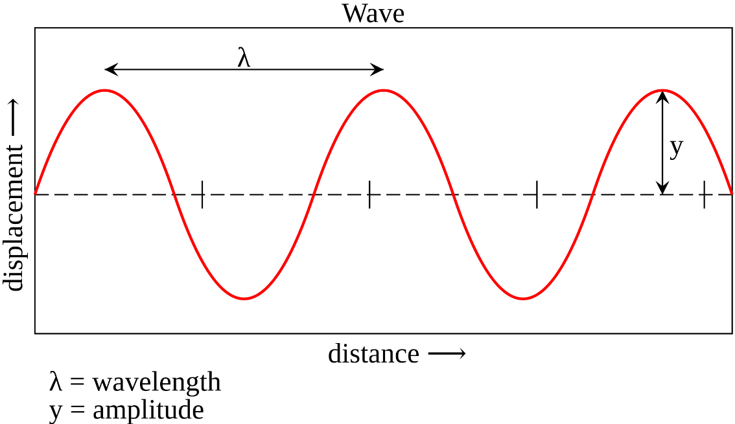
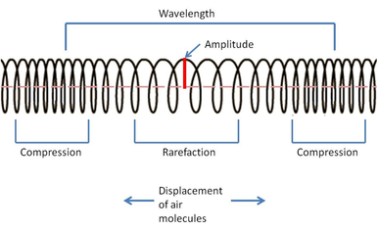
  Transverse and Longitudinal Waves
Wavelength (m) – the distance from one point on a wave to the same point on the next wave.
Amplitude (m) – the waves maximum displacement of a point on a wave from its undisturbed position.
Frequency (Hz) – the number of waves passing a point per second.
Period (s) - the time taken to produce one complete wave.
The displacement of a transverse wave is described as peaks and troughs. In a longitudinal wave these are described as compressions and rarefactions.

Slide 9
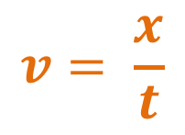

  Properties of waves
Recall and use both the equations below for all waves:
Wave speed is the speed at which energy is transferred by the wave (how quickly the wave moves) through the medium it is travelling in.
wave speed (m/s) = frequency (Hz) x wavelength (m)
wave speed (m/s) = distance (m) ÷ time (s)
$$v=f λ$$
$$v= \frac{x}{t}$$

Slide 10
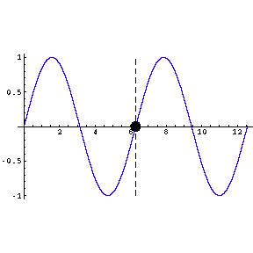



  Properties of waves
Recall and use both the equations below for all waves:
Example 1:
The wave below has a frequency of 0.5Hz and a wavelength of 6cm (0.06m).
Calculate the wave speed.
wave speed = frequency x wavelength
$$v=f λ$$
$$v=0.5 × 0.06$$
Click to reveal answer
$$v=0.3 m/s$$

Slide 11
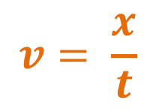

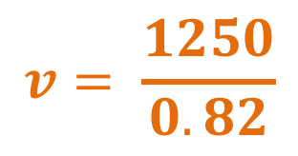
  Properties of waves
Recall and use both the equations below for all waves:
Example 2:
A sound wave travels 1250 m in 0.82 s underwater.
Calculate the speed of this wave.
wave speed (m/s) = distance (m) ÷ time (s)
$$v= \frac{x}{t}$$
$$v= \frac{1250}{0.82}$$
$v=$ 1524 m/s
Click to reveal answer

Slide 12

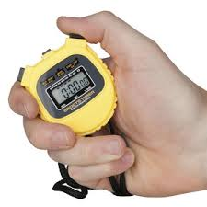
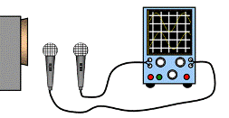
  Properties of waves
Method for measuring the speed of sound waves in air
100m
The cannon fires and the stopwatch is started (you can see a flash of light which takes almost zero time to travel 100m). When the sound reaches the observer the stopwatch is stopped. The time was 0.3s
This will give the time for sound to travel 100m.
Speed (m/s) = Distance (m) / Time (s)
Speed of sound = 100 / 0.3 = 333.3m/s
In the laboratory, a sound from a loudspeaker passes two microphones a set distance apart. The time recorded for the sound to travel this distance is measured and speed is calculated using the same formula as above.

Slide 13
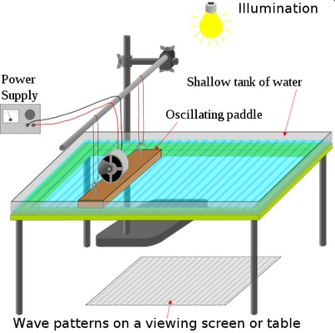



  Properties of waves
Method for measuring the speed of ripples on a water surface
A ripple tank is used to make waves which are seen under the glass tank.
A strobe light has its frequency of flashes adjusted until the wave appears stationary – this is the frequency of the water wave.
Then, the wavelength of the water wave is measured by using a ruler to measure the distance from one peak to the next peak (white line to white line). This is converted to metres.
wave speed (m/s) = frequency (Hz) x wavelength (m)
If the frequency of the water wave is 5Hz and the wavelength is 0.6cm:
wave speed = 0.5 x 0.006 = 0.03m/s
Strobe
Click to reveal answer

Slide 14




Calculate depth or distance (Physics only Higher tier)
Example 1:
A man uses a dog whistle to call his dog, the whistle uses ultrasound.
The ultrasound takes 0.47 s to travel from the man to the dog.
The speed of sound in air is 330 m/s
How far away was the dog?
wave speed (m/s) = distance (m) ÷ time (s)
$$v= \frac{x}{t}$$
Click to reveal answer
$$330= \frac{x}{0.47}$$
Click to reveal answer
rearrange
$x =330 × 0.4$7
Click to reveal answer
$x=$ 155.1 m

Slide 15



Calculate depth or distance (Physics only Higher tier)
Example 2:
A pulse of ultrasound takes 0.75 s to travel from a fishing vessel to a shoal of shrimp in the sea.
The speed of sound in air is 1500 m/s
How deep in the sea is the shoal of shrimp?
wave speed (m/s) = distance (m) ÷ time (s)
$$v= \frac{x}{t}$$
Click to reveal answer
$$1500= \frac{x}{0.375}$$
Remember to divide the time by 2
Click to reveal answer
rearrange
$x =1500 × 0.$375
Click to reveal answer
$x=$ 562.5 m

Slide 16
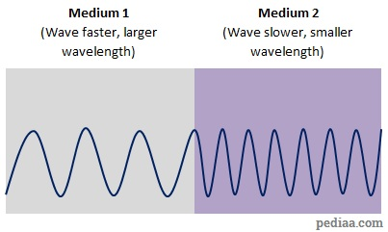
  Sound waves changing medium
When a sound wave travels from one medium to another e.g. air to water, the frequency remains the same. This is because frequency is a property of the object producing the sound, not the medium it travels through.
Air Water
The sound wave will travel faster in water than air.
Remember, wave speed (m/s) = frequency (Hz) x wavelength (m) or f = v / λ.
So, if the frequency remains the same, as velocity increases, the wavelength must also increase proportionally.
If a sound wave has a frequency of 260Hz:
Speed of sound in air = 330m/s. Speed of sound in water = 1500m/s.
λ in air = 330 / 260 = 1.27m λ in water = 1500 / 260 = 5.77m

Slide 17
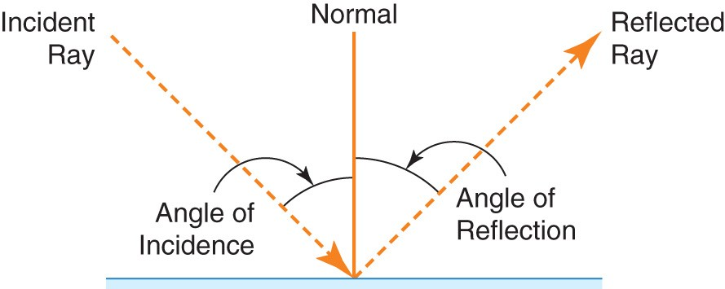
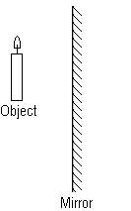
  Reflection of waves (Physics only)
When light waves strike a boundary they can be reflected, absorbed or transmitted depending on the substance they strike.
Reflected light bounces off the object surface
Transmitted light passes through the object
Absorbed light heats the object
Light reflected from a specular surface, e.g. a mirror, reflects at the same angle it strikes the mirror.
Angle of incidence (i) =
angle of reflection (r)

Slide 18
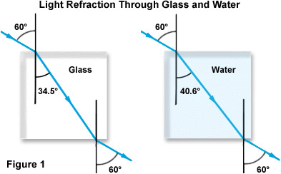
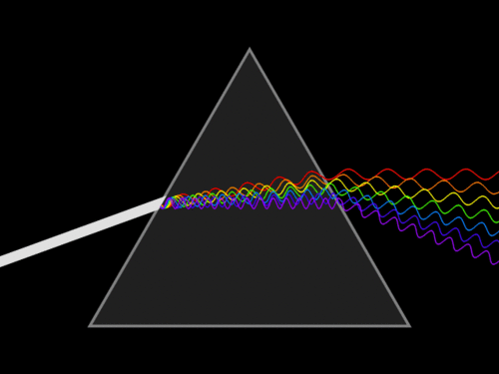
  Refraction of waves (Physics only)
Refraction of different wavelengths of light in different materials
Refraction of electromagnetic waves occurs
because the wave changes speed when it
enters a substance of different optical density.
The light wave will only refract if one side of the wave strikes the new material before the other side.
The amount of refraction is different for materials of different optical density as seen in Figure 1 opposite.
Different wavelengths of light are diffracted by different amounts, resulting in a spectrum of colour being produced when white light is refracted (dispersed) by a prism.

Slide 19

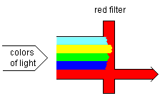
  Absorption and transmission of waves (Physics only, higher tier)
Absorption, transmission and reflection of different wavelengths of light
Most materials absorb some of the light falling on it. A white or shiny surface reflects most of the incident light whereas a black surface absorbs most wavelengths of light.
Absorbed light is changed into a heat energy store so is not re-radiated as light.
White light/sunlight is made from all the wavelengths of light in the spectrum.
A red object appears red in white light because it only reflects the red wavelengths of light, all other colours are absorbed.
If light transmits through a coloured object, the colour passing through is the colour we see. As with reflected light, all other wavelengths of light are absorbed by the transparent or translucent material.
White light

Slide 20
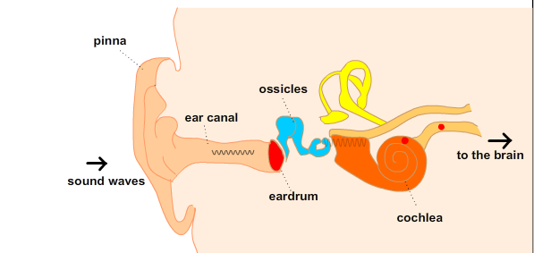

  Sound waves (Physics only, higher tier)
Sound waves can travel through solids causing vibrations in the solid.
In the ear, sound waves cause the ear drum and other parts to vibrate which causes the sensation of sound. The conversion of sound waves to solids only happens over a limited frequency range. This restricts the human hearing range to between 20Hz and 20,000Hz (20kHz).
Ear drum
Sound waves

Slide 21
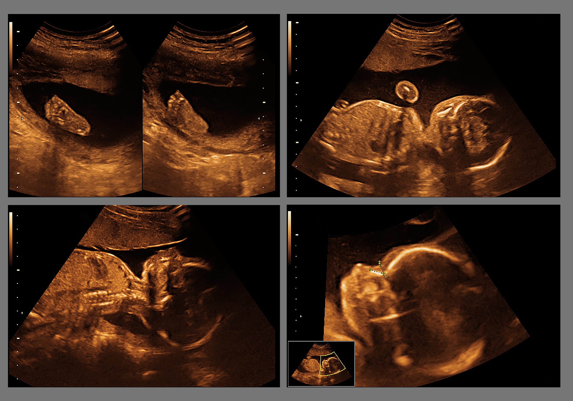
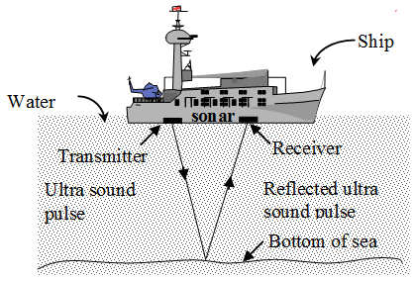
  Ultrasound (Physics only higher tier)
Ultrasounds are sound waves with a higher frequency than humans can hear.
Sound with frequencies greater than 20 000 hertz, Hz, is known as ultrasound
Ultrasound waves are partially reflected when they meet a boundary between two different media. The time taken for the reflections to meet a detector can be used to determine how far away the boundary is.
Ultrasound waves can therefore be used for medical imaging.
The ultrasound waves used to image babies have small amplitude so are low energy. This makes it safer, as no damage is done to any living cells.
Echo location or SONAR uses high frequency sound waves to detect objects in deep water (shipwrecks, shoals of fish) and measure water depth.

Slide 22
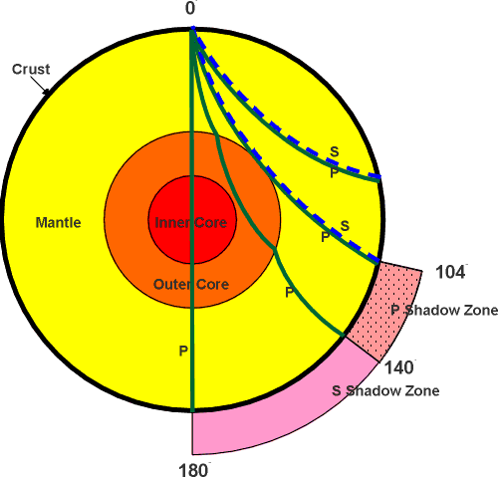
  Exploring the Earth’s core (Physics only, higher tier)
Earthquake epicentre
Seismic waves used for exploration
Earthquakes produce P and S waves.
This information can be used to determine the size, density and state of the Earth’s structure. As S waves do not penetrate the outer core, they can not be used to determine whether the inner core is liquid or solid.
P waves: fast longitudinal; travel at different speeds through solids and liquids.
S waves: slower transverse; cannot travel through liquids.
The study of seismic waves provided new evidence that led to discoveries about parts of the Earth which are not directly observable.

Slide 23
QuestionIT!
Waves
  Wave basics
  Wave speed/velocity
  Effects of waves (physics only)

Slide 24
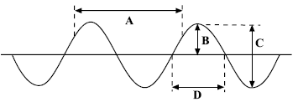
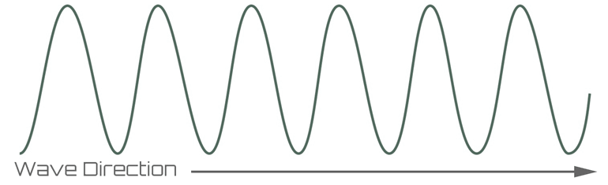
  Waves – QuestionIT
What do waves transfer?
a. What type of wave is shown above?
b. Which letter represents the amplitude of the wave?
c. Which letter shows the wavelength?
2. Draw a longitudinal wave and label a compression, rarefaction and the wavelength.
3. The diagram shows a cork floating on a water wave which has a frequency of 0.5 Hz. Which letter shows where the cork will be 2 seconds later?
A
B
D
C

Slide 25
  Waves– QuestionIT
4. What is meant by the period of a wave?
5. State the two equations that you can use to calculate wave speed.
6. A sound wave has a frequency of 240Hz and a wavelength of 1.38m. Calculate the velocity of this sound wave. Show clearly the formula you use for this calculation.

Slide 26
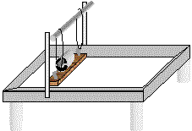
  Waves– QuestionIT
7. The diagram shows a ripple tank, used to
generate waves in the laboratory.
Describe the measurements that must be made in
order to calculate the velocity of water waves in the tank.

Slide 27
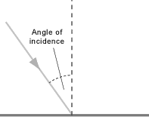
  Waves– QuestionIT
(Physics HT only) The sound waves from a noisy jet travel from the air into water. Which property of the wave will not change?
(Physics HT only) The Eiffel Tower is made of iron. The speed of sound in iron is 4000m/s. Someone at the top hits the iron with a hammer and the sound can be heard at the bottom 0.08s later. How tall is the Eiffel Tower?
(Physics only) The diagram shows a light ray striking a plane mirror. Copy and complete the diagram (include all labels).

Slide 28
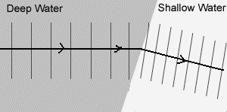
  Waves– QuestionIT
(Physics only) When light strikes a black curtain, very little light gets reflected. What happens to the light?
(Physics only) Explain why you can not see your reflection when you look into a piece of white plastic held in front of you.
(Physics only) When waves flow from deep water to shallow water the wave can bend (diffract). What happens to the speed of the wave to allow this to happen?

Slide 29
  Waves– QuestionIT
(Physics HT only) Describe how sound waves in the air are converted to vibrations in solids by the ear.
(Physics HT only) Which of the following represents the frequency range of human hearing?
200Hz to 2000Hz 20Hz to 20 000Hz 2000Hz to 200 000Hz
(Physics HT only) What are ultrasound waves?

Slide 30

  Waves– QuestionIT
(Physics HT only) The picture shows the
  ultrasound image of an unborn baby.
  Explain how ultrasound is able to produce
  an image from the outside of the mother.

Slide 31
  Waves– QuestionIT
(Physics HT only) Seismic waves are described as P or S waves. Copy the table and put ticks in the correct column to show the difference in these two seismic waves.
(Physics HT only) Describe how P and S seismic waves can be used to show part of the Earth’s core is liquid.
Wave type | Longitudinal wave | Fastest wave | Can travel through liquid and solid
P wave
S wave

Slide 32

AnswerIT!
Waves
  Wave basics
  Wave speed/velocity
  Effects of waves (physics only)

Slide 33
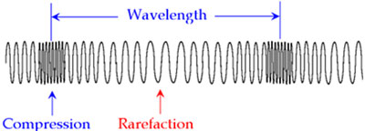
  Waves– AnswerIT
What do waves transfer?
  Energy
a. What type of wave is shown above? Transverse
b. Which letter represents the amplitude of the wave? B
c. Which letter shows the wavelength? A
2. Draw a longitudinal wave and label a compression, rarefaction and the wavelength.
3. The diagram shows a cork floating on a water wave which has a frequency of 0.5 Hz. Which letter shows where the cork will be 2 seconds later? A
A
B
D
C

Slide 34
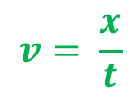

  Waves– AnswerIT
4. What is meant by the period of a wave?
  Time taken to complete 1 full wave.
5. State the two equations that you can use to calculate wave speed.
wave speed (m/s) = frequency (Hz) x wavelength (m)
wave speed (m/s) = distance (m) ÷ time (s)
6. A sound wave has a frequency of 240Hz and a wavelength of 1.38m. Calculate the velocity of this sound wave. Show clearly the formula you use for this calculation.
  v = f λ v = 240 x 1.38
Velocity of the wave = 331.3m/s
$$v=f λ$$
$$v= \frac{x}{t}$$

Slide 35

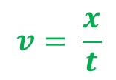
  Waves– AnswerIT
7. The diagram shows a ripple tank, used to
generate waves in the laboratory.
Describe the measurements that must be made in
order to calculate the velocity of water waves in the tank.
  Measure wave frequency with a strobe light and wavelength of a wave with a ruler then use
  or: measure time for a wave to travel a measured distance and
  use
$$v=f λ$$
$$v= \frac{x}{t}$$

Slide 36
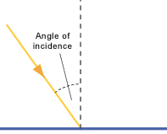
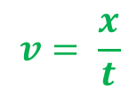

  Waves– AnswerIT
(Physics HT only) The sound waves from a noisy jet travel from the air into water. Which property of the wave will not change?
  Frequency.
(Physics HT only) The Eiffel Tower is made of iron. The speed of sound in iron is 4000m/s. Someone at the top hits the iron with a hammer and the sound can be heard at the bottom 0.08s later. How tall is the Eiffel Tower?
  x (height) = 4000 x 0.08 = 320m
(Physics only) The diagram shows a light ray striking a plane mirror. Copy and complete the diagram (include all labels).
  (angle of incidence = angle of reflection)
$$v= \frac{x}{t}$$
$$4000= \frac{x}{0.08}$$
Angle of reflection

Slide 37
  Waves– AnswerIT
(Physics only) When light strikes a black curtain, very little light gets reflected. What happens to the light?
  It is absorbed by the curtain as heat energy.
(Physics only) Explain why you can not see your reflection when you look into a piece of white plastic held in front of you.
  Light rays are scattered in all directions – diffuse reflection.
(Physics only) When waves flow from deep water to shallow water the wave can bend (diffract). What happens to the speed of the wave to allow this to happen?
  Waves slow down in shallow water.
Bottom of wave enters shallow water before top
of wave. Therefore bottom of wave slows down
before the top, causing the wave to bend.

Slide 38
  Waves– AnswerIT
(Physics HT only) Describe how sound waves in the air are converted to vibrations in solids by the ear.
  Compressions in the air cause the ear drum to flex inwards and outwards. This sets up vibrations of the bones in the inner ear.
(Physics HT only) Which of the following represents the frequency range of human hearing?
200Hz to 2000Hz 20Hz to 20 000Hz 2000Hz to 200 000Hz
(Physics HT only) What are ultrasound waves?
  Sound waves with a frequency higher than humans can hear.

Slide 39
  Waves– AnswerIT
(Physics HT only) The picture shows the
  ultrasound image of an unborn baby.
  Explain how ultrasound is able to produce
  an image from the outside of the mother.
  Ultrasounds penetrate the body. Some of the waves are reflected when they meet a boundary between two structures. These reflected waves are received at different times and are formed into an image.

Slide 40
  Waves– AnswerIT
(Physics HT only) Seismic waves are described as P or S waves. Copy the table and put ticks in the correct column to show the difference in these two seismic waves.
(Physics HT only) Describe how P and S seismic waves can be used to show part of the Earth’s core is liquid.
  Detectors on the opposite side of the Earth to the earthquake epicentre can record both P and S waves. Only P waves are detected meaning S waves can not penetrate through the Earth. As S waves can not travel through liquids, it is deduced that part of the core is liquid .
Wave type | Longitudinal wave | Fastest wave | Can travel through liquid and solid
P wave | ✓ | ✓ | ✓
S wave

