Slide 1


The PiXL Club The PiXL Club The PiXL Club The PiXL Club The PiXL Club The PiXL Club The PiXL Club The PiXL Club The PiXL Club The PiXL Club The PiXL Club The PiXL Club The PiXL Club The PiXL Club The PiXL Club The PiXL Club The PiXL Club The PiXL Club The PiXL Club The PiXL Club The PiXL Club The PiXL Club The PiXL Club The PiXL Club The PiXL Club The PiXL Club The PiXL Club The PiXL Club The PiXL Club The PiXL Club The PiXL Club The PiXL Club The PiXL Club The PiXL Club The PiXL Club The PiXL Club The PiXL Club The PiXL Club The PiXL Club The PiXL Club The PiXL Club The PiXL Club The PiXL Club The PiXL Club The PiXL Club XL Club The PiXL Club The PiXL Club The PiXL Club The PiXL Club The PiXL Club The PiXL Club The PiXL Club The PiXL Club The PiXL Club The PiXL Club The PiXL Club The PiXL Club The PiXL Club The PiXL Club The PiXL Club The PiXL Club The PiXL Club The PiXL Club The PiXL Club The PiXL Club The PiXL Club The PiXL Club The PiXL Club The PiXL Club The PiXL Club The PiXL Club The PiXL Club The PiXL Club The PiXL Club The PiXL Club The PiXL Club The PiXL Club The PiXL Club The PiXL Club The PiXL Club The PiXL Club The PiXL Club The PiXL Club The PiXL Club The PiXL Club The PiXL Club The PiXL Club The PiXL Club The PiXL Club The PiXL Club The PiXL Club The PiXL Club The PiXL Club The PiXL Club The PiXL Club The PiXL Club The PiXL Club The PiXL Club The PiXL Club The PiXL Club The PiXL Club The PiXL Club The PiXL Club The PiXL Club The PiXL Club The PiXL Club The PiXL Club The PiXL Club The PiXL Club The PiXL Club The PiXL Club The PiXL Club The PiXL Club The PiXL Club The PiXL Club The PiXL Club The PiXL Club The PiXL Club The PiXL Club The PiXL Club The PiXL Club The PiXL Club The PiXL Club The PiXL Club The PiXL Club The PiXL Club The PiXL Club The PiXL Club The PiXL Club The PiXL Club The PiXL Club The PiXL Club The PiXL Club The PiXL Club The PiXL Club The PiXL Club The PiXL Club The PiXL Club The PiXL Club The PiXL Club The PiXL Club The PiXL Club The PiXL Club The PiXL Club The PiXL Club The PiXL Club The PiXL Club The PiXL Club The PiXL Club The PiXL Club The PiXL Club The PiXL Club The PiXL Club The PiXL Club The PiXL Club The PiXL Club The PiXL Club The PiXL Club The PiXL Club The PiXL Club The PiXL Club The PiXL Club The PiXL Club The PiXL Club The PiXL Club The PiXL Club The PiXL Club The PiXL Club The PiXL Club The PiXL Club The PiXL Club The PiXL Club The PiXL Club The PiXL Club The PiXL Club The PiXL Club The PiXL Club The PiXL Club The PiXL Club The PiXL Club The PiXL Club The PiXL Club The PiXL Club The PiXL Club The PiXL Club The PiXL Club The PiXL Club The PiXL Club The PiXL Club The PiXL Club The PiXL Club The PiXL Club The PiXL Club The PiXL Club The PiXL Club The PiXL Club The PiXL Club The PiXL Club The PiXL Club The PiXL Club The PiXL Club The PiXL Club The PiXL Club The PiXL Club The PiXL Club The PiXL Club The PiXL Club The PiXL Club The PiXL Club The PiXL Club The PiXL Club The PiXL Club The PiXL Club The PiXL Club The PiXL Club The PiXL Club The PiXL Club The PiXL Club The PiXL Club The PiXL Club The PiXL Club The PiXL Club The PiXL Club The PiXL Club The PiXL Club The PiXL Club The PiXL Club The PiXL Club The PiXL Club The PiXL Club The PiXL Club The PiXL Club The PiXL Club The PiXL Club The PiXL Club The PiXL Club The PiXL Club The PiXL Club The PiXL Club The PiXL Club The PiXL Club The PiXL Club The PiXL Club The PiXL Club The PiXL Club The PiXL Club The PiXL Club The PiXL Club The PiXL Club The PiXL Club The PiXL Club The PiXL Club The PiXL Club The PiXL Club The PiXL Club The PiXL Club The PiXL Club The PiXL Club The PiXL Club The PiXL Club The PiXL Club The PiXL Club The PiXL Club The PiXL Club The PiXL Club The PiXL Club The PiXL Club The PiXL Club The PiXL Club The PiXL Club The PiXL Club The PiXL Club The PiXL Club The PiXL Club The PiXL Club The PiXL Club The PiXL Club The PiXL Club The PiXL Club The PiXL Club The PiXL Club The PiXL Club The PiXL Club The PiXL Club The PiXL Club The PiXL Club The PiXL Club The PiXL Club The PiXL Club The PiXL Club The PiXL Club The PiXL Club The PiXL Club The PiXL Club The PiXL Club The PiXL Club The PiXL Club The PiXL Club The PiXL Club The PiXL Club The PiXL Club The PiXL Club The PiXL Club The PiXL Club The PiXL Club The PiXL Club The PiXL Club The PiXL Club The PiXL Club The PiXL Club The PiXL Club The PiXL Club The PiXL Club The PiXL Club The PiXL Club The PiXL Club The PiXL Club The PiXL Club The PiXL Club The PiXL Club The PiXL Club The PiXL Club The PiXL Club The PiXL Club The PiXL Club The PiXL Club The PiXL Club The PiXL Club The PiXL Club The PiXL Club The PiXL Club The PiXL Club The PiXL Club The PiXL Club The PiXL Club The PiXL Club The PiXL Club The PiXL Club The PiXL Club The PiXL Club The PiXL Club The PiXL Club The PiXL Club The PiXL Club The PiXL Club The PiXL Club The PiXL Club The PiXL Club The PiXL Club The PiXL Club The PiXL Club The PiXL Club The PiXL Club The PiXL Club The PiXL Club The PiXL Club The PiXL Club The PiXL Club The PiXL Club The PiXL Club The PiXL Club The PiXL Club The PiXL Club The PiXL Club The PiXL Club The PiXL Club The PiXL Club The PiXL Club The PiXL Club The PiXL Club The PiXL Club The PiXL Club The PiXL Club The PiXL Club The PiXL Club The PiXL Club The PiXL Club The PiXL Club The PiXL Club The PiXL Club The PiXL Club The PiXL Club The PiXL Club The PiXL Club The PiXL Club The PiXL Club The PiXL Club The PiXL Club The PiXL Club The PiXL Club The PiXL Club The PiXL Club The PiXL Club The PiXL Club The PiXL Club The PiXL Club The PiXL Club The PiXL Club The PiXL Club The PiXL Club The PiXL Club The PiXL Club The PiXL Club The PiXL Club The PiXL Club The PiXL Club The PiXL Club The PiXL Club The PiXL Club The PiXL Club The PiXL Club The PiXL Club The PiXL Club The PiXL Club The PiXL Club The PiXL Club The PiXL Club The PiXL Club The PiXL Club The PiXL Club The PiXL Club The PiXL Club The PiXL Club The PiXL Club The PiXL Club The PiXL Club The PiXL Club The PiXL Club The PiXL Club The PiXL Club The PiXL Club The PiXL Club The PiXL Club The PiXL Club The PiXL Club The PiXL Club The PiXL Club The PiXL Club The PiXL Club The PiXL Club The PiXL Club The PiXL Club The PiXL Club The PiXL Club The PiXL Club The PiXL Club The PiXL Club The PiXL Club The PiXL Club The PiXL Club The PiXL Club The PiXL Club The PiXL Club The PiXL Club The PiXL Club The PiXL Club The PiXL Club The PiXL Club The PiXL Club The PiXL Club The PiXL Club The PiXL Club The PiXL Club The PiXL Club The PiXL Club The PiXL Club The PiXL Club The PiXL Club The PiXL Club The PiXL Club The PiXL Club The PiXL Club The PiXL Club The PiXL Club The PiXL Club The PiXL Club The PiXL Club The PiXL Club The PiXL Club The PiXL Club The PiXL Club The PiXL Club The PiXL Club The PiXL Club The PiXL Club The PiXL Club The PiXL Club The PiXL Club The PiXL Club The PiXL Club The PiXL Club The PiXL Club The PiXL Club The PiXL Club The PiXL Club The PiXL Club The PiXL Club The PiXL Club The PiXL Club The PiXL Club The PiXL Club The PiXL Club The PiXL Club The PiXL Club The PiXL Club The PiXL Club The PiXL Club The PiXL Club The PiXL Club The PiXL Club The PiXL Club The PiXL Club The PiXL Club The PiXL Club The PiXL Club The PiXL Club The PiXL Club The PiXL Club The PiXL Club The PiXL Club The PiXL Club The PiXL Club The PiXL Club The PiXL Club The PiXL Club The PiXL Club The PiXL Club The PiXL Club The PiXL Club The PiXL Club The PiXL Club The PiXL Club The PiXL Club The PiXL Club The PiXL Club The PiXL Club The PiXL Club The PiXL Club The PiXL Club The PiXL Club The PiXL Club The PiXL Club The PiXL Club The PiXL Club The PiXL Club The PiXL Club The PiXL Club The PiXL Club The PiXL Club The PiXL Club The PiXL Club The PiXL Club The PiXL Club The PiXL Club The PiXL Club The PiXL Club The PiXL Club The PiXL Club The PiXL Club The PiXL Club The PiXL Club The PiXL Club The PiXL Club The PiXL Club The PiXL Club The PiXL Club The PiXL Club The PiXL Club The PiXL Club The PiXL Club The PiXL Club The PiXL Club The PiXL Club The PiXL Club The PiXL Club The PiXL Club The PiXL Club The PiXL Club The PiXL Club The PiXL Club The PiXL Club The PiXL Club The PiXL Club The PiXL Club The PiXL Club The PiXL Club The PiXL Club The PiXL Club The PiXL Club The PiXL Club The PiXL Club The PiXL Club The PiXL Club The PiXL Club The PiXL Club The PiXL Club The PiXL Club The PiXL Club The PiXL Club The PiXL Club The PiXL Club The PiXL Club The PiXL Club The PiXL Club The PiXL Club The PiXL Club The PiXL Club The PiXL Club The PiXL Club The PiXL Club The PiXL Club The PiXL Club The PiXL Club The PiXL Club The PiXL Club The PiXL Club The PiXL Club The PiXL Club The PiXL Club The PiXL Club The PiXL Club The PiXL Club The PiXL Club The PiXL Club The PiXL Club The PiXL Club The PiXL Club The PiXL Club The PiXL Club The PiXL Club The PiXL Club The PiXL Club The PiXL Club The PiXL Club The PiXL Club The PiXL Club The PiXL Club The PiXL Club The PiXL Club The PiXL Club The PiXL Club The PiXL Club The PiXL Club The PiXL Club The PiXL Club The PiXL Club The PiXL Club The PiXL Club The PiXL Club The PiXL Club The PiXL Club The PiXL Club The PiXL Club The PiXL Club The PiXL Club The PiXL Club The PiXL Club The PiXL Club The PiXL Club The PiXL Club The PiXL Club The PiXL Club The PiXL Club The PiXL Club The PiXL Club The PiXL Club The PiXL Club The PiXL Club The PiXL Club The PiXL Club The PiXL Club The PiXL Club The PiXL Club The PiXL Club The PiXL Club The PiXL Club The PiXL Club The PiXL Club The PiXL Club The PiXL Club The PiXL Club The PiXL Club The PiXL Club The PiXL Club The PiXL Club The PiXL Club The PiXL Club The PiXL Club The PiXL Club The PiXL Club The PiXL Club The PiXL Club The PiXL Club The PiXL Club The PiXL Club The PiXL Club The PiXL Club The PiXL Club The PiXL Club The PiXL Club The PiXL Club The PiXL Club The PiXL Club The PiXL Club The PiXL Club The PiXL Club The PiXL Club The PiXL Club The PiXL Club The PiXL Club The PiXL Club The PiXL Club The PiXL Club The PiXL Club The PiXL Club The PiXL Club The PiXL Club The PiXL Club The PiXL Club The PiXL Club The PiXL Club The PiXL Club The PiXL Club The PiXL Club The PiXL Club The PiXL Club The PiXL Club The PiXL Club The PiXL Club The PiXL Club The PiXL Club The PiXL Club The PiXL Club The PiXL Club The PiXL Club The PiXL Club The PiXL Club The PiXL Club The PiXL Club The PiXL Club The PiXL Club The PiXL Club The PiXL Club The PiXL Club The PiXL Club
PiXL KnowIT!
GCSE Physics
Edexcel Light and the electromagnetic spectrum
© Copyright The PiXL Club Ltd, 2017
This resource is strictly for the use of member schools for as long as they remain members of The PiXL Club. It may not be copied, sold nor transferred to a third party or used by the school after membership ceases. Until such time it may be freely used within the member school.
All opinions and contributions are those of the authors. The contents of this resource are not connected with nor endorsed by any other company, organisation or institution.
www.pixl.org.uk The PiXL Club Ltd, Company number 07321607

Slide 2
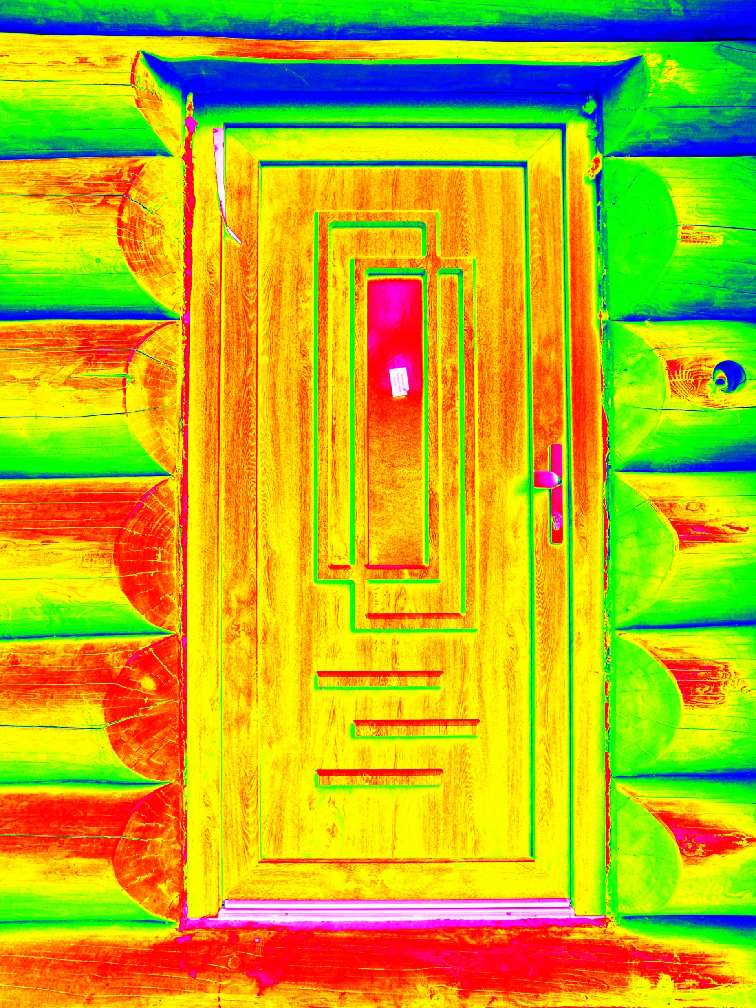
Overview
Edexcel Topic 5
  Light and the electromagnetic spectrum
  Part 1
  Ray diagrams
  Colour (Physics only)
  Lenses (Physics only)
  Part 2
  Electromagnetic spectrum
  Radiation and temperature (Physics only)
  Uses of EM radiation

Slide 3
LearnIT!
KnowIT!
Part 1 (Physics only)
Ray diagrams
Colour
Lenses

Slide 4
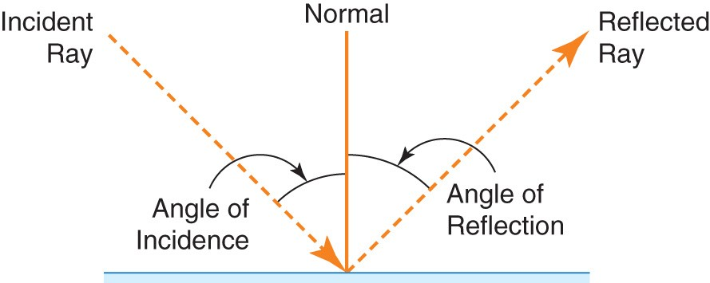
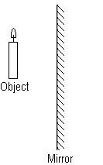
  Ray diagrams – reflection (Physics only)
A ray diagram is a representation of the path a wave can take to get from from a source to an observer or screen.
Mirror
Light waves
Water waves
The law of reflection states:
Angle of incidence (i) = Angle of reflection (r)
For example:
If a light ray hits a mirror at an angle of incidence of 30º from the normal the angle of the reflected ray will also be 30º from the normal.

Slide 5
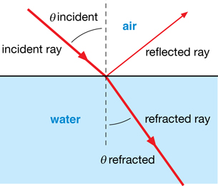
  Ray diagrams – refraction (Physics only)
Refraction of waves at a boundary – ray diagrams
When light strikes a transparent material, some of the light may be reflected but some will also be refracted.
When light enters a substance of greater density, it will be bent (refracted) towards the normal line.
Angle of incidence > Angle of refraction
Normal
When light enters a substance of lower density, it will be bent (refracted) away from the normal line.
Angle of incidence < Angle of refraction

Slide 6
  Ray diagrams – total internal reflection (Physics only)
When a light ray reaches a boundary between two transparent materials it may be refracted. If it is leaving a substance of greater density, it will be bent (refracted) away from the normal line.
If the ray out is at an angle of more than 90° from the normal, the refraction is not possible. In this situation, the ray is reflected inside the more dense substance. This is called total internal reflection (TIR).
The angle of incidence when the ray changes from just refracting to TIR is called the critical angle.

Slide 7
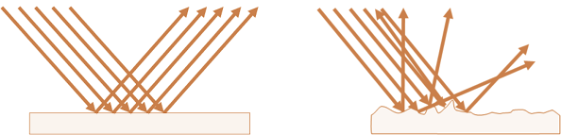
  Specular and diffuse reflection (Physics only)
Objects that give off light are called luminous objects e.g. the sun, a candle, a TV screen the light travels from the object to our eyes and that is how we can see them. All non-luminous objects reflect light from their surfaces into our eyes.
There are two types of reflection specular and diffuse
Specular reflection:
All the incident light rays are is reflected into a single direction.
Diffuse reflection:
All the incident light rays are is reflected in different directions due to the uneven surface.

Slide 8
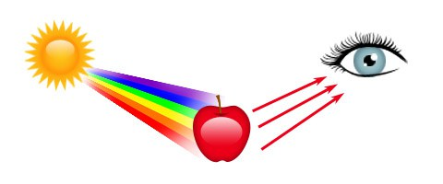
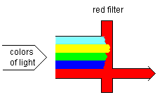
  Colour (Physics only)
Absorption, transmission and reflection of different wavelengths of light
Most materials absorb some of the light falling on it. A white or shiny surface reflects most of the incident light whereas a black surface absorbs most wavelengths of light.
Absorbed light is changed into a heat energy store so is not re-radiated as light.
White light/sunlight is made from all the wavelengths of light in the spectrum.
A red object appears red in white light because it only reflects the red wavelengths of light, all other colours are absorbed.
If light transmits through a coloured object, the colour passing through is the colour we see. As with reflected light, all other wavelengths of light are absorbed by the transparent or translucent material.
White light

Slide 9
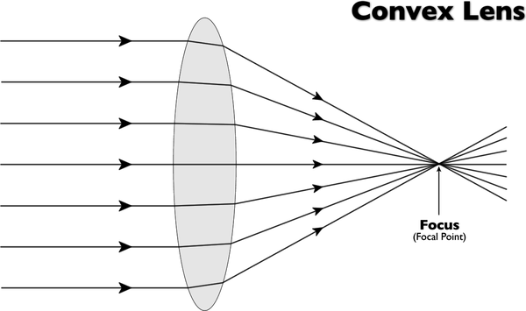
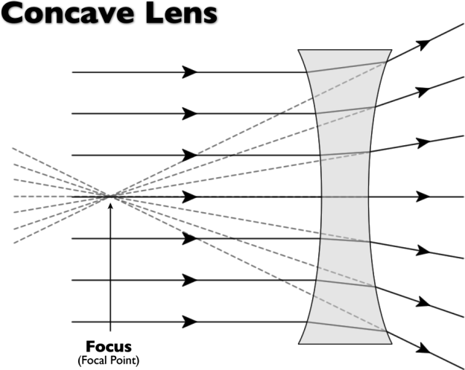


  Lenses (Physics only)
Lenses refract light to produce an image at a principal focus.
Focal Length
Focal Length
Convex lenses are also called converging lenses. They can produce real or virtual images.
Concave lenses are also called diverging lenses. They always produce virtual images.
A real image is the image formed where the light rays are focussed.
A virtual image is one from which the light rays appear to come from but don’t actually come from that image.

Slide 10
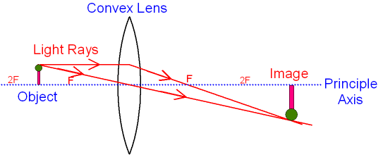
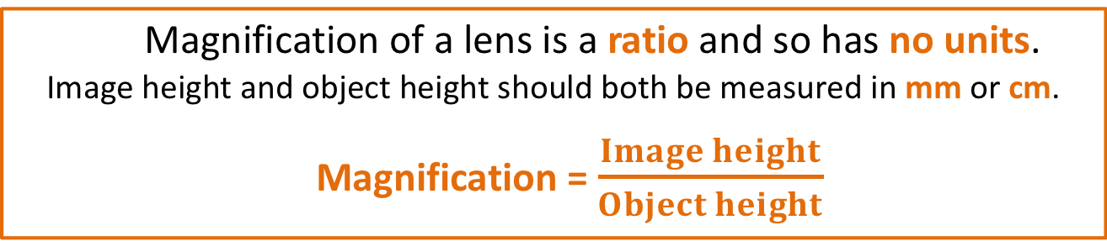
  Lenses (Physics only)
Magnification of a lens is a ratio and so has no units.
Image height and object height should both be measured in mm or cm.
Magnification = $\frac{Image height}{Object height}$
In the above diagram, the object height is 12mm and the image size is 24mm. The magnification of the lens is:
Magnification = 24 = 2
12
The magnification is x2. As this is a ratio there are no units for magnification.
The image type and magnification will also depend on the position of the object.

Slide 11
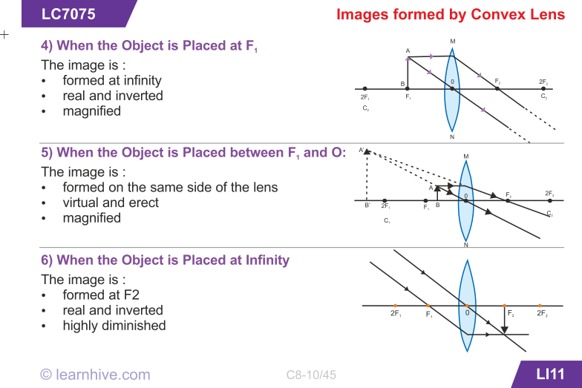
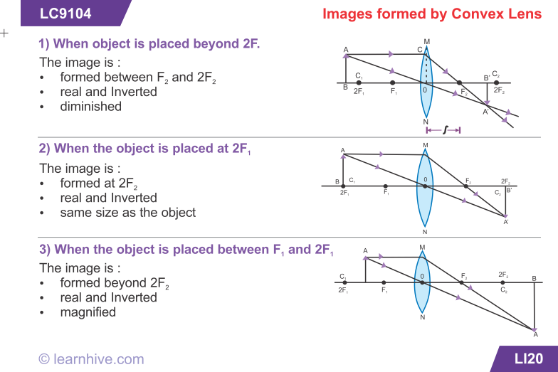
  Lenses (Physics only)
The image produced by a convex lens depends on the position of the object. The object can be placed anywhere between the lens, the focal length (F) and twice the focal length (2F) of the lens.
Object at the focal length (F)
Object closer than the focal length (<F)
Object at more than twice the focal length (>2F)
Object at twice the focal length (2F)
Object between F and 2F
Object at infinity

Slide 12
QuestionIT!
Part 1 (Physics only)
Ray diagrams
Colour
Lenses

Slide 13

  Part 1– QuestionIT (Physics only)
1. The light wave shown below meets a boundary between glass and air.
Continue the light ray to show its path after passing the boundary.
2. The wave front below is travelling from air into water.
Explain why the wave front bends.
3. Complete the sentences.
  When light enters a substance of greater density, it will be refracted …………….. the normal line.
  When light enters a substance of lower density, it will be refracted ………….. from the normal line.
Glass
Air

Slide 14
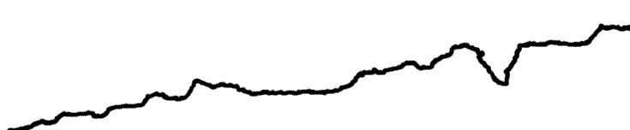
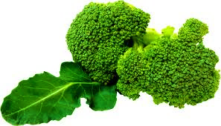
  Part 1– QuestionIT (Physics only)
4. What is total internal reflection?
5. A vase is illuminated with green and blue light. What colour would the vase appear if viewed through a red filter?
6. Which colour of light has the shortest wavelength?
7. Copy and complete the ray diagrams .
White light
Green vegetable

Slide 15

  Part 1– QuestionIT (Physics only)
8.
a. Copy and complete the two light rays on the diagram.
b. Label the principle axis, object and focal length on the diagram.
c. Describe the image produced by the above lens.
9. A 12cm object viewed in a convex lens has an image size of 54cm.
Calculate the magnification of the lens.
F
F

Slide 16

AnswerIT!
Part 1 (Physics only)
Ray diagrams
Colour
Lenses

Slide 17
  Part 1– AnswerIT (Physics only)
1. The light wave shown below meets a boundary between glass and air.
Continue the light ray to show its path after passing the boundary.
2. The wave front below is travelling from air into water.
Explain why the wave front bends.
  Left side of wave meets the denser material first.
The left side will slow down before the right side.
This will cause the wave to bend.
3. Complete the sentences.
  When light enters a substance of greater density, it will be refracted towards the normal line.
  When light enters a substance of lower density, it will be refracted away from the normal line.
Glass
Air

Slide 18
  Part 1– AnswerIT (Physics only)
4. What is total internal reflection?
  When the ray out of a boundary is at an angle of more than 90° from the normal and refraction is not possible. The ray is reflected inside the more dense substance.
5. A vase is illuminated with green and blue light. What colour would the vase appear if viewed through a red filter?
  No colour (black).
6. Which colour of light has the shortest wavelength?
  Violet
7. Copy and complete the ray diagrams .
White light
Green only reflected
Green vegetable

Slide 19
  Part 1– AnswerIT (Physics only)
8.
a. Copy and complete the two light rays on the diagram.
b. Label the principle axis, object and focal length on the diagram.
c. Describe the image produced by the above lens.
Inverted, laterally inverted, magnified, real
9. A 12cm object viewed in a convex lens has an image size of 54cm.
Calculate the magnification of the lens.
Magnification = image height/object height = 54/12 = x4.5
Object
Principle axis
F
F
Focal length

Slide 20
LearnIT!
KnowIT!
Part 2
Electromagnetic spectrum
Radiation and temperature (Physics only)
Uses of EM radiation

Slide 21
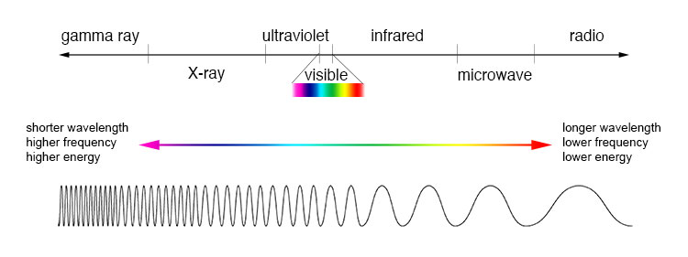
  Electromagnetic spectrum
Electromagnetic waves are transverse waves that transfer energy from the wave source to an absorber.
Electromagnetic waves form a continuous spectrum from the shortest gamma waves (< 10⁻¹¹m wavelength) to radio waves (> 100km wavelength).
Shorter wavelengths have a higher frequency and higher energy.
All electromagnetic waves travel at the same velocity in a vacuum:
300 000 000m/s.
Our eyes are only able to detect a small range of these waves shown as the visible range above. Some animals can see in ultra violet and some can detect infra red.

Slide 22
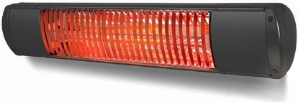
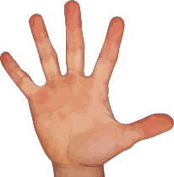

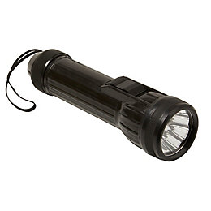
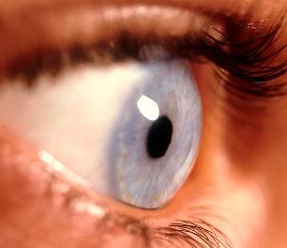
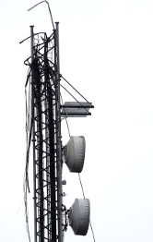
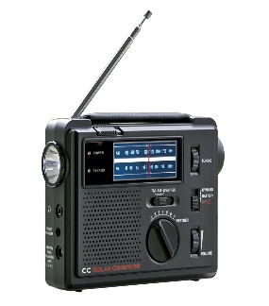
  Electromagnetic spectrum
Examples of transfer of energy by electromagnetic waves
Detected by heat sensors in the hand
Heater
Infra red waves
Detected by cells in the retina
Torch
Visible light waves
Radio transmitter
Detected by the aerial in the radio
Radio waves

Slide 23
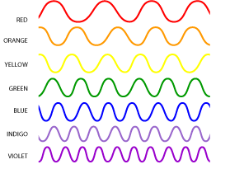

  Visible light
Red
Orange
Yellow
Green
Blue
Indigo
Violet
Visible light contains the limited range of frequencies that can be detected by the human eye.
Each colour within the visible spectrum has its own narrow band of wavelength and frequency.
Colour filters work by absorbing certain wavelengths (and colour) and transmitting other wavelengths (and colour).
The colour of an opaque object is determined by which wavelengths of light are more strongly reflected.
Wavelengths that are not reflected are absorbed.
If all wavelengths are reflected equally the object will appear white. If all the wavelengths of light are absorbed equally the object will appear black.

Slide 24
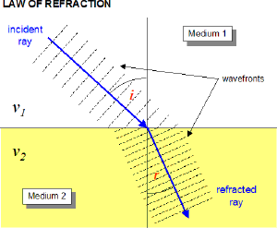
  Refraction of electromagnetic waves (HT)
Explaining refraction using wave front diagrams
The incident ray is shown as wave fronts where all the waves are in phase with each other. This is drawn as a wave line at right angles to the direction in which the wave is travelling.
The incident ray strikes the denser medium 2 at an angle.
When the wave front hits a denser material it slows down. One side of the wave front hits before the other side, so slows down first.
This causes the wave front to bend towards the normal line. Wave fronts will be closer together as the velocity is decreased. Frequency is unchanged.
Wave refraction Normal

Slide 25
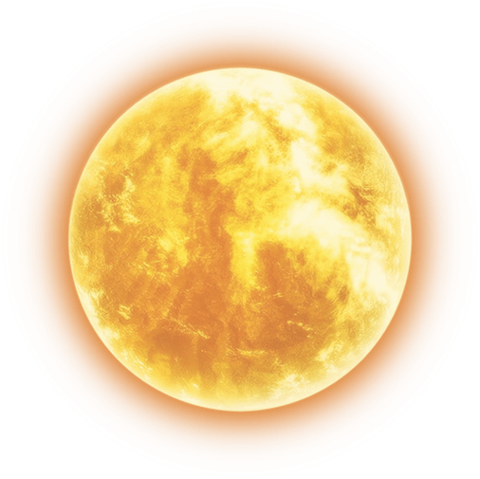
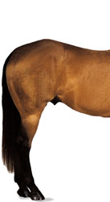
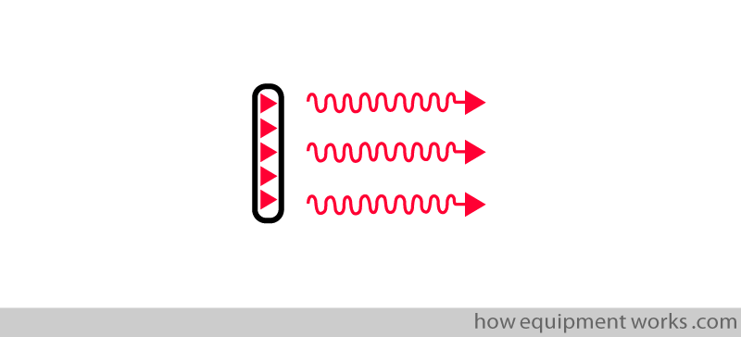
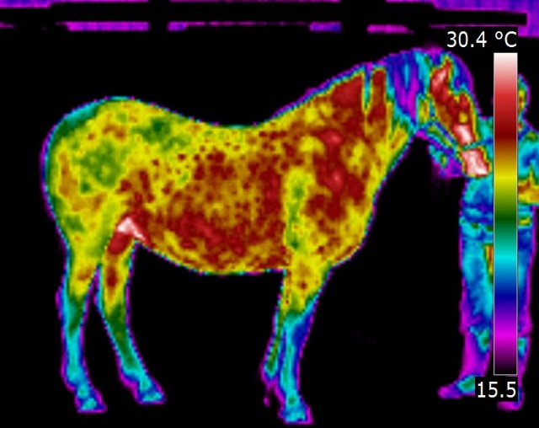
  Radiation and temperature (Physics only)
All objects (bodies) absorb and reflect infrared radiation. The hotter the object is, the more infrared radiation it emits.
An infrared detecting camera is needed to “see” the heat radiated by the horse
The horse absorbs infrared heat from the sun and then re-radiates this heat, sometimes at a different wavelength.
The intensity and wavelength of energy radiated by the horse depends on its temperature.
If the horse is to remain at a constant temperature, it must radiate infrared heat energy at the same rate as it absorbs it. If the horse can not emit radiation as quickly as it is absorbed, its temperature will increase.

Slide 26
  Radiation and temperature (Physics only)
A perfect black body is an object that absorbs all of the radiation incident on it. It does not reflect or transmit any radiation. Since a good absorber is a good emitter, a perfect black body would be the best possible emitter.
All bodies (objects) emit radiation.
The intensity and wavelength distribution of any emission depends on the temperature of the body.
Temperature (HT):
A body at a constant temperature is absorbing radiation at the same average power as it is emitting radiation.
The temperature of a body increases when the body absorbs radiation faster than it emits radiation.
The temperature of a body is related to the balance between incoming radiation absorbed and radiation emitted.

Slide 27
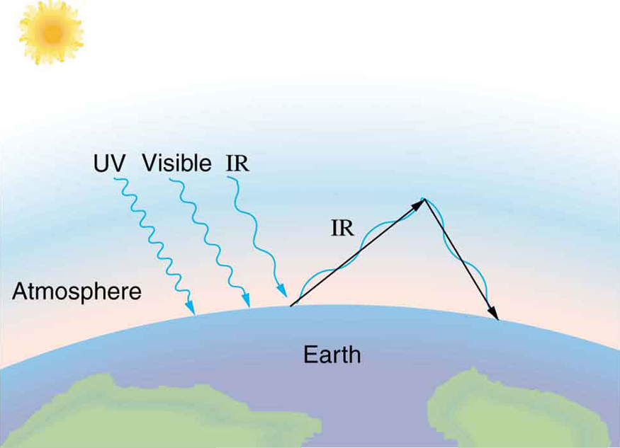
  Radiation and temperature (Physics only and Higher tier))
The Earth behaves in a similar way to a black body.
Wavelengths of electromagnetic energy from the sun including ultraviolet, visible light and infrared, penetrate the Earth’s atmosphere and heat up the surface of the Earth.
As the Earth heats up, it radiates infrared waves at a longer wavelength than those entering the atmosphere.
These longer wavelength infrared waves are reflected back to Earth by the upper atmosphere.
This prevents energy from being lost at the same rate as energy is received resulting in the Earth’s temperature increasing. This is known as global warming.
Increased carbon dioxide in the atmosphere (from burning fuels) reduces the amount of radiation leaving the Earth. This results in a warming of the atmosphere (global warming). Snow and ice reflect incoming radiation. Global warming melts snow and ice resulting in further global warming.

Slide 28
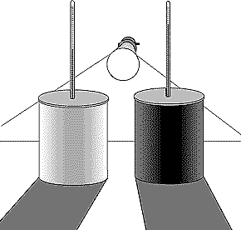
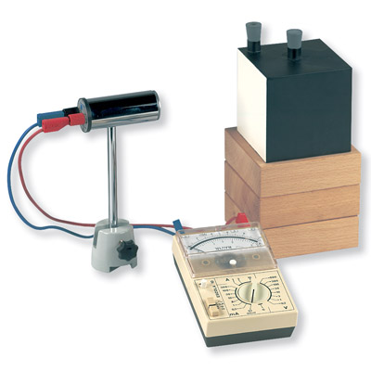
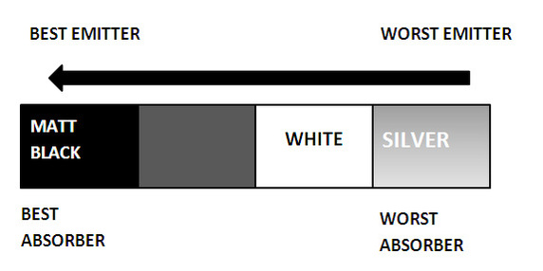
  Radiation and temperature (Physics only)
Absorption and radiation of infra red waves
Black surfaces absorb infrared waves better than white or shiny surfaces.
Black surfaces also emit infrared radiation quicker than light coloured surfaces
This is the reason black cars and black curtains get hot in sunshine.
Petrol storage tankers are painted white or polished to reflect the suns IR heat waves.
A black kettle would radiate IR heat quicker than a shiny silver kettle and so would cool down faster. Car radiators are painted black to help them emit IR heat quickly.

Slide 29
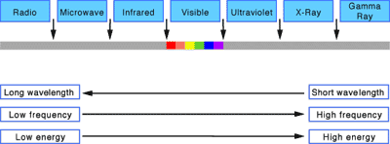
  Health risks of electromagnetic waves
Health risks of high energy electromagnetic radiations: High frequency radiations have high energy. They can have a hazardous effect on human tissue.
microwaves: can cause internal heating of body cells
infrared: can skin burns
ultraviolet: can damage to surface cells and eyes, leading to skin cancer and eye conditions
x-rays and gamma rays: can cause mutation or damage to cells in the body
The hazard from high energy radiations also depends on the dose.
Radiation dose is a measure of the risk when exposed to these radiations.
Radiation dose is measured in Sieverts.

Slide 30
  Uses of electromagnetic waves
 | Type | Application
Low frequency low wavelength High frequency short wavelength | Radio | Television, radio broadcasting and satellite transmissions
 | Microwave | Cooking, communications and satellite transmissions
 | Infrared | Cooking, thermal imaging, short range communications, optical fibres, T V controls and security systems
 | Visible | Vision, photography and illumination
 | Ultraviolet | Security marking, fluorescent lamps, detecting forged bank notes and disinfecting water
 | X-rays | Observing the internal structure of objects, airport security scanners and medical x-rays
 | Gamma rays | Sterilising food and medical equipment, and the detection of cancer and its treatment

Slide 31
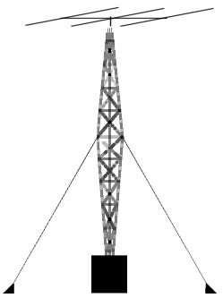
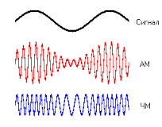
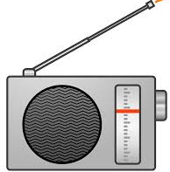
  Electromagnetic waves radio waves (HT)
Radio waves
A radio wave is transmitted at the same frequency as the a.c. current which produced it.
When this radio signal reaches another antenna (e.g. aerial on a radio) the radio waves cause oscillations in the wire. This produces an alternating current of the same frequency as the radio signal.
Radio signals are produced when an alternating current is passed through a wire in a radio transmitter. The oscillating (vibrating) particles in the wire produce a radio wave which is modulated and boosted so it can carry the signal over a great distance.

Slide 32
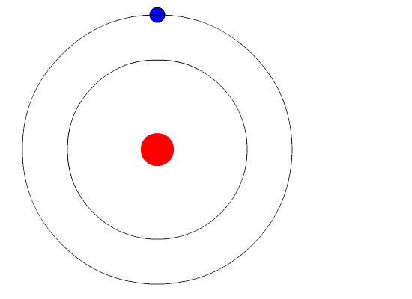
  Changes in atoms and nuclei
Atoms and electromagnetic waves
Input energy could be:
light, heat, electricity, X rays etc
Energy out will be a type of electromagnetic radiation i.e.
X ray, ultra violet, visible,
infra red, microwave or radio waves.
Changes within the nucleus of an atom can result in the emission of gamma waves. This occurs during the radioactive decay of some unstable atoms.
Atoms can receive energy from external sources.
This energy can cause electrons to “jump” to a higher energy level.
When the electron falls back to its original energy level it will release the stored energy in the form of a photon of electromagnetic radiation.

Slide 33
QuestionIT!
Part 2
Electromagnetic spectrum
Radiation and temperature (Physics only)
Uses of EM radiation

Slide 34
  Part 2 – QuestionIT
What type of waves are electromagnetic waves?
List the main electromagnetic waves in order from lowest to highest
frequency.
3. Which of the following is the speed of electromagnetic waves in a
vacuum?
300 m/s 300 000m/s 300 000 000m/s
Which colour of light has the longest wavelength?
Describe one piece of evidence to show that light waves do not need a medium to travel from one place to another.

Slide 35

  Part 2 – QuestionIT
6. The four surfaces below are heated equally with infrared (IR) heat.
a. Which surface will absorb the most IR radiation?
b. Which surface will reflect the most IR radiation?
The diagrams show three waves travelling from air into different materials.
Which wave will be travelling the slowest?
Shiny black
Matt black
White
Shiny
silver
Light
Water
X ray
Vacuum
Infrared
Glass

Slide 36
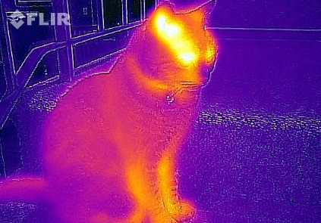
  Part 2 – QuestionIT (Physics only)
8. A black body is:
a. an object that emits no electromagnetic radiation.
b. an object that absorbs all electromagnetic radiation that falls on it.
c. an object that only emits invisible electromagnetic radiation.
d. an object that absorbs all electromagnetic radiation that falls on it and emits no electromagnetic radiation.
9. Explain how black body radiation differs from reflected radiation.
10. The picture shows a thermal image of a cat.
Why can we not see this thermal emission from
the cat without using a specialised camera?

Slide 37
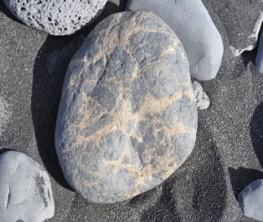
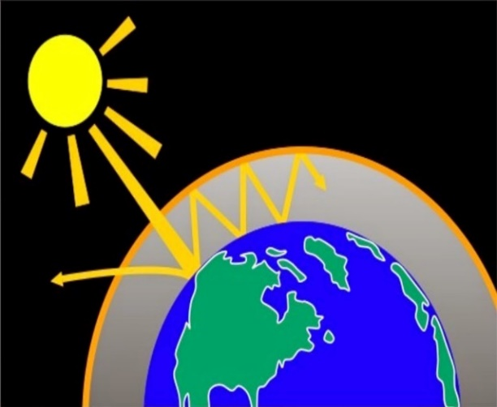
  Part 2 – QuestionIT (Physics only)
11. The stone is in the sunshine and emitting radiation.
As the stone heats up through the day, how will
the nature of the emitted radiation change?
12. If a body absorbs radiation at a faster rate than it emits radiation,
what change will happen to the body?
13. The diagram shows how global warming of the Earth can occur.
Explain what is happening in terms of
changes to absorbed and emitted radiation.

Slide 38
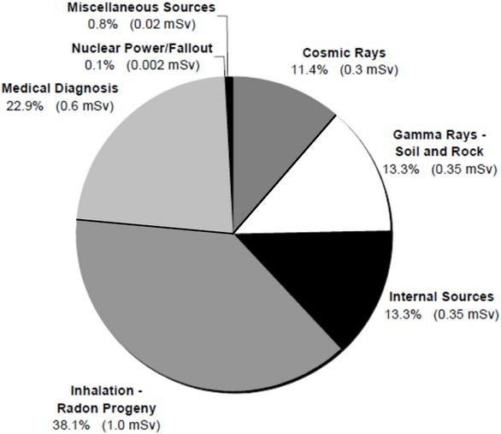
  Part 2 – QuestionIT
14. Which three types of electromagnetic waves can cause damage to cells in the body?
15. What is meant by radiation dose?
16. The chart shows the average radiation dose a UK person is exposed to in a year.
  What percentage of the radiation
    dose comes from natural sources?
  Give two reasons why a person
    could receive a higher dose of
    background radiation.
Food and drink
Radon gas

Slide 39
  Part 2 – QuestionIT
17. Complete the table for uses of electromagnetic waves.
Type | Application
Radio
Microwave
Infrared
Visible
Ultraviolet
X-rays
Gamma rays

Slide 40
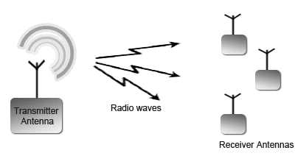
  Part 2 – QuestionIT
18. (HT) Radio waves are transmitted through the air and received by aerials.
a. How are radio waves produced in the transmitter aerial?
b. What is produced in the receiving antenna when radio waves are
absorbed?
19. Most electromagnetic waves are produced from energy changes in electron levels. How does gamma wave production differ from this?

Slide 41
AnswerIT!
Part 2
Electromagnetic spectrum
Radiation and temperature (Physics only)
Uses of EM radiation

Slide 42
  Part 2 – AnswerIT
What type of waves are electromagnetic waves?
  Transverse.
List the main electromagnetic waves in order from lowest to highest
frequency.
  Radio microwave infrared visible ultraviolet X ray gamma ray
3. Which of the following is the speed of electromagnetic waves in a
vacuum?
300 m/s 300 000m/s 300 000 000m/s
Which colour of light has the longest wavelength?
  Red.
Describe one piece of evidence to show that light waves do not need a medium to travel from one place to another.
  Light waves travel through space which is a vacuum.

Slide 43
  Part 2 – AnswerIT
6. The four surfaces below are heated equally with infrared (IR) heat.
a. Which surface will absorb the most IR radiation? Matt black.
b. Which surface will reflect the most IR radiation? Shiny silver.
The diagrams show three waves travelling from air into different materials.
Which wave will be travelling the slowest? Glass.
Shiny black
Matt black
White
Shiny
silver
Light
Water
X ray
Vacuum
Infrared
Glass

Slide 44
  Part 2 – AnswerIT (Physics only)
8. A black body is
a. an object that emits no electromagnetic radiation.
b. an object that absorbs all electromagnetic radiation that falls on it.
c. an object that only emits invisible electromagnetic radiation.
d. an object that absorbs all electromagnetic radiation that falls on it and emits no electromagnetic radiation.
9. Explain how black body radiation differs from reflected radiation.
Black body radiation is radiation that is absorbed by an object and then re-radiated out, sometimes as a different wavelength.
10. The picture shows a thermal image of a cat.
Why can we not see this thermal emission from
the cat without using a specialised camera?
The radiation is in the infrared range which humans can not see.

Slide 45
  Part 2 – AnswerIT (Physics only)
11. The stone is in the sunshine and emitting radiation.
As the stone heats up through the day, how will
the nature of the emitted radiation change?
It will be more intense and of a higher frequency.
12. If a body absorbs radiation at a faster rate than it emits radiation,
what change will happen to the body?
The body will increase in temperature.
13. The diagram shows how global warming of the Earth can occur.
Explain what is happening in terms of
changes to absorbed and emitted radiation.
Radiation that can pass through the atmosphere
reaches the Earth. This radiation will heat up the
Earth’s surface. The Earth will radiate infrared
energy back out but at a wavelength that can not
penetrate the atmosphere.
The Earth will warm up as more radiation is being
absorbed than emitted.

Slide 46
  Part 2 – AnswerIT
14. Which three types of electromagnetic waves can cause damage to cells in the body?
  Gamma waves, X rays and Ultraviolet.
15. What is meant by radiation dose?
  A measure of the risk of harm from exposure to radiation.
16. The chart shows the average radiation dose a UK person is exposed to in a year.
  What percentage of the radiation
    dose comes from natural sources?
    70 – 80%
  Give two reasons why a person
    could receive a higher dose of
    background radiation.
Receive increased medical diagnosis.
Live in a higher radon area.
Increased cosmic rays from flying.
Food and drink
Radon gas

Slide 47
  Part 2 – AnswerIT
17. Complete the table for uses of electromagnetic waves.
Type | Application
Radio | Television, radio broadcasting and satellite transmissions
Microwave | Cooking, communications and satellite transmissions
Infrared | Cooking, thermal imaging, short range communications, optical fibres, T V controls and security systems
Visible | Vision, photography and illumination
Ultraviolet | Security marking, fluorescent lamps, detecting forged bank notes and disinfecting water
X-rays | Observing the internal structure of objects, airport security scanners and medical x-rays
Gamma rays | Sterilising food and medical equipment, and the detection of cancer and its treatment

Slide 48
  Part 2 – AnswerIT
18. (HT) Radio waves are transmitted through the air and received by aerials.
a. How are radio waves produced in the transmitter aerial?
Produced by oscillations (vibrations) in a wire or electrical circuit.
b. What is produced in the receiving antenna when radio waves are
absorbed?
An alternating current of the same frequency as the radio wave.
19. Most electromagnetic waves are produced from energy changes in electron levels. How does gamma wave production differ from this?
Gamma waves are emitted from changes in the nucleus of an atom.

