Slide 1


The PiXL Club The PiXL Club The PiXL Club The PiXL Club The PiXL Club The PiXL Club The PiXL Club The PiXL Club The PiXL Club The PiXL Club The PiXL Club The PiXL Club The PiXL Club The PiXL Club The PiXL Club The PiXL Club The PiXL Club The PiXL Club The PiXL Club The PiXL Club The PiXL Club The PiXL Club The PiXL Club The PiXL Club The PiXL Club The PiXL Club The PiXL Club The PiXL Club The PiXL Club The PiXL Club The PiXL Club The PiXL Club The PiXL Club The PiXL Club The PiXL Club The PiXL Club The PiXL Club The PiXL Club The PiXL Club The PiXL Club The PiXL Club The PiXL Club The PiXL Club The PiXL Club The PiXL Club XL Club The PiXL Club The PiXL Club The PiXL Club The PiXL Club The PiXL Club The PiXL Club The PiXL Club The PiXL Club The PiXL Club The PiXL Club The PiXL Club The PiXL Club The PiXL Club The PiXL Club The PiXL Club The PiXL Club The PiXL Club The PiXL Club The PiXL Club The PiXL Club The PiXL Club The PiXL Club The PiXL Club The PiXL Club The PiXL Club The PiXL Club The PiXL Club The PiXL Club The PiXL Club The PiXL Club The PiXL Club The PiXL Club The PiXL Club The PiXL Club The PiXL Club The PiXL Club The PiXL Club The PiXL Club The PiXL Club The PiXL Club The PiXL Club The PiXL Club The PiXL Club The PiXL Club The PiXL Club The PiXL Club The PiXL Club The PiXL Club The PiXL Club The PiXL Club The PiXL Club The PiXL Club The PiXL Club The PiXL Club The PiXL Club The PiXL Club The PiXL Club The PiXL Club The PiXL Club The PiXL Club The PiXL Club The PiXL Club The PiXL Club The PiXL Club The PiXL Club The PiXL Club The PiXL Club The PiXL Club The PiXL Club The PiXL Club The PiXL Club The PiXL Club The PiXL Club The PiXL Club The PiXL Club The PiXL Club The PiXL Club The PiXL Club The PiXL Club The PiXL Club The PiXL Club The PiXL Club The PiXL Club The PiXL Club The PiXL Club The PiXL Club The PiXL Club The PiXL Club The PiXL Club The PiXL Club The PiXL Club The PiXL Club The PiXL Club The PiXL Club The PiXL Club The PiXL Club The PiXL Club The PiXL Club The PiXL Club The PiXL Club The PiXL Club The PiXL Club The PiXL Club The PiXL Club The PiXL Club The PiXL Club The PiXL Club The PiXL Club The PiXL Club The PiXL Club The PiXL Club The PiXL Club The PiXL Club The PiXL Club The PiXL Club The PiXL Club The PiXL Club The PiXL Club The PiXL Club The PiXL Club The PiXL Club The PiXL Club The PiXL Club The PiXL Club The PiXL Club The PiXL Club The PiXL Club The PiXL Club The PiXL Club The PiXL Club The PiXL Club The PiXL Club The PiXL Club The PiXL Club The PiXL Club The PiXL Club The PiXL Club The PiXL Club The PiXL Club The PiXL Club The PiXL Club The PiXL Club The PiXL Club The PiXL Club The PiXL Club The PiXL Club The PiXL Club The PiXL Club The PiXL Club The PiXL Club The PiXL Club The PiXL Club The PiXL Club The PiXL Club The PiXL Club The PiXL Club The PiXL Club The PiXL Club The PiXL Club The PiXL Club The PiXL Club The PiXL Club The PiXL Club The PiXL Club The PiXL Club The PiXL Club The PiXL Club The PiXL Club The PiXL Club The PiXL Club The PiXL Club The PiXL Club The PiXL Club The PiXL Club The PiXL Club The PiXL Club The PiXL Club The PiXL Club The PiXL Club The PiXL Club The PiXL Club The PiXL Club The PiXL Club The PiXL Club The PiXL Club The PiXL Club The PiXL Club The PiXL Club The PiXL Club The PiXL Club The PiXL Club The PiXL Club The PiXL Club The PiXL Club The PiXL Club The PiXL Club The PiXL Club The PiXL Club The PiXL Club The PiXL Club The PiXL Club The PiXL Club The PiXL Club The PiXL Club The PiXL Club The PiXL Club The PiXL Club The PiXL Club The PiXL Club The PiXL Club The PiXL Club The PiXL Club The PiXL Club The PiXL Club The PiXL Club The PiXL Club The PiXL Club The PiXL Club The PiXL Club The PiXL Club The PiXL Club The PiXL Club The PiXL Club The PiXL Club The PiXL Club The PiXL Club The PiXL Club The PiXL Club The PiXL Club The PiXL Club The PiXL Club The PiXL Club The PiXL Club The PiXL Club The PiXL Club The PiXL Club The PiXL Club The PiXL Club The PiXL Club The PiXL Club The PiXL Club The PiXL Club The PiXL Club The PiXL Club The PiXL Club The PiXL Club The PiXL Club The PiXL Club The PiXL Club The PiXL Club The PiXL Club The PiXL Club The PiXL Club The PiXL Club The PiXL Club The PiXL Club The PiXL Club The PiXL Club The PiXL Club The PiXL Club The PiXL Club The PiXL Club The PiXL Club The PiXL Club The PiXL Club The PiXL Club The PiXL Club The PiXL Club The PiXL Club The PiXL Club The PiXL Club The PiXL Club The PiXL Club The PiXL Club The PiXL Club The PiXL Club The PiXL Club The PiXL Club The PiXL Club The PiXL Club The PiXL Club The PiXL Club The PiXL Club The PiXL Club The PiXL Club The PiXL Club The PiXL Club The PiXL Club The PiXL Club The PiXL Club The PiXL Club The PiXL Club The PiXL Club The PiXL Club The PiXL Club The PiXL Club The PiXL Club The PiXL Club The PiXL Club The PiXL Club The PiXL Club The PiXL Club The PiXL Club The PiXL Club The PiXL Club The PiXL Club The PiXL Club The PiXL Club The PiXL Club The PiXL Club The PiXL Club The PiXL Club The PiXL Club The PiXL Club The PiXL Club The PiXL Club The PiXL Club The PiXL Club The PiXL Club The PiXL Club The PiXL Club The PiXL Club The PiXL Club The PiXL Club The PiXL Club The PiXL Club The PiXL Club The PiXL Club The PiXL Club The PiXL Club The PiXL Club The PiXL Club The PiXL Club The PiXL Club The PiXL Club The PiXL Club The PiXL Club The PiXL Club The PiXL Club The PiXL Club The PiXL Club The PiXL Club The PiXL Club The PiXL Club The PiXL Club The PiXL Club The PiXL Club The PiXL Club The PiXL Club The PiXL Club The PiXL Club The PiXL Club The PiXL Club The PiXL Club The PiXL Club The PiXL Club The PiXL Club The PiXL Club The PiXL Club The PiXL Club The PiXL Club The PiXL Club The PiXL Club The PiXL Club The PiXL Club The PiXL Club The PiXL Club The PiXL Club The PiXL Club The PiXL Club The PiXL Club The PiXL Club The PiXL Club The PiXL Club The PiXL Club The PiXL Club The PiXL Club The PiXL Club The PiXL Club The PiXL Club The PiXL Club The PiXL Club The PiXL Club The PiXL Club The PiXL Club The PiXL Club The PiXL Club The PiXL Club The PiXL Club The PiXL Club The PiXL Club The PiXL Club The PiXL Club The PiXL Club The PiXL Club The PiXL Club The PiXL Club The PiXL Club The PiXL Club The PiXL Club The PiXL Club The PiXL Club The PiXL Club The PiXL Club The PiXL Club The PiXL Club The PiXL Club The PiXL Club The PiXL Club The PiXL Club The PiXL Club The PiXL Club The PiXL Club The PiXL Club The PiXL Club The PiXL Club The PiXL Club The PiXL Club The PiXL Club The PiXL Club The PiXL Club The PiXL Club The PiXL Club The PiXL Club The PiXL Club The PiXL Club The PiXL Club The PiXL Club The PiXL Club The PiXL Club The PiXL Club The PiXL Club The PiXL Club The PiXL Club The PiXL Club The PiXL Club The PiXL Club The PiXL Club The PiXL Club The PiXL Club The PiXL Club The PiXL Club The PiXL Club The PiXL Club The PiXL Club The PiXL Club The PiXL Club The PiXL Club The PiXL Club The PiXL Club The PiXL Club The PiXL Club The PiXL Club The PiXL Club The PiXL Club The PiXL Club The PiXL Club The PiXL Club The PiXL Club The PiXL Club The PiXL Club The PiXL Club The PiXL Club The PiXL Club The PiXL Club The PiXL Club The PiXL Club The PiXL Club The PiXL Club The PiXL Club The PiXL Club The PiXL Club The PiXL Club The PiXL Club The PiXL Club The PiXL Club The PiXL Club The PiXL Club The PiXL Club The PiXL Club The PiXL Club The PiXL Club The PiXL Club The PiXL Club The PiXL Club The PiXL Club The PiXL Club The PiXL Club The PiXL Club The PiXL Club The PiXL Club The PiXL Club The PiXL Club The PiXL Club The PiXL Club The PiXL Club The PiXL Club The PiXL Club The PiXL Club The PiXL Club The PiXL Club The PiXL Club The PiXL Club The PiXL Club The PiXL Club The PiXL Club The PiXL Club The PiXL Club The PiXL Club The PiXL Club The PiXL Club The PiXL Club The PiXL Club The PiXL Club The PiXL Club The PiXL Club The PiXL Club The PiXL Club The PiXL Club The PiXL Club The PiXL Club The PiXL Club The PiXL Club The PiXL Club The PiXL Club The PiXL Club The PiXL Club The PiXL Club The PiXL Club The PiXL Club The PiXL Club The PiXL Club The PiXL Club The PiXL Club The PiXL Club The PiXL Club The PiXL Club The PiXL Club The PiXL Club The PiXL Club The PiXL Club The PiXL Club The PiXL Club The PiXL Club The PiXL Club The PiXL Club The PiXL Club The PiXL Club The PiXL Club The PiXL Club The PiXL Club The PiXL Club The PiXL Club The PiXL Club The PiXL Club The PiXL Club The PiXL Club The PiXL Club The PiXL Club The PiXL Club The PiXL Club The PiXL Club The PiXL Club The PiXL Club The PiXL Club The PiXL Club The PiXL Club The PiXL Club The PiXL Club The PiXL Club The PiXL Club The PiXL Club The PiXL Club The PiXL Club The PiXL Club The PiXL Club The PiXL Club The PiXL Club The PiXL Club The PiXL Club The PiXL Club The PiXL Club The PiXL Club The PiXL Club The PiXL Club The PiXL Club The PiXL Club The PiXL Club The PiXL Club The PiXL Club The PiXL Club The PiXL Club The PiXL Club The PiXL Club The PiXL Club The PiXL Club The PiXL Club The PiXL Club The PiXL Club The PiXL Club The PiXL Club The PiXL Club The PiXL Club The PiXL Club The PiXL Club The PiXL Club The PiXL Club The PiXL Club The PiXL Club The PiXL Club The PiXL Club The PiXL Club The PiXL Club The PiXL Club The PiXL Club The PiXL Club The PiXL Club The PiXL Club The PiXL Club The PiXL Club The PiXL Club The PiXL Club The PiXL Club The PiXL Club The PiXL Club The PiXL Club The PiXL Club The PiXL Club The PiXL Club The PiXL Club The PiXL Club The PiXL Club The PiXL Club The PiXL Club The PiXL Club The PiXL Club The PiXL Club The PiXL Club The PiXL Club The PiXL Club The PiXL Club The PiXL Club The PiXL Club The PiXL Club The PiXL Club The PiXL Club The PiXL Club The PiXL Club The PiXL Club The PiXL Club The PiXL Club The PiXL Club The PiXL Club The PiXL Club The PiXL Club The PiXL Club The PiXL Club The PiXL Club The PiXL Club The PiXL Club The PiXL Club The PiXL Club The PiXL Club The PiXL Club The PiXL Club The PiXL Club The PiXL Club The PiXL Club The PiXL Club The PiXL Club The PiXL Club The PiXL Club The PiXL Club The PiXL Club The PiXL Club The PiXL Club The PiXL Club The PiXL Club The PiXL Club The PiXL Club The PiXL Club The PiXL Club The PiXL Club The PiXL Club The PiXL Club The PiXL Club The PiXL Club The PiXL Club The PiXL Club The PiXL Club The PiXL Club The PiXL Club The PiXL Club The PiXL Club The PiXL Club The PiXL Club The PiXL Club The PiXL Club The PiXL Club The PiXL Club
PiXL KnowIT!
GCSE Physics
Edexcel Physics
Forces and matter
© Copyright The PiXL Club Ltd, 2017
This resource is strictly for the use of member schools for as long as they remain members of The PiXL Club. It may not be copied, sold nor transferred to a third party or used by the school after membership ceases. Until such time it may be freely used within the member school.
All opinions and contributions are those of the authors. The contents of this resource are not connected with nor endorsed by any other company, organisation or institution.
www.pixl.org.uk The PiXL Club Ltd, Company number 07321607

Slide 2
Overview
Edexcel Topic 15
  Forces and matter
  Part 1
  Forces and springs
  Stretching springs
  Part 2
  Atmospheric pressure
  (physics only)
  Pressure in fluids 1 (physics only)
  Pressure in fluids 2
  (HT and physics only)

Slide 3
LearnIT!
KnowIT!
  Part 1
  Forces and springs
  Stretching springs

Slide 4
Forces and springs
Springs
Springs are used in many everyday objects. Springs are found in beds, in motorcycle and bike suspension, weighing scales and trampolines.
Springs can either be used in tension (where the spring is stretched) or compression (where the spring is squashed).
Springs have a store of elastic potential energy when they have changed shape.
Not all springs are cylindrical in shape.

Slide 5
Forces and springs
Uses of Springs
Some common uses of springs, in compression and tension, include:
uses of springs in compression | uses of springs in tension
ball point pen | trampolines
beds (mattresses) | garage doors
suspension springs (bikes) | Newton meter
electrical switches | exercise equipment (chest expander)

Slide 6
Forces and elasticity
Elastic and inelastic distortion
To stretch a spring at least two forces are required – otherwise the whole spring will move.
When a spring is stretched, the spring may return to it’s original shape. In this case the distortion of the spring is said to be elastic.
If the spring is stretched too far then the spring will never return to it’s original length. The distortion is said to be inelastic.

Slide 7
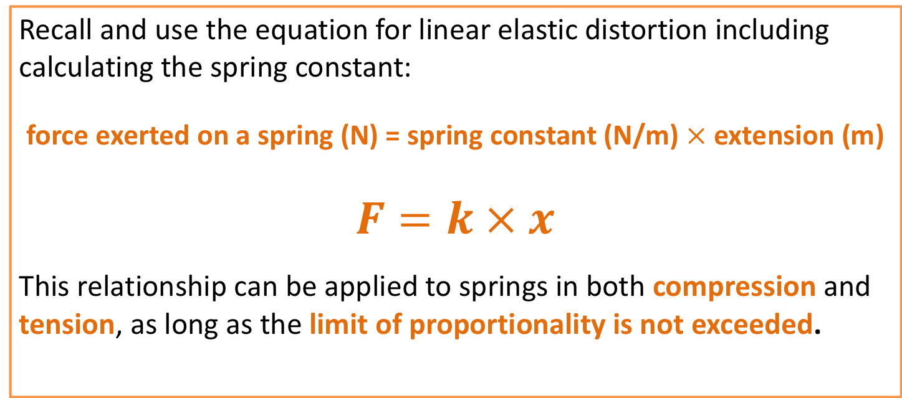
Force exerted on a spring
The amount a spring stretches depends on the force applied to the spring and also to the spring constant of the spring.
The spring constant of a spring is measured in newtons per meter (N/m). The higher the spring constant the greater the force required to produce a given extension, in metres.
Recall and use the equation for linear elastic distortion including calculating the spring constant:
force exerted on a spring (N) = spring constant (N/m) $×$extension (m)
$$F=k × x$$
This relationship can be applied to springs in both compression and tension, as long as the limit of proportionality is not exceeded.

Slide 8
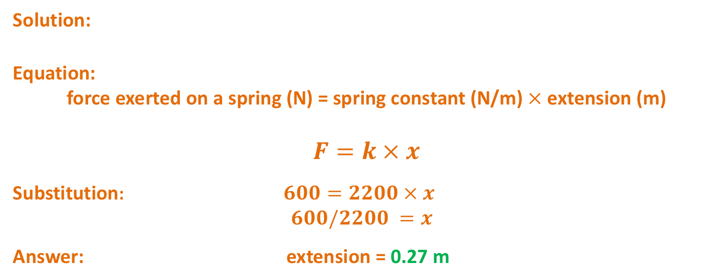
Force exerted on a spring
Force exerted on a spring calculation
A trampoline spring has a spring constant of 2200 N/m.
Work out the extension of the trampoline spring if a weight of 600 N is applied.
Solution:
Equation:
force exerted on a spring (N) = spring constant (N/m) $×$extension (m)
$$F=k × x$$
Substitution: $600=2200 × x$
$600/2200 =x$
Answer: extension = 0.27 m
Click to reveal answer

Slide 9
Forces and elasticity
Limit of Proportionality
The extension (the length of a spring minus the original length) of a spring is directly proportional to the force applied – provided that the limit of proportionality is not exceeded.
This means that if the force on the spring is doubled then the extension of the spring will be doubled too.
A graph of force against extension for a spring that has not been stretched beyond the limit of proportionality.

Slide 10
Forces and elasticity
Permanent distortion of a spring
If the force applied to a spring is too great the the spring will be inelastically deformed.
A graph showing force against extension for a spring stretched beyond it’s limit of proportionality will no longer be a straight line through 0,0.
The graph opposite shows the force – extension graph for a spring stretched beyond it’s limit of proportionality.

Slide 11
Forces and elasticity
Stretching Other Materials
Objects and materials other than metal springs can be stretched.
An elastic band is an example of a material that can be stretched and stores elastic potential energy.
The extension of an elastic band is not directly proportional to the force applied. A graph of extension against length for an elastic band will produce a curve, yet the material may still go back to it’s original shape.

Slide 12
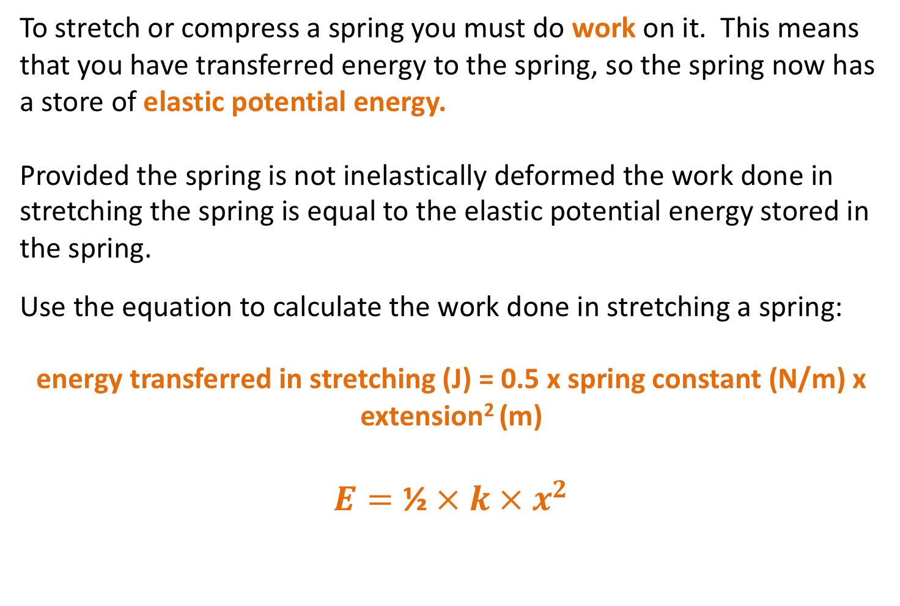
Forces and elasticity
Energy stored in a spring
To stretch or compress a spring you must do work on it. This means that you have transferred energy to the spring, so the spring now has a store of elastic potential energy.
Provided the spring is not inelastically deformed the work done in stretching the spring is equal to the elastic potential energy stored in the spring.
Use the equation to calculate the work done in stretching a spring:
energy transferred in stretching (J) = 0.5 x spring constant (N/m) x extension² (m)
$$E=\text{½} × k × x^{2}$$

Slide 13
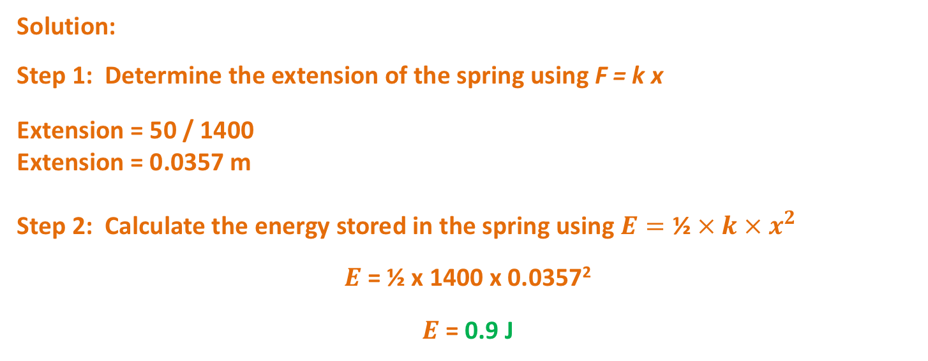
Forces and elasticity
A trampoline spring has a spring constant of 1400 N/m.
The spring has a 50 N load added to the spring.
Work out the amount of elastic potential energy stored in the spring when the 50 N load is added to the spring.
Solution:
Step 1: Determine the extension of the spring using F = k x
Extension = 50 / 1400
Extension = 0.0357 m
Step 2: Calculate the energy stored in the spring using $E=\text{½} × k × x^{2}$
$E$ = ½ x 1400 x 0.0357²
$E$ = 0.9 J
Click to reveal answer

Slide 14
Forces and elasticity
Graphs of Force Against Extension
The gradient of a force against extension graph gives you the spring constant of the spring.
Force / N
Gradient = k
Extension / m
The energy stored as elastic potential energy is the area under a force against extension graph.
Force / N
Area = E
Extension / m

Slide 15
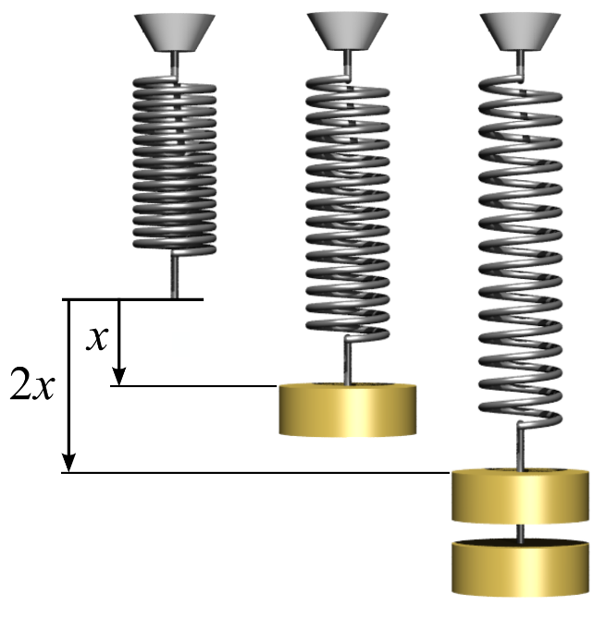
Practical procedure: Force and extension
Video 1
Video 2
Notes:
Click on each of the tabs to take you to a YouTube clip. Please note these are external sites to PiXL, PiXL does not control the content of these sites.

Slide 16
QuestionIT!
  Part 1
  Forces and springs
  Stretching springs

Slide 17
Part 1 - QuestionIT
What type of energy is stored in a stretched spring?
What is the least number of forces required to stretch a spring?
A student investigates the stretching of a spring. The student adds weight to the spring and measures the extension.
  Sketch the force – extension graph the student would expect for the spring.

Slide 18
Part 1 - QuestionIT
A spring is stretched beyond its elastic limit. Describe the effect that this would have on the spring.
Explain how the extension of a spring is determined.
Motorcycles use springs for their suspension.
  The spring is compressed when the motorcycle rides over bumps.
  A force of 240 N compresses the spring 2 cm.
  Calculate the spring constant of the motorcycle spring in N/m.

Slide 19
Part 1 - QuestionIT
The graph below shows the force-extension graph for a spring.
Calculate the spring constant of the spring.
Calculate the energy stored in the spring when it is stretched 50 cm.

Slide 20

AnswerIT!
  Part 1
  Forces and springs
  Stretching springs

Slide 21
Part 1 - AnswerIT
What type of energy is stored in a stretched spring?
Elastic potential energy
What is the least number of forces required to stretch a spring?
2
A student investigates the stretching of a spring. The student adds weight to the spring and measures the extension.
Sketch the force – extension graph the student would expect for the
spring.

Slide 22
Part 1 - AnswerIT
A spring is stretched beyond its elastic limit. Describe the effect that this
would have on the spring.
The spring would be inelastically distorted
so would not return to its original shape
Explain how the extension of a spring is determined.
The length of the extended spring minus the original length
Motorcycles use springs for their suspension.
The spring is compressed when the motorcycle rides over bumps.
A force of 240 N compresses the spring 2 cm.
Calculate the spring constant of the motorcycle spring in N/m.
Using F = k x
Rearranging gives k = F/x
Substitution gives k = 240 / 0.02
Spring constant is 12 000 N/m

Slide 23
Part 1 - AnswerIT
The graph below shows the force-extension graph for a spring.
Calculate the spring constant of the spring.
Using k = F / x k = 7 / 0.14 spring constant = 50 N/m
Calculate the energy stored in the spring when it is stretched 50 cm.
Using E = ½ k x² E = 0.5 x 50 x (0.5)²
Elastic Potential Energy = 6.25 J

Slide 24
LearnIT!
KnowIT!
  Part 2
  Atmospheric pressure
  (physics only)
  Pressure in fluids 1 (physics only)
  Pressure in fluids 2
  (HT and physics only)

Slide 25
Atmospheric pressure
The Earth’s atmosphere is a very thin (relative to the size of the Earth) layer of gas. The density of this layer of gas gets lower as you go higher.
The weight of air pushing down on a surface decreases with height. With fewer particles the higher up you go there will be fewer collisions, per unit time, with a surface. This means that the atmospheric pressure decreases with height.
When air molecules collide with a surface it creates air pressure. The more molecules that collide with a surface in a given time, the greater the pressure on that surface.
Less dense lower pressure
Increasing altitude
More dense higher pressure
Surface of the Earth

Slide 26
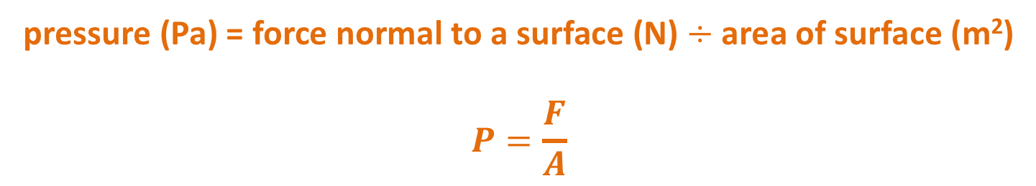
Pressure in fluids 1
Fluids are substances that flow.
Liquids and gases are both fluids.
When there is a pressure in a fluid a force is produced at right angles to the surface containing the fluid.
The size of the force acting at the surface of a fluid can be calculated using the equation:
The pressure in a fluid produces a force at right angles (normal) to the surface .
pressure (Pa) = force normal to a surface (N) $÷$ area of surface (m²)
$$P=\frac{F}{A}$$

Slide 27
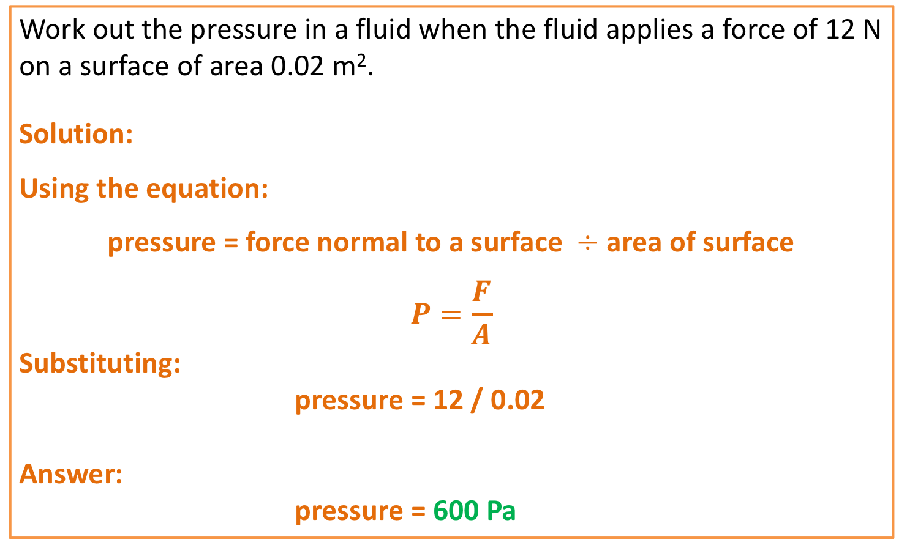
Pressure in fluids 1
Work out the pressure in a fluid when the fluid applies a force of 12 N on a surface of area 0.02 m².
Solution:
Using the equation:
pressure = force normal to a surface $÷$ area of surface
$$P=\frac{F}{A}$$
Substituting:
pressure = 12 / 0.02
Answer:
pressure = 600 Pa
Click to reveal answer

Slide 28

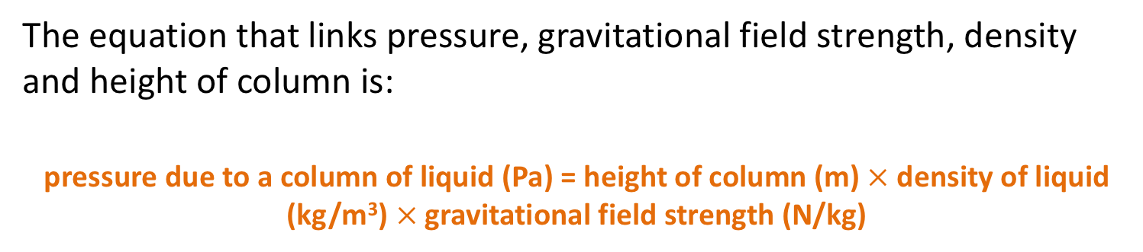
Pressure in fluids 2 (HT ONLY)
Pressure in fluids 2
When a submarine is underwater there is a pressure acting. The pressure depends on the depth of the submarine, the density of the water it is in (salt water is more dense than fresh water) and on the gravitational field strength.
The equation that links pressure, gravitational field strength, density and height of column is:
pressure due to a column of liquid (Pa) = height of column (m) $×$density of liquid (kg/m³)$×$gravitational field strength (N/kg)
$$P=h × ρ × g$$

Slide 29


Pressure in fluids 2 (HT ONLY)
Example:
The top of a submarine is 50 m underwater. The density of seawater is 1030 kg/m³. Work out the pressure on the top of the submarine.
Take g = 10 N/kg.
Solution:
Using the equation:
Substitution gives:
Answer: pressure = 515 000 Pa
$$P=h × ρ × g$$
$$P=50 × 1030 × 10$$
Click to reveal answer

Slide 30
Pressure in fluids 2 (HT ONLY)
Pressure differences
When a 2 litre bottle has holes drilled into the sides and is then filled with water leaks out. The water that escapes out the bottom of the bottle comes out faster than the water from the top hole – so it travels further.
This is due to the pressure at the bottom of the bottle being greater than the pressure at the top of the bottle – there is a greater height of the column of water above the hole at this point, so there is more weight pushing down per unit area.

Slide 31
Pressure in fluids 2 (HT ONLY)
Upthrust
A submarine can float mid-water. This happens when the weight of the submarine equals the upthrust from the water.
The upthrust on the submarine depends on the pressure difference between the top of the submarine and the bottom of the submarine. When the pressure difference between the top and the bottom of the submarine equals the weight of the submarine then it will float.
Submarines can adjust the depth they float at by adding or removing water from ballast tanks. Scuba divers use air in a jacket to control their depth. Fish have swim bladders which serve a similar purpose.

Slide 32


Pressure in fluids 2 (HT ONLY)
Example:
Calculate the upthrust on a submarine that has a height of 15 m and is submerged at a depth of 60 m (to the top of the submarine). The submarine has a surface area of 100 m² on the top and on the bottom of the submarine.
Take the density of sea water to be 1100 kg/m³ and the gravitational field strength of the Earth to be 10 N/kg.
Solution:
The difference in pressure between the top and bottom of the sub is due to a difference in height of the column of water of 15 m.
So, using the equation:
Substitution:
pressure = 165 000 Pa
Since Pressure = force / area
force (upthrust) = 165 000 x 200 = 33 000 000 N
$$P=h × ρ × g$$
$P=15 × 1100 ×$10
Click to reveal answer
Click to reveal answer

Slide 33
QuestionIT!
  Part 2
  Atmospheric pressure
  (physics only)
  Pressure in fluids 1 (physics only)
  Pressure in fluids 2
  (HT and physics only)

Slide 34
Part 2 - QuestionIT
In a bath full of water a force of 1250 N acts on an area of 0.5 m² at the bottom of the bath.
  Calculate the pressure acting on the bottom of the bath.
A pressure of 4000 Pa acts in a hydraulic brake fluid. The surface of the slave cylinder inside the brake system has a surface area of 0.03 m².
  Calculate the force acting on the slave cylinder.

Slide 35
Part 2 - QuestionIT
A beaker is filled to a depth of 10 cm with water. Water has a density of 1000 kg/m³. Calculate the pressure acting at the bottom of the beaker.
Take g = 10 N/kg.
A scuba diver is diving in the sea. The pressure acting on the scuba diver is 267 800 Pa. Salt water has a density of 1030 kg/m³.
Calculate the depth of the scuba diver.

Slide 36
Part 2 - QuestionIT
A boat floats in sea water (density = 1030 kg/m³). The boat has a surface area of 15 m² in contact with the water and has a pressure of 4120 Pa acting on it.
Find the depth the boat floats at.
Take g = 10 N/kg.
Explain why the atmospheric pressure on the top of Mount Everest is lower than the atmospheric pressure at sea level.

Slide 37
AnswerIT!
  Part 2
  Atmospheric pressure
  (physics only)
  Pressure in fluids 1 (physics only)
  Pressure in fluids 2
  (HT and physics only)

Slide 38
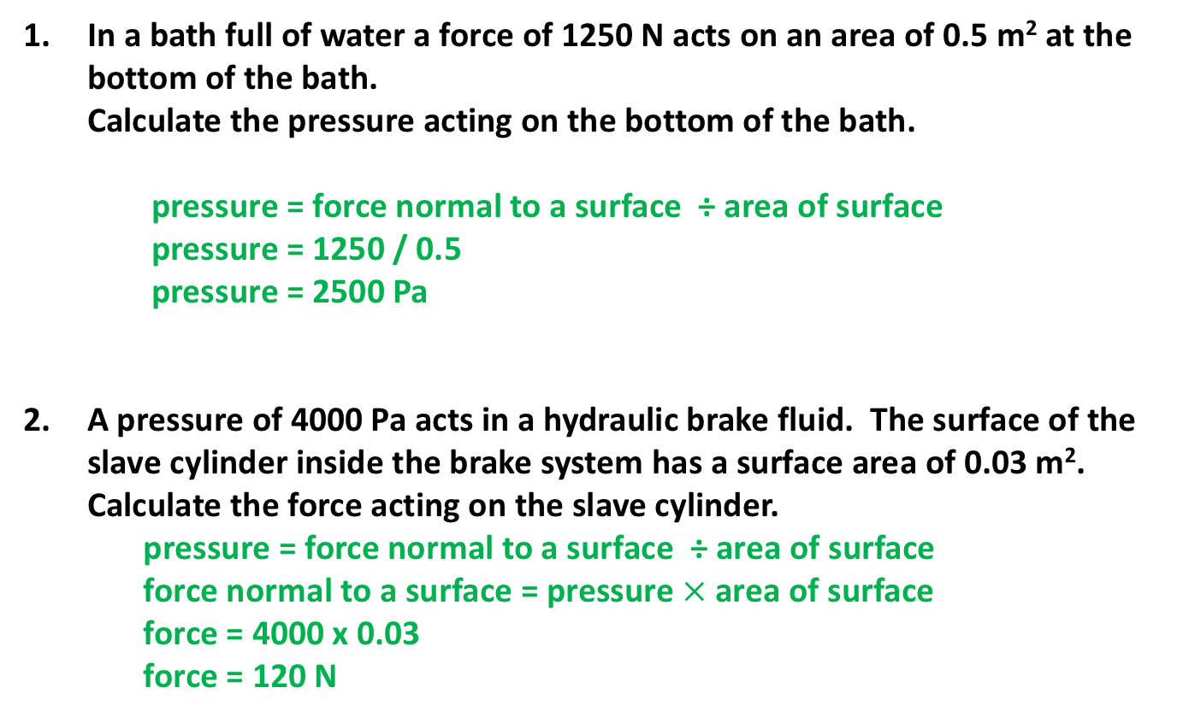
Part 2 - AnswerIT
In a bath full of water a force of 1250 N acts on an area of 0.5 m² at the bottom of the bath.
Calculate the pressure acting on the bottom of the bath.
pressure = force normal to a surface ÷ area of surface
pressure = 1250 / 0.5
pressure = 2500 Pa
A pressure of 4000 Pa acts in a hydraulic brake fluid. The surface of the
slave cylinder inside the brake system has a surface area of 0.03 m².
Calculate the force acting on the slave cylinder.
pressure = force normal to a surface ÷ area of surface
force normal to a surface = pressure$×$area of surface
force = 4000 x 0.03
force = 120 N

Slide 39

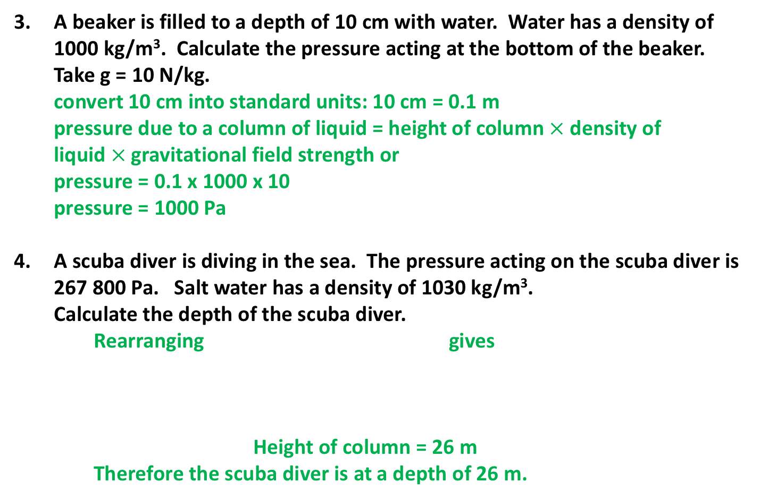
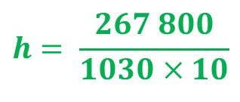
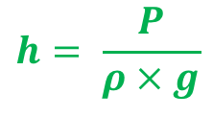

Part 2 - AnswerIT
A beaker is filled to a depth of 10 cm with water. Water has a density of 1000 kg/m³. Calculate the pressure acting at the bottom of the beaker.
Take g = 10 N/kg.
  convert 10 cm into standard units: 10 cm = 0.1 m
  pressure due to a column of liquid = height of column $×$density of liquid$×$gravitational field strength or
  pressure = 0.1 x 1000 x 10
  pressure = 1000 Pa
A scuba diver is diving in the sea. The pressure acting on the scuba diver is 267 800 Pa. Salt water has a density of 1030 kg/m³.
Calculate the depth of the scuba diver.
Rearranging gives
Height of column = 26 m
Therefore the scuba diver is at a depth of 26 m.
$$P=h × ρ × g$$
$$h= \frac{P}{ρ × g}$$
$$P=h × ρ × g$$
$$h= \frac{267 800}{1030 × 10}$$

Slide 40

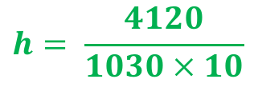
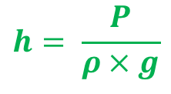
Part 2 - AnswerIT
A boat floats in sea water (density = 1030 kg/m³). The boat has a surface area of 15 m² in contact with the water and has a pressure of 4120 Pa acting on it.
Find the depth the boat floats at.
Take g = 10 N/kg.
  Rearranging gives
  Height of column = 0.4 m
  Therefore the depth of the boat is 0.4 m.
Explain why the atmospheric pressure on the top of Mount Everest is lower than the atmospheric pressure at sea level.
  At sea level there is more air above you
  This gives a greater weight of air pushing on you per unit area
  Increasing the pressure
$$h= \frac{P}{ρ × g}$$
$$P=h × ρ × g$$
$$h= \frac{4120}{1030 × 10}$$

