Slide 1
www.CHEMSHEETS.co.uk
STRUCTURE TYPES
Chemsheets AS1024 07-June-2015

Slide 2
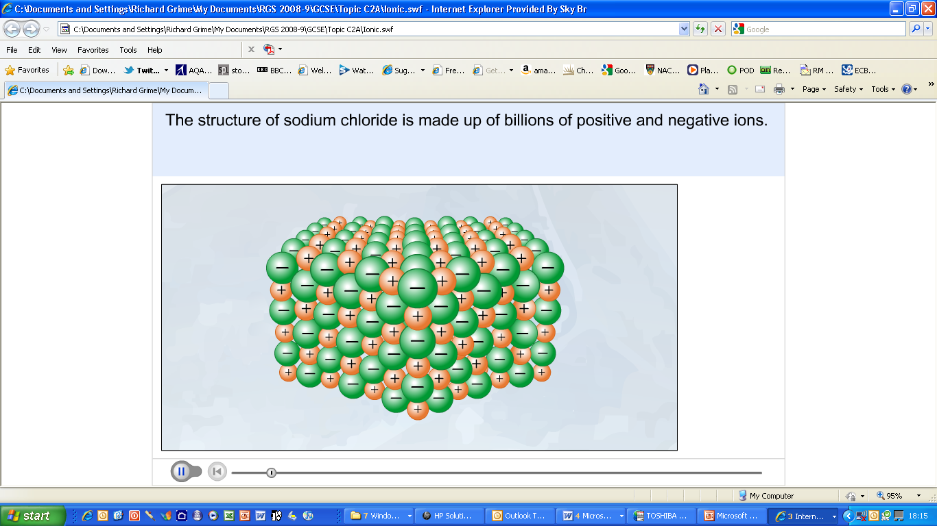
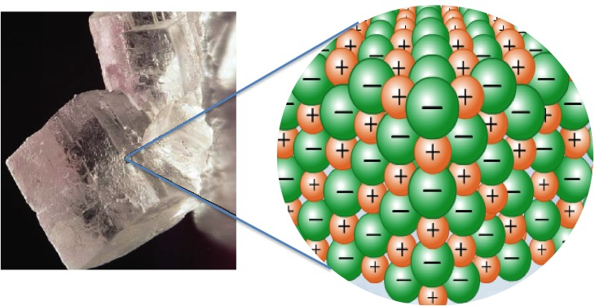
IONIC e.g. NaCl

Slide 6
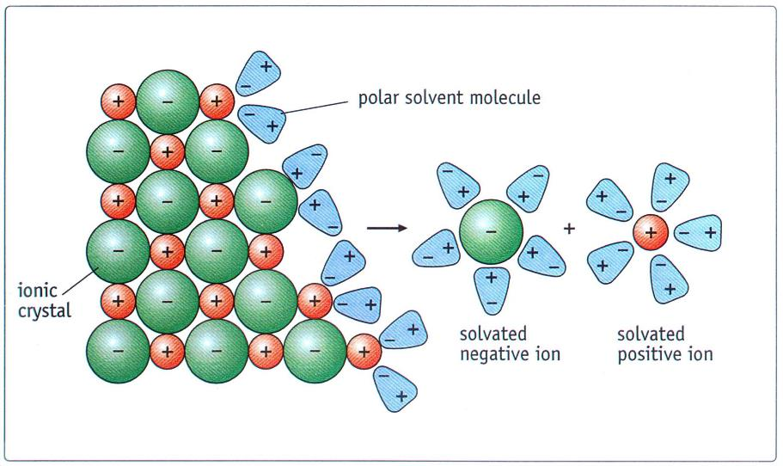

Slide 7
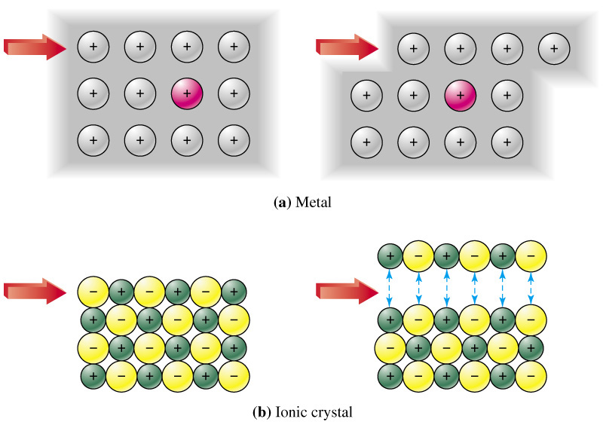

Slide 8
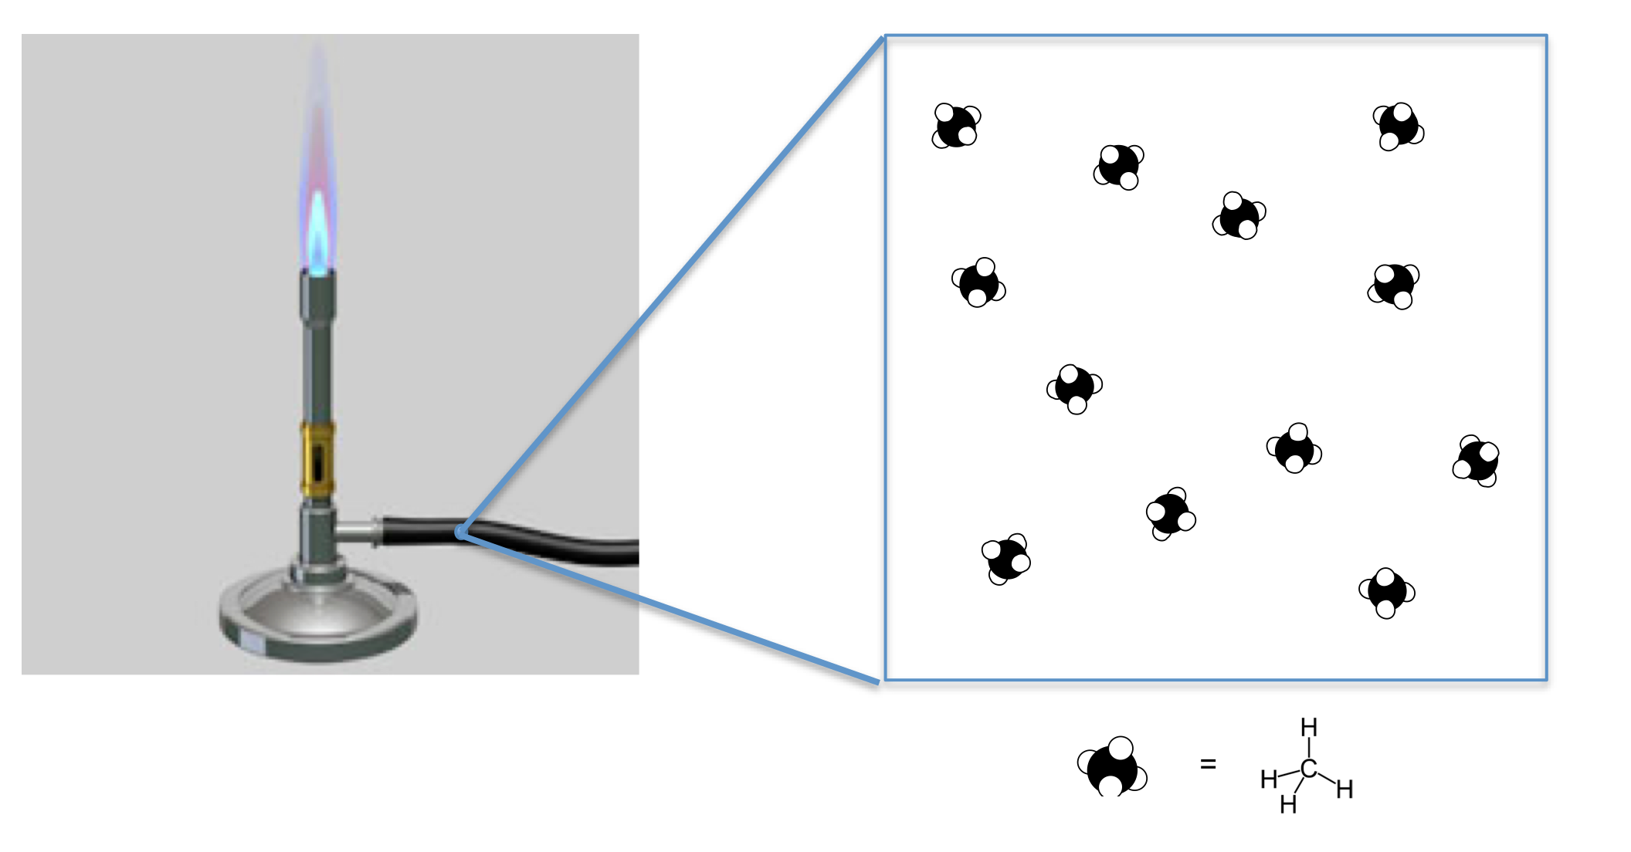
SIMPLE MOLECULAR e.g. CH₄

Slide 9
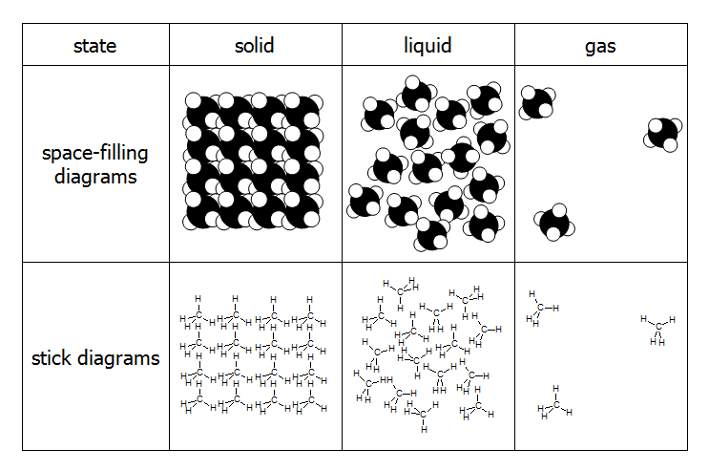
SIMPLE MOLECULAR e.g. CH₄

Slide 10
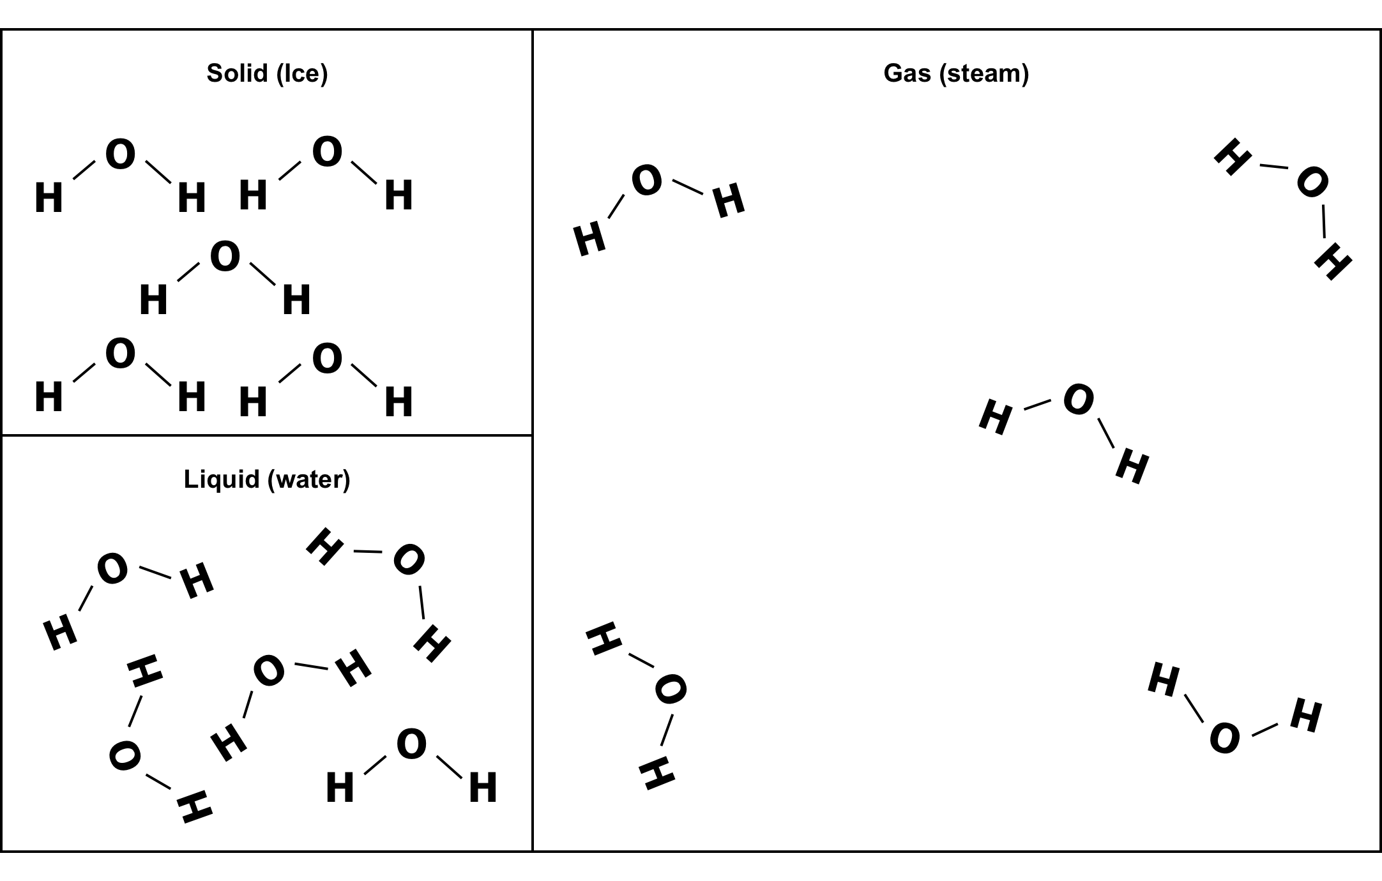

Slide 11
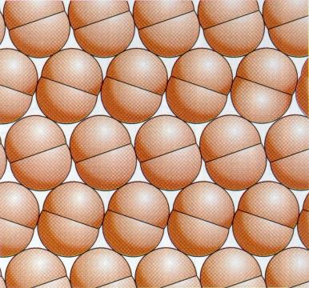
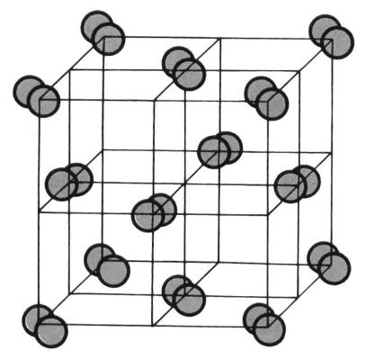

SIMPLE MOLECULAR e.g. I₂

Slide 12
GAS I₂
I
I
I
I
I
I
I
I
SOLID I₂
I
I
LIQUID I₂
I
I
I
I
I
I
I
I
I
I
I
I
I
I

Slide 13
 | PROPERTY | EXPLANATION
Melting & boiling points | LOW | Weak forces between molecules
Electrical conductivity | DOES NOT CONDUCT | No mobile charged particles
Strength | BRITTLE | Weak forces between molecules
Solubility in water | SLIGHTLY SOLUBLE

Slide 14
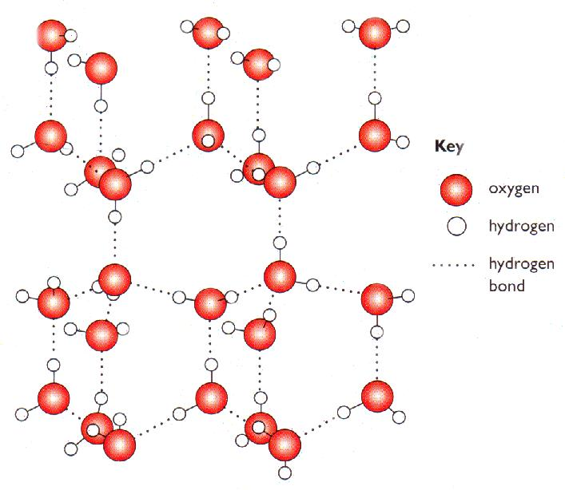
SIMPLE MOLECULAR e.g. ice

Slide 15
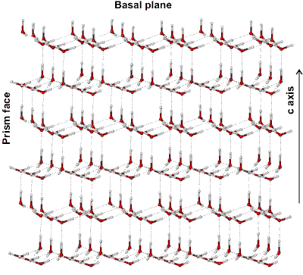
SIMPLE MOLECULAR e.g. ice

Slide 16
 | PROPERTY | EXPLANATION
Melting & boiling points | LOW | Weak forces between molecules
Electrical conductivity | DOES NOT CONDUCT | No mobile charged particles
Density of ice v water | ICE IS LESS DENSE THAN WATER | In ice molecules are arranged in lattice due to H-bonds; as a liquid molecules are closer as not in lattice

Slide 17
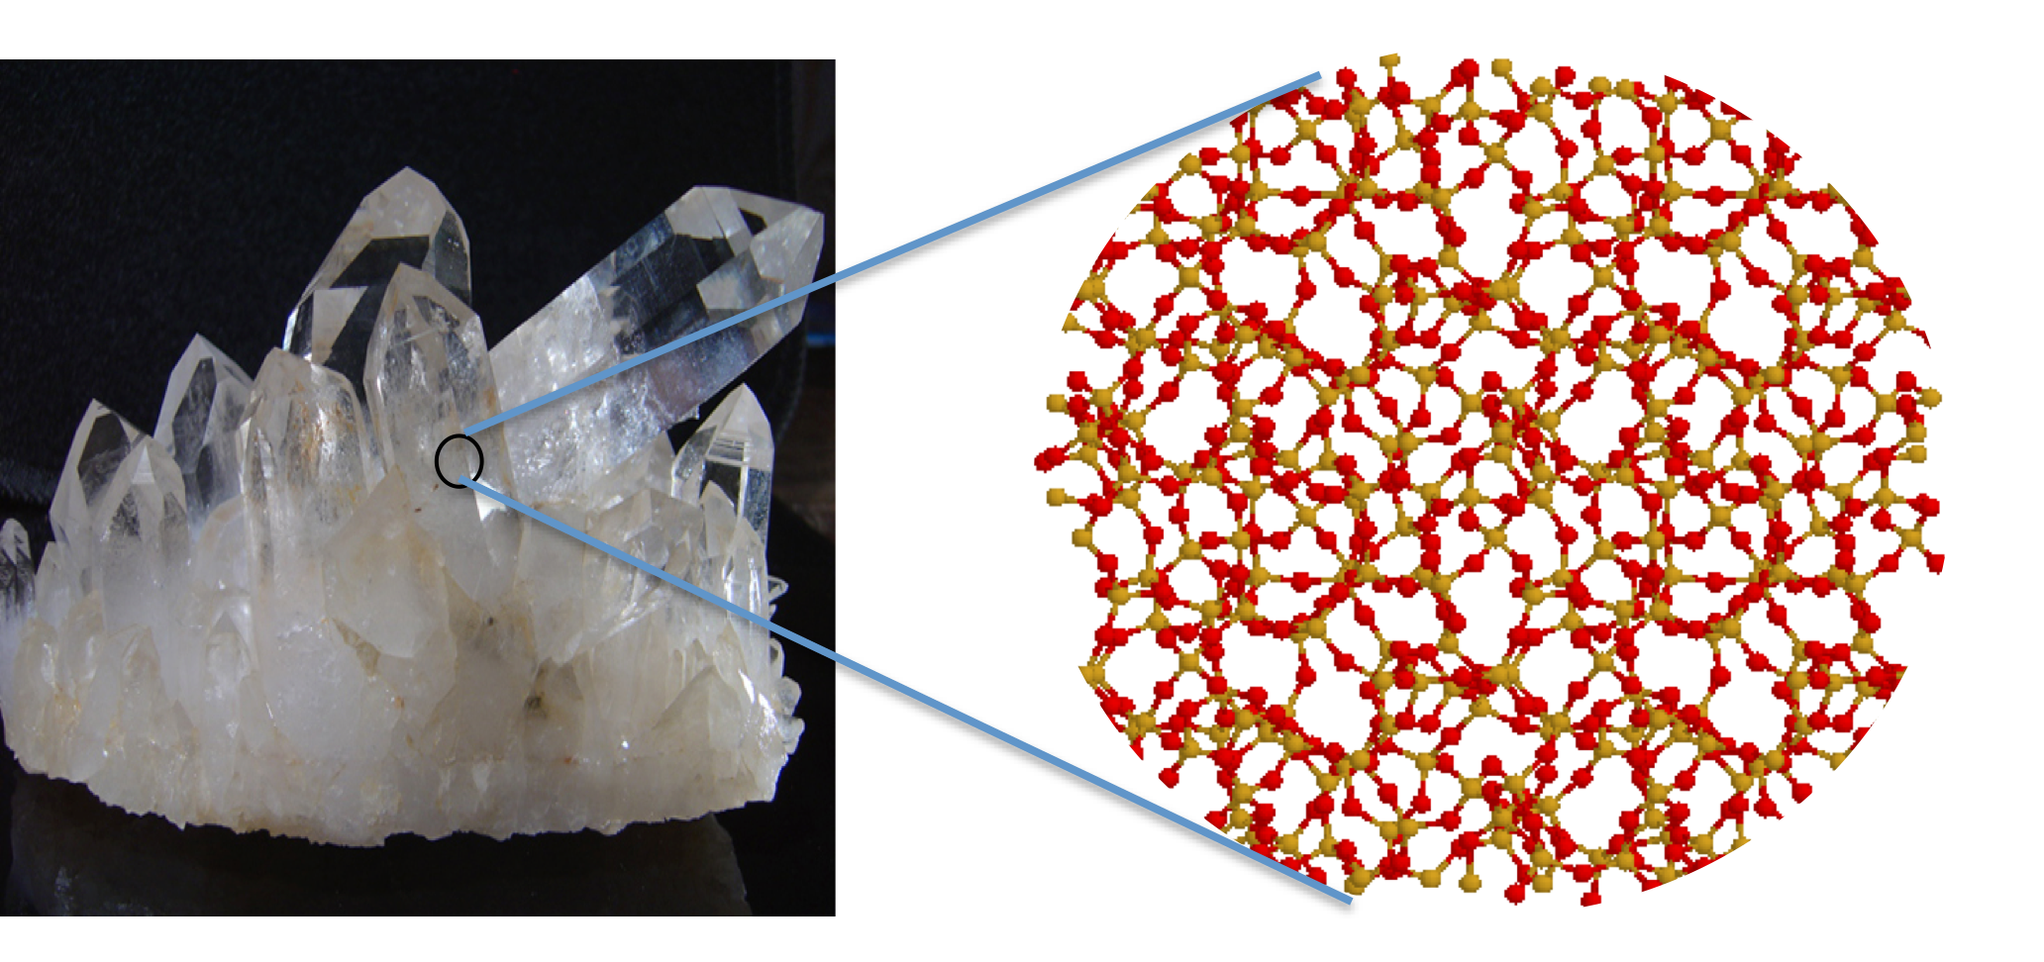
GIANT COVALENT e.g. SiO₂

Slide 18
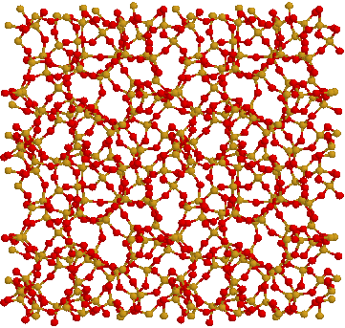
GIANT COVALENT e.g. SiO₂

Slide 19
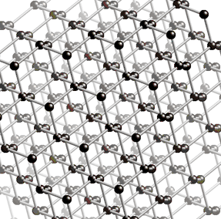
GIANT COVALENT e.g. diamond
http://www.edinformatics.com/interactive_molecules/diamond.htm
Great rotatable structures (but they are NOT molecules!!)

Slide 20
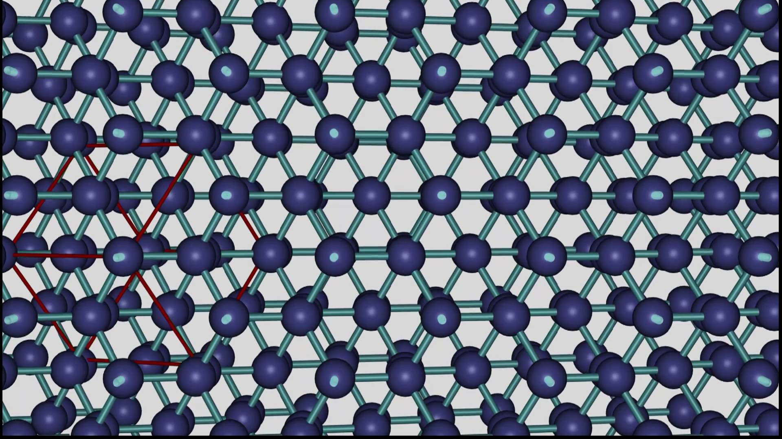

Slide 21
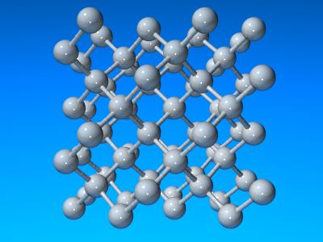

Slide 22
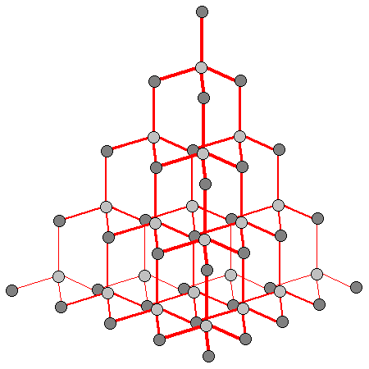
GIANT COVALENT e.g. diamond

Slide 23
 | PROPERTY | EXPLANATION
Melting & boiling points | VERY HIGH | Need to break all strong covalent bonds
Electrical conductivity | DOES NOT CONDUCT | No mobile charged particles
Strength | STRONG | Rigid arrangement of atoms held by covalent bonds
Solubility in water | INSOLUBLE

Slide 24
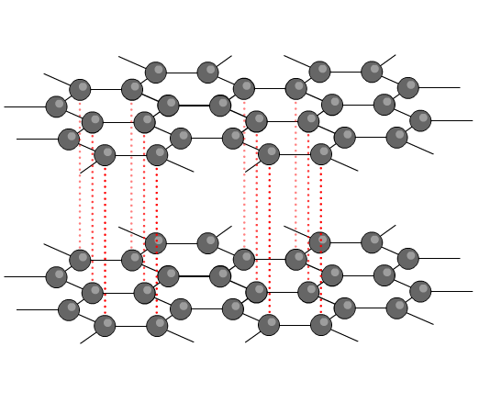
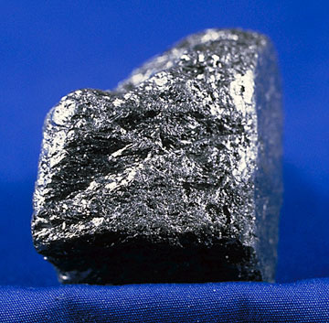
GIANT COVALENT e.g. graphite
http://www.edinformatics.com/interactive_molecules/diamond.htm
Great rotatable structures (but they are NOT molecules!!)

Slide 25
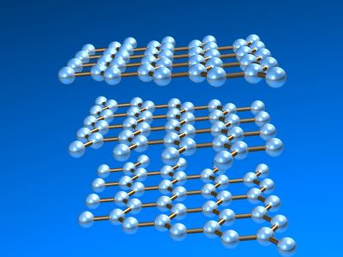

Slide 26
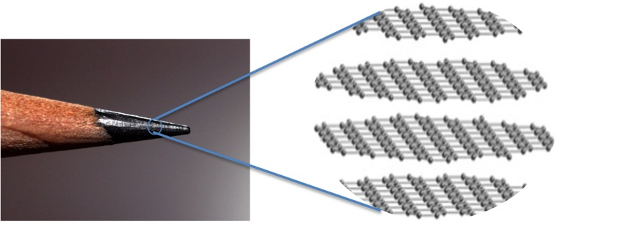
GIANT COVALENT e.g. graphite

Slide 27
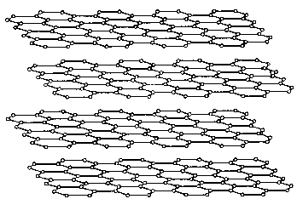

Slide 28
 | PROPERTY | EXPLANATION
Melting & boiling points | VERY HIGH | Need to break all strong covalent bonds
Electrical conductivity | CONDUCTS | Some electrons free to move between layers
Strength | BRITTLE | Weak forces between layers so layers can slide
Solubility in water | INSOLUBLE

Slide 29
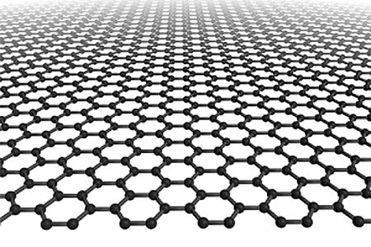
GIANT COVALENT e.g. graphene
C Graphene

Slide 30
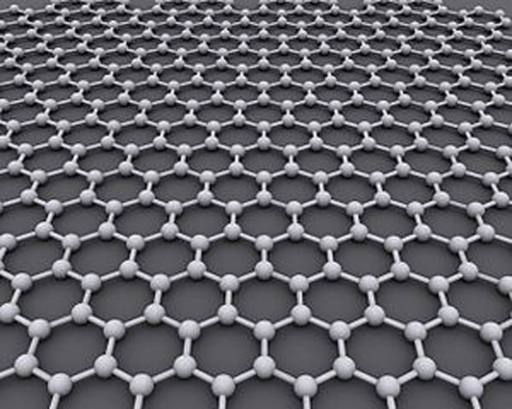
GIANT COVALENT e.g. graphene

Slide 31
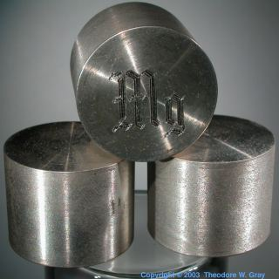
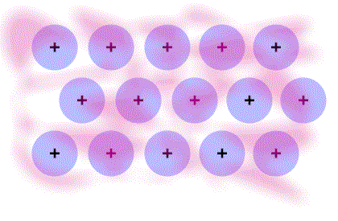
METALLIC e.g. Mg

Slide 32
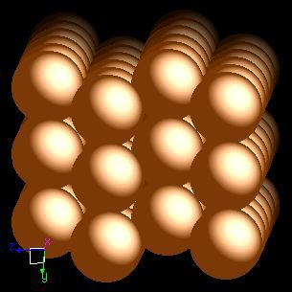

Slide 34
 | PROPERTY | EXPLANATION
Melting & boiling points | HIGH | Strong attraction between +ve ions and delocalised e-’s
Electrical conductivity | CONDUCTS | Outer shell electrons free to move
Strength | STRONG | Layers can slide while maintaining metallic bonding
Solubility in water | INSOLUBLE

Slide 35
Rank these metals in order of melting points:
Sodium
Potassium
Magnesium

Slide 36
e-
e-
e-
e-
+
e-
e-
+
+
+
e-
e-
2+
e-
2+
2+
e-
e-
2+
e-
e-
Sodium
(Na)
e-
e-
Magnesium
(Mg)
+
+
e-
e-
e-
+
2+
e-
2+
e-
e-
e-
e-
2+
e-
e-
e-
2+
2+
2+
2+
+
+
e-
e-
e-
+
+
e-
e-
e-
e-
e-
e-
2+
2+
2+
e-
e-
+
+
+
e-
+
e-
+
+
e-
e-
e-
e-
e-
Potassium
(K)
+
+
+
+
e-
e-
+
+
+
e-
e-
e-
e-
e-
+
+
+
+

Slide 37
e-
e-
e-
e-
+
e-
e-
+
+
+
e-
e-
2+
e-
2+
2+
e-
e-
2+
e-
e-
Sodium
(Na)
Mpt 98ºC
e-
e-
Magnesium
(Mg)
Mpt 650ºC
+
+
e-
e-
e-
+
2+
e-
2+
e-
e-
e-
e-
2+
e-
e-
e-
2+
2+
2+
2+
+
+
e-
e-
e-
+
+
e-
e-
e-
e-
e-
e-
2+
2+
2+
e-
e-
+
+
+
e-
+
e-
+
+
e-
e-
e-
e-
e-
Potassium
(K)
Mpt 64ºC
+
+
+
+
e-
e-
+
+
+
e-
e-
e-
e-
e-
+
+
+
+

Slide 38
e-
e-
e-
e-
+
e-
e-
+
+
+
e-
e-
2+
e-
2+
2+
e-
e-
2+
e-
e-
Sodium
(Na)
Mpt 98ºC
Con 0.218
e-
e-
Magnesium
(Mg)
Mpt 650ºC
Con 0.224
+
+
e-
e-
e-
+
2+
e-
2+
e-
e-
e-
e-
2+
e-
e-
e-
2+
2+
2+
2+
+
+
e-
e-
e-
+
+
e-
e-
e-
e-
e-
e-
2+
2+
2+
e-
e-
+
+
+
e-
Con = Electrical conductivity
(measured as 10⁻⁸ Ω⁻¹m⁻¹)
+
e-
+
+
e-
e-
e-
e-
e-
Potassium
(K)
Mpt 64ºC
Con 0.143
+
+
+
+
e-
e-
+
+
+
e-
e-
e-
e-
e-
+
+
+
+

