Slide 1
www.CHEMSHEETS.co.uk
BOND POLARITY
© www.chemsheets.co.uk AS 1026 07-Jun-2016

Slide 2
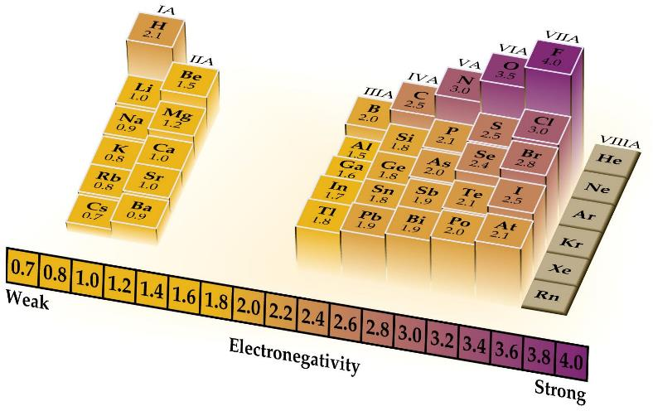
Electronegativity = the power of an atom to attract the electrons in a covalent bond

Slide 3
 |  |  |  |  |  |  |  | H 2.1 |  |  |  |  |  |  |  |  | He
Li 1.0 | Be 1.5 |  |  |  |  |  |  |  |  |  |  | B 2.0 | C 2.5 | N 3.0 | O 3.5 | F 4.0 | Ne
Na 0.9 | Mg 1.2 |  |  |  |  |  |  |  |  |  |  | Al 1.5 | Si 1.8 | P 2.1 | S 2.5 | Cl 3.0 | Ar
K 0.8 | Ca 1.0 | Sc 1.3 | Ti 1.5 | V 1.6 | Cr 1.6 | Mn 1.5 | Fe 1.8 | Co 1.8 | Ni 1.8 | Cu 1.9 | Zn 1.6 | Ga 1.6 | Ge 1.8 | As 2.0 | Se 2.4 | Br 2.8 | Kr
Rb 0.8 | Sr 1.0 | Y 1.2 | Zr 1.4 | Nb 1.6 | Mo 1.8 | Tc 1.9 | Ru 2.2 | Rh 2.2 | Pd 2.2 | Ag 1.9 | Cd 1.7 | In 1.7 | Sn 1.8 | Sb 1.9 | Te 2.1 | I 2.5 | Xe
Cs 0.7 | Ba 0.9 | La 1.1 | Hf 1.3 | Ta 1.5 | W 1.7 | Re 1.9 | Os 2.2 | Ir 2.2 | Pt 2.2 | Au 2.4 | Hg 1.9 | Tl 1.8 | Pb 1.8 | Bi 1.9 | Po 2.0 | At 2.2 | Rn

Slide 4
Factors affecting electronegativity
1+
9+
H – F

Slide 5
Factors affecting electronegativity
1) Nuclear charge – the more protons, the stronger the attraction from the nucleus to the bonding pair of electrons.
2) Atomic radius – the closer the bonding electrons to the nucleus, the stronger the attraction from the nucleus to the bonding pair of electrons.
3) Shielding – the less shells of electrons shielding (repelling) the bonding electrons, the stronger the attraction from the nucleus to the bonding pair of electrons.

Slide 6
Factors affecting electronegativity
1) Nuclear charge – more protons, stronger attraction between nucleus and bonding pair of electrons.
2) Atomic radius – closer to the nucleus, stronger attraction between nucleus and bonding pair of electrons.
3) Shielding – less shells of electrons between the nucleus and the electrons, less shielding (less repulsion), stronger attraction between nucleus and bonding pair of electrons.

Slide 7
Trend down a group
Electronegativity decreases
Atomic radius increases
More shielding
∴ Less attraction between nucleus and bonding pair of electrons

Slide 8
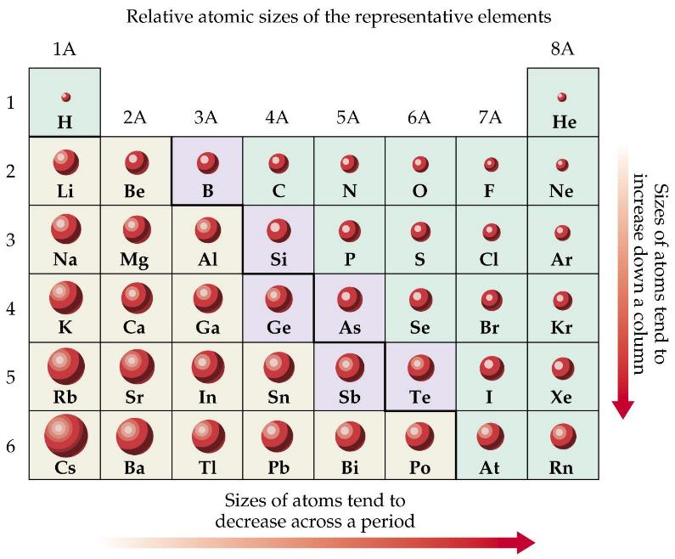

Slide 9
Trend across a period
Electronegativity increases
Atomic radius decreases
More nuclear charge
∴ Stronger attraction between nucleus and bonding pair of electrons

Slide 10

Formation of a covalent bond

Slide 11
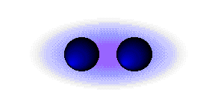
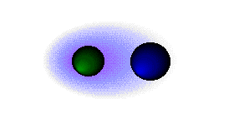
Non-polar bond
Polar bond

Slide 12
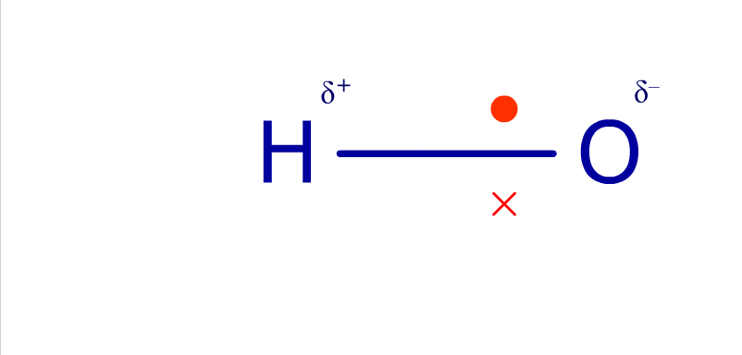

Slide 13
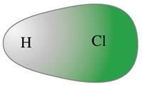


 | HCl polar bond showing the unequal sharing of a cloud of electron density.
 | HCl polar bond showing the partial (δ+) change on hydrogen and the partial (δ -) change on chlorine.
 | HCl polar bond showing the direction of the dipole with an arrow pointing toward the more negative atom. The + on the opposite end also reminds us which atom is more positive.

Slide 14
0
Electronegativity Difference
4
δ-
δ+
X
Y
X
Y
X⁻
Y⁺
X⁻
Y⁺
Pure covalent
Polar covalent
Electrons not
equally shared
Polar ionic
Distorted ions
Pure ionic
Polarisation of covalent bonds
Polarisation of ions
Favoured by small, highly charged +ve ions, e.g. Li⁺, Be²⁺

Slide 15
Covalent
bonding
Ionic
bonding

Slide 16
 | NaCl | MgCl₂ | AlCl₃ | SiCl₄
Mpt | 801ºC | 714ºC | 190ºC | -70ºC
Structure | Ionic | Polar ionic | Polar covalent | Covalent
Difference in electronegativity decreases
+ve ion gets smaller and more highly charged, so –ve polarised more

Slide 17
 | BeCl₂ | MgCl₂ | CaCl₂ | SrCl₂ | BaCl₂
Mpt | 401ºC | 714ºC | 782ºC | 870ºC | 963ºC
Structure | Polar covalent | Ionic | Ionic | Ionic | Ionic
Difference in electronegativity decreases
+ve ion gets smaller and more highly charged, so –ve polarised more

Slide 18
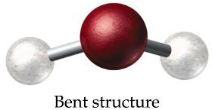
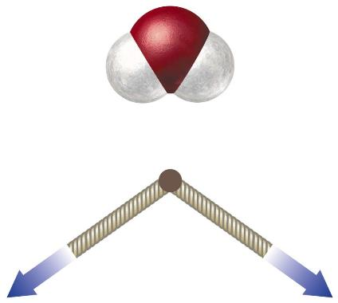
H₂O
δ-
O
H
H
δ+
δ+
Bonds: polar
Molecule: polar

Slide 19
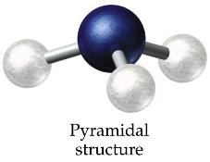
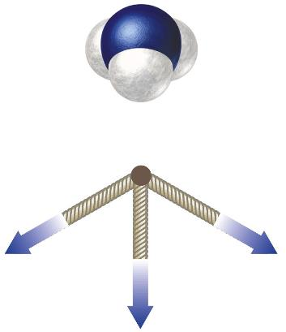
NH₃
δ-
N
H
H
δ+
H
δ+
δ+
Bonds: polar
Molecule: polar

Slide 20
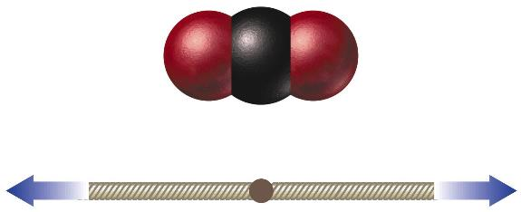
CO₂
δ-
δ+
δ-
O
C
O
Bonds: polar
Molecule: non-polar

Slide 21
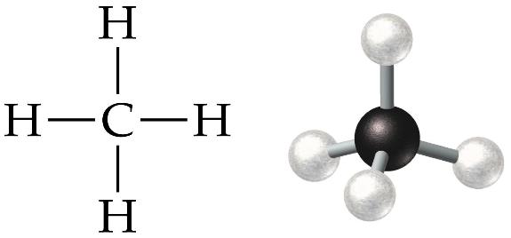
CCl₄
δ-
Cl
δ+
C
Cl
Cl
δ-
Cl
δ-
δ-
Bonds: polar
Molecule: non-polar

Slide 22


