Slide 1
INDUCTION TASK
A LEVEL FINE ART YEAR 12
NATURAL FORMS
You have a series of tasks to do based on the theme Natural Forms.
Collect minimum of 5 Natural forms of your choice. For example fruit, vegetables, walnuts, shells, seed heads, pine cones, stones, sticks, leaves, flowers etc.) There are examples of images of natural forms on the next sheet but they are by no means intended to limit you. Select things that are interesting and you are able to draw.
Create a minimum of 10 observational drawings that are related to the theme ‘Natural Forms’. Use a variety of different media and techniques. You don’t have to just draw on a white surface or just draw with pencil? When drawing consider the view or angle of the form. Think about the scale, pattern, symmetry, surface texture and shape of the natural form you have selected to draw. Think carefully about the type of drawing, line, tonal? Please produce a variety short and longer sketches. You could watch this youtube channel for drawing techniques
https://www.youtube.com/channel/UCDd5Kl6VNwLXkZzTjvPjy_w
Take 10 photographs of your natural forms from different angles and perspectives. Look at the photographer slide to see how you might compose you images.
Present your work; On A3 cartridge paper, (available from Student Reception), working on one side of the page only. At this stage please DO NOT present this information in your L6 sketchbook.

Slide 2
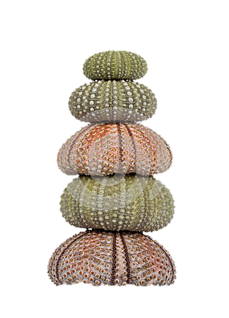
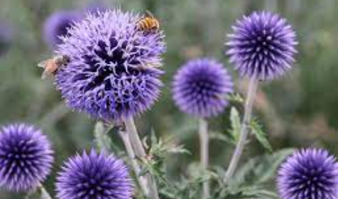
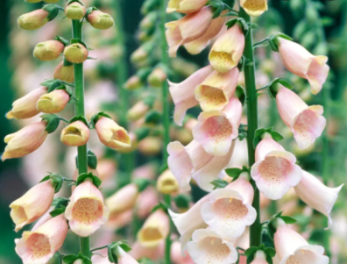
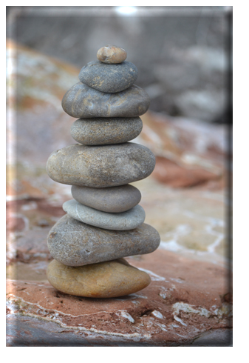
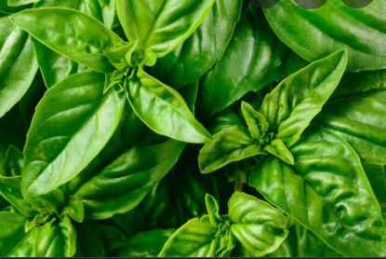
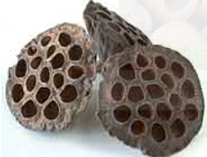
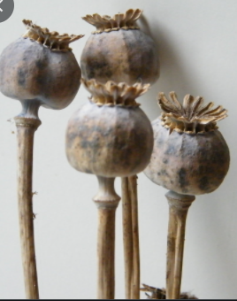
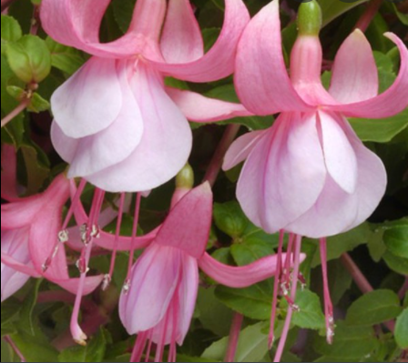
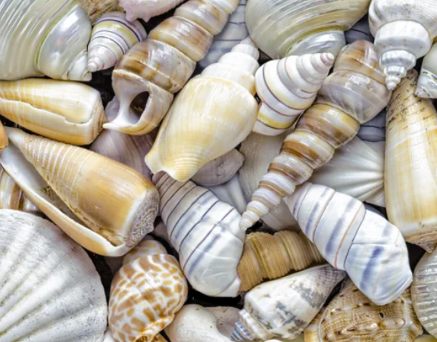
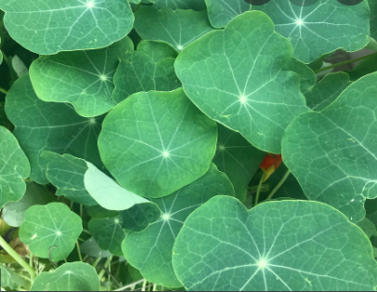
Natural Forms

Slide 3
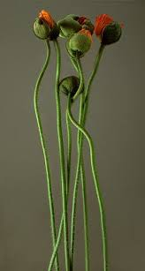
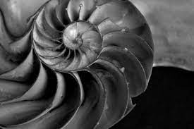
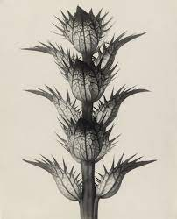
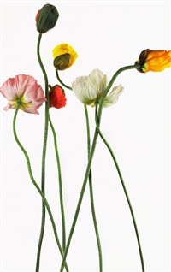
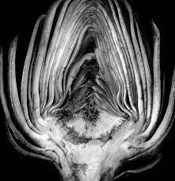
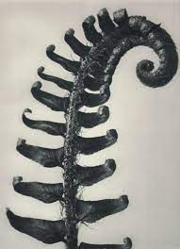
Photographers
Bill Beckley, Edward Weston & Karl Blossfeldt

Slide 4
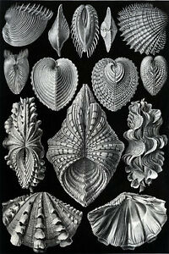
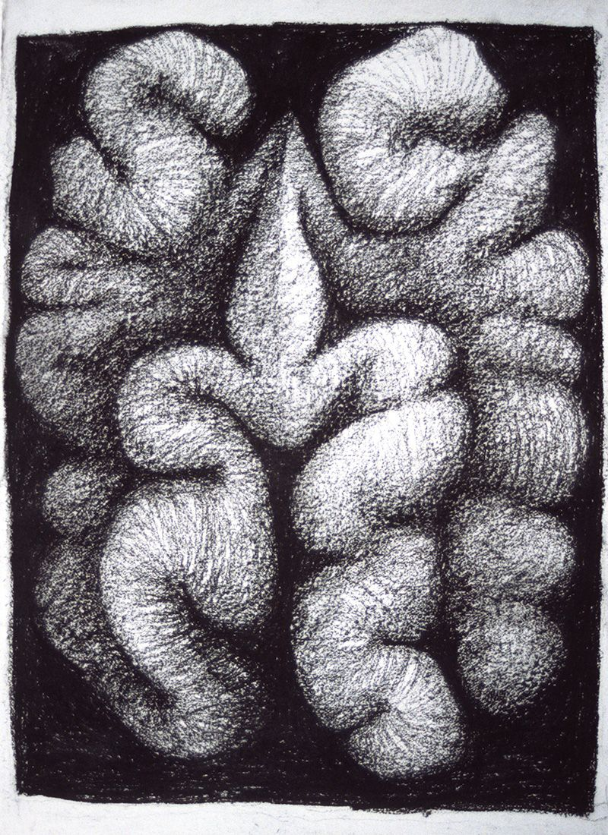
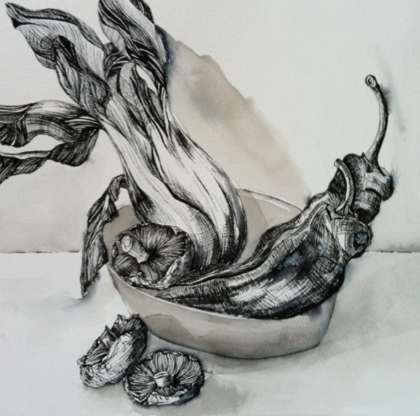
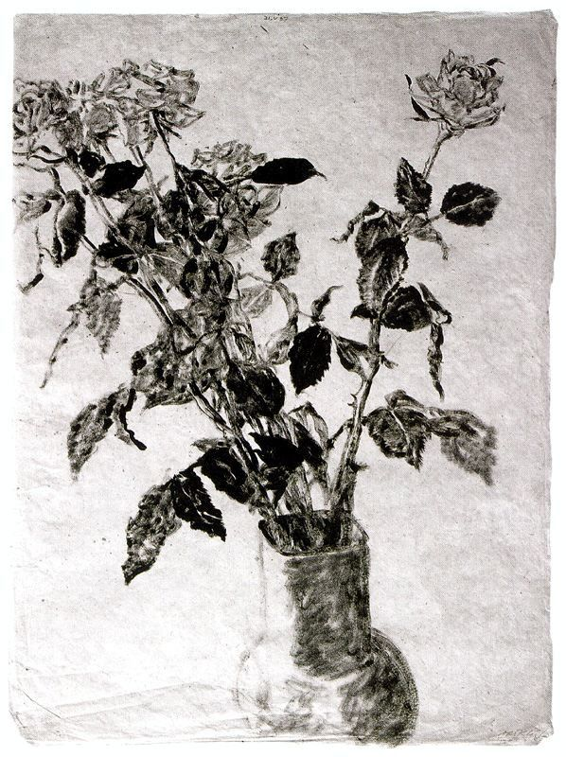
Artists Avigdor Arikha, Ernst Haekel, Peter Randall-Page & Arlene Sharp

