Slide 1
INDUCTION TASK
A LEVEL PHOTOGRAPHY YEAR 12
STRUCTURE

Slide 2
Task 1 – Shoot 1
You have a series of Photoshoots to do based on the theme Structure:
1. Shoot 1 – A minimum of 50 images that explore manmade structure
Explore manmade structure.
Demonstrate an understanding of balance, line, shape and form through your use the camera.
Take your first photo shoot around your home area. There are aspects of domestic buildings which can be interesting if focussed on.
Carefully consider the angles, perspectives, framing and the focal distance of your shots. See the examples on the following slides.

Slide 3
Task 1 - Shoot 1 Presentation
You will need a minimum of 50 photographs. You will select from these the best 35 images before loading a contact gallery to a PowerPoint online or Google Slides. (You can create a contact gallery quite quickly by loading your photos into a folder and taking a screen snip of the folder. Paste this onto your slide.)
On the next slide, create a selection Gallery of the best 6-8 images. Insert these as separate images and add a text box to each explaining why you think these are you best images.

Slide 4
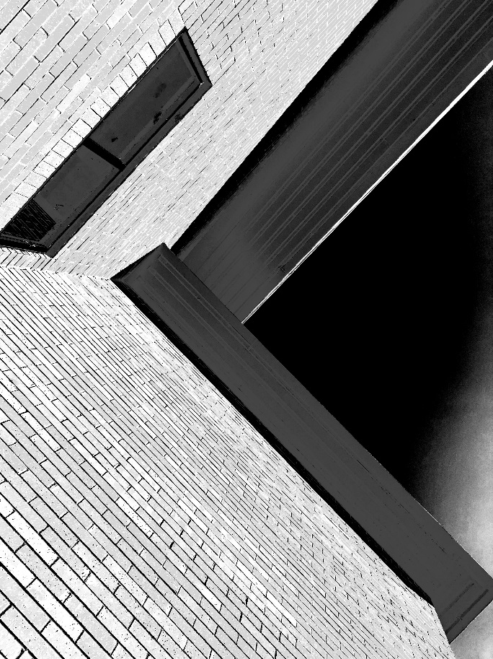
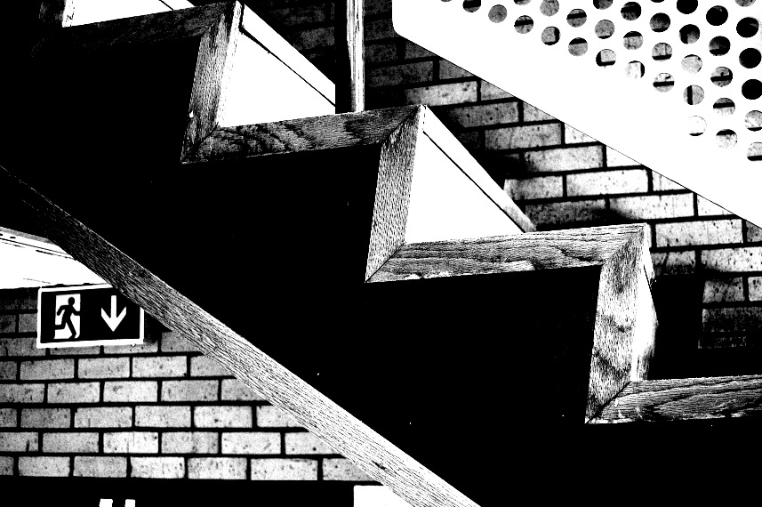
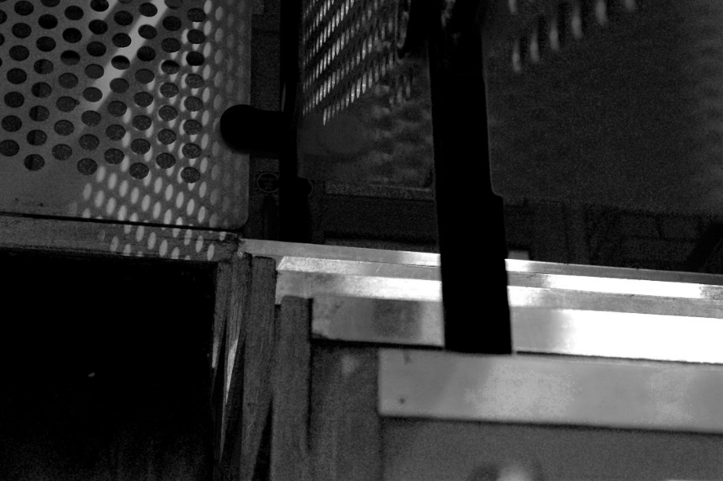
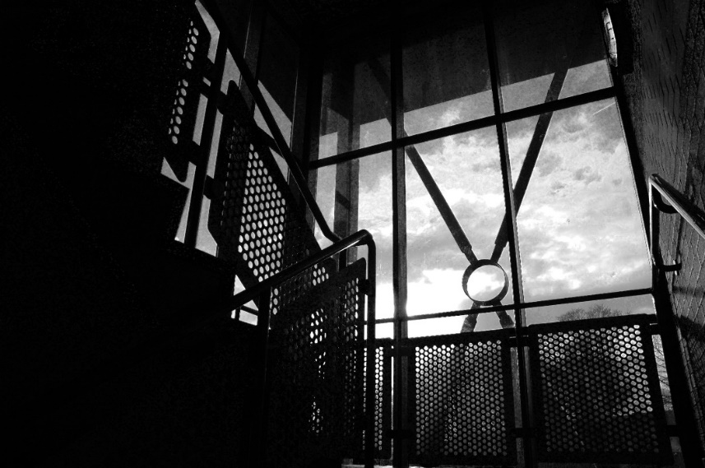
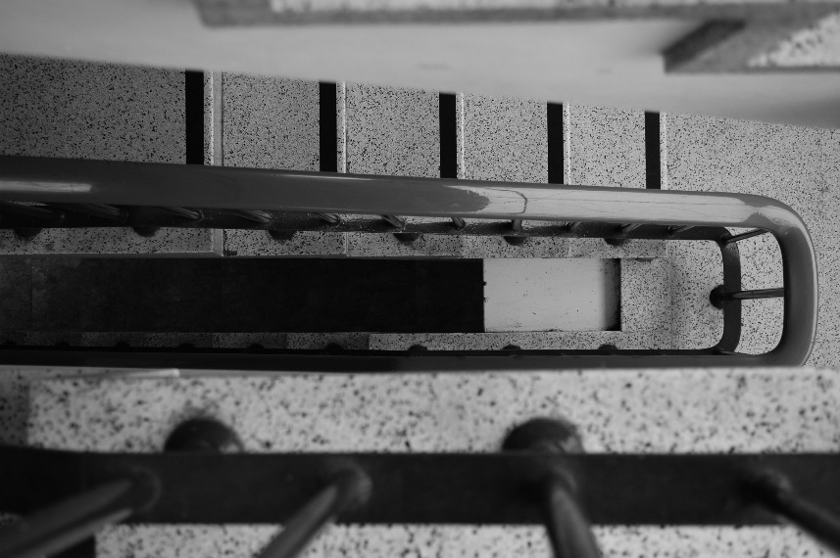
Task: Composition discussion to prompt Photo shoot 1
What do these images have in common?
Where do you think these might have been taken?
How are they different from what you’d expect to see of a photograph of a building?

Slide 5
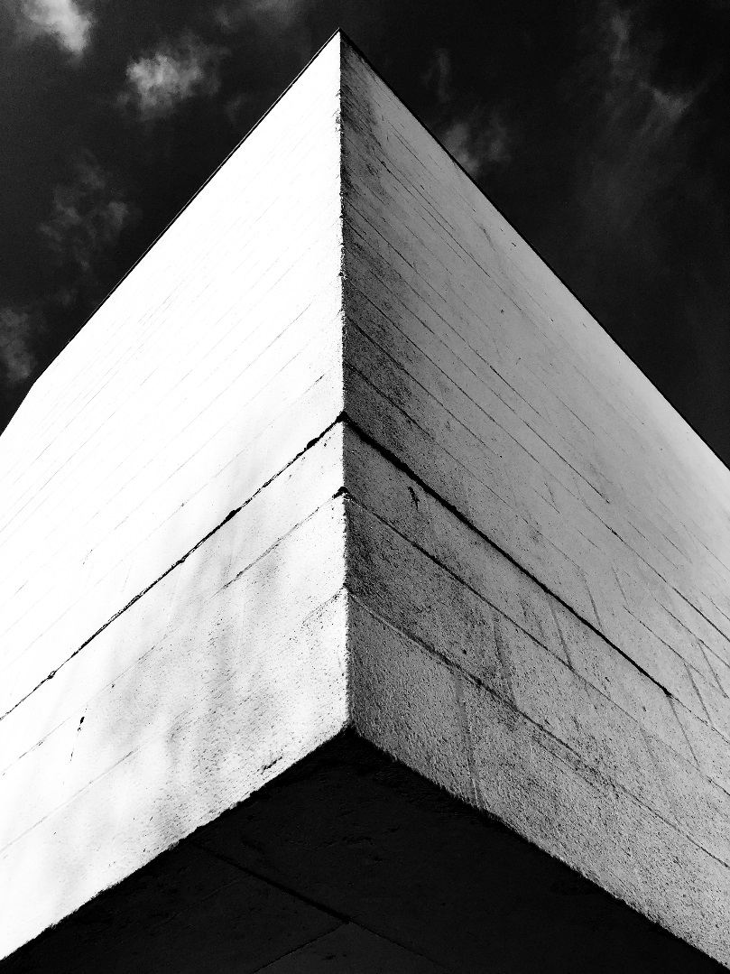
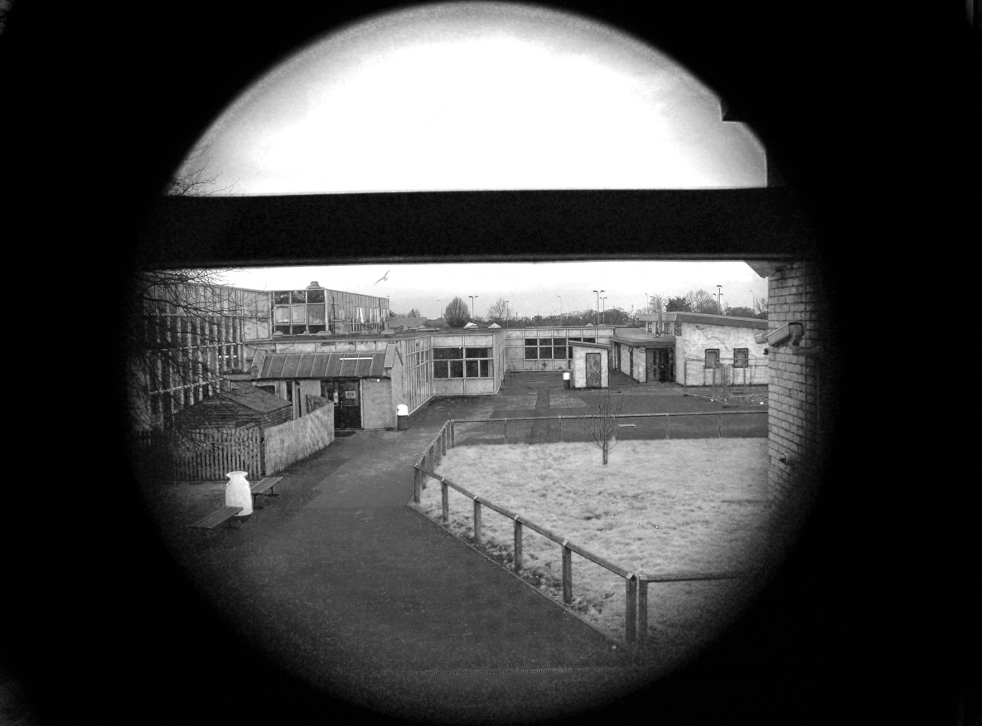
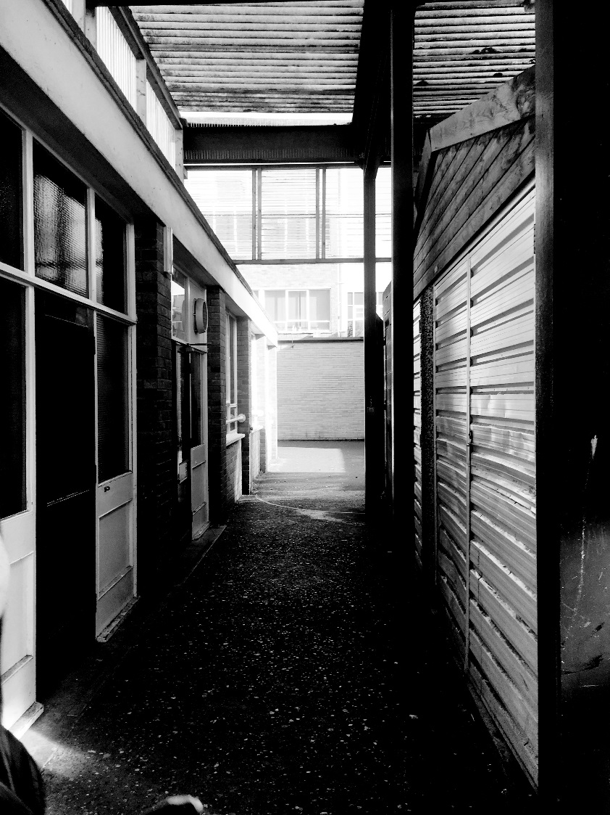
Take your first photo shoot around your home area. There are aspects of domestic buildings which can be interesting if focussed on.
Carefully consider the angles, perspectives, framing and the focal distance of your shots.
You will need a minimum of 50 photographs.

Slide 6
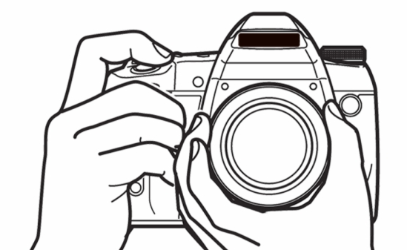
Task 2 - Shoot 2
2
Photo shoot 2
Take a minimum of 50 photographs which explore architectural structures around the local town.
Look at your local area which will have some interesting structures, (for example, street lighting, domestic buildings, bus stops, petrol stations, churches, schools, libraries etc.)
You may consider going into Chester to do this shoot. (Please; however, be covid compliant). As well as buildings think about bridges and other constructions.
You may see some scaffolding and/or building work – please be safe and NO climbing on this or trespass.
Carefully consider what worked in shoot 1.

Slide 7
Task 2 - Shoot 2 Presentation
You will need a minimum of 50 photographs. You will select from these the best 35 images before loading a contact gallery to a PowerPoint online or Google Slides. (You can create a contact gallery quite quickly by loading your photos into a folder and taking a screen snip of the folder. Paste this onto your slide.)
On the next slide, create a selection Gallery of the best 6-8 images. Insert these as separate images and add a text box to each explaining why you think these are you best images.

Slide 8
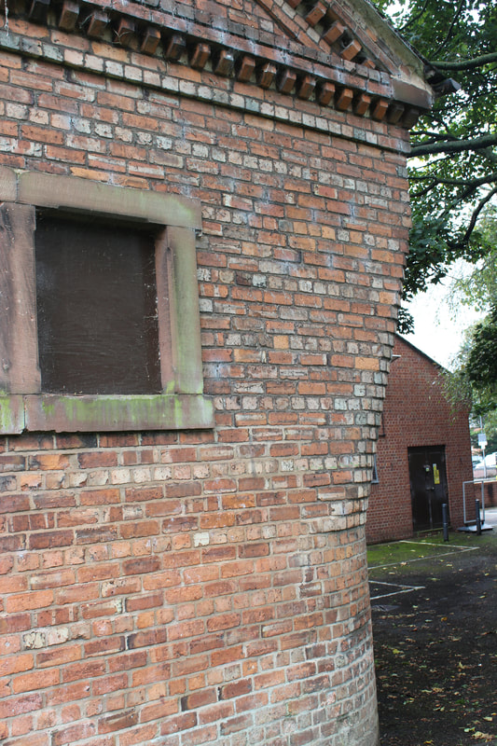
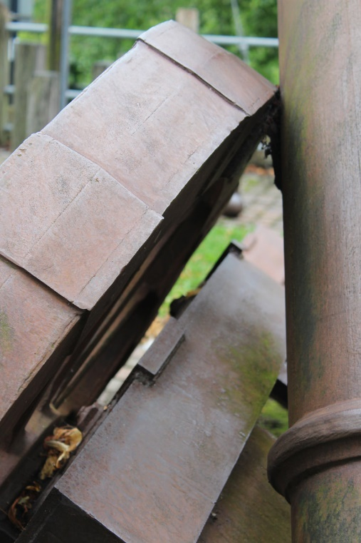
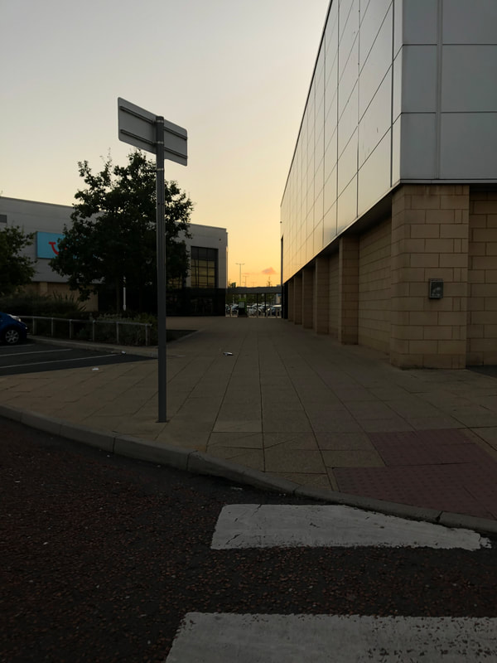
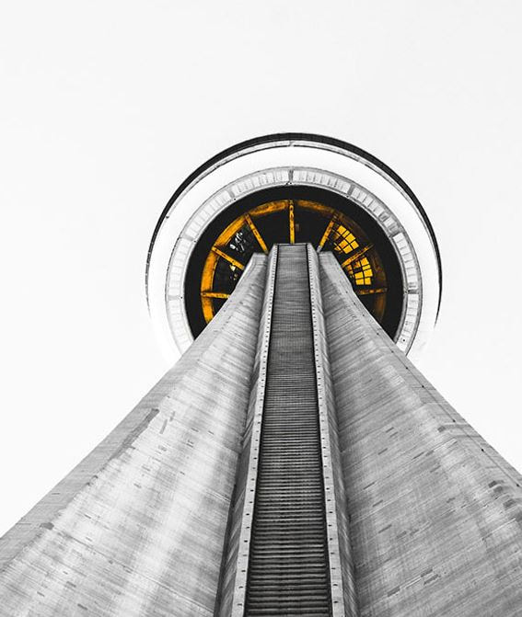
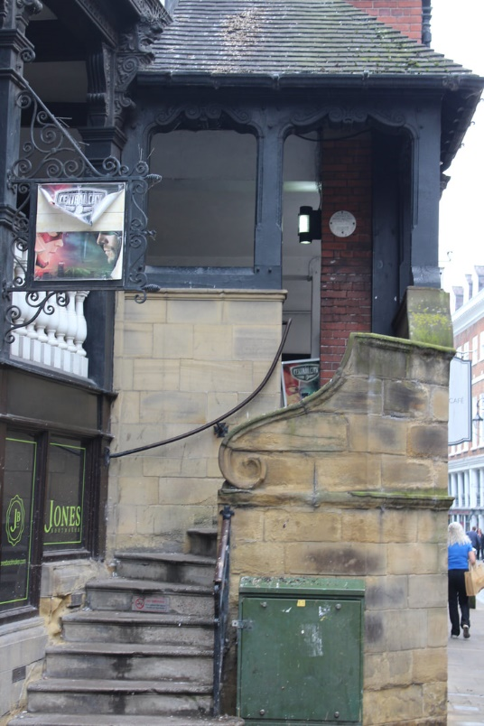
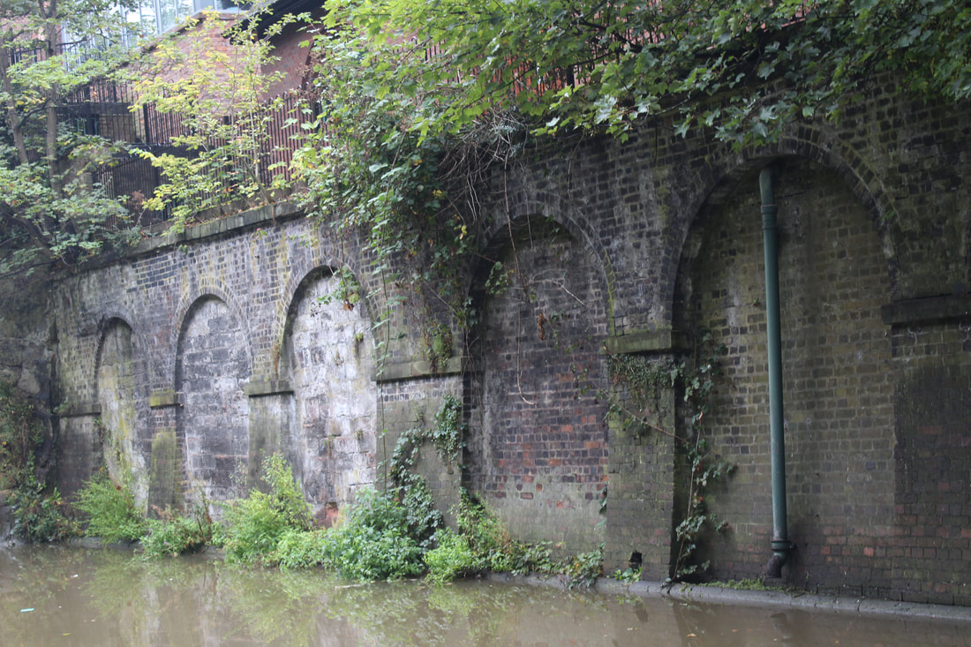
Examples of structure in your local area

Slide 9
Presenting your work
You should use PowerPoint Online or Google Slides to present your work. (If you cannot access these, use PowerPoint.)
Make a screen snip of the folder which contains your shoot for your contact gallery.
Select the best 6-8 images to present as individual images in your selection gallery.
Add text boxes to each of these to explain why you think they work well as photographs showing structure.

Slide 10
Task 3 – Artist link
Choose one of the famous Architectural photographers on the following slide and create a link to their work.
You need:
Title – Artist/photographers name
4 Images of their work.
Some basic background information.
A detailed analysis of one of the images.
Your opinion on the work.
How might this artist influence your work in the future?
Present this work on one slide.

Slide 11
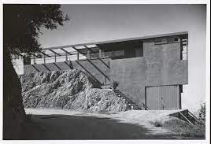
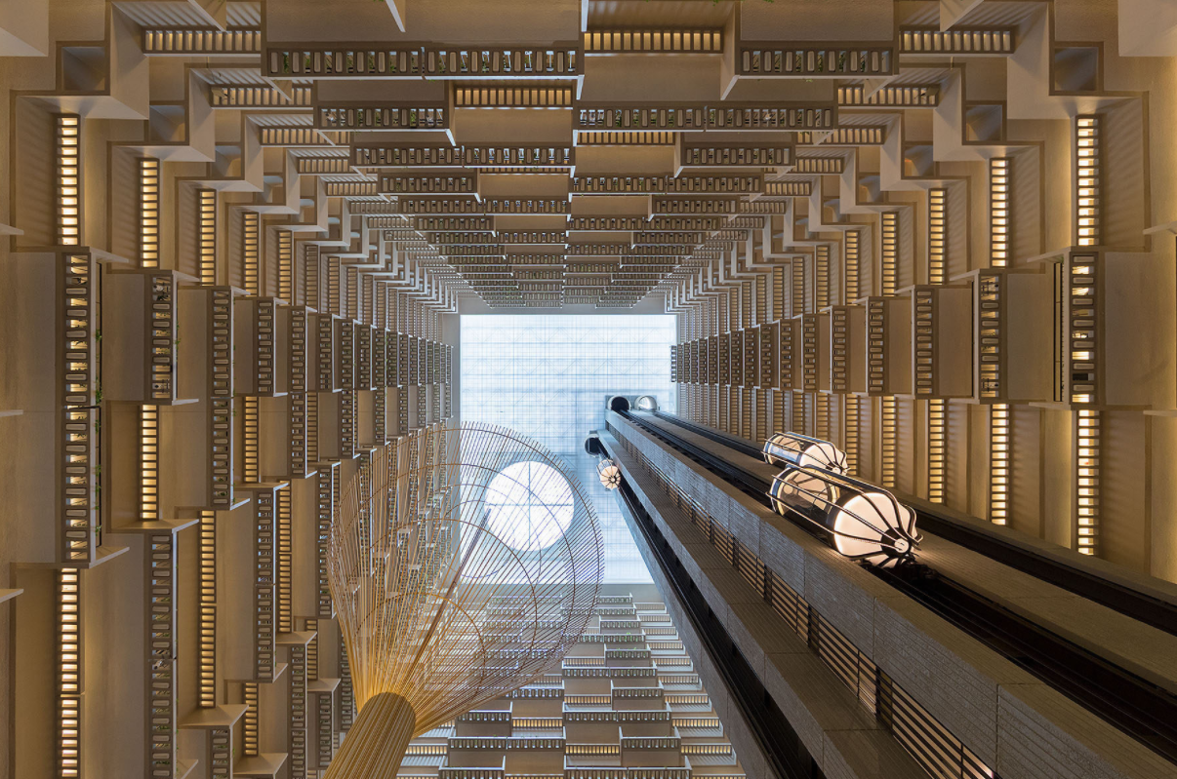
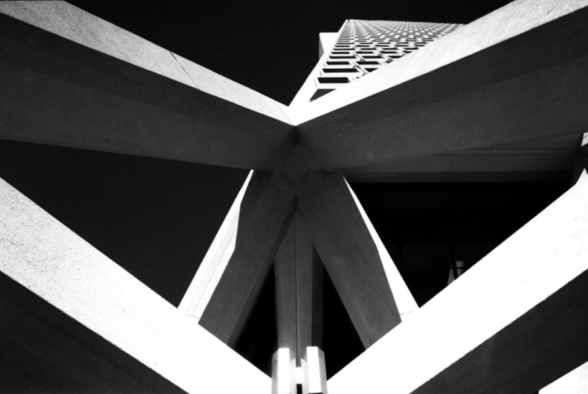
Architectural Photographers
Julius Shulman
Iwan Baan
Wayne Thom

Slide 12
Handing in your work
You will hand in your work to Google Classroom by the deadline.
You will be given you class code at the start of term.

