Slide 1
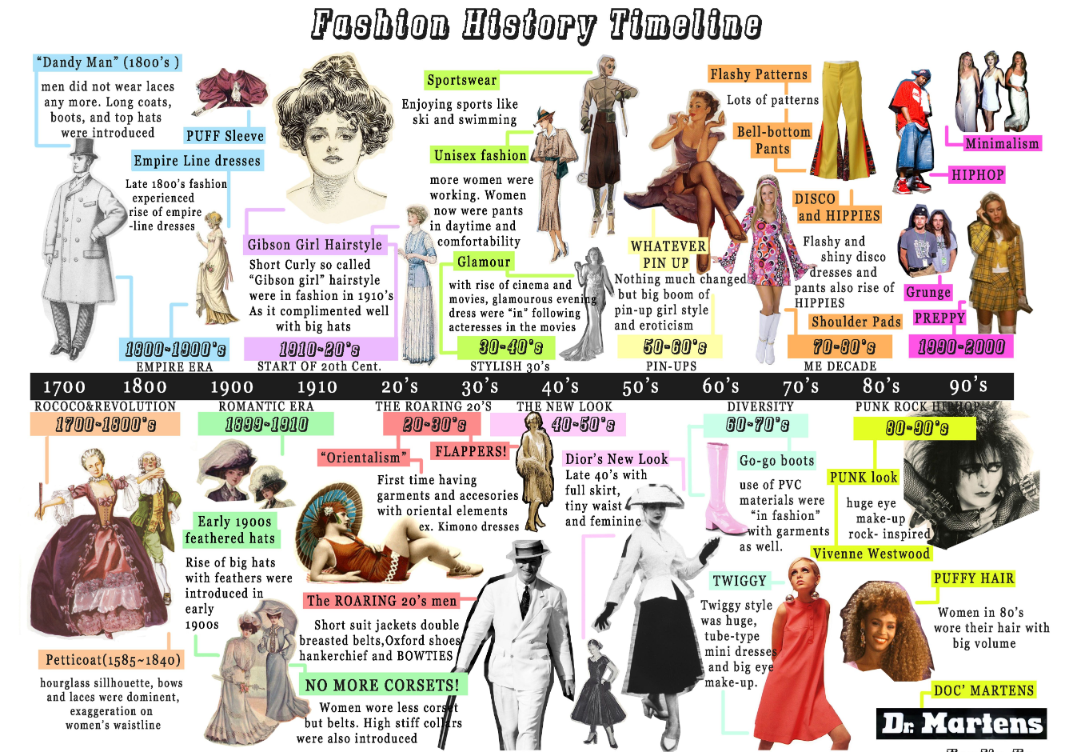
Fashion and Textiles
Tasks
Purchase an A3 sketchbook to work in
2. Research a fashion era that interests you.
e.g 1920 , 1960’s, 1980’s
Present work
Create mood boards / Information page.
3. Produce FOUR /FIVE OUTFIT designs for any occasion. Include aspects of your research and your fabric samples.
Or
Produce FOUR interior products designs for a boutique hotel. Include aspects of your research and your fabric samples.

Slide 3
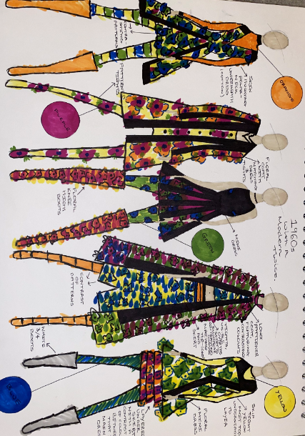
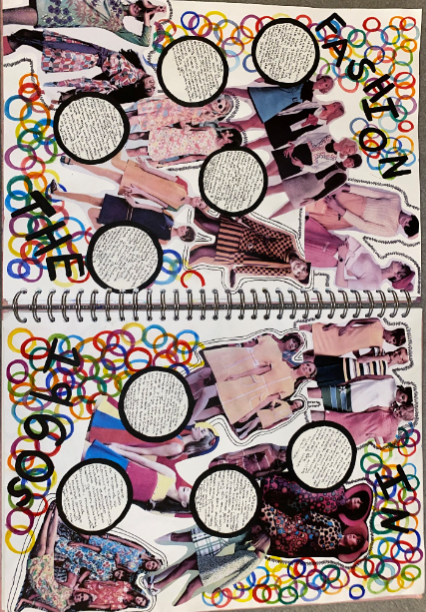
Examples

Slide 4
Fabric/ fiber information pages
http://resource.download.wjec.co.uk.s3.amazonaws.com/vtc/2016-17/16-17_1-3/website/pdf/_eng/_wjec/textiles-1/materials-resource-1.pdf
http://resource.download.wjec.co.uk.s3.amazonaws.com/vtc/2016-17/16-17_1-3/website/pdf/_eng/_wjec/textiles-1/materials-resource-2.pdf

