Slide 1

A Level Psychology
Induction Task 2021
This research based project is designed to give you an ideal grounding for your A Level Psychology course.
Research and complete the tasks independently over the summer to get a head start and prepare for two of the key topics within Year 1 A Level Psychology.
Present the tasks on a PowerPoint in any way you like and email the finished work to psychologysummertask@uptonhigh.co.uk by 10th September 2021. Make sure your name is clear on the email.
Good luck and Enjoy ☺

Slide 2
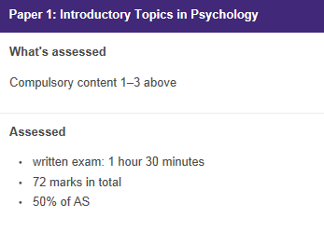
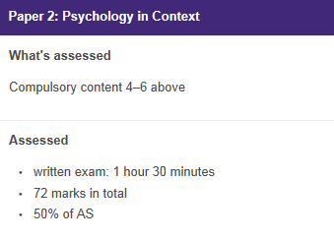
The AQA Course
A Level Year 1
Topics:
Social Influence
Memory
Attachment
Topics:
Research Methods
Psychopathology
Approaches in Psychology (including Bio Psychology)
100% Exam (two papers), 0% Coursework

Slide 3
Memory Research https://www.youtube.com/watch?v=qbP43N95MKM
Use the internet to search a detailed summary of Loftus and Palmer’s 1974 study on Memory.
Create a summary of what you find on your PowerPoint. You should use the following headings;
Aim
Hypothesis
Procedure – as detailed as possible
Findings
Conclusions
Criticisms – at least two

Slide 4

Approaches to Psychology
The Famous Five
There are five main Psychological approaches or perspectives. Research them and explain the key terms, assumptions and psychologists which fit into each one.
Behaviourist
Psychodynamic
Humanistic
Cognitive
Biological

Slide 5
Useful Resources & Further Reading
To help you on your way…
Add us on Twitter: @UptonPsychology
Websites:
Youtube have a number of really good factual clips. In particular ‘Crash Course’ have produced a number of introductory videos to key elements in Psychology.
http://www.simplypsychology.org/a-level-psychology.html - Tailored to the old specification, but has all the relevant key information for A Level Psychology.
http://www.psychteacher.co.uk/ - Tailored to the old specification but contains key information for A Level Psychology.
Books:
Working Memory, Thought and Action – Alan Baddeley
The Lucifer Effect – Phillip Zimbardo
Obedience to Authority – Stanley Milgram
Opening Skinners Box -
Psychology: The Science of the Mind and Behaviour – Richard Gross
The Complete Companions: AQA Psychology Year 1 and AS Student Book – Mike Cardwell & Cara Flanagan
AQA Psychology for A Level Year 1 and AS Student Book – Cara Flanagan & Dave Berry
You may want to Google these to read a summary of what they are about. We guarantee you’ll be interested in a few of them. (e.g. Films have been made about the experiments which Zimbardo and Milgram did)

