Slide 1

A Level Sociology
Induction Task 2021
This research based project is designed to give you an ideal grounding to start your A Level Sociology course.
Research and complete the tasks independently over the summer to get a head start and prepare for some of the key topics within Year 1 A Level Sociology.
Present the tasks in a PowerPoint format and email your work to sociologysummertask@uptonhigh.co.uk. By 10th September 2019. Make sure your name is clear on the email.
Good luck and Enjoy ☺

Slide 2
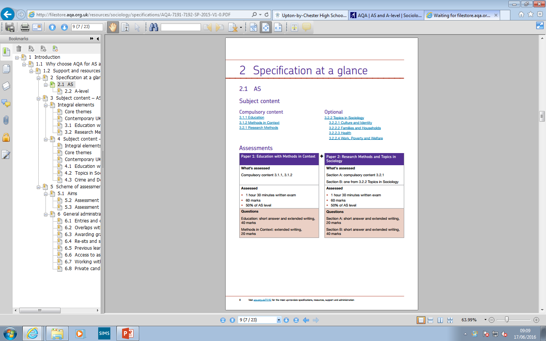
The AQA Course
A Level Year 1
Topics:
Sociology of Education.
Research Methods
Topics:
Families and Households
Research Methods
100% Exam (two papers), 0% Coursework

Slide 3
Watch
https://www.youtube.com/watch?v=AqkfmnkcLHQ
Task 1: Make a brief summary outlining the key points raised in the video. (you may have to watch it a few times)
Create a PowerPoint to display the issues you have identified and use images which are appropriate for each key idea and key term.

Slide 4
Task 2:
Copy the following 2 slides onto your PowerPoint.
Research these two theories in sociology and add a description of each to the slide.
You should include; basic ideology, key terminology, key theorists, are they ‘consensus’ or ‘conflict’ theories? How do they view society? How can social problems be resolved?
You can design the slide in any way you see fit, so long as the information is clear.
These short clips may help;
https://www.youtube.com/watch?v=0bT298xw7Q0
https://www.youtube.com/watch?v=W0GFSUu5UzA&t=188s

Slide 5
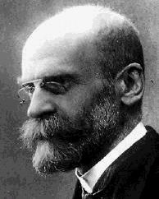
FUNCTIONALISM

Slide 6
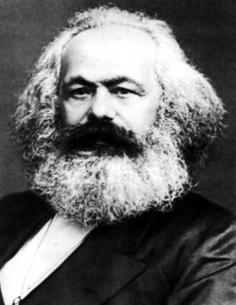
MARXISM

Slide 7
Task 3:
Researching key sociological studies is an important skill to develop.
Investigate the following study (next slide) and find out the information under the headings.
Present your findings on slides clearly but in any way you can create to reflect what Willis studied.

Slide 8


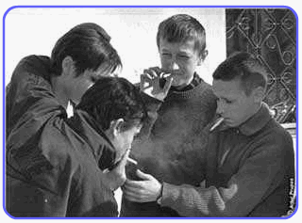
PAUL WILLIS – LEARNING TO LABOUR
Aim of the research
Methods used
Findings
Conclusions
Two strengths of this study
Two weaknesses of this study
https://revisesociology.com/2016/01/25/learning-to-labour-paul-willis-summary-evaluation-research-methods/
https://en.wikipedia.org/wiki/Learning_to_Labour

Slide 9
Useful Resources & Further Reading
To help you on your way…
Add us on Twitter @UptonSociology
Websites:
Youtube have a number of really good factual clips. In particular there are a number of introductory videos to key elements in Sociology.
New York Times Fixes Blog – Any article.
S-Cool – Revise Sociology
sociologytwynham.com – A site devoted to A level Sociology students
Books:
Gang leader for a Day – Sudhir Venkatesh
Join the Club – Tina Rosenberg
Queen Bees and Wannabees – Rosalind Wiseman
So You’ve Been Publicly Shamed – Jon Ronson
Freakonomics – Stephen D Levitt
The Sociological Imagination – C. Wright Mills
No Logo – Naomi Klein
Black Like Me – John Howard Griffin
You may want to Google these to read a summary of what they are about. We guarantee you’ll be interested in a few of them. (e.g. ‘Queen Bees’ was the inspiration behind the film ‘Mean Girls’)

