Slide 1


POMODORO TECHNIQUE
A way to keep yourself working effectively

Slide 2
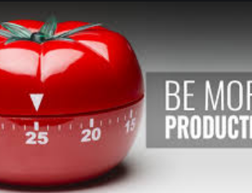

POMODORO TECHNIQUE
A well used strategy for productivity
Widely used in the work place
Also widely used in schools/universities as a strategy for effective study time

Slide 3

WATCH:
https://www.youtube.com/watch?v=mNBmG24djoY

Slide 4
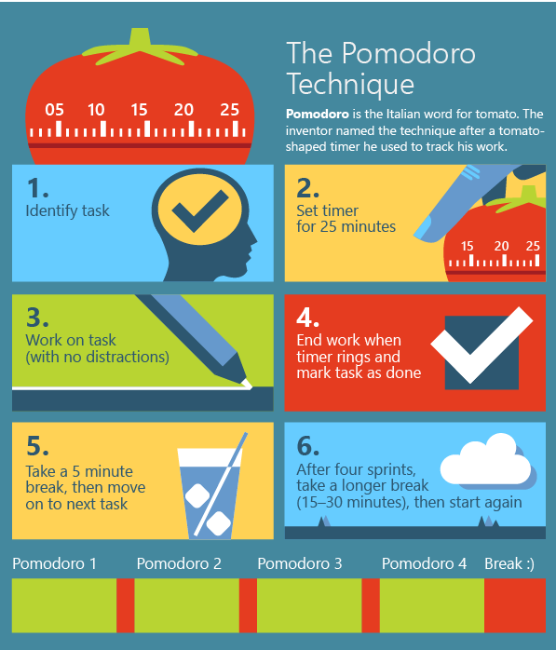
HOW DO I DO IT?

Slide 5




APPLYING THIS TO GCSE STUDY
Your revision should follow this kind of pattern.
It is much easier to commit to getting started on something if it is only a short amount of time!
Plan your slots, especially in terms of revising knowledge – this technique works really well for ensuring key coverage of subjects.
Go through each subject and work out what you need to know. Turn these into chunks of what you can cover in 25 minutes. Once you to the leg work setting it up, it’s lots easier to do in the long run.

