Slide 1

Exam stress
What is it?
How can I deal with it?

Slide 2
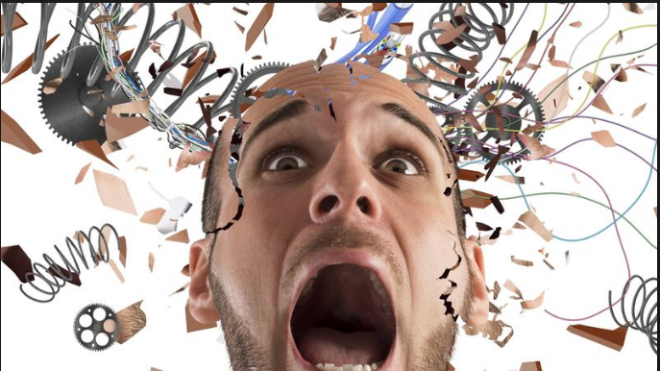
“I am so stressed, I think I might explode”
“I can’t cope, I am too stressed”

Slide 3
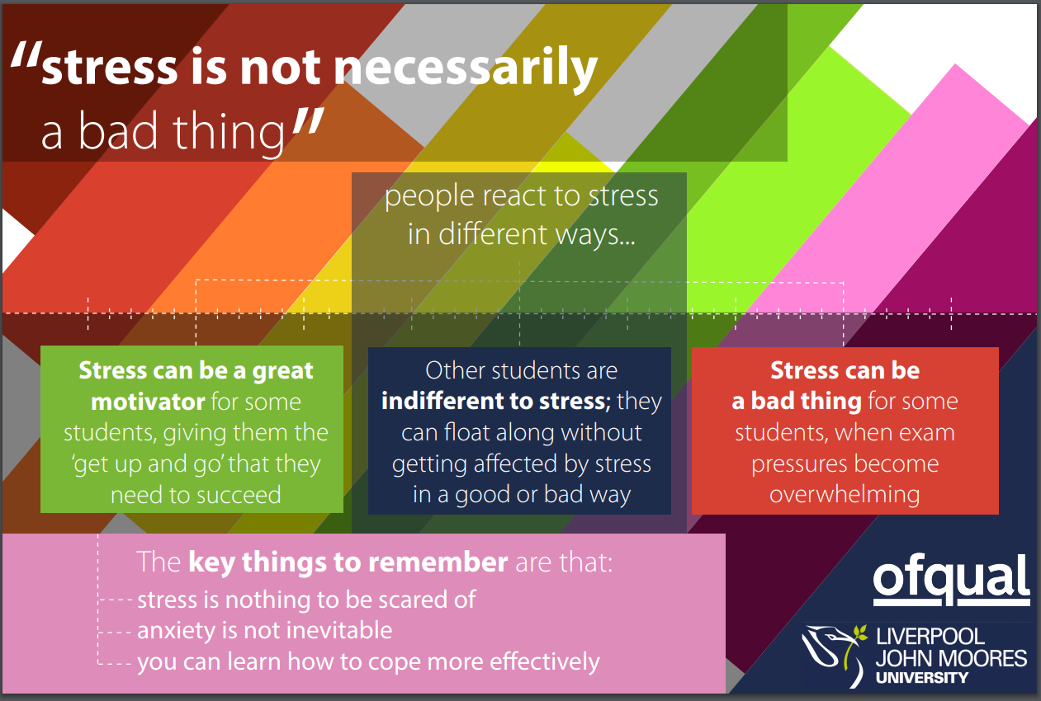
Notes:
Stress is normal – we all have it and it is a normal human reaction to things that are happening around us. It is something you will feel throughout life and isn’t something that is unhealthy or means there is anything wrong with you.

Slide 4
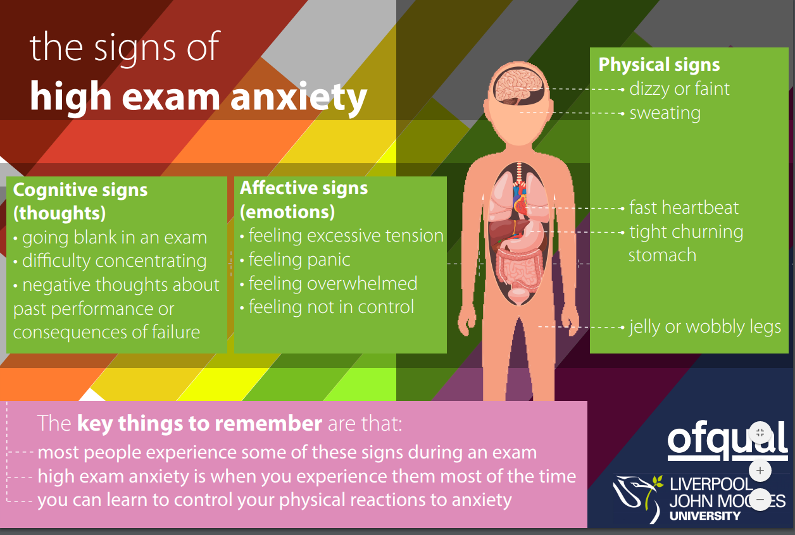
Notes:
Sometimes, external triggers make us feel more stressed – again, this is normal. But it helps if you can control those feelings and thoughts – your brain isn’t always your friend in these situations! You may worry about things that ‘might’ happen, and then have some emotional responses to this. But you can control this. You have to.

Slide 5
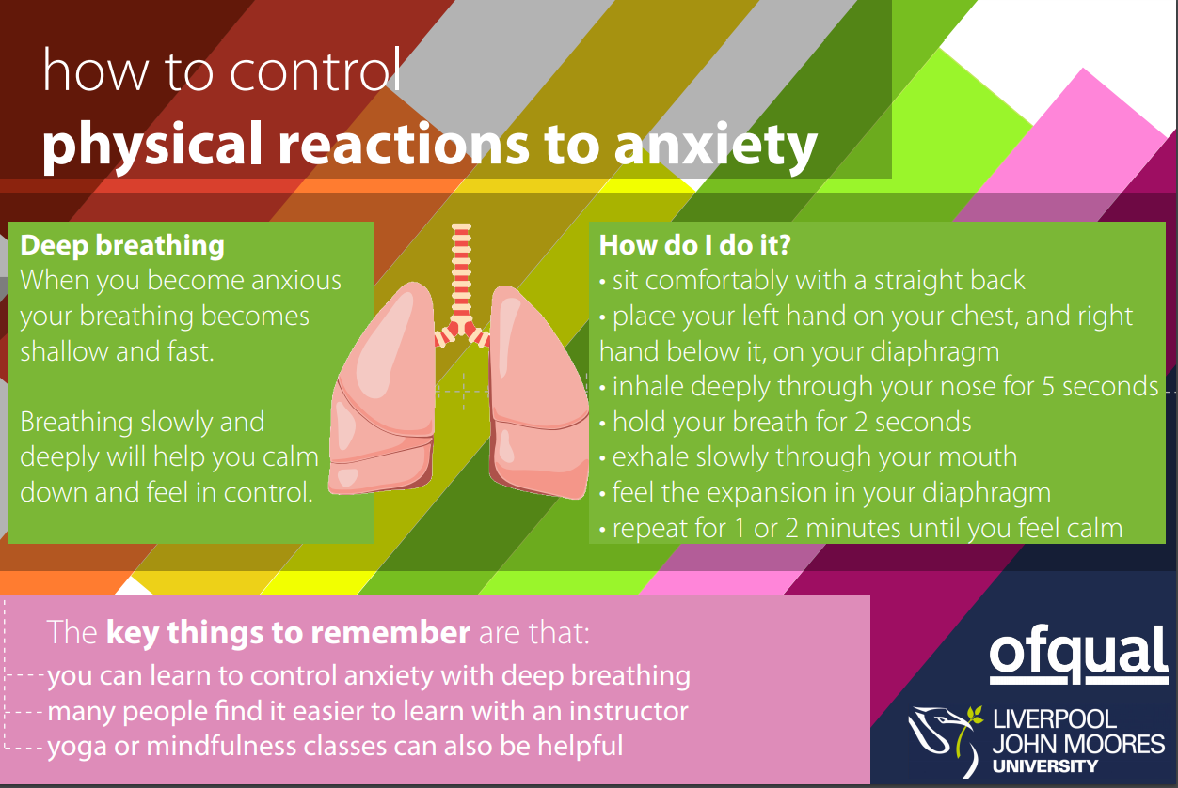
Notes:
Managing stress is something that we all learn in time – exams are a perfect point for learning this! At first, techniques like this will feel mechanical and robotic. In time, you will be able to do them almost without even thinking – anecdote.

Slide 6
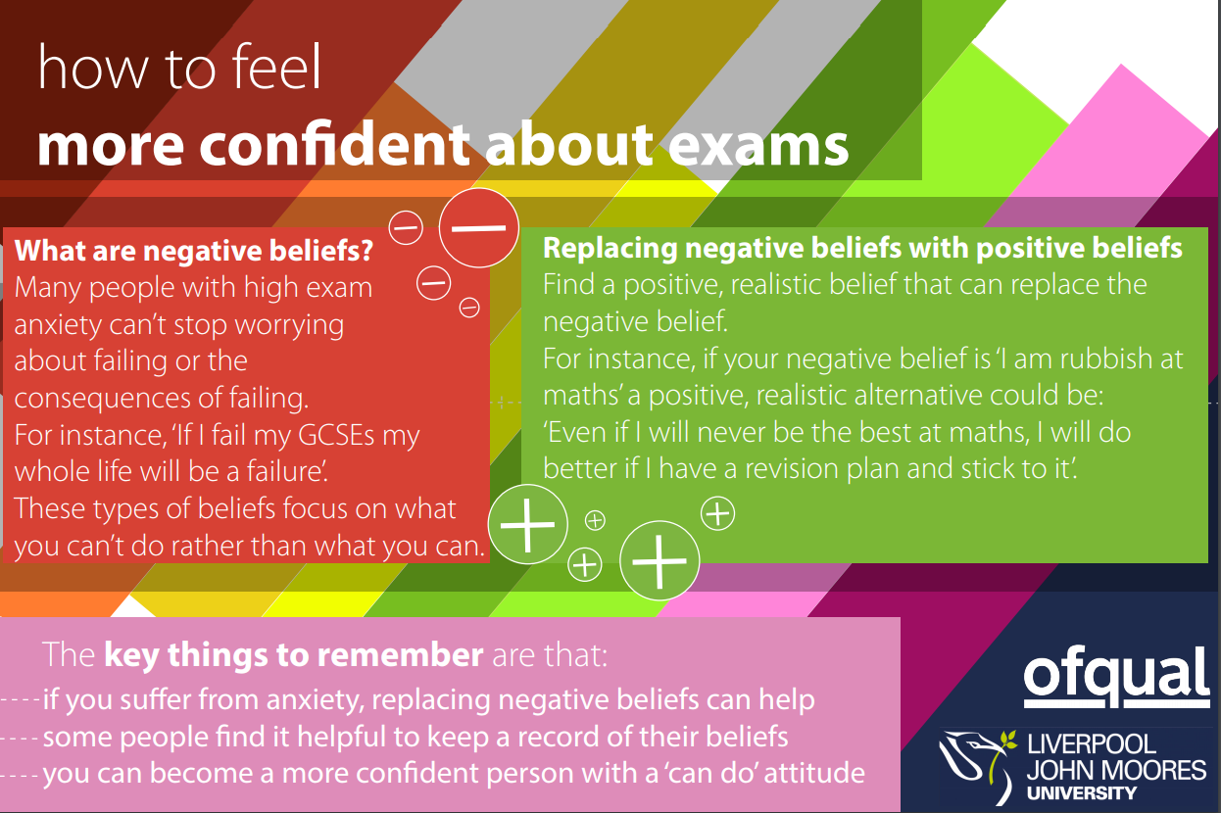
Notes:
Confidence is often the key to improving a stressful situation – and this comes from having a plan that you can stick to and boost your confidence with.

Slide 7

Notes:
Be proactive- it is easier to stick your head in the sand, but this just leads to more stress, as you know that you aren’t doing what is required.

