Slide 1


FEYNMAN TECHNIQUE
A strategy for Self Explanation and Elaboration

Slide 2


“IF YOU CAN’T EXPLAIN IT SIMPLY, YOU DON’T UNDERSTAND IT WELL ENOUGH.”

Slide 3

WATCH
https://collegeinfogeek.com/feynman-technique/

Slide 4
WHY?
By attempting to explain a concept in simple terms, you’ll quickly see where you have a good understanding of that concept. You’ll also be able to instantly pinpoint your problem areas, because they’ll be the areas where you either get stuck or where you end up resorting to using complex language and terminology.

Slide 5
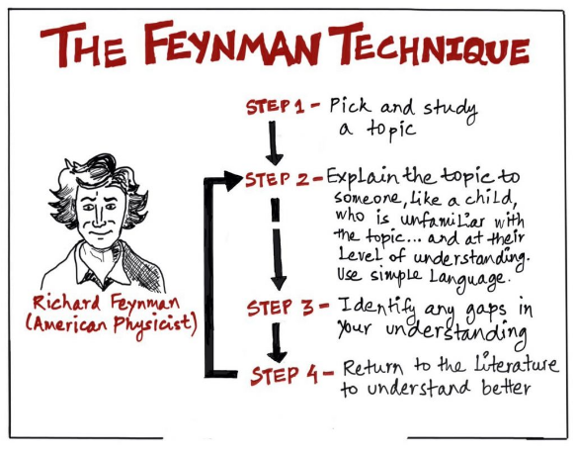

HOW TO DO IT

Slide 6
HOW?
The most important part of this technique is that you are explaining a concept.
How you do it is up to your – you could explain it to a friend, a relative, the mirror, your dog,…
Step 1 – Using a sheet of paper, write the name of the concept at the top.
Step 2 – Write out an explanation of the concept in your own words. Use really basic, plain language and keep is simple. The more simple you can make it, the better.
Step 3 – review your explanation against your more detailed notes/revision guide. Pinpoint any areas that you are bit weaker on or that you have missed as re it.
Step 4 – If there are any areas where you are still using quite complex language, re write these bits to make them more simple.

