Slide 1
FORGETTING…THE ENEMY OF LEARNING?
Ebbinghaus

Slide 2


FORGETTING THINGS
How often do you forget things?
How much can you remember from your lessons yesterday?
What about your lessons last week?
What about last month?
It’s hard, right? You don’t remember much!
Our brains are not built to remember everything. You will forget things – that’s how they work.
Luckily, forgetting and re learning actually helps you remember things more effectively over time!

Slide 3

EBBINGHAUS
Watch:
https://www.youtube.com/watch?v=SCsQHe-NpaM
A German Psychologist
A key player in understanding how we learn and forget things

Slide 4
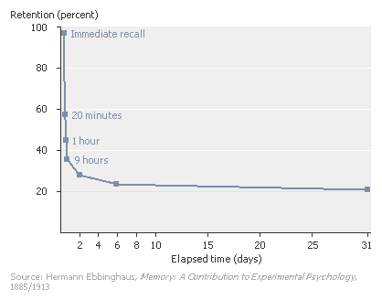
THE CURVE
As you can see, the more time passes, the more you forget things!

Slide 5
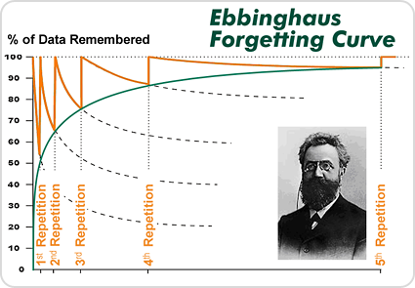
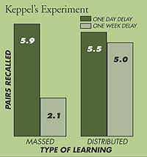

WORKING TO OVER COME IT
The more repetition (practice), the more likely information is to be remembered later.

Slide 6



APPLYING THIS TO GCSE STUDY
You need to build in time for refreshing your memory on your learning.
Do this throughout year 11 – there often isn’t time for teachers to re cover curriculum content. You have to be responsible for your own learning over time.
How might this look?

Slide 7



DOS AND DON’TS
HOW DO YOU THINK YOU CAN OVER COME THIS?

Slide 8

DO
DON’T
Self quiz on your learning
Make sure you spread your time across different subjects
Re quiz on the same things over a longer period of time
Make sure your notes/books/folders are organized and you can revisit them in a helpful way when you have forgotten things (which we now know you will!)
Just re read your notes – you need to do something active with it like quizzing first and checking your answers afterwards.
Fall into the highlighter trap – just highlighting stuff doesn’t help your brain remember information.
Expect to remember everything – you will forget things over time!

Slide 9
HOW OFTEN?
You need to be doing this regularly in Year 11 – at least once a day spend time re capping some things from some subjects.
This doesn’t have to be a huge workload – recite quotes in your head whilst you’re washing your hair, send your mate texts with your science equations, recite key dates in your history module in your head.
The aim here is to build up your knowledge so that it’s easily accessible in the exam. You need to free up your working memory so you can focus on applying the knowledge, rather than trying to remember it!

