Slide 1


REVISION
What not to do…

Slide 2

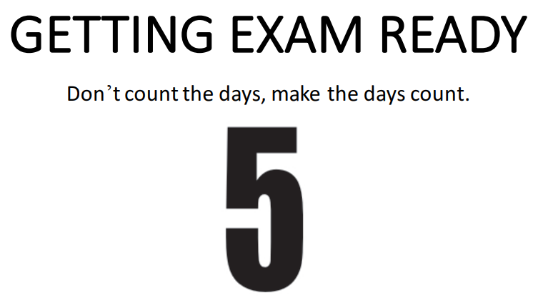


Slide 3
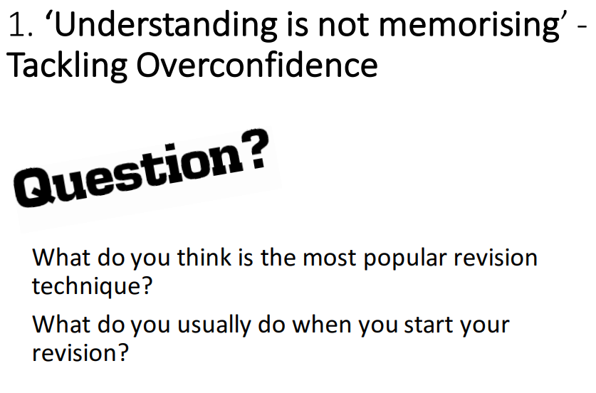

Slide 4
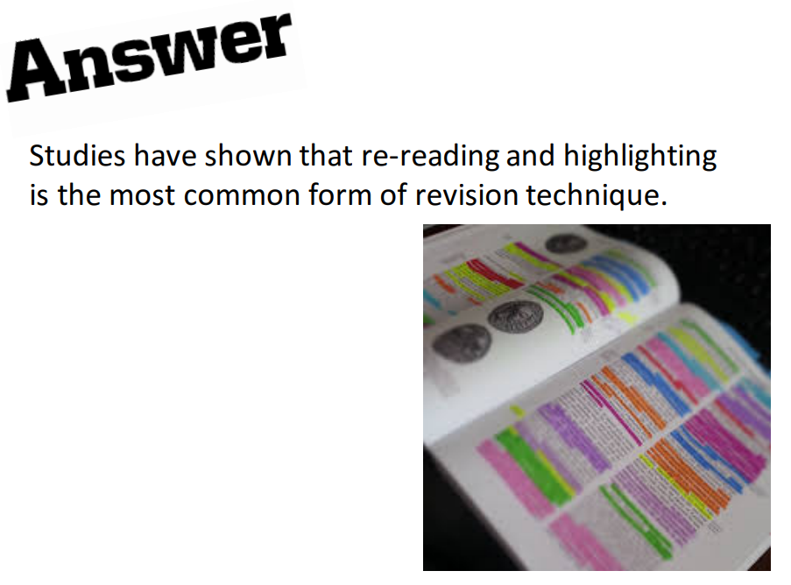

Slide 5

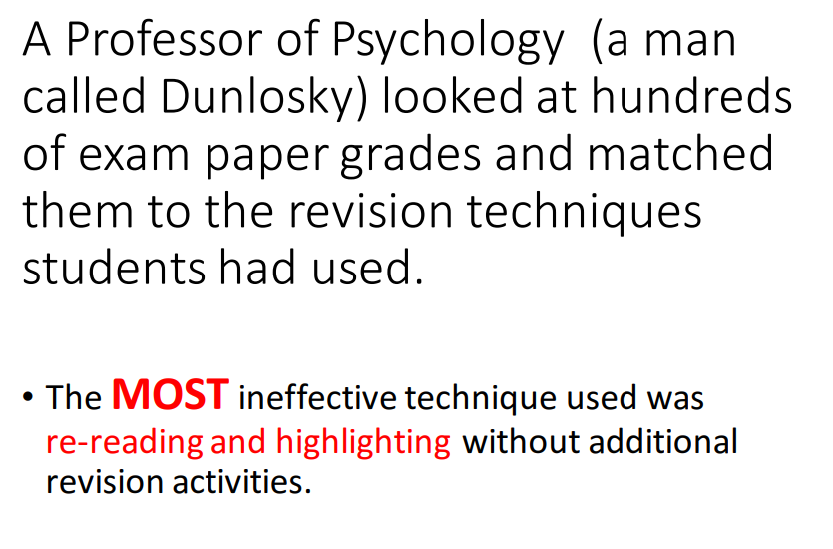

Slide 6
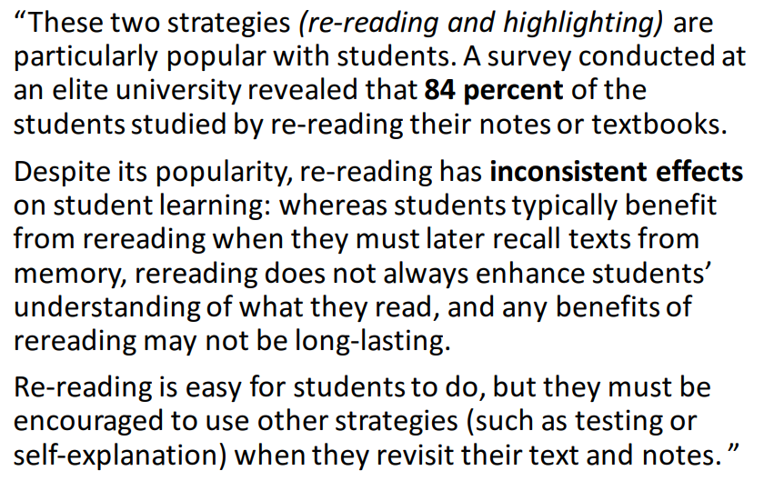

DUNLOSKY SAID…

Slide 7
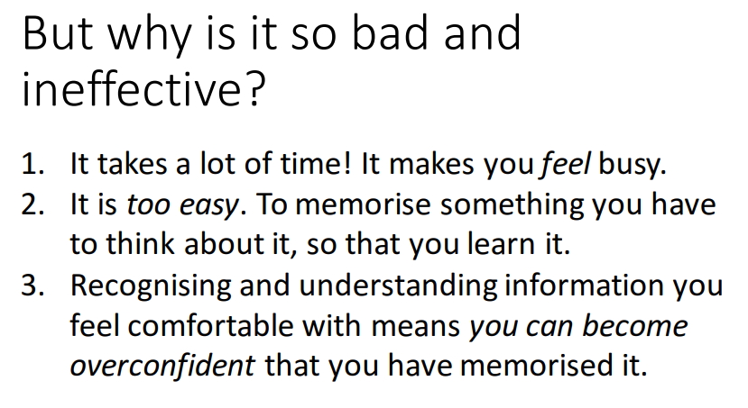

Slide 8
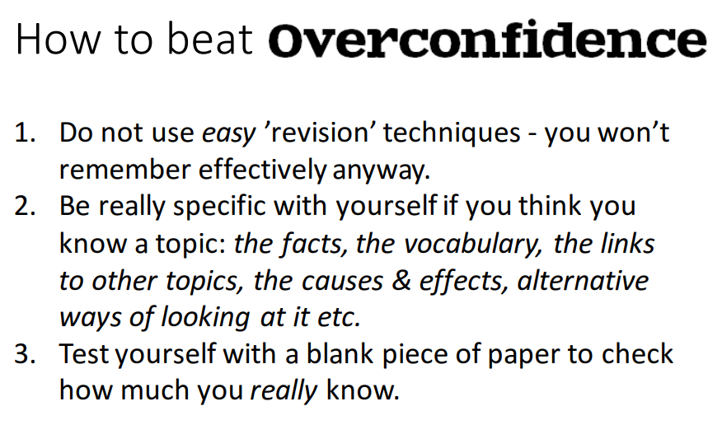

Slide 9
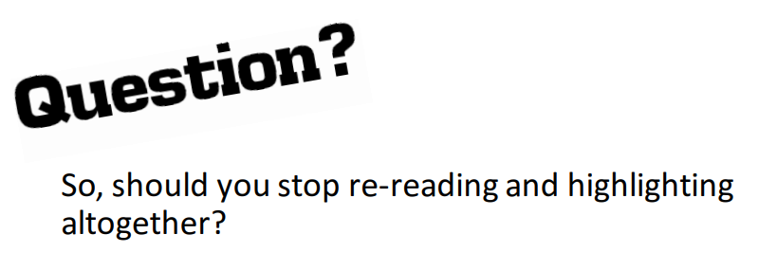
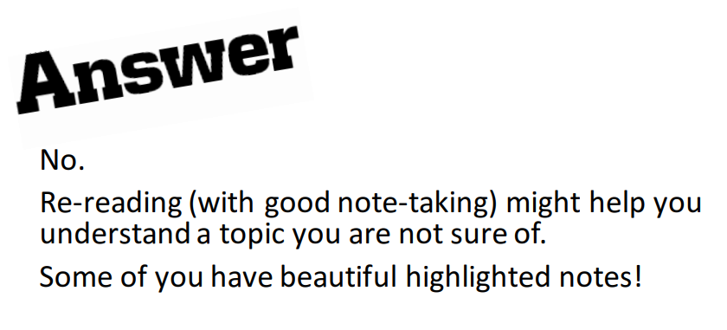
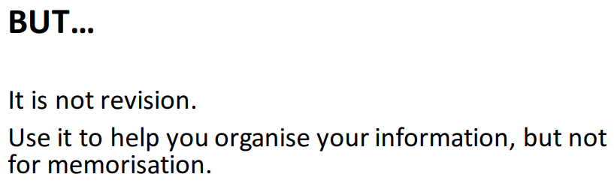

Slide 10
WHAT SHOULD I BE DOING INSTEAD?
Cornell Notes
Retrieval Practice
Elaboration/Self Explanation
And some strategies to help you organise your revision further:
Leitner Method
Pomodoro Method

Slide 11

RETRIEVAL PRACTICE
The foundations of excellent long term learning

Slide 12



WHAT IS IT?
IT IS A PROCESS OF MAKING LEARNING MORE EASILY RETRIEVABLE IN THE LONGER TERM.
IT IS MORE ACTIVE THAN THINGS SUCH AS RE READING NOTES OR HIGHLIGHTING, WHICH WE KNOW AREN’T GOING TO HELP MUCH.
YOU HAVE TO PRACTICE RETRIEVING LEARNING FROM YOUR MEMORY TO MAKE IT MORE LIKELY THAT YOU WILL REMEMBER THAT INFORMATION IN THE LONG TERM.

Slide 13

WATCH
https://www.youtube.com/watch?v=Pjrqc6UMDKM&feature=youtu.be

Slide 14
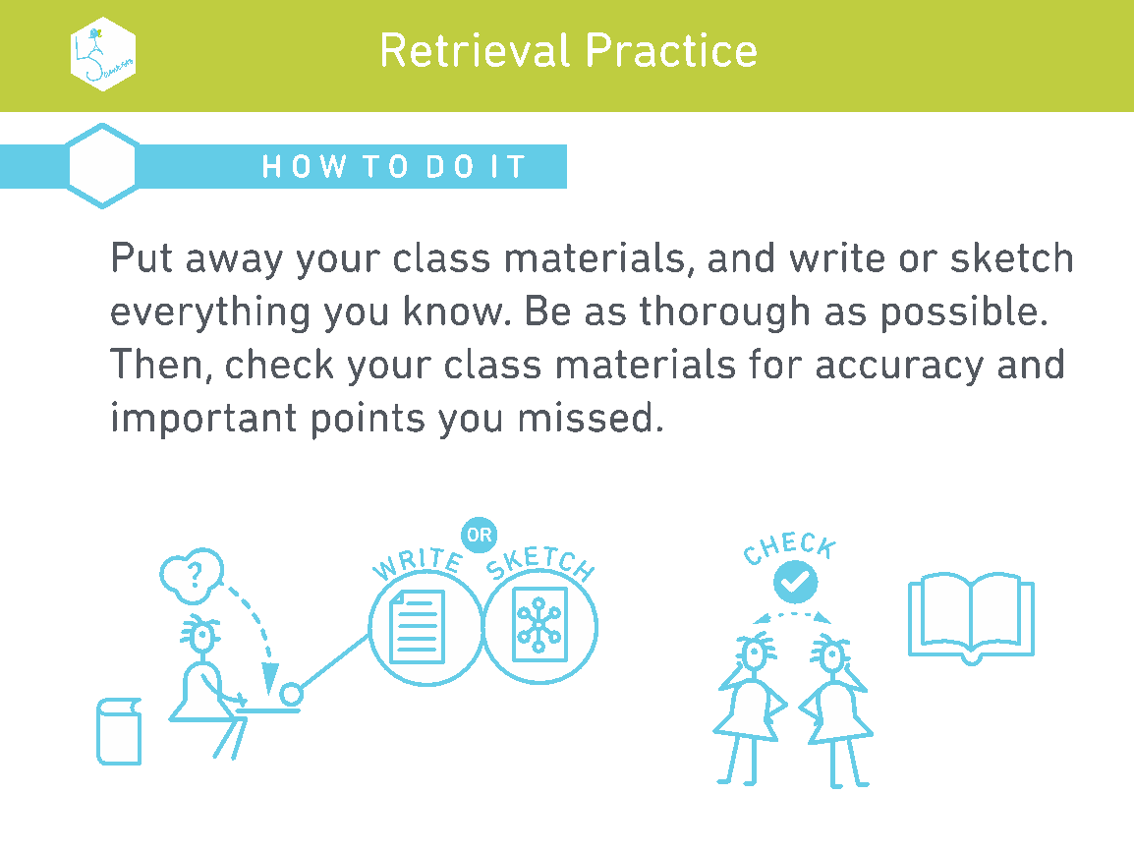

Slide 15
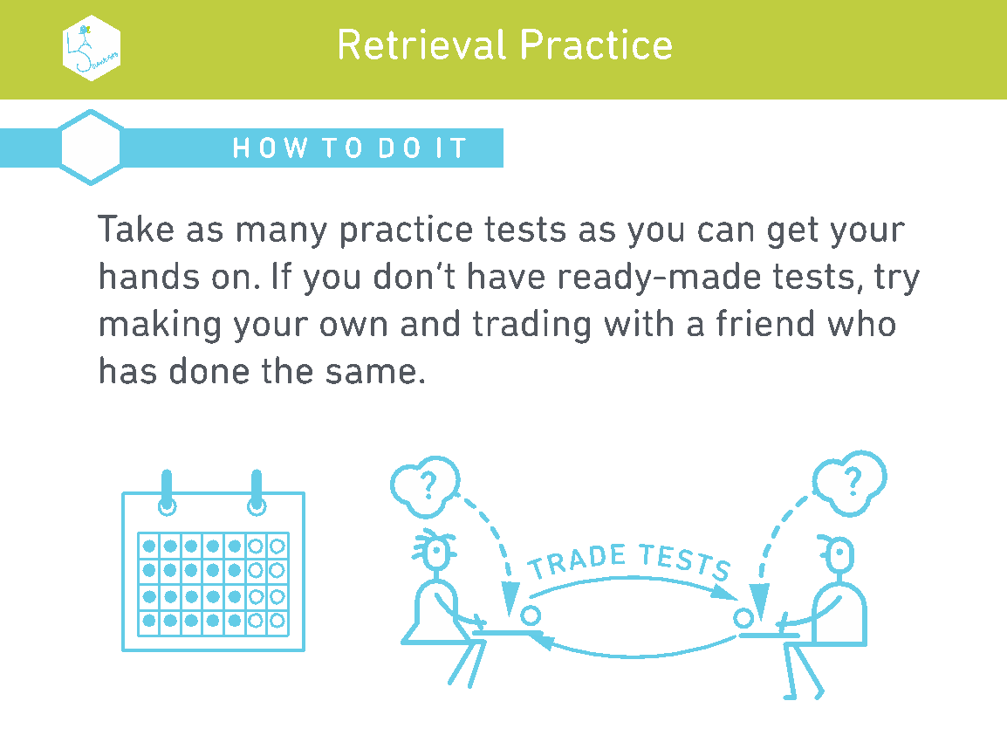

Slide 16
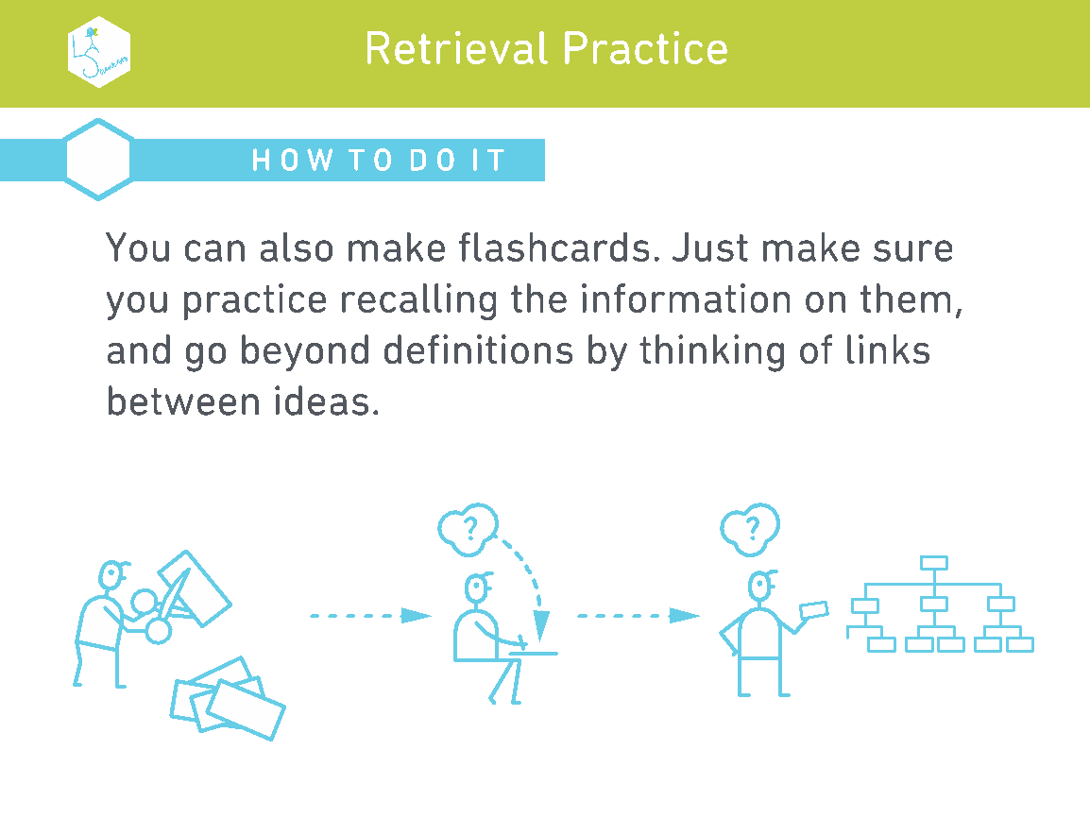

Slide 17
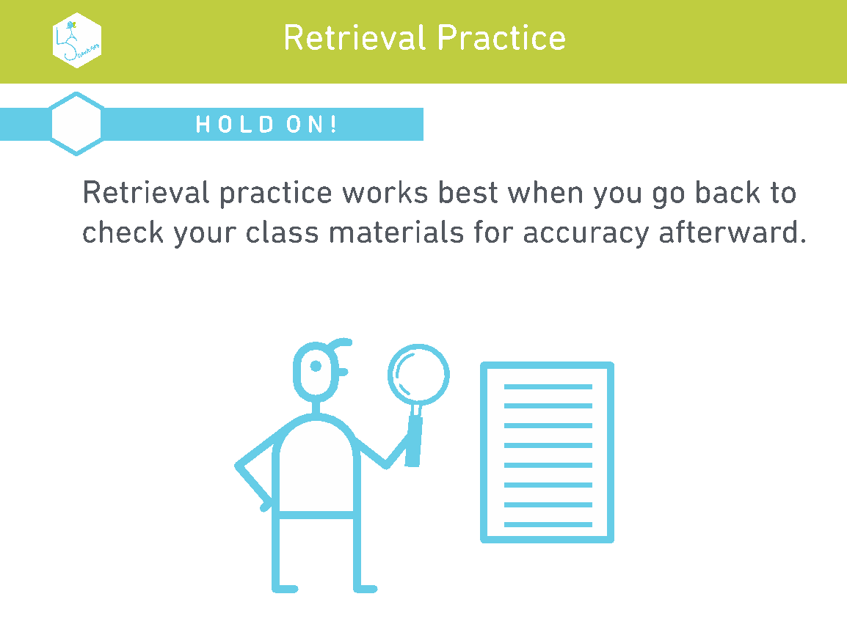

Slide 18
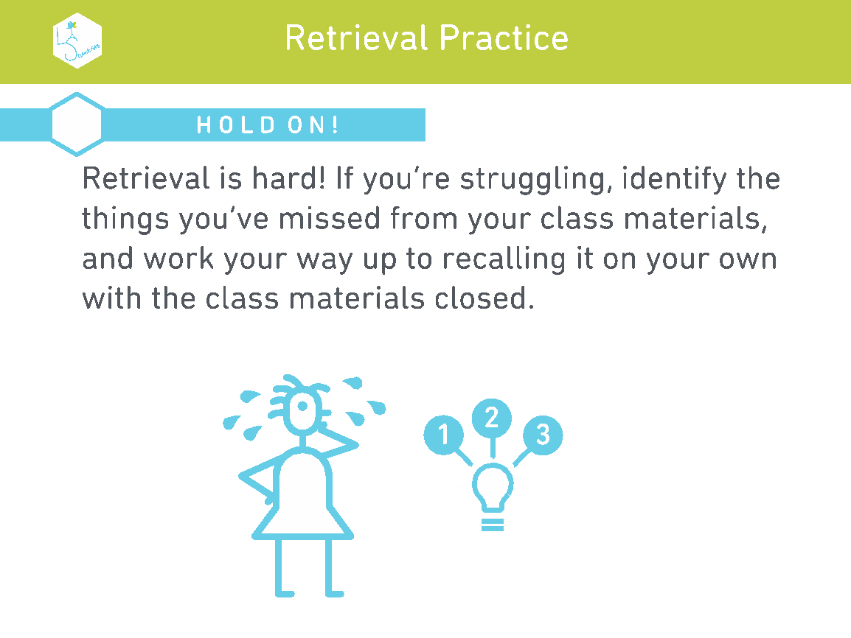

Slide 19
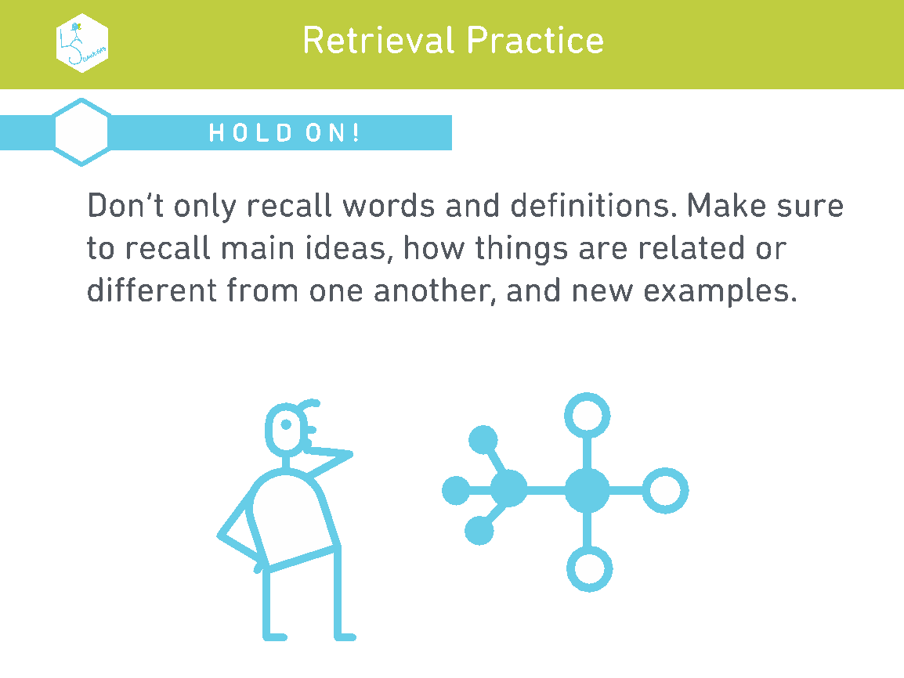

Slide 21

CORNELL NOTES
A specific strategy to help your long term learning.

Slide 22
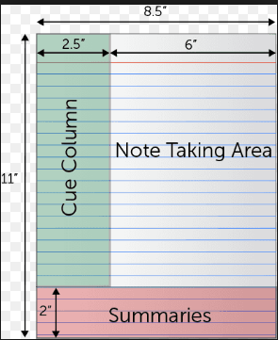
CORNELL NOTES METHOD
https://www.youtube.com/watch?v=ErSjc1PEGKE

Slide 23
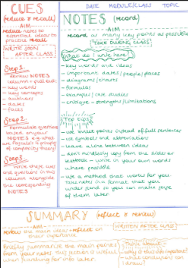
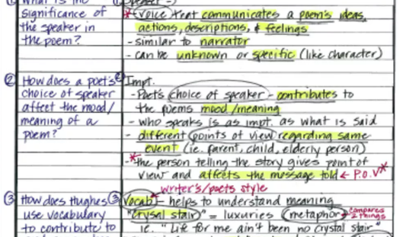
CORNELL NOTES – HOW?

Slide 24
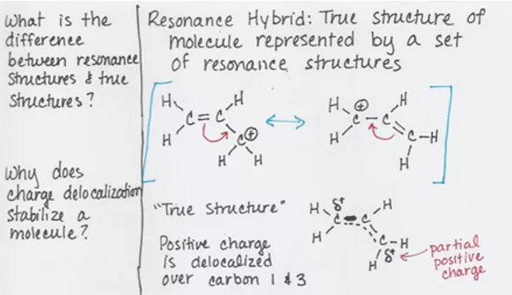
CORNELL NOTES – MAKING THEM USEFUL
Your questions need to be clear – remember you’ll come back to these out of context. Do you know what you’re on about?!
The notes section needs to be detailed enough to cover everything you need to know. Remember you’re using it in the future when you’ve actually forgotten it. Write it for your future self.

Slide 25
“It helps you to learn the subject in detail as you are reflecting on the key points.”
“It is useful for re testing – you just go back to the questions on the side in a few days and check if you remember the answer. If not, you can remind yourself easily with the bit on the right.”
“Summarising the content really helps you learn it. You’re doing something active with it which has more impact on your long term learning.”

Slide 26





WHAT SHOULD I BE DOING?
Using your notes/knowledge organiser/revision guide, read through one topic.
Using the resource above, produce your notes on the right.
Once you have produced your notes, move on to the questions. Pick things that have clear answers in your notes.
Once you have done this, move on to the summary at the bottom. In your own words, summarise the topic.
Once or twice a week, check back and try to answer the questions on the left. If you have forgotten, that is fine. The brain forgets things. Re read through the notes and the summary then answer the question again.

Slide 27
POMODORO TECHNIQUE
A way to keep yourself working effectively

Slide 28

POMODORO TECHNIQUE
A well used strategy for productivity
Widely used in the work place
Also widely used in schools/universities as a strategy for effective study time

Slide 29
WATCH:
https://www.youtube.com/watch?v=mNBmG24djoY

Slide 30
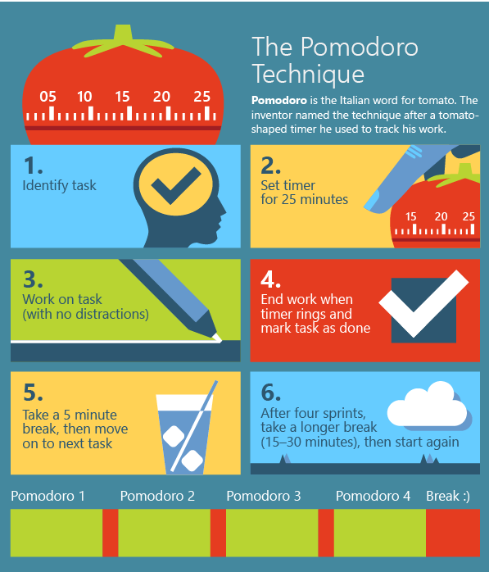
HOW DO I DO IT?

Slide 31




APPLYING THIS TO GCSE STUDY
Your revision should follow this kind of pattern.
It is much easier to commit to getting started on something if it is only a short amount of time!
Plan your slots, especially in terms of revising knowledge – this technique works really well for ensuring key coverage of subjects.
Go through each subject and work out what you need to know. Turn these into chunks of what you can cover in 25 minutes. Once you to the leg work setting it up, it’s lots easier to do in the long run.

Slide 32

Exam stress
What is it?
How can I deal with it?

Slide 33

“I am so stressed, I think I might explode”
“I can’t cope, I am too stressed”

Slide 34
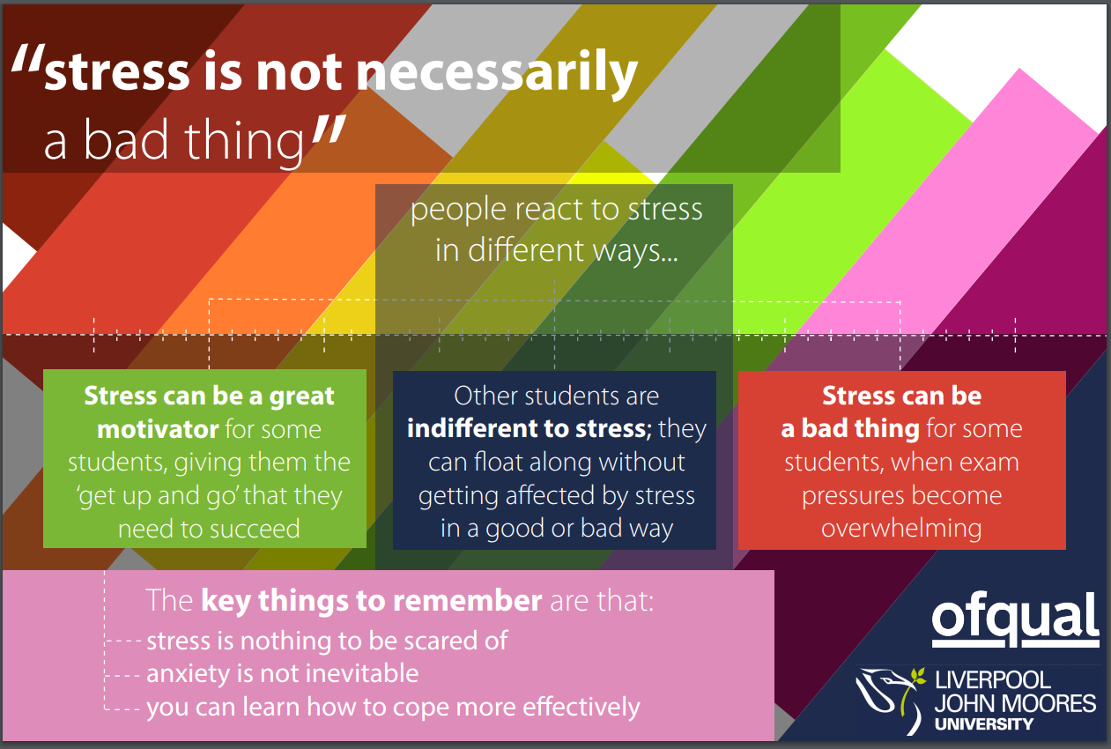
Notes:
Stress is normal – we all have it and it is a normal human reaction to things that are happening around us. It is something you will feel throughout life and isn’t something that is unhealthy or means there is anything wrong with you.

Slide 35

Notes:
Sometimes, external triggers make us feel more stressed – again, this is normal. But it helps if you can control those feelings and thoughts – your brain isn’t always your friend in these situations! You may worry about things that ‘might’ happen, and then have some emotional responses to this. But you can control this. You have to.

Slide 36
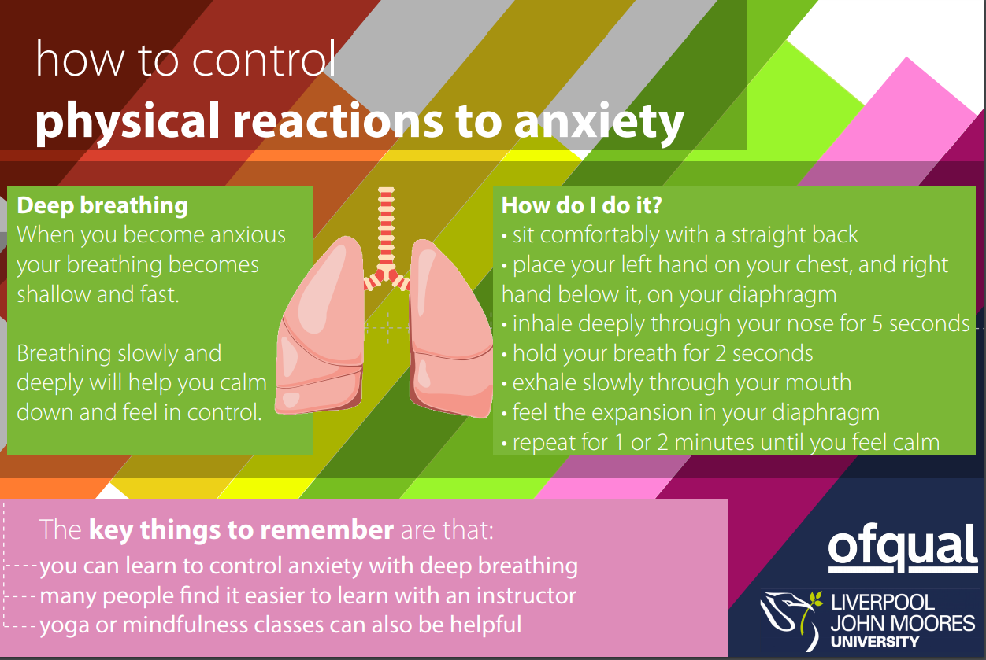
Notes:
Managing stress is something that we all learn in time – exams are a perfect point for learning this! At first, techniques like this will feel mechanical and robotic. In time, you will be able to do them almost without even thinking – anecdote.

Slide 37

Notes:
Confidence is often the key to improving a stressful situation – and this comes from having a plan that you can stick to and boost your confidence with.

Slide 38
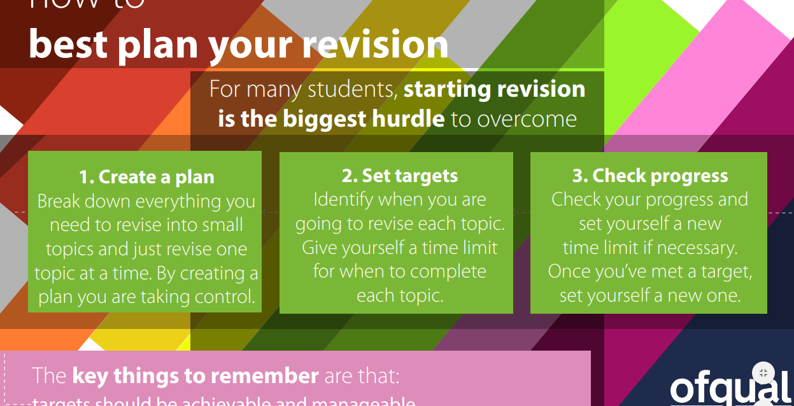
Notes:
Be proactive- it is easier to stick your head in the sand, but this just leads to more stress, as you know that you aren’t doing what is required.

