Slide 1


RETRIEVAL PRACTICE
The foundations of excellent long term learning

Slide 2





WHAT IS IT?
IT IS A PROCESS OF MAKING LEARNING MORE EASILY RETRIEVABLE IN THE LONGER TERM.
IT IS MORE ACTIVE THAN THINGS SUCH AS RE READING NOTES OR HIGHLIGHTING, WHICH WE KNOW AREN’T GOING TO HELP MUCH.
YOU HAVE TO PRACTICE RETRIEVING LEARNING FROM YOUR MEMORY TO MAKE IT MORE LIKELY THAT YOU WILL REMEMBER THAT INFORMATION IN THE LONG TERM.

Slide 3


WATCH
https://www.youtube.com/watch?v=Pjrqc6UMDKM&feature=youtu.be

Slide 4
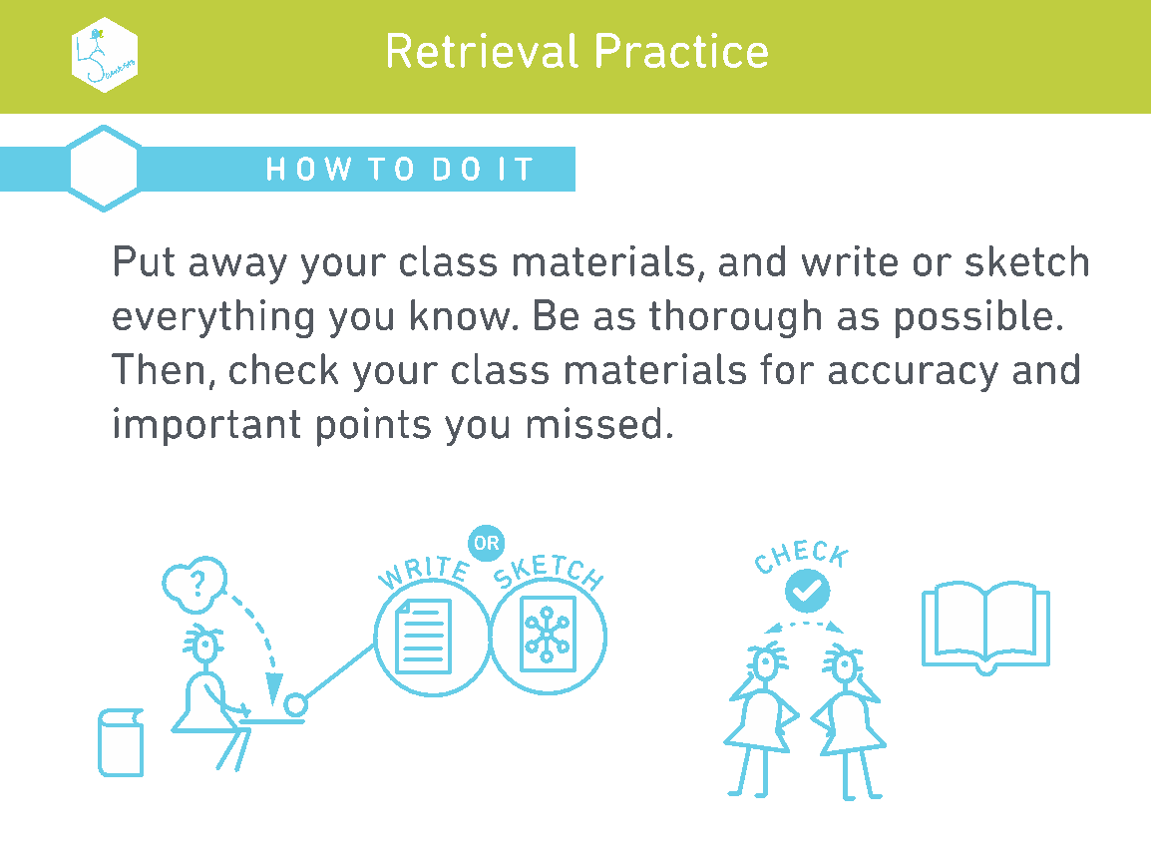

Slide 5
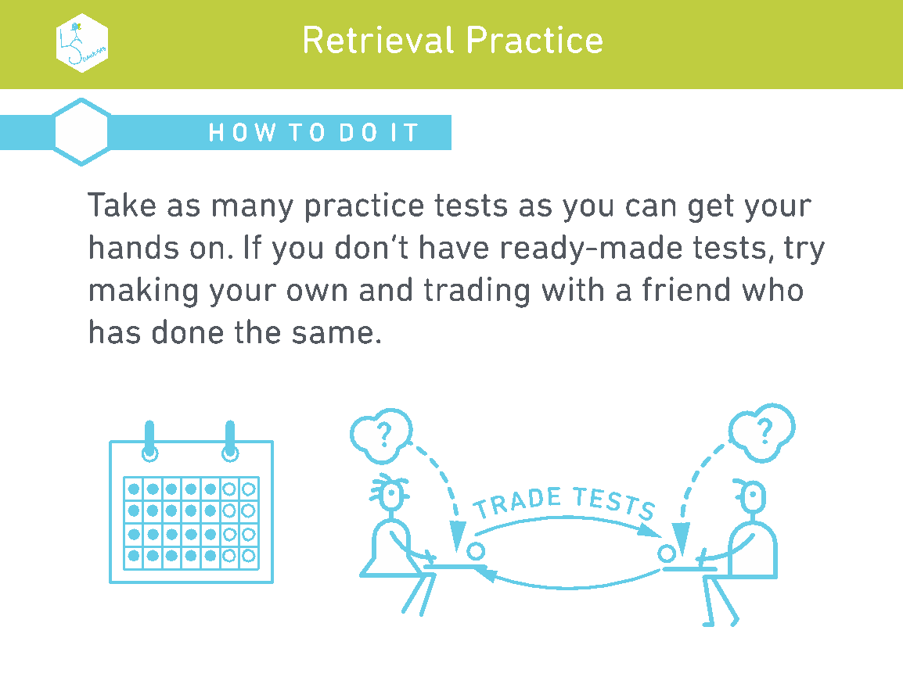

Slide 6
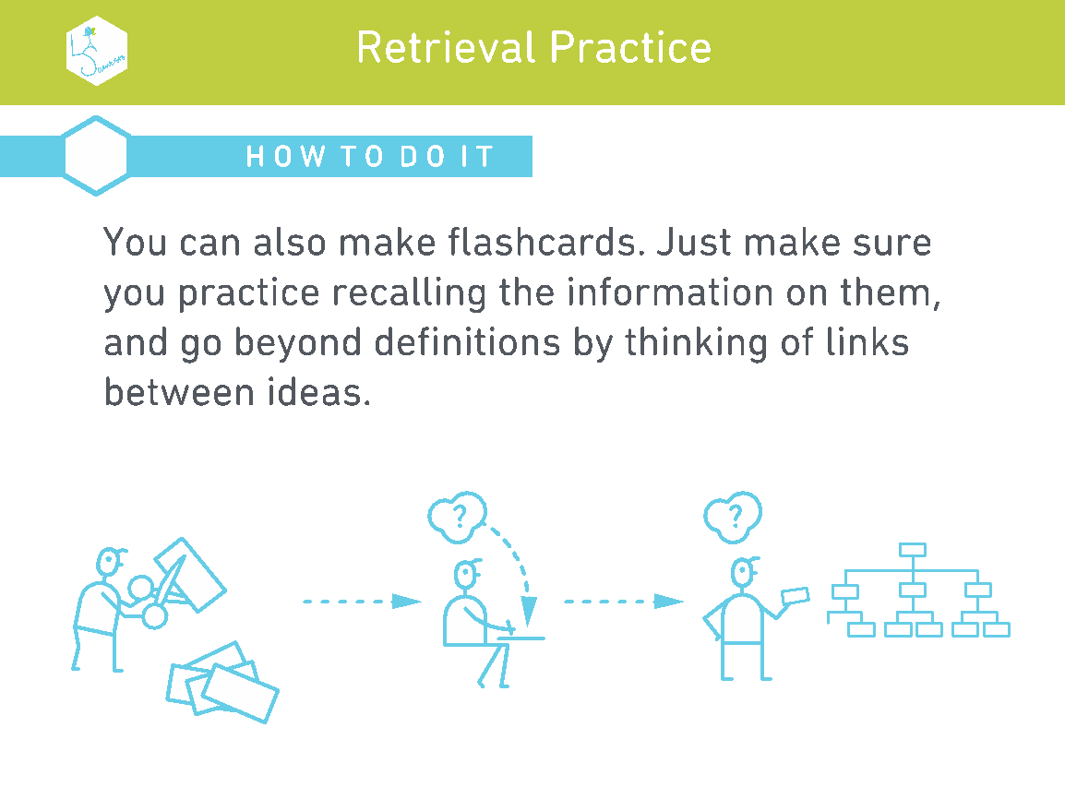

Slide 7
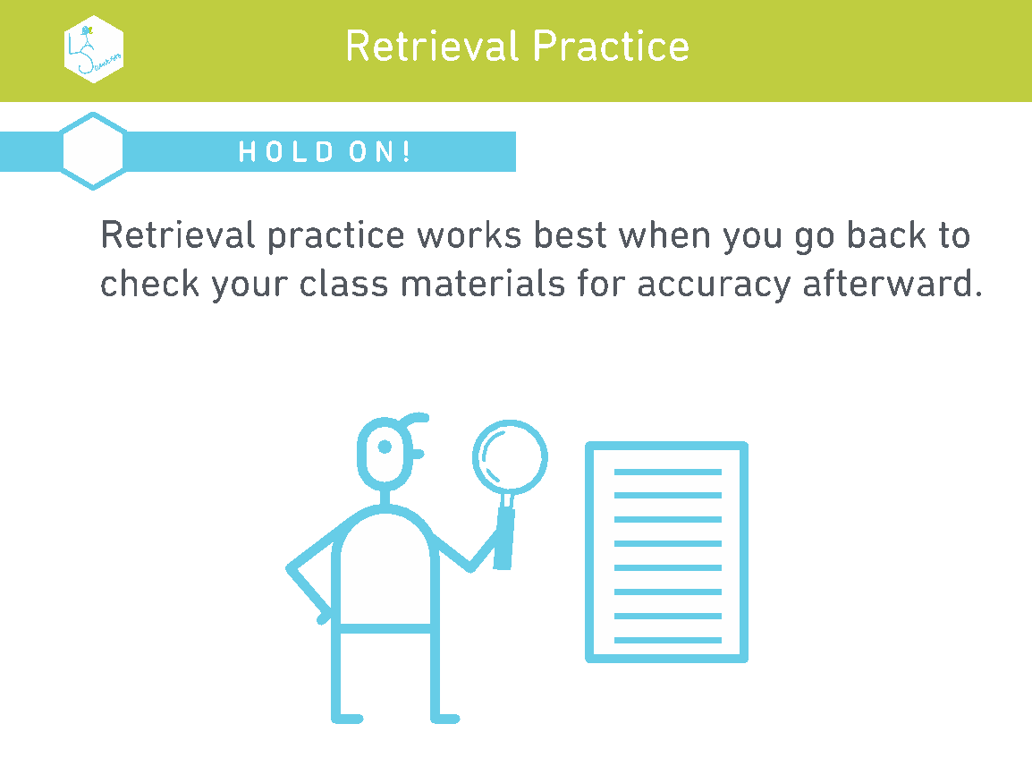

Slide 8
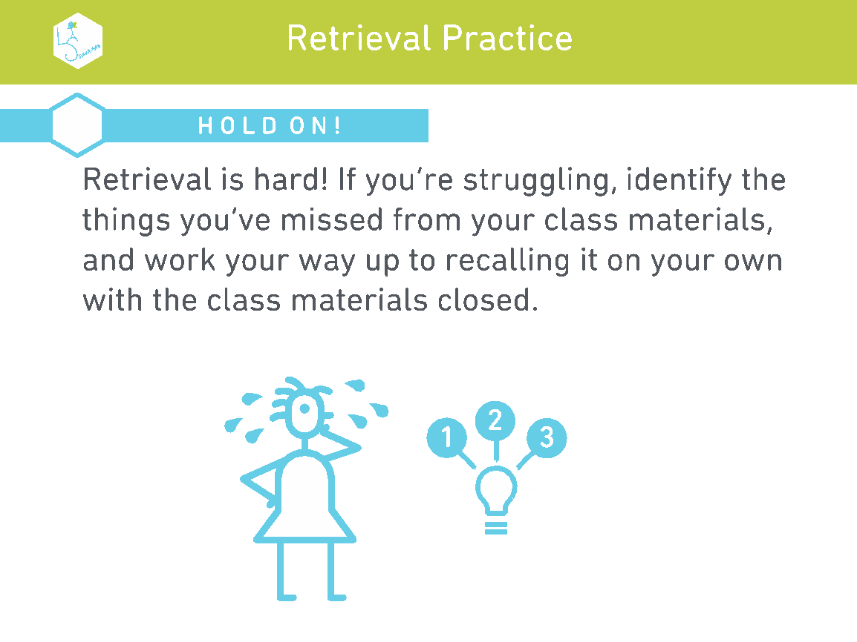

Slide 9


