Slide 1


SELF EXPLANATION
Elaboration – a key study strategy

Slide 2


WHAT IS IT?
It is a study strategy that involves explaining and describing ideas with lots of detail.
It involves making lots of connections among ideas you are trying to learn.
It can also involve you asking questions of yourself, about how and why things work. This will vary depending on the subject you are working on. However, the principle remains – you can ask yourself why a certain thing happens in physics, or you can ask yourself how a writer uses a specific language device for effect in English when you are learning quotations.
https://www.youtube.com/watch?v=gQRzW24KrDc

Slide 3


Slide 4
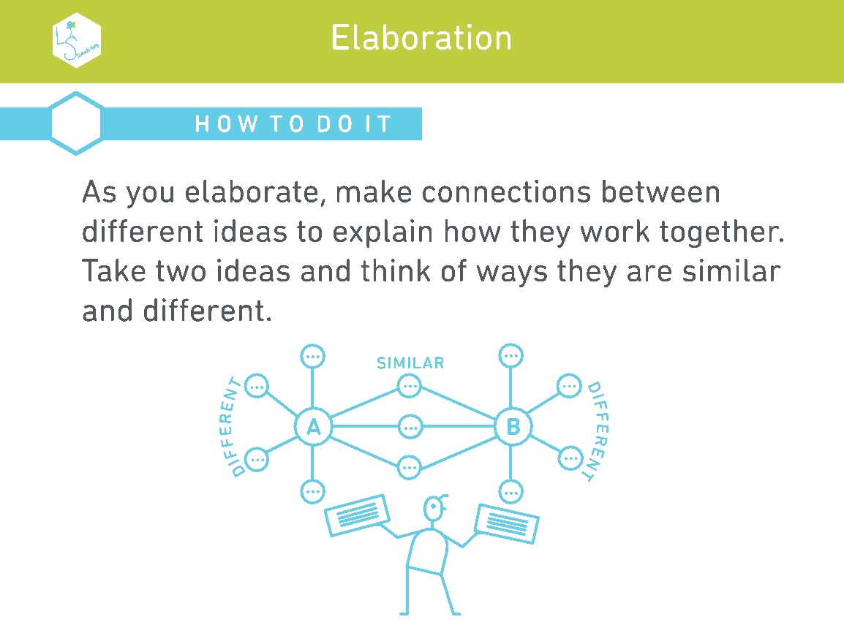

Slide 5


Slide 6
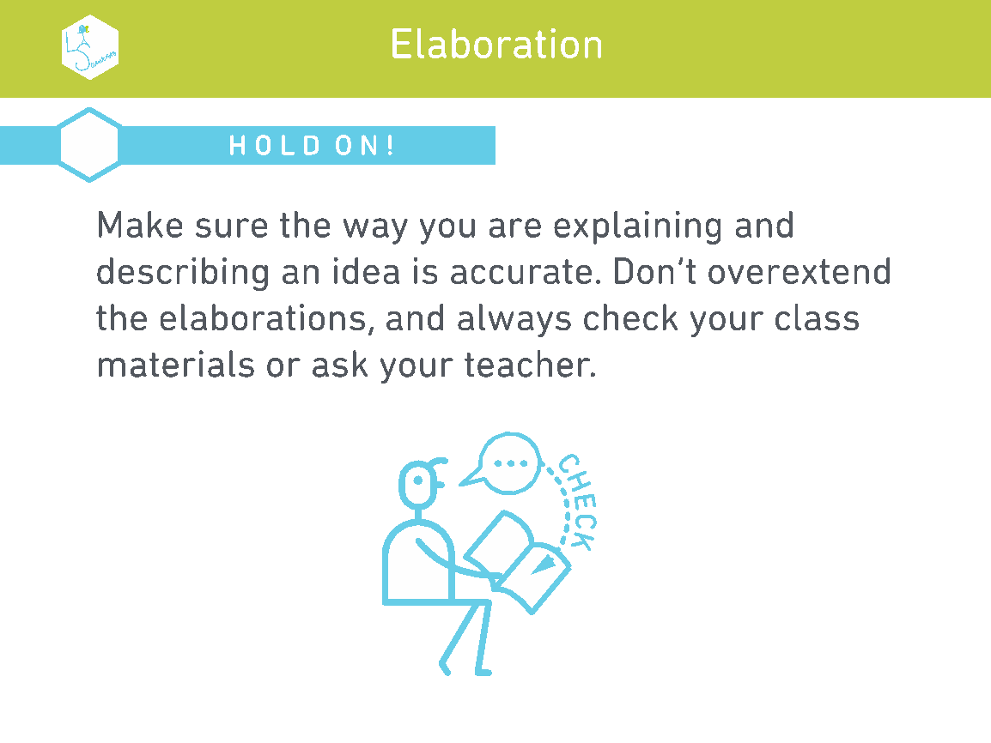

Slide 7


Slide 8

HOW CAN I START ON THIS?
You could start by making a list of all of the things that you need to learn for a certain subject.
Work your way down the list and ask yourself questions about how these ideas work and why they work that way.
There will be some that you don’t know – find out either using your revision materials or from your class teacher. Remember they’re a subject expert so anything you are finding difficult you must speak to them about it to make sure you learn it correctly.
As you continue to work your way through the ideas that you are learning, make connections between multiple ideas. For example, in English, you might note that Dickens’ A Christmas Carol is a scathing critique of social attitudes at the time – which you could then link to Animal Farm as an equally contemptuous critique but a government’s abuse of its citizens, much like how Dickens felt about how governments treated the poor.
Think about how they are similar and different.
Describe how the ideas you are studying apply to your own life and link ideas as you progress with revision or learning in class. The more connections, the better.

Slide 9
OTHER EXAMPLES – HISTORY
Imagine you’re studying World War II, and specifically the attack on Pearl Harbor.
You could ask yourself, how did this attack happen?
On December 7, 1941, the Imperial Japanese Navy attacked the United States Naval Base at Pearl Harbor. The attack included Japanese fighter planes, bombers, and torpedo planes.
Why did this happen?
The Japanese intended to destroy the United States’ Pacific Fleet so that it could not interfere with Japanese operations.
Here you could also ask another type of question: What was the result of this historic event? Well, Japanese casualties were light, while they damaged eight U.S. Navy battleships. The Arizona was among those that the Japanese sunk, and was not raised from the shallow water. U.S. aircrafts were also destroyed, and 2,403 Americans were killed (1,178 were injured).
Why is this event important? The day after the attack, Roosevelt delivered his Infamy Speech, the United States formally declared war on Japan, and Japanese-Americans were then relocated to internment camps.
You could then go on: how did the U.S. enter the war? How did the Pearl Harbor attack lead up to the release of the atomic bomb? How did the war end? And so on.

