Slide 1


REVISION
What not to do…

Slide 2

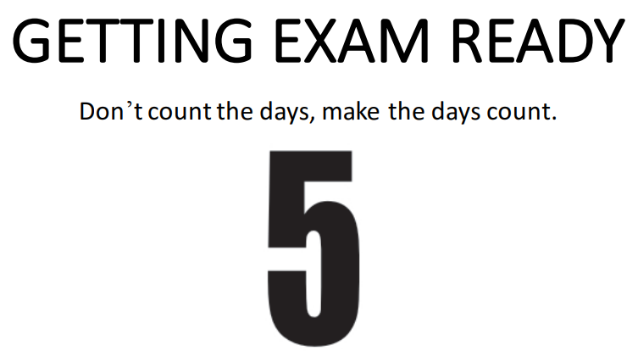


Slide 3
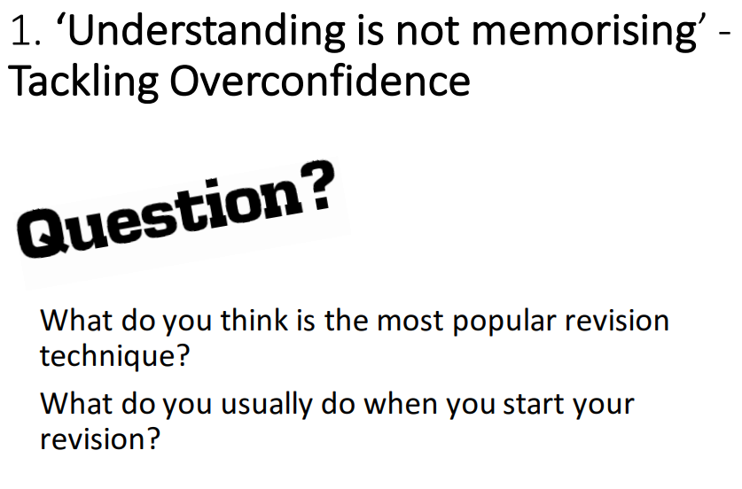

Slide 4
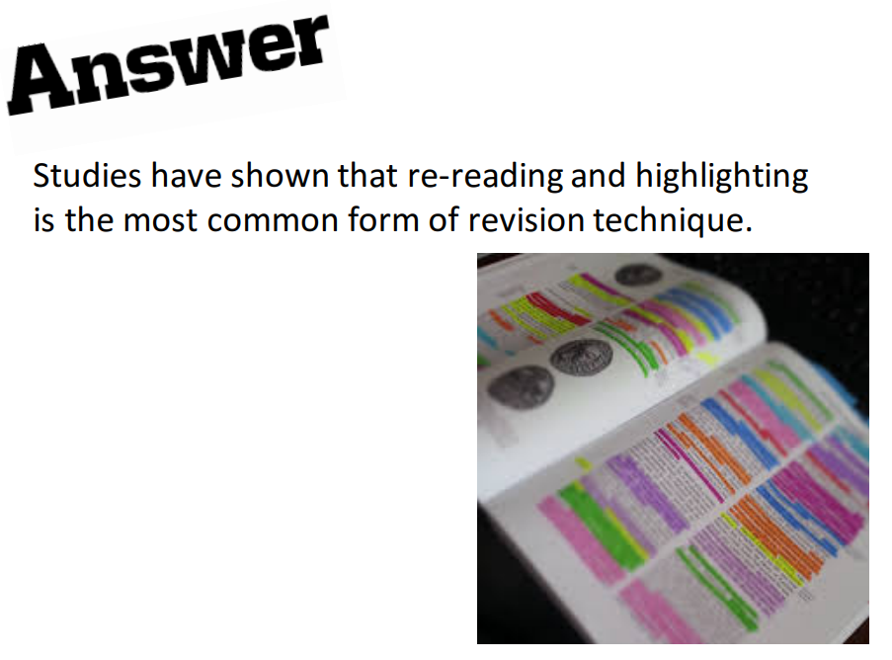

Slide 5

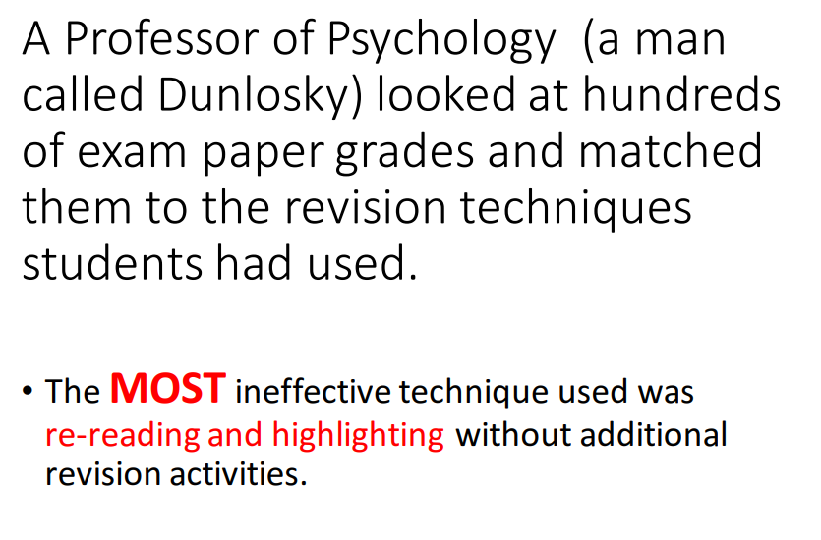

Slide 6
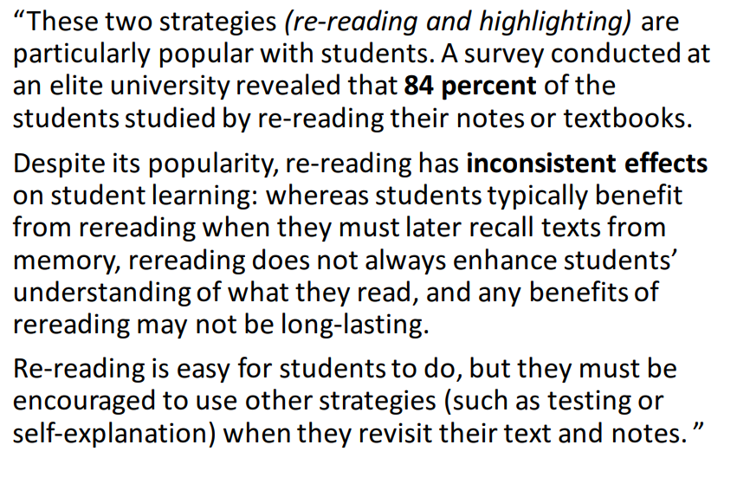

DUNLOSKY SAID…

Slide 7
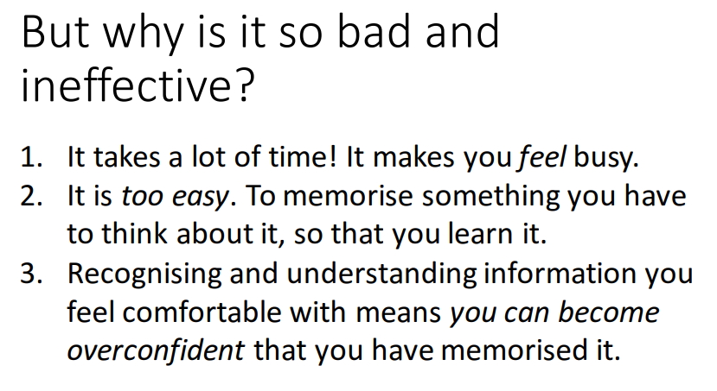

Slide 8
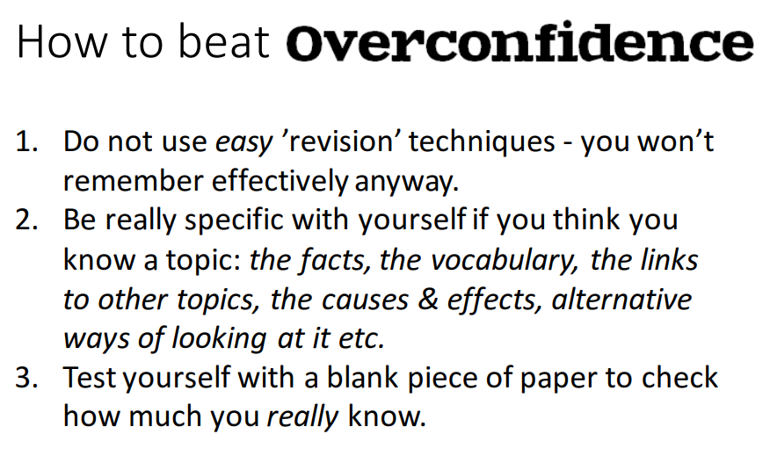

Slide 9
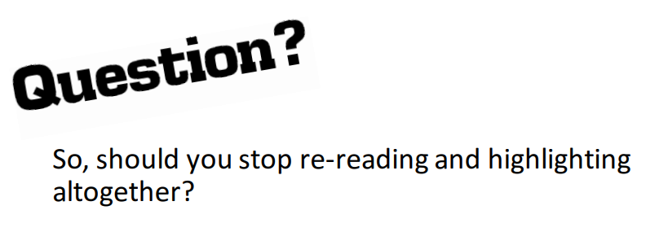
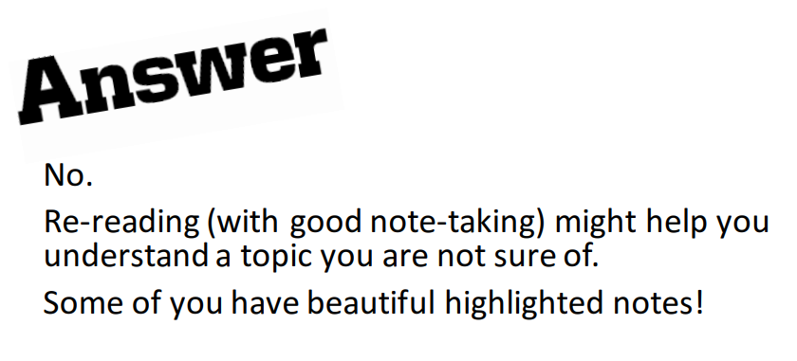
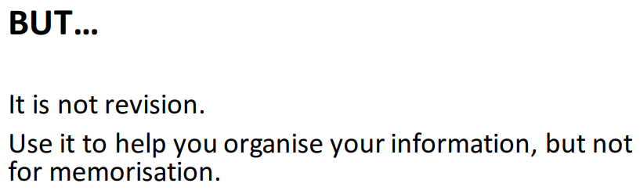

Slide 10
WHAT SHOULD I BE DOING INSTEAD?
Cornell Notes
Retrieval Practice
Spacing
Elaboration/Self Explanation
Dual Coding
Interleaving
And some strategies to help you organise your revision further:
Leitner Method
Pomodoro Method

